Slide 1
An Empirical Study of a Large-Scale Agile Transformation of an Online Retailer
Melisa Uluer, 30.03.2020, Final Presentation Bachelor’s Thesis

Slide 2
Agenda
Motivation
Research Methodology
Case Study
Discussion
Outlook

Slide 3


Motivation
Digitalization confronts organizations with multiple challenges:
customer demands
Increasing market dynamics
Continuous emergence of novel advancements in IT
Requires organizations to rethink how to:
Interact with customers
Define value propositions
Leverage data
Organize internal operations
[5;7]
Notes:
-organizations are confronted with challenges by the omnipresent digital transformation
-requires organizations to rethink how they interact with customers, how they define value propositions, leverage data and organize internal operations.

Slide 4


Motivation
Digital transformation imposes the need to react to rapidly changing market demands
Agile methods enable faster response to changes in organizational environments
[5;7;11]
Notes:
Competitors develop new products and services using digital technologies
Thus…
One popular option to address this challenges is to introduce agile methods
agile methods promise higher quality in products and higher customer satisfaction by short iterations and continous delivery, active customer involvement, deals better with changing requirements

Slide 5

Motivation
Companies are increasingly adopting agile methods to become more flexible and adaptive
The ability to sense and to respond swiftly and flexibly to technical changes, new business opportunities and unexpected environmental changes
[2;6]
Notes:
Companies adapt the agile methods to their needs and not only are the methods applied by firms outside the IT and software industry but also employed beyond their traditional application areas like IT related projects and software development
Wider application areas allow an overarching implementation of agile methods within firms, which leads to the large-scale application of agile methods
- In order to succeed at the large-scale application, the organization’s processes, policies, and culture must all reflect agile values and basically develop an agile mindset
- Their goal is to become agile in the enterprise context which is defined as …
And the process to achieve this goal is called the agile transformation

Slide 6
Definition of Large-Scale Agile Transformation
“
The switch of an organization from a different development approach or work organization concept to the application of agile methods on an organizational level with at least two teams.
Definition of Large-Scale Agile Transformation
[2;4]
Notes:
Where the transformation can cover a one-time big bang transfer to agile methods or a stepwise approach where an agile pilot is subsequently scaled up into a large setting
Scaling up:
More organizational members employing agile methods
Extending the application of agile methods within the firm
Deepening the application of agile methods

Slide 7
Agenda
Motivation
Research Methodology
Case Study
Discussion
Outlook

Slide 8
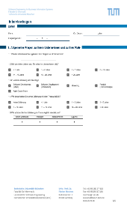
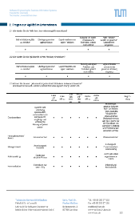
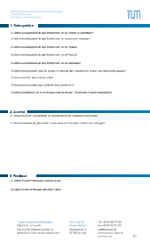


Research Methodology
Case Study Research Process
What is the actual state regarding the large-scale agile transformation at PosterXXL?
RQ01
1. Designing case study
Context
Case
Which impact does the large-scale agile transformation at PosterXXL has on the organization?
RQ02
2. Preparing case study
What are success factors and barriers of the large-scale agile transformation at PosterXXL?
RQ03
3. Collecting data
What are the lessons learned of the large-scale agile transformation at PosterXXL?
4. Analyzing data
RQ04
Notes:
In order to answer the research questions, a case study was conducted. First, the case study was designed, and then prepared. For this a interview sheet was created. After that, data was collected by means of semi structured interviews and thereafter analysed.
Question 3 and 4 could be addressed and answered only by means of the interviews by asking open questions whereas additional proceedings were necessary to answer the first and second question, which I will explain in the following.

Slide 9



Research Question 1
Structured Literature Review
1. Definition of research question and scope
RQ1
Agile Transformation
Large-Scale Agile Transformation
2. Determination of relevant key terms for searching phase
Agile Development
Key Terms
Large-Scale Agile Transformation
What is the actual state regarding the large-scale agile transformation at PosterXXL?
RQ01
Agile Software Development
Large-Scale Agile Software Development
3. Search process
4. Analyzing and synthesizing literature
Notes:
So, in order to pursue the first research question a structured literature review was condcuted. This can also be described in four steps.
After defining the research question, key terms were determined in order to find literature which was afterwards examined to identify relevant literature.
categories were identified that enable the distinction between the plany-driven way and the agile way of working.

Slide 10
Research Question 1
Total of 35 categories
Excerpt:
After coding
is completed
Command and
Control
Leadership
distributed
collocated
Up front
continuous
Every iteration
Management style | Team location | Project planning | Testing
Role Assignment | Team size | Documentation | Requirements
Individual –
favour
specialization
Self-organizing
teams –
encourages role
interchangeability
> 10
< 10
substantial
minimal
Very stable,
known in
advance
Emergent,
with rapid changes
[1;3;9;10]
Notes:
These categories can be split up into two contradicting dimensions as agile methods and plan-driven methods have a different focus
Meaning that the participants rate in a scale of 6 whether they are rather agile, agile or fully agile or rathe traditional, traditional or fully traditional
This is used to describe what the actual state is and to find out what the desired state is.
By doing this, the company can reflect critically by answering the questions what they have achieved so far and what they still want to do or whether the final status has already been achieved.
Furthermore, Agile Transformation is made comparable by categories.

Slide 11
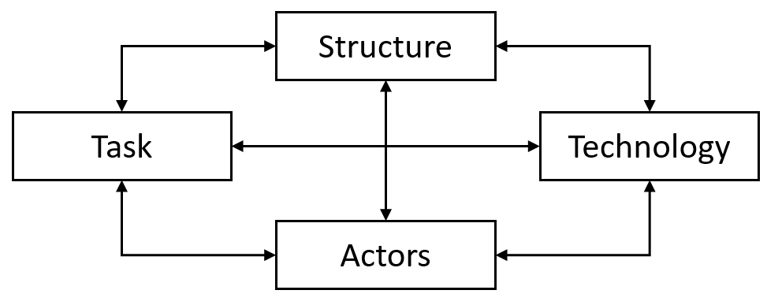
Research Question 2
Which impact does the large-scale agile transformation at PosterXXL has on the organization?
RQ02
Socio-technical model by [8]
Notes:
To pursue the second research question, we use the socio-technical systems theory.
-The theory distinguishes between two interacting systems in a company, the social system and the technical system. --The social system consists of the components persons and structure and the technical system of task and technologies.
-These components are interdependent, i.e. if a task changes, then all other components change as well.
-Theory is used as a guide to analyse changes.
-The idea is to describe the effects of transformation using these four dimensions.

Slide 12
Research Question 3&4
What are success factors and barriers of the large-scale agile transformation at PosterXXL?
RQ03
What are the lessons learned of the large-scale agile transformation at PosterXXL?
RQ04
Notes:
The last two were addressed by open questions.

Slide 13
Agenda
Motivation
Research Methodology
Case Study
Data Collection
Case Description
Findings
Discussion
Outlook

Slide 14
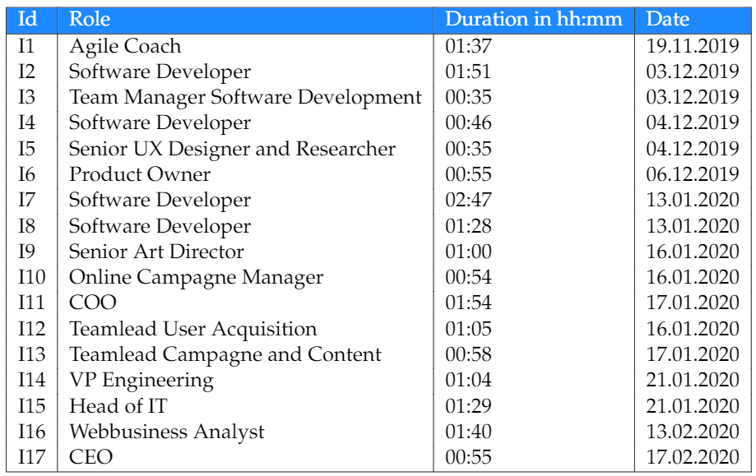
Case Study – Data Collection
Total amount of interviews: 17
Total hours of interviews: ~ 21 h 30 min
Average time of interviews: ~ 1 h 16 min
Notes:
Moving on with the data collection.
A total amount of 17 interviews were conducted, which took approximately 22 hours.

Slide 15
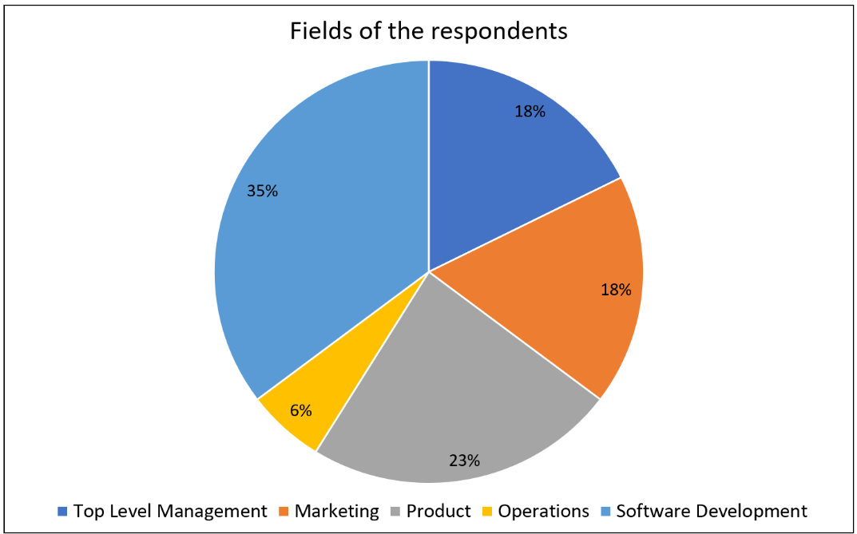
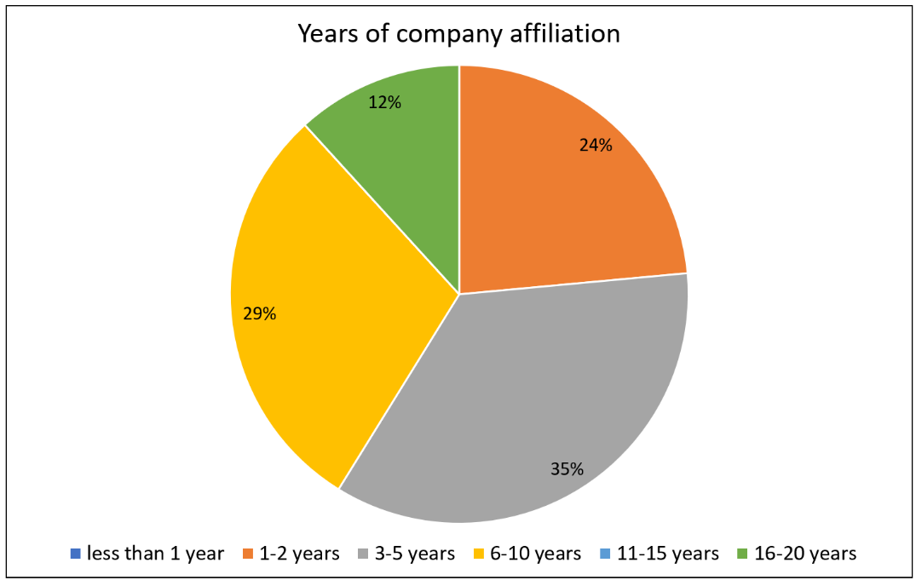
Case Study – Data Collection
N=17
N=17
Notes:
To the respondents profile:
35% were of the software development teams followed by 23% being of the product team. The remaining ones are the marketing department, top level management and the operations department.
Regarding their years of company affiliation…

Slide 16
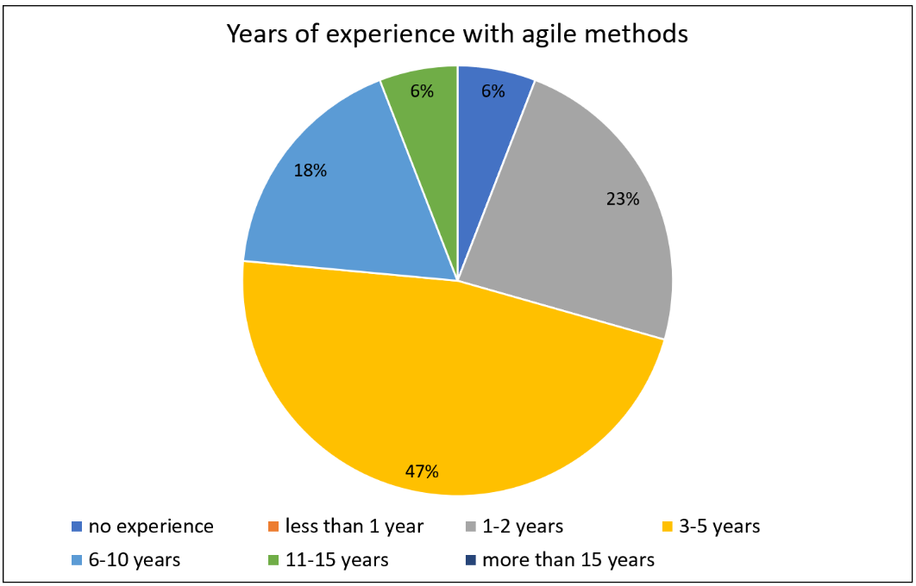
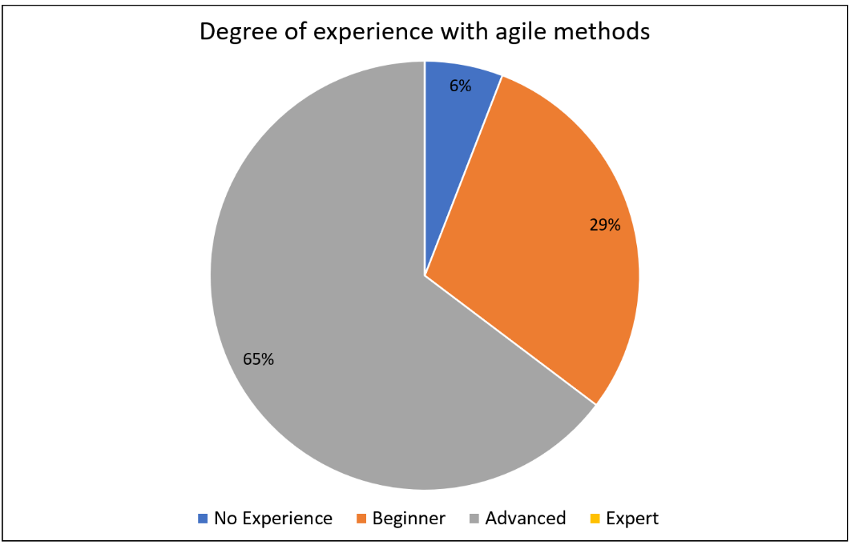
Case Study – Data Collection
N=17
N=17
Notes:
Moving on with their years of expeiene with agile methods, 47% stated that they have had experience for 3-5 years, followed by 23% having experience for 1 to 2 years.
The last one, their degree of experience with agile methods. 65% rate themselves as advanced, followed by 29% being beginners, 6% rate that they do not have any experience and none of them rated themselves as an expert.

Slide 17

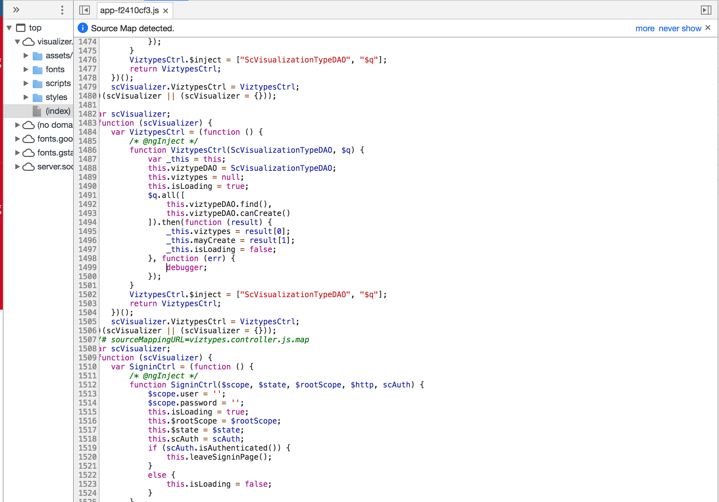
Case Study – Case Description
Industry partner
Online retailer for photo products in Germany
Subsidiary of the PhotoBox Group
Founded in 2004
Location and production in Munich
Currently approx. 200 employees

Slide 18
Case Study – Case Description
2013
Extra room “Scrum” where management isolated themselves with the goal to develop a new digital product using Scrum without involving the employees
2015
Project management team and software development team initiated the second attempt and introduced Scrum but with a different proceeding.
They held workshops, formed appropriate teams and defined common goals to achieve, and were able to successfully develop a new digital product within two and a half years.
Currently
Migration to the technological platform of their parent company
Only have the software development teams working according to Kanban.
Notes:
They had two attempts for introducing agile to the company:
First one in 2013,
At this time, they have opened far too many projects, have done too much and consequently did not have the
right focus anymore. They recognized that the long-term project planning phases were
not working properly and decided to introduce agile, which was at this time felt as very
exciting.
Their objective:
to increase their productivity
to focus and simply to move faster and more efficiently
Without setting up a plan, the COO and a new employee with already existing practical experience in agile, started introducing the agile method Scrum.
They had an extra room they called Scrum where the management had isolated themselves
regularly with the goal to develop a new digital product as fast as possible without
involving the employees.
The COO called their approach retrospectively "an electrifying
personal ego thing".
At this time, traditional project management structures were still existing in the organization which caused a discrepancy between management and employees. Consequently, they failed at introducing agile to the company.
Second attempt in 2015:
The objectives similar to former ones:
to react faster
to increase the flexibility
to have a customer-oriented product development process
to increase the intrinsic motivation of the employees
This time, the traditional project management team and the software
development team initiated the introduction of agile methods with support from the top level management.
Again they decided to introduce Scrum but with a different proceeding.
They held workshops, formed appropriate teams and defined common goals to achieve,
and were able to successfully develop a new digital product within two and a half years.
In addition, they conducted a short-term experiment in which they formed one Squad inspired
by the Spotify Model with the goal to increase the conversion rates. They aborted
this experiment due to major disagreements within the company.
Currently, they are migrating to the technological platform of their parent company and
only have the software development teams working according to Kanban.
4.3.

Slide 19
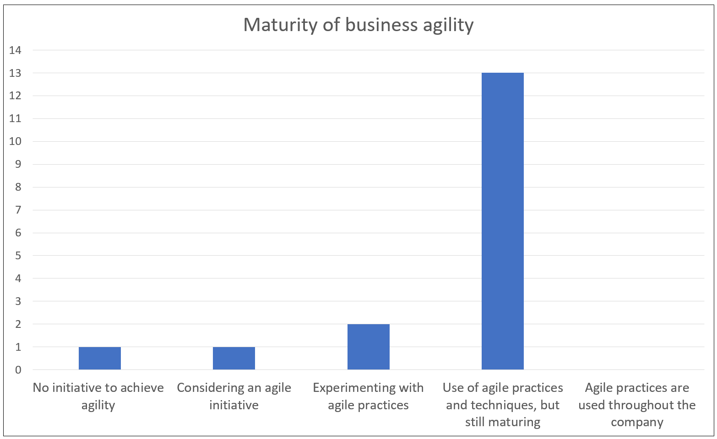
Case Study – Findings on State of Agility
N=17
Notes:
Moving on with the findings on the state of agility. Before rating the catgories, the participants were asked to rate ther maturity of business agility where 13 stated that they use agile methods but which are still maturing, 2 that they experiment with those methods, 1 that they only consider introducing them and also 1 that they do not even cinsider the introduction. None of them stated that agile practices are used throughout the organization.

Slide 20
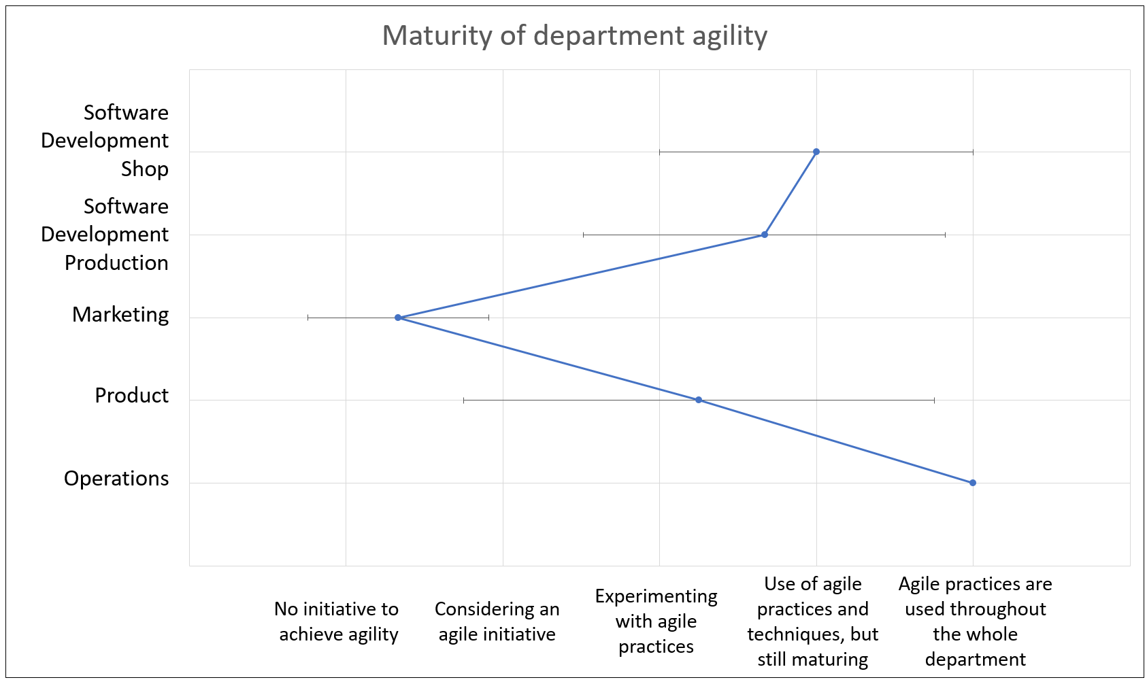
Case Study – Findings on State of Agility
N=14
Notes:
After that, the particpants were asked to classifiy the maturity of agility of their departments. To classify this, the mean values were used. So, the operations department which only consisted of one agile coach, stated that they do use agile methods troughout the department, whereas both software developmet teams state that they use the methods but are still maturing. The product team stated that they experiment with the methods and the Marketing department stated that they do not consider the introduction of agile methods.

Slide 21
Case Study – Findings on State of Agility
Very stable, known in advance
After coding is completed
Substantial
Up front
Distributed
> 10
Individual
Command and Control
Emergent with rapid changes
Every iteration
Minimal
Continuous
Collocated
< 10
Self-organizing teams
Leadership and collaboration
Requirements
Testing
Documentation
Project planning
Team location
Team size
Role assignment
Management style
Left applies strongly | Left applies | Rather left applies | Rather right applies | Right applies | Right applies strongly
Notes:
After that, every interviewee rated the actual state and the target state according to the identified categories by means of a scale from „left applies strongly“ which represents the plan driven way to „right applies strongly“ which represents the agile way of working whereas the blue line represents the actual state and the orange one the target state. The categories were evaluated by their mean value and classified according to the scale.

Slide 22
Case Study – Findings on State of Agility
Left applies strongly |  | Left applies |  | Rather left applies |  | Rather right applies |  | Right applies |  | Right applies strongly
Notes:
For the actual state, a total of 23 can be classified in the range
between "Rather right applies" and "Right applies". Whereas 2 categories can be classified
between "right applies" and "Right applies strongly" and 7 categories between the range
of "Rather right applies" and "Rather left applies".
For the target state, 21 categories are classified in the range of "Rather right applies" and "Right applies" whereas
6 categories are classified in the range of "Right applies" and "Right applies strongly". For
4 categories in fact it would be more appropriate being in the range of "Rather left applies"
and "Rather right applies", as well as for the remaining 4 categories that are classified between
"Left applies" and "Rather left applies".

Slide 23
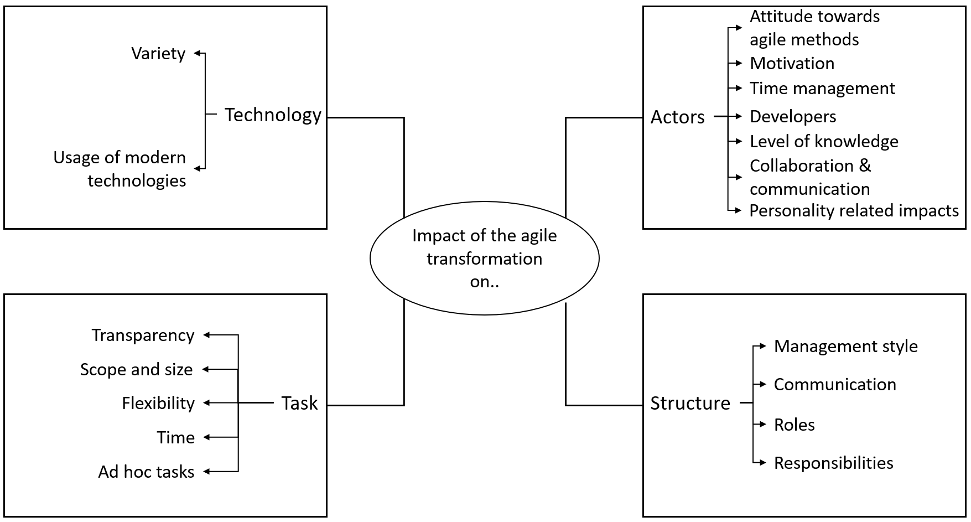
Case Study – Findings on Impacts
Notes:
To identify the impacts, a deductive approach was used and only codes mentioned at least twice were merged into one impact.
A total of 18 impacts were identified and the most impact has been identified being on the actors or people of the organization, most mentioned impact has been the attitude towards agile methods. They described the emerge of two contradicting opinions within the organization, that ones being against the introduction of agile and those being for the introduction. Some even left the company. However some also report that there has been a change if the attitude towards agile methods, from being secptical to being satisfied with the way of wokring because of the shown benefits.
Secondly, the tasks, most mentioned impact has been on the scope and size of the tasks which need to be defined more precisely and shortened in order to fit into the small iterations.
Tasks are followed by the structure, and the least impact has been noticed on the used technology.

Slide 24
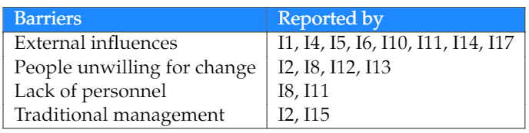
Case Study – Findings on Barriers
Total amount of codes: 18
Total amount of barriers: 4
Notes:
For this, also a deductive approach was used and only codes mentioned at least twice were merged into one barrier. 4 barriers could be identified through 18 codes and the most mentioned barrier are the external influences. Which refers to the migration project to the technological platform of their parent company , which is executed by the parent company. Because, this project was extremely time-consuming and led to the fact that they were not able to carry out other projects on their own at that time and also, they actually had no clear perspective on what will happen after the connection of both systems.

Slide 25
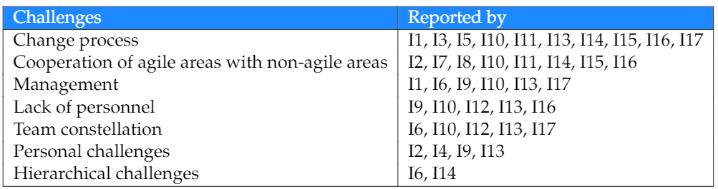
Case Study – Findings on Challenges
Total amount of codes: 37
Total amount of challenges: 7
Notes:
Besides barriers, challenges were also identified. 7 challenges could be identified through 37 codes.
The most mentioned challenge was the change process which refers to the change of the peoples mindest, some recected change in general and others receted agile methods because they had for example made bad experiences in the past.
The second most mentioned challenge was the cooperation of agile areas with non-agile areas where conflicts arose between people due to different mindsets, different processes and often no understanding of agile methods.

Slide 26
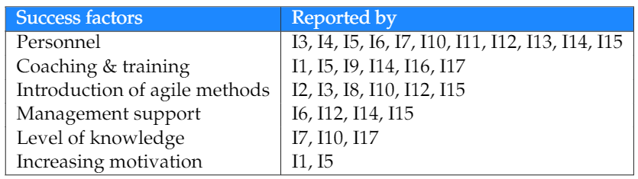
Case Study – Findings on Success Factors
Total amount of codes: 40
Total amount of success factors: 6
Notes:
6 success factor could be dientifed through 40 codes.
Most mentioned success factor was having the approproiate personnel in the company. Meaning that people in the company need to have an agile mindset or at least need to be willing for changing their mindset, also that the agile way of working needs to be supported by evry employee.
Second most mentioned success factor was Coaching and Training by agile coaches which will more likely increase the openness to the topic and consequently lead to acceptance
by people, furthermore, the supervision of agile coaches ensures the correct implementation of the agile methods.

Slide 27
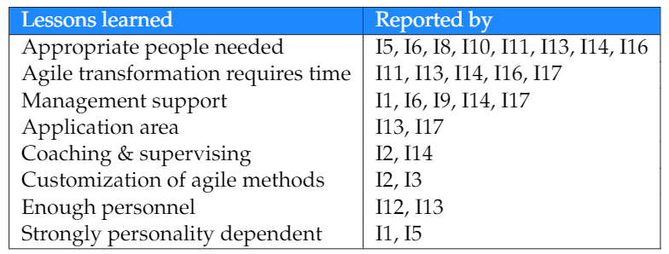
Case Study – Findings on Lessons Learned
Total amount of codes: 42
Total amount of lessons learned: 8
Notes:
The last one, the lessons learned. 8 could be identified through 42 codes.
The most mentioned lesson learned was that appropriate people are needed in order to perform a large-scale agile transformation. with appropriate people is meant that people need to have internalized the agile mindset, need to be
fully committed to the process, and need to be willing to work in a cross functional team.
Second lesson learned is that this transformation is a complex and tedious process which requires time for people to be understand and accepted and if people are not given time to accept the change and deal with
the issue, it is more likely to lead to conflict and rejection.

Slide 28
Agenda
Motivation
Research Methodology
Case Study
Discussion
Key Findings
Limitations
Outlook

Slide 29
Discussion – Key Findings
Achieving full agility in every category is not the organizational goal
Large-scale agile transformation has impact on the whole organization
Continuous emergence of new challenges
Success factors and lessons learned can be derived from emerged challenges and barriers
Success of the large-scale agile transformation depends on the people in the organization
Notes:
To the key findings:

Slide 30
Discussion – Limitations
Construct validity
Multiple people of different roles were interviewed
Introduction of the topic took place before the interview
Possibility that not all occurring impacts, challenges, barriers, and success factors within the organization are included in this thesis
Internal validity
Explicitly asked about the agile transformation
Frequently reminded only to mention impacts that occurred within the organization
External validity
Case study provides empirical insights that allow an understanding for challenges, barriers, success factors, and impacts on the organization of a large-scale agile transformation
Current state and target state analysis can be used as a template for further research
Reliability
Study relies on subjective opinions
Notes:
In this part, the threats to the validity and how they have been addressed are discussed according to the
recommended scheme by Runeson & Höst [37].
Accordingly, four distinctions of validity can be made.
Construct:
This validity aspect addresses the degree to which the examined measures actually reflect what the researcher intended and what he actually examined.
Internal:
This aspect should be addressed when examining causal relations. This can be a threat to the thesis’ validity when the investigated factor is also affected by a third factor, which is not known or the researches is not aware of.
External:
External validity concerns the degree to which the findings can be generalized and to which the findings are of interest to people not included in the investigated case.
As this thesis analyzes occurring success factors, challenges, barriers, lessons
learned, and the impacts on the organization, which can emerge during an agile transformation,
the results can be generalized for any organizational member intending to initiate
or currently undergoing an agile transformation within their organization. The analysis
of the current state and the target state can be used as a framework and applied to any
organization currently undergoing an agile transformation.
Reliabilty:
This aspect addresses the degree to which the analyzed data depends on a researcher. Accordingly, the results of another researcher conducting the same study should be the same. Since this study relies on interviews and therefore subjective opinions,
conducting this study at a different organization can not guarantee same results. This is
because another organization can have a different maturity of business agility, different
employees with different cultures and mindsets, and a different approach for initiating the

Slide 31
Agenda
Motivation
Research Methodology
Case Study
Discussion
Outlook

Slide 32
Outlook
Research on the agility maturity in order to be able to measure and compare
Overcoming challenges emerging due the large-scale agile transformation
Further investigation regarding the target state of the organization
The impacts of the large-scale agile transformation on the organization
Notes:
So, four topics were identified that demand for further examination.
First, since the large-scale agile transformation of the German online retailer is still ongoing,
further investigation of this transformation process might be of great importance.
One should analyze how their transformation process proceeded in the future and whether
they have reached their reported target state or whether the actual target state represents
the target state of the future.
Second, more research should be conducted on the impact of
the large-scale agile transformation since this thesis identified impacts not mentioned in
other literature.
Third, more research should be conducted on challenges and success factors
that emerge due to large-scale agile transformation and whether the organization was
able to overcome their reported challenges and how to overcome these challenges. Also, since new challenges are emerging continuously, although there is already a great amount of literature on this topic, attention should be still paid on this.
Fourth, since this thesis provides a framework to measure the agility maturity by means of categories, it would be
of great value if more research is conducted on this topic in order to make the large-scale
agile transformation measurable and comparable. Because, although the agility maturity of each
category was examined, no general statement could be made as to whether the company
can now be described as an agile organization or not.

Slide 33
References
[1] Conboy, Kieran; Coyle, Sharon; Wang, Xiaofeng; Pikkarainen, Minna (2011): People over Process: Key Challenges in Agile Development. In: IEEE Softw. 28 (4), S. 48–57. DOI: 10.1109/MS.2010.132.
[2] Dikert, Kim; Paasivaara, Maria; Lassenius, Casper (2016): Challenges and success factors for large-scale agile transformations: A systematic literature review. In: Journal of Systems and Software (119), S. 87–108. DOI: 10.1016/j.jss.2016.06.013.
[3] Dingsøyr, Torgeir; Moe, Nils Brede; Fægri, Tor Erlend; Seim, Eva Amdahl (2018): Exploring software development at the very large-scale: a revelatory case study and research agenda for agile method adaptation. In: Empir Software Eng 23 (1), S. 490–520. DOI: 10.1007/s10664-017-9524-2.
[4] Fuchs, Christoph; Hess, Thomas: Becoming Agile in the Digital Transformation (2018): The Process of a Large-Scale Agile Transformation.
[5] Gerster, Daniel; Dremel, Christian; Kelker, Prashant (2018): "Agile Meets Non-Agile": Implications of Adopting Agile Practices at Enterprises.
[6] Hekkala, R., Stein, M.-K., Rossi, M., and Smolander, K. (2017). "Challenges in Transitioning to an Agile Way of Working," Proceedings of the 50th Hawaii International Conference on System Sciences, Hawaii, USA.

Slide 34
References
[7] Joehnk, J., Röglinger, M., Thimmel, M., and Urbach, N. (2017). "How to Implement Agile IT Setups: A Taxonomy of Design Options," in: Proceedings of the 24th Eurpean Conference on Information Systems (ECIS). Guimaraes, Portugal.
[8] Leavitt, Harold J. (1965): Applied Organizational Change in Industry: Structural, Technological and Humanistic Approaches. In: Handbook of Organizations, S. 1144–1170.
[9] Nerur, Sridhar; Mahapatra, RadhaKanta; Mangalaraj, George (2005): Challenges of migrating to agile methodologies. In: Commun. ACM 48 (5), S. 72–78. DOI: 10.1145/1060710.1060712.
[10] STOICA, Marian; MIRCEA, Marinela; GHILIC-MICU, Bogdan (2013): Software Development: Agile vs. Traditional. In: IE 17 (4/2013), S. 64–76. DOI: 10.12948/issn14531305/17.4.2013.06.
[11] Torgeir Dingsøyr, Sridhar Nerur, VenuGopal Balijepally, and Nils Brede Moe. “A decade of agile methodologies: Towards explaining agile software development”. In: Journal of Systems and Software 85.6 (2012), pp. 1213–1221

Slide 35
Melisa Uluer
17132
melisa.uluer@tum.de

Slide 36
BACKUP SLIDES

Slide 37



Timeline
Sep
Oct
Nov
Dec
Jan
Feb
Mar
Literature Review
Prepare and conduct Interviews
Data Analysis
Writing Bachelor’s Thesis
official start
15th September 2019
kick-off presentation
2nd December 2019
official end
15th March 2020
Notes:
Next steps:
Conducting interviews which are already scheduled
Starting as soon as possible with the data analysis
And finishing my thesis

Slide 38
Research Approach - Interviews
5-10 min
20 min
30 min
15 min
Introduction
Identifying actual state
Identifying impact
Identifying success factors & barriers
Identifying lessons learned

