Slide 1
How To Extend the Training Data?
Comparison of Two Methods
Applied for the training-intensive algorithms
Shabnam Sadegharmaki, Oct 2018

Slide 2
Outline
Motivation
  Euler Hermes project at Allianz
  Legal text classification at Sebis
Problem Statement
  Supervised classification challenges
  Learning with minimum supervision
Solution
  Text Data Augmentation
  Semi Supervised Learning
    Graph based SSL
Research approach
  Comparison of the two methods
  Across the two datasets
Timeline
Overview

Slide 3
Euler Hermes Project
An Early Warning System
Financial Experts → Read News and Signals → Grade the companies
Vast amount of coming News → Not all of them are critically important
Phase 1: Filtering out the important news about a company to utilize human time and effort
→ Classification of News based on their criticalness
→ News are labeled by financial experts
Phase n: An early warning system

Slide 4
Sebis Project
Legal Text Annotation/Classification
Classification of legal sentences in norms (laws) and clauses (contracts)
    semantic and functionality
A taxonomy constituting 9 different functional classes exist
Different datasets
  ~600 Sentences from the German BGB with regard to the tenancy law
  ~600 Sentences from German AGB with regard to the sales of good law
  ~300 Sentences from German rental agreements
  ~200 Sentences from German purchasing agreements

Slide 5
Outline
Motivation
  Euler Hermes project at Allianz
  Legal text classification at Sebis
Problem Statement
  Supervised classification challenges
  Learning with minimum supervision
Solution
  Text Data Augmentation
  Semi Supervised Learning
    Graph based SSL
Research approach
  Comparison of the two methods
  Across the two datasets
Timeline
Overview

Slide 6












Supervised Classification
Training
Classification
$$L :labeled data$$
$$L_{Training}$$
$$U_{unseen}=$$
$$U_{unlabeled}$$
$$L_{Test}$$
$$L_{Training}$$
Classifier
$$U_{unseen}$$
$$L_{Test}$$
Classifier
ML

Slide 7

The Challenge
Labeled Data:
The More, The Better
However:
Expensive and Scarce
On the other hand,
Vast amount of unlabeled data
  How to extend the labeled data?
Machine Learning Techniques
With Minimal Supervision

Slide 8
Outline
Motivation
  Euler Hermes project at Allianz
  Legal text classification at Sebis
Problem Statement
  Supervised classification challenges
  Learning with minimum supervision
Solution
  Text Data Augmentation
  Semi Supervised Learning
    Graph based SSL
Research approach
  Comparison of the two methods
  Across the two datasets
Timeline
Overview

Slide 9







Two Approaches
1. Text Data Augmentation
Still no use of unlabeled data
Training
$$L_{Training}$$
$$L_{Augmented}$$
$$L_{Test}$$
Classification
ML
$$U_{unseen}$$
2. Semi-Supervised Learning
Classifier
Training
$$L_{Training}$$
$$U_{Unlabeled}$$
$$L_{Test}$$
ML

Slide 10
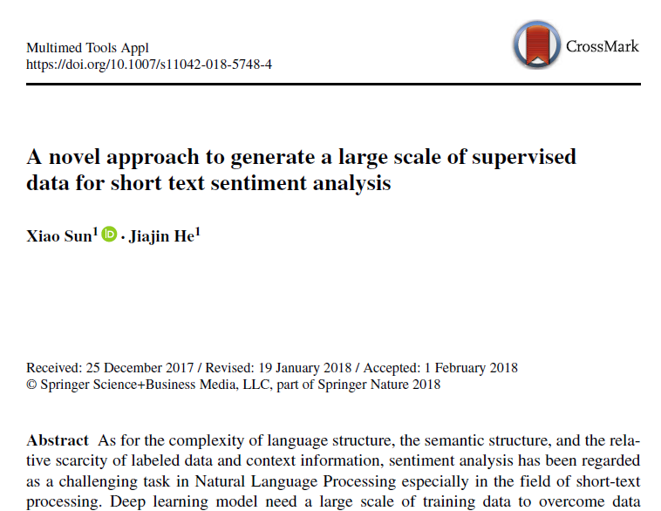
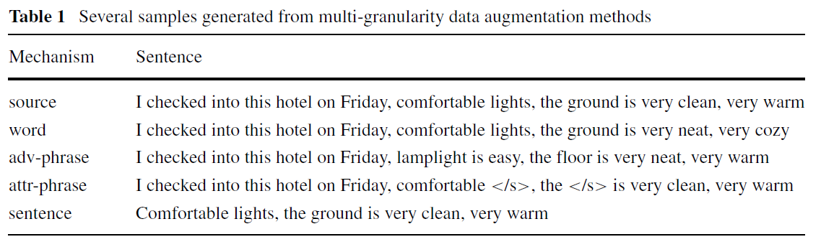
1. Text Data Augmentation
Add other variants of a text to the train data with the same label
Comes from Image Processing research area. But cannot be directly applied in the text area. Because the order of the words matters in this case.
Applied on text data: first time by X. Sun & J. He

Slide 11
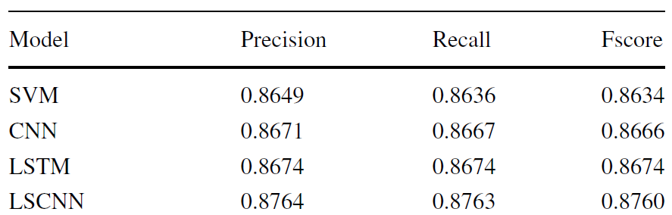

1. Text Data Augmentation
hotel on-line evaluation dataset
Chinese
Sentiment Analysis
Models used:
  SVM
  CNN(Convolutional Neural Network)
  LSTM(Long Short Term Memory)
  LSTM+CNN
[1] X. Sun and J. He, “A novel approach to generate a large scale of supervised data for short text sentiment analysis,” Multimedia Tools and Applications, pp. 1–21, 2018.

Slide 12
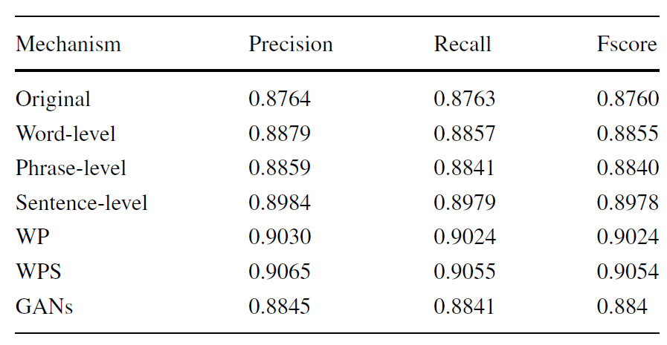

1. Text Data Augmentation
  The Augmentation has increased the performance
  Also compared with GAN
  Results →

Slide 13
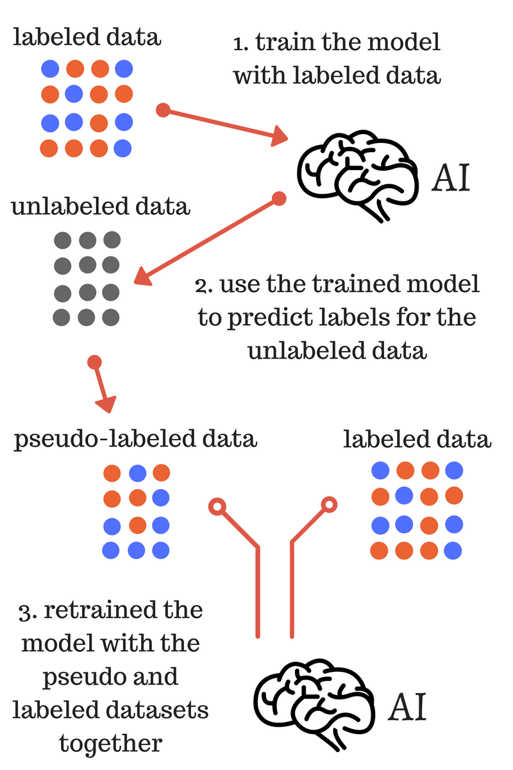
2. Semi-Supervised Learning
Generative models
Self training
Co training
Graph based
Active learning

Slide 14
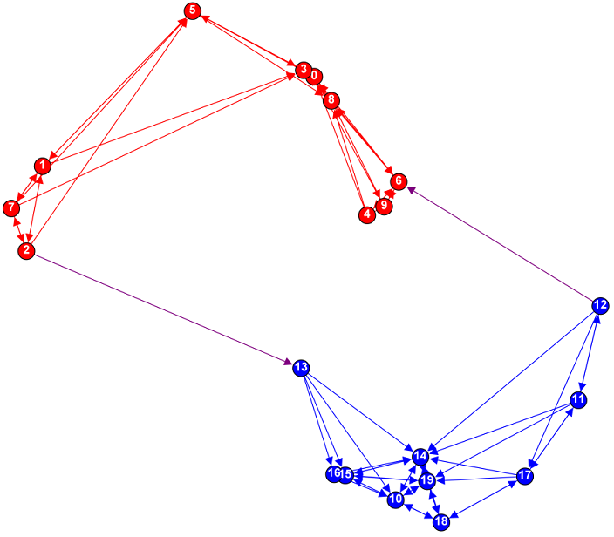

2. Semi-Supervised Learning
Generative models
Self training
Co training
Graph based
Active learning
Graph:
Nodes are both labeled and unlabeled
Edges reflect the similarity of examples.
Classification: Label Propagation

Slide 15
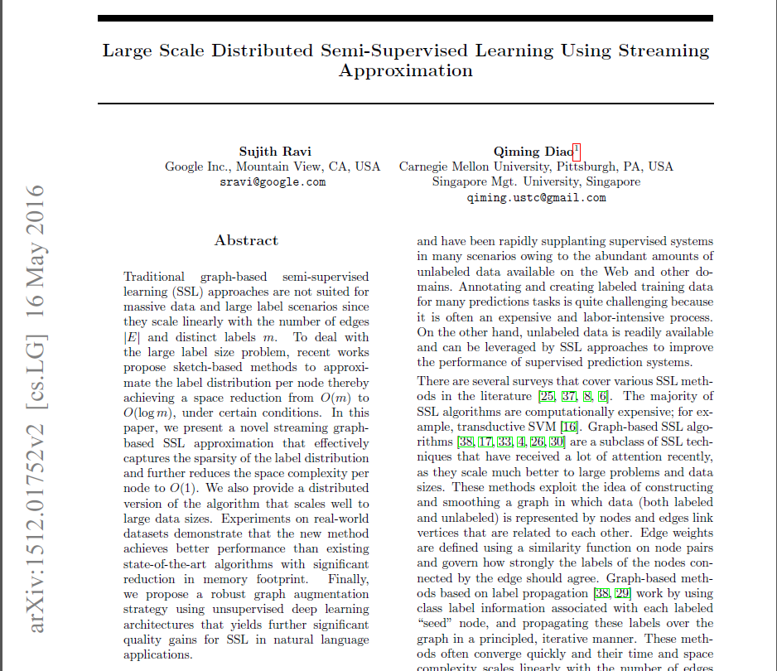
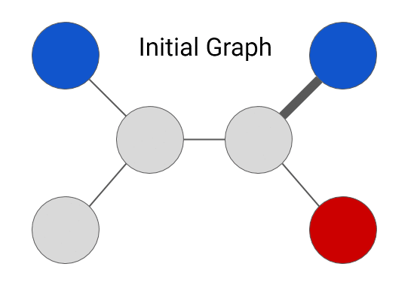
2. Semi-Supervised Learning

Slide 16
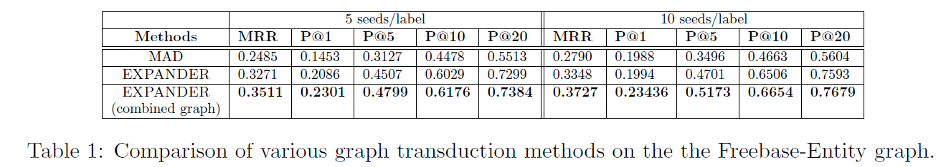
2. Semi-Supervised Learning

Slide 17
Outline
Motivation
  Euler Hermes project at Allianz
  Legal text classification at Sebis
Problem Statement
  Supervised classification challenges
  Learning with minimum supervision
Solution
  Text Data Augmentation
  Semi Supervised Learning
    Graph based SSL
Research approach
  Comparison of the two methods
  Across the two datasets
Timeline
Overview

Slide 18
Research Approach
Datasets
  Financial news dataset (in German, provided by Allianz)
  Law and contract dataset (in German, provided by the chair)
Methods
  Text augmentation
  Graph-based SSL
Research possible solutions for the Text Data Augmentation
Implementation of a supervised learning suitable for the dataset as a base of the comparison
Implementation of the two text augmentation methods
Analysis/Comparison of the results for both methods
Analysis/Comparison of the results between datasets

Slide 19
Outline
Motivation
  Euler Hermes project at Allianz
  Legal text classification at Sebis
Problem Statement
  Supervised classification challenges
  Learning with minimum supervision
Solution
  Text Data Augmentation
  Semi Supervised Learning
    Graph based SSL
Research approach
  Comparison of the two methods
  Across the two datasets
Timeline
Overview

Slide 20
Timeline
Guided Research = 300 h
Research 80 hours end of Oct
Document & Presentation 40hours Feb
Implementation 120 hours 21th Dec
Analysis of the results 60 hours 15thJan

Slide 21
Guided Research Overview
Motivation: Amount of labeled training data is limited and costly to produce
Idea: Extend training data by machine learning
Scope: Compare two text data augmentation approaches on two
datasets and investigate effects on model performance
Planned duration: Oct 18 – Feb 1st
Supervision: Jointly by AZ(Basil Komboz) and TUM(Ingo Glaser, Prof. Matthes)
Datasets
  Financial news dataset (in German, provided by Allianz)
  Law and contract dataset(in German, provided by the chair)
Methods
  Text augmentation
  Graph-based SSL

Slide 22
References
[1] Sun, X., & He, J. (2018). A novel approach to generate a large scale of supervised data for short text sentiment analysis. Multimedia Tools and Applications, 1-21.
[2] Ravi, S., & Diao, Q. (2016, May). Large scale distributed semi-supervised learning using streaming approximation. In Artificial Intelligence and Statistics (pp. 519-528).
[3] Hussain, A., & Cambria, E. (2018). Semi-supervised learning for big social data analysis. Neurocomputing, 275, 1662-1673.
[4] Shams, R. (2014). Semi-supervised Classification for Natural Language Processing. arXiv preprint arXiv:1409.7612.
[5] Zhu, X. (2006). Semi-supervised learning literature survey. Computer Science, University of Wisconsin-Madison, 2(3), 4.
[6] Goyal, P., & Ferrara, E. (2018). Graph embedding techniques, applications, and performance: A survey. Knowledge-Based Systems, 151, 78-94.
[7] Grover, A., & Leskovec, J. (2016, August). node2vec: Scalable feature learning for networks. In Proceedings of the 22nd ACM SIGKDD international conference on Knowledge discovery and data mining (pp. 855-864). ACM.

Slide 23
Thank You
Question?

Slide 24
Research Approach
Datasets
  Financial news dataset (in German, provided by Allianz)
  Law and contract dataset (in German, provided by the chair)
Methods
  Text augmentation
  Graph-based SSL
For each dataset:
1. Divide the dataset to training/test, labeled/unlabeled, Clean the data
2. Apply supervised method (Base of the comparison)
3. Transform the labeled data.
4. Apply the same supervised method (2) on the labeled and psudo-labeled(3)
5. Apply graph-based SSL
6. Compare the results of 2,4,5
7. Compare the results cross the two datasets

