Slide 1
Automated documentation of Business Domain assignments and cloud application information from an application development pipeline
Master Thesis: Kickoff
Nicolas Corpancho Villasana 10.09.2018

Slide 2
Agenda
1. Motivation
2. Literature review
3. Derivation for EAM
4. Research questions
5. Evaluation environment
6. Solution
7. Timeline
8. Next steps

Slide 3









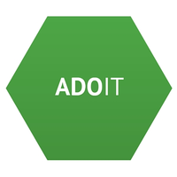


1. Motivation: Major technology trends that have an impact on EAM
Agile development and continuous delivery (CD) approaches are becoming more important in todays enterprises. CD leads to short lifecycles which implies a quicker update of the EA Tool information
Cloud migration reduces infrastructure and maintenance costs. Cloud reduces transparency and increases complexity of EA documentation
Modularization of legacy systems into application components and microservices causes a higher number of applications
??? ??? ??? ???
Monolith
Automation
EA Tools
?????
Notes:
MAJOR

Slide 4
2. Literature review
Year | Author | Title | Outlook | CD | CC | Mod.
2010 | Matthias Farwick, Berthold Agreiter, Ruth Breu, Matthias Häring, Karsten Voges, Inge Hanschke | Towards Living Landscape Models: Automated Integration of Infrastructure Cloud in Enterprise Architecture Management | Cloud Integration (PaaS and SaaS)
2012 | Buschle, M., Ekstedt, M., Grunow, S.,Matheus Hauder, Florian Matthes, Sascha Roth | Automated Enterprise Architecture Documentation using an Enterprise Service Bus | Modeling EA transformations
2013 | Matthias Farwick, Ruth Breu, Matheus Hauder, Sascha Roth, Florian Matthes | Enterprise Architecture Documentation: Empirical Analysis of Information Sources for Automation | Automation opportunities
2013 | Sascha Roth, Matheus Hauder, Felix Michel, Dominik Münch, Florian Matthes | Facilitating Conflict Resolution of Models for Automated Enterprise Architecture Documentation | Combination of approach with other automated EA documentation approaches
2013 | Sascha Roth, Matheus Hauder, Matthias Farwick, Ruth Breu, and Florian Matthes | Enterprise Architecture Documentation: Current Practices and Future Directions | Automation mechanisms to improve EAD
2018 | Jorg Landthaler, Ömer Uludag, Gloria Bondel, Ahmed Elnaggar, Saasha Nair, and Florian Matthes | A Machine Learning Based Approach to Application Landscape Documentation | Research in automated EAD
Research in automated EA documentation integrating todays Cloud (PaaS and SaaS) is needed
CD: Continuous Delivery, CC: Cloud Computing, Mod.: Modularization, EAD: Enterprise Architecture Documentation

Slide 5
3. Derivation for EAM
Challenges of current EA documentation
No single automated EA documentation standard
Many documenting approaches exist, mostly manual data collection
Helps to manage information complexity due to higher number of applications in different environments
Increases support fast changing environments (multi environments) and technologies
Automated EA Documentation
Cloud
EAM Use cases
Application Portfolio Management
Information Management
Technology and Risk Management
Consequences
High error rate documenting and collecting EA information
Time consuming collection of information
Expensive tasks maintaining and gathering information of the EA
IT Controlling
Business/ IT Transformation
Decommission
based on usage metrics
Improved EAM use cases can be derived from an automated EA documentation process
Notes:
It controlling: was kostet die app. PlanningIT, software ag,
VERBESSERTE
Bisiness IT Transofmraiotn: in the digital tranformation era blablabla business plan: target architecture.

Slide 6
4. Research Questions
How to obtain EA relevant information from the runtime behaviour of cloud based environments?
How to assign the application landscape to business domains?
How to automate the assignment process with an integrated toolchain?
How does a prototype implementation of the automated documentation process of cloud applications look like?
RQ1
RQ2
RQ3
RQ4

Slide 7
5. Evaluation environment
Group
Insurance company
Manual collection of EA information with Excel
Integration of other repositories into EA Tool
Import of Excel into EA Tool
Federated approach relating EA Tool to other Tools such as a CMDB and a Wiki
Integration of application inventory to Group EA Tool due to VAIT-regulation (Versicherungsaufsichtliche Anforderungen an die IT)
No cloud application documentation
Modularization of legacy systems into application components and microservices
Migration of application components and microservices to cloud environments
Cloud 1
Cloud 2
EA Tool
Excel
Other repositories
EA Tool
Classic environment
CMDB
Wiki
Non documented applications
Documented applications
Notes:
Left: toolchain in the insurance company in the field of EA

Slide 8
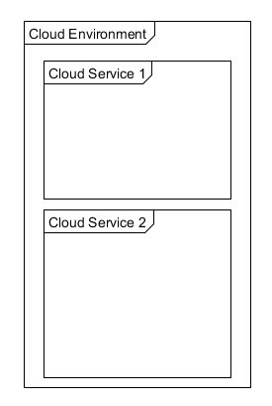


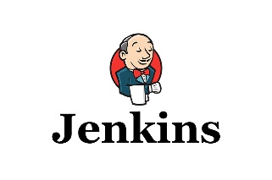



6. Solution: High level architecture
EA Tool
Pivio 2.0
6
crawler
Web client
5
Dynamic data
4
2
Retrieved information
exported to EA Tool
Continuous Integration
7
1
Version control service
5
Static data
3
Business-specific Information Source
DB
Notes:
Numbern. Ids,loeschen, crawler

Slide 9
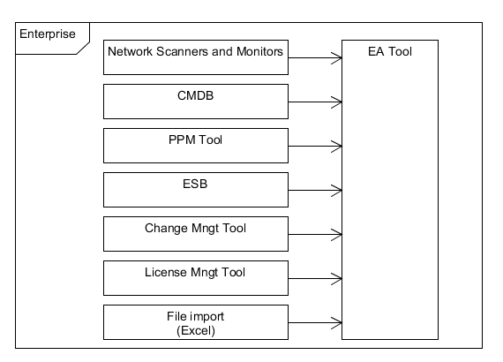







6. Solution: Information collection process
Pivio 2.0
Web client
Enterprise Architect
verifies
Dynamic data
Crawler job
Static data
takes strategic decisions
CIO
script
Plan
Build
Document
Develop
Deploy
Run
KPIs
Monitor
Analyse
Evaluate
Execute
controls
DevOps
DevOps
PO
IT Governance
Automatic process
Manual process
Enterprise Architect
Notes:
Major challenge of EA: Lack of governance (conventions, tool integration, continuous delivery, etc.)

Slide 10
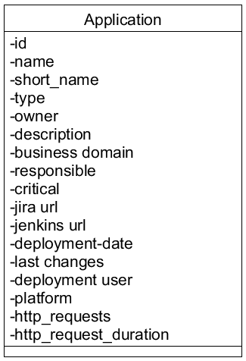


6. Solution: Data model
Attributes structured in 4 parts:
Required fields in Pivio
Business specific information
Technical specifications
Application performance metrics
Required fields from data model of Pivio
Business specific information is gathered from JIRA
Technical information is retrieved from the cloud environments
Application performance metrics collected from monitoring systems such as Prometheus
Attributes extend existing “Anwendung-Service (IS)”-object in EA Tool (iteraplan)

Slide 11
7. Timeline
August
September
October
November
December
January
February
Literature review
Prototype development
Prototype evaluation
Prototype adjustments
Writing
Today
Registered Date: 15.08.2018
Submission Date: 15.02.2019

Slide 12
8. Next Steps
4
5
Integration of JIRA as a business specific information source
Integration the EA Tool (iteraplan)
Implementation of crawler jobs (Cloudfoundry and Openshift)
Alignment on Monitoring-KPIs
Implementation of
additional visualizations
(if needed)
Extend data model
Pivio 2.0
Web client
Enterprise Architect
verifies
2
Dynamic data
6
3
1
Static data
IT Governance
script
Plan
Build
Document
Develop
Deploy
Run
controls
Monitor
Analyse
Evaluate
Execute
DevOps
PO
DevOps
Automatic process
Manual process
Enterprise Architect

Slide 13
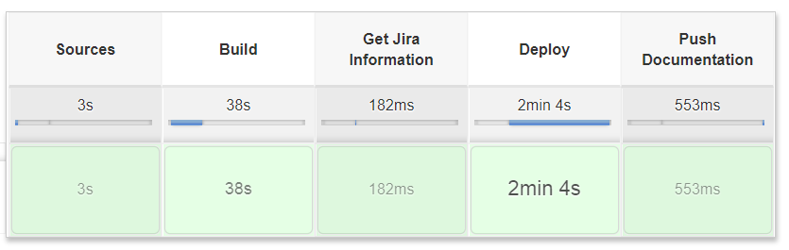
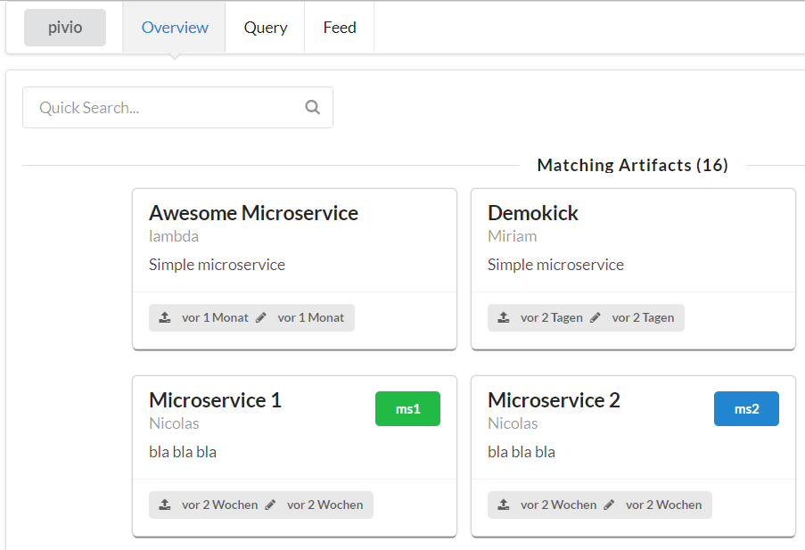
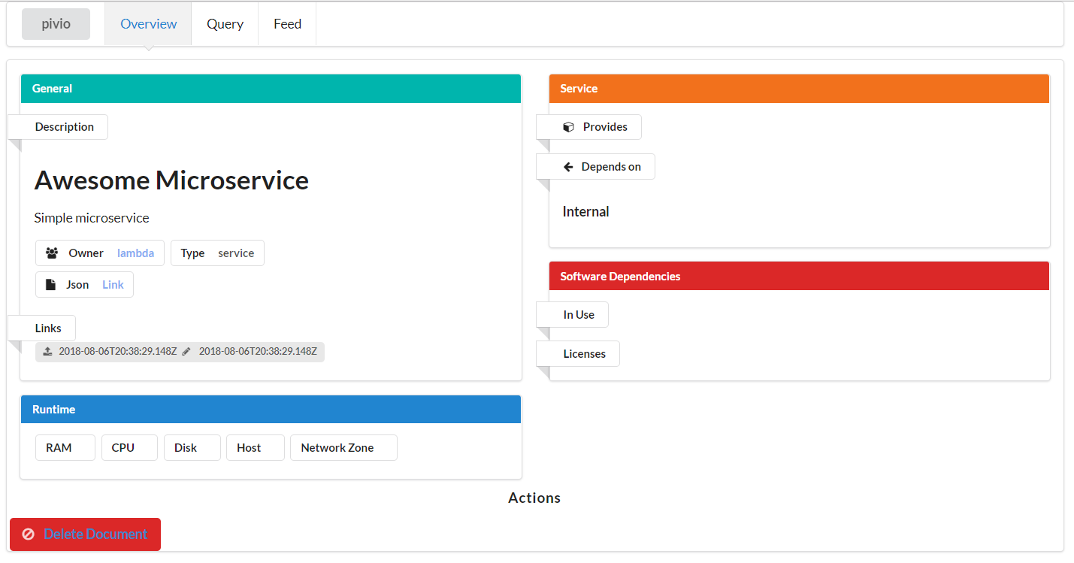
Live Demo

Slide 14
Thank you for your attention!
Do you have any questions?

Slide 15
Backup

Slide 16
Evaluation process
Solution approach will be implemented in an insurance company
Tools used during the development:
Project management: Jira
Continuous Delivery: Jenkins
EA Tool: iteraplan
Monitoring: Pivio 2.0
Cloud environment: CloudFoundry and Openshift
Integration of solution into development pipeline and tools
Test solution approach in pilot project
Solution approach adjustments
Evaluation

Slide 17
Monitoring KPIs
Cloud clustering as additional visualization
Backlog-items KPI: How many items are missing. Application portfolio purposes
Status of applications: running, stopped or crashed.
Number of deployments per time unit: Which applications change frequently?
Traffic KPI: Decommission purposes
Traffic heatmaps: Which applications are important. Relevant for planification and costs. Ratio costs maintenance and costs
LOC: Maintenance vs Complexity (related to maintenance costs)
Additional KPIs

Slide 18
Groovy script
def callPost(String urlString, String queryString) {
def url = new URL(urlString)
def connection = url.openConnection()
connection.setRequestMethod("POST")
connection.doInput = true
connection.doOutput = true
connection.setRequestProperty("content-type", "application/json;charset=UTF-8")
def writer = new OutputStreamWriter(connection.outputStream)
writer.write(queryString.toString())
writer.flush()
writer.close()
connection.connect()
new groovy.json.JsonSlurper().parseText(connection.content.text)
}
node {
deleteDir()
stage('Sources') {
checkout([
$class : 'GitSCM',
branches : [[name: "refs/heads/master"]],
extensions : [[$class: 'CleanBeforeCheckout', localBranch: "master"]],
userRemoteConfigs: [[
credentialsId: 'cbf178fa-56ee-4394-b782-36eb8932ac64',
url : "https://github.com/Nicocovi/MS-Repo"
]]
])
}
dir("") {
stage("Build"){
sh "gradle build"
}
stage("Get Jira Information"){
//TODO
}
stage('Deploy') {
def branch = ['master']
def name = "sping-microservice1"
def path = "build/libs/gs-spring-boot-0.1.0.jar"
def manifest = "manifest.yml"
if (manifest == null) {
throw new RuntimeException('Could not map branch ' + master + ' to a manifest file')
}
withCredentials([[
$class : 'UsernamePasswordMultiBinding',
credentialsId : '98c5d653-dbdc-4b52-81ba-50c2ac04e4f1',
usernameVariable: 'CF_USERNAME',
passwordVariable: 'CF_PASSWORD'
]]) {
sh 'cf login -a https://api.run.pivotal.io -u $CF_USERNAME -p $CF_PASSWORD --skip-ssl-validation'
sh 'cf target -o ga72hib-org -s masterarbeit'
sh 'cf push sping-microservice1 -f '+manifest+' --hostname '+name+' -p '+path
}
}
stage("Push Documentation"){
try {
callPost("http://192.168.99.100:9123/document", "{\"id\": \"0987654321\", \"name\": \"Kick-off-App\", \"owner\": \"Nico\", \"description\": \"bla\", \"short_name\": \"serviceAZ12\", \"type\": \"service\"}") //Include protocol
} catch(e) {
// if no try and catch: jenkins prints an error "no content-type" but post request succeeds
}
}//stage
}
}

Slide 19
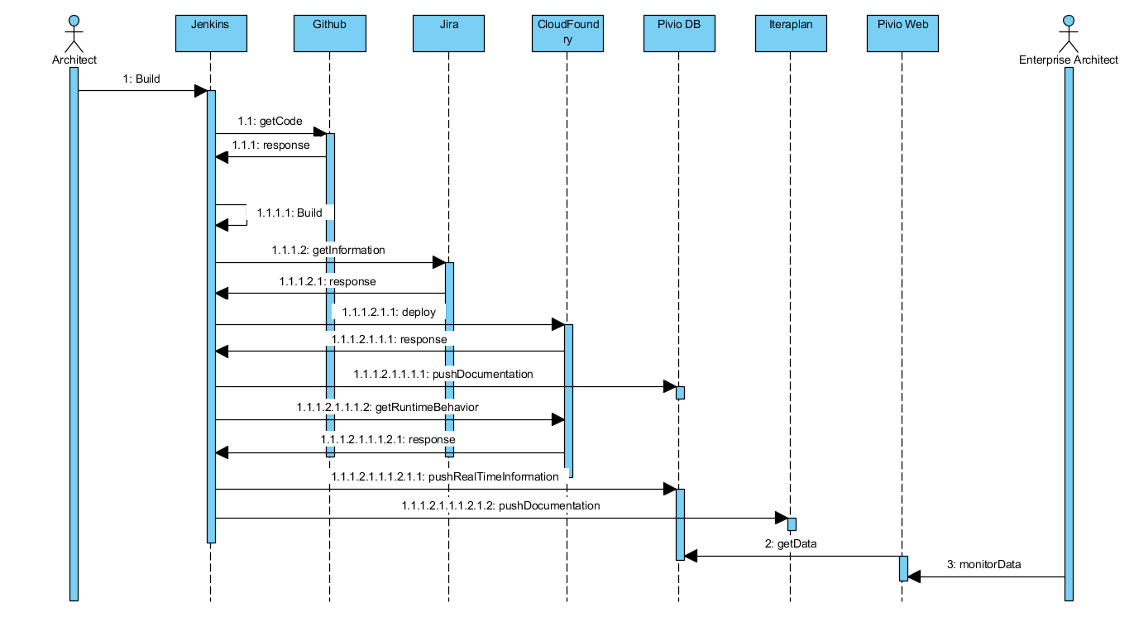
4. Solution: Sequence diagram

Slide 20
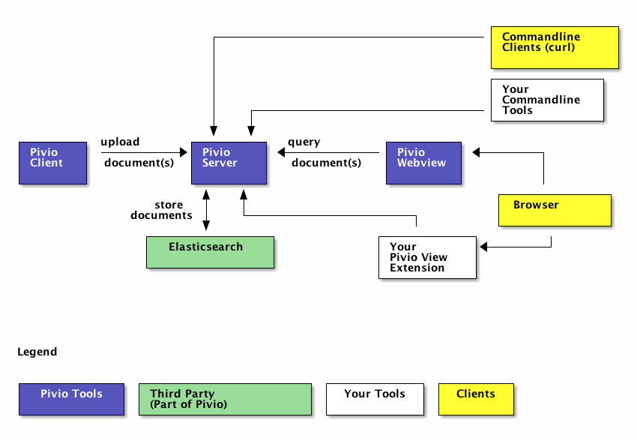
Pivio.io
What is Pivio ? Pivio is a service registry for humans.
Why Pivio ?
Overview for platforms, especially for microservice environment.
Reusability of services
A growing number of services means also a challenge not only for developers.
Which service runs where? What does it do? Who is responsible for that?
Concept of pivio:

Slide 21
Pivio data model
Pivio needs certain mandatory fields:
id: Unique id in pivio.
name: The name of the artefact.
short_name: A very brief name for the service.
type: The type of this artefact. Values could be service, library or mobile_app.
owner: Which team is responsible for this artefact.
description: What does this service do?

