Slide 1
Automated Documentation of Business Domain Assignments and Cloud Application Information from an Application Development Pipeline
Master Thesis: Final presentation
Nicolas Corpancho Villasana 08.02.2019

Slide 2
Agenda
1. Motivation
2. Research
2.1 Research questions
2.2 Existing tools with related functionality
2.3 Literature review
3. Solution
3.1 Solution architecture
3.2 Concept
3.3 Sample scenario
3.4 Class diagram
3.5 Live Demo
4. Evaluation
5. Conclusion
Notes:
1. Introduce my research topic,
2. Show you the research approach
3. Show you the solution concept and prototype
4. Results of the evaluation
5. conclusion

Slide 3

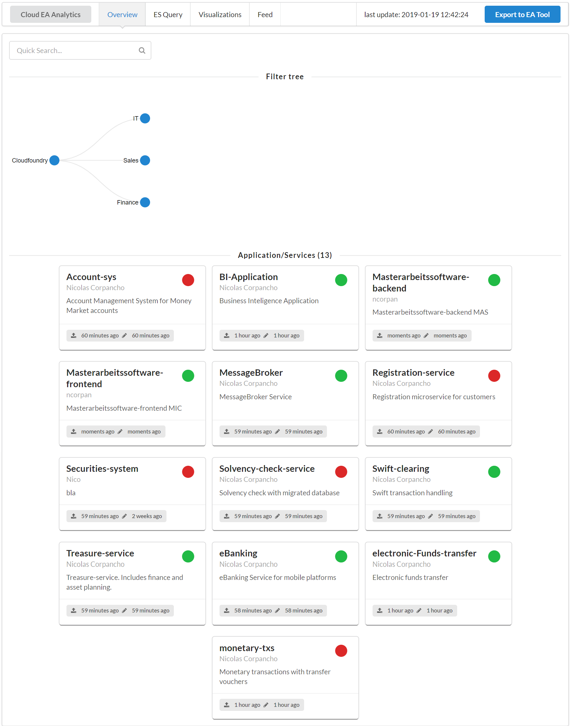
1. Motivation
Continuous Architecture Documentation
??? ??? ??? ???
MS
IS
MS
MS
MS
MS
IS
IS
MS
MS
IS
Trend to large amount of microservices
Shift to Agile Development and Continuous Delivery (CD)
Cloud environments and monitoring tools provide architecture information
How can architecture documentation and assessment be integrated in the software development process?
IS: Information System, MS: Microservice
Notes:
Cloud migration and deployment reduces infrastructure and maintenance costs. Cloud reduces transparency and increases complexity of EA documentation
Agile development and continuous delivery (CD) leads to short lifecycles which implies a quicker update of the EA Tool information
Benefit of cloud infrastructure and monitoring tools provide architecture information
problem: how can architecture documentation and assesment be integrated in the software development process?
Assessment: use architecture documentation to derive more knowledge.
Main idea: continuously document the architecture

Slide 4
Agenda
1. Motivation
2. Research
2.1 Research questions
2.2 Existing tools with related functionality
2.3 Literature review
3. Solution
3.1 Solution architecture
3.2 Concept
3.3 Sample scenario
3.4 Class diagram
3.5 Live Demo
4. Evaluation
5. Conclusion
Notes:
Now to the research approach

Slide 5
2.1 Research Questions
How to obtain EA relevant information from the runtime behaviour of cloud based environments?
How to assign the application landscape to business domains?
How to automate the assignment process with an integrated toolchain?
How does a prototype implementation of the automated documentation process of cloud applications look like?
RQ1
RQ2
RQ3
RQ4
Notes:
Vorlesen!

Slide 6
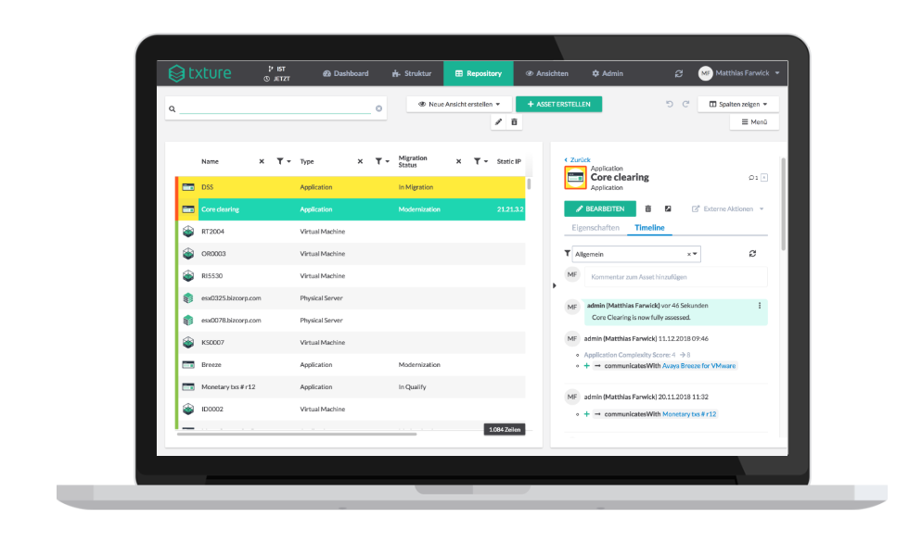
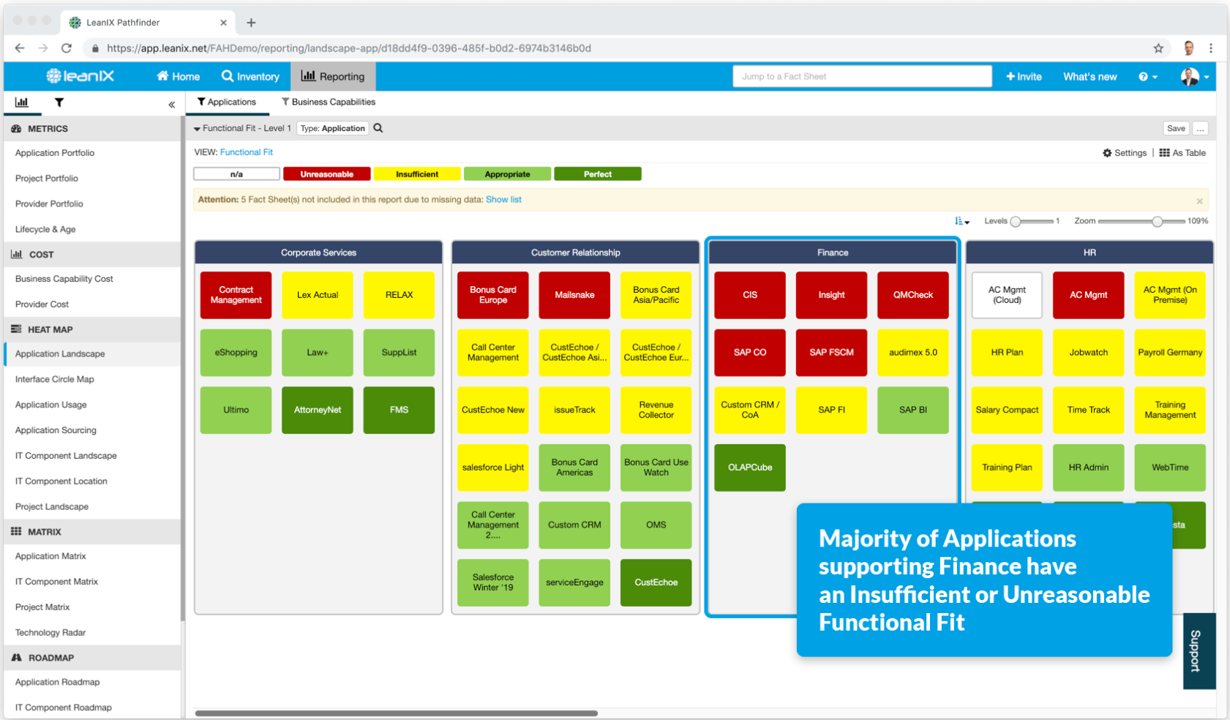
2.2 Existing tools with related functionality*
LeanIX
Txture
Rest API for integration of different
information sources
R&D - Pivio integration
No Continuous Delivery integration
No focus on cloud environments
No focus on runtime information
Meta-model can be adapted at runtime
Automated import mechanisms from various data sources
Cloud environments integration
No Continuous Delivery integration
https://wwwmatthes.in.tum.de/pages/1wdia0twywb0w/Enterprise-Architecture-Management-Tool-Survey-2008-EAMTS-2008, https://txture.io, https://www.leanix.net, https://wwwmatthes.in.tum.de/pages/lw3g9moh1o0c/Enterprise-Architecture-Management-Tool-Survey-2014-Update
Notes:
Found 2 tools with related functionality to the tool i have developed.
investigating
Tonspur: alle andere ea tool traditionell
AZ: Tool auswahl

Slide 7
2.3 Literature review
Year | Author | Title | CD | CC | RI
2012 | Hauder et al. | Challenges for automated enterprise architecture documentation |  |  | X
2013 | Roth et al. | Enterprise Architecture Documentation: Current Practices and Future Directions
2010 | Farwick et al. | Towards Living Landscape Models: Automated Integration of Infrastructure Cloud in Enterprise Architecture Management |  | X | X
2012 | Buschle et al. | Automating Enterprise Architecture Documentation using an Enterprise Service Bus |  |  | X
2014 | Holm et al. | Automatic data collection for enterprise architecture models
2015 | Välja et al. | A requirements based approach for automating enterprise it architecture modeling using multiple data sources
2015 | Farwick et al. | A situational method for semiautomated enterprise architecture documentation
2016 | Johnson et al. | Automatic probabilistic enterprise IT architecture modeling: A dynamic bayesian networks approach
2018 | Landthaler et al. | A Machine Learning Based Approach to Application Landscape Documentation
2016 | Bogner et al. | Towards Integrating Microservices with Adaptable Enterprise Architecture |  | X
Current research endeavours lack in integrating cloud aspects (PaaS and SaaS) for
a continuously automated EA documentation
CD: Continuous Delivery, CC: Cloud Computing, RI: Runtime Instrumentation
Notes:
Ive listed here some related publications regarding Automated Enterprise Architecture Documentation.

Slide 8
Agenda
1. Motivation
2. Research
2.1 Research questions
2.2 Existing tools with related functionality
2.3 Literature review
3. Solution
3.1 Solution architecture
3.2 Concept
3.3 Sample scenario
3.4 Class diagram
3.5 Live Demo
4. Evaluation
5. Conclusion
Notes:
Now to my solution

Slide 9









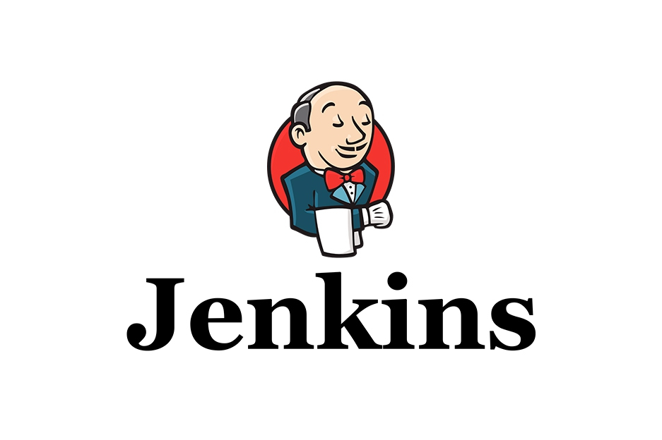



3.1 Solution – Solution Architecture
CMDB
Wiki
Microservice 1
EA Tool
Microservice N
PPM Tool
Automated EAD Tool
Web
CD/ CI Tool
Crawler
Job
Server
Version Control
Deployment Job

Slide 10

3.2 Solution - Concept
PPM Tool*
VCS
CD/ CI Tool
Plan
Build
Develop
Deploy
Config.
File*
Pipeline
script*
Monitor
Analyse
Document
Automated EAD Tool
Webview
Crawler job
database
PPM: Project Portfolio Management, CD: Continuous Delivery, CI: Continuous Integration, EA: Enterprise Architecture, EAD: Enterprise Architecture Documentation, optional*
Notes:
First: devops team and PO plan application in PPM tool.
They start developing. New in this approach is to include config file and pipeline script.
When build: pipelinescript is executed.

Slide 11
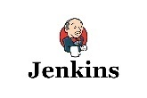


3.3 Solution - Sample scenario
Dynamic data
URL: XXX
Last-deployment: …
Runtime:
ram: XXX,
cpu: XXX,
disk: XXX
Buildpacks: …
Network policy:
Service 1, …
Links.config
jira: http://www....
wiki: http://www...
Static data
Name: XXX,
Description: XXX,
Owner: XXX,
Domain: XXX
Subdomain: XXX
Product: XXX
Microservice
information
Other tools
Wiki
DevOps
Links.config
Static data
Dynamic data
Get Sources
Validate configuration
Get Jira information
Deploy
Get runtime information
Push documen-tation
Cloud crawler
EA Tool integra-tion
Build
VCS
CD/CI
PPM
CD/CI
Cloud provider
EAD
Tool
Cloud provider
EAD Tool
EA Tool
Dynamic data
Microservice
information
Dynamic
data
Last update
Last update
code
Links.config
Static data
jar
jar
DB
data
CI/CD Tool
EAD Tool
Pipeline Script

Slide 12
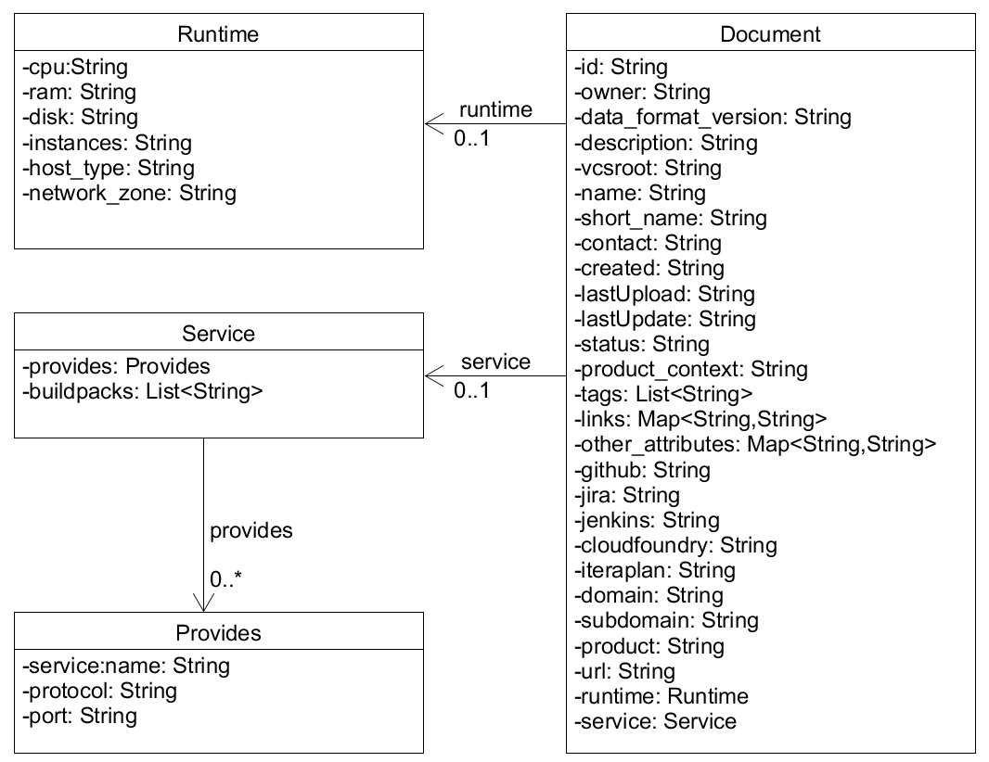
3.4 Solution – Class diagram
Every artifact is stored as a Document in the database
Every Document can contain a Runtime object which gets updated by the cloud-crawler
Every document can contain a Service object
A Service can contain buildpacks (software dependencies) and Provides objects
A Provides object represents a connected artifact
Specific links are modelled as attributes of a Document
Link to other tools are stored in a key-value-pair attribute
Business information is also modelled as individual attributes in a Document

Slide 13
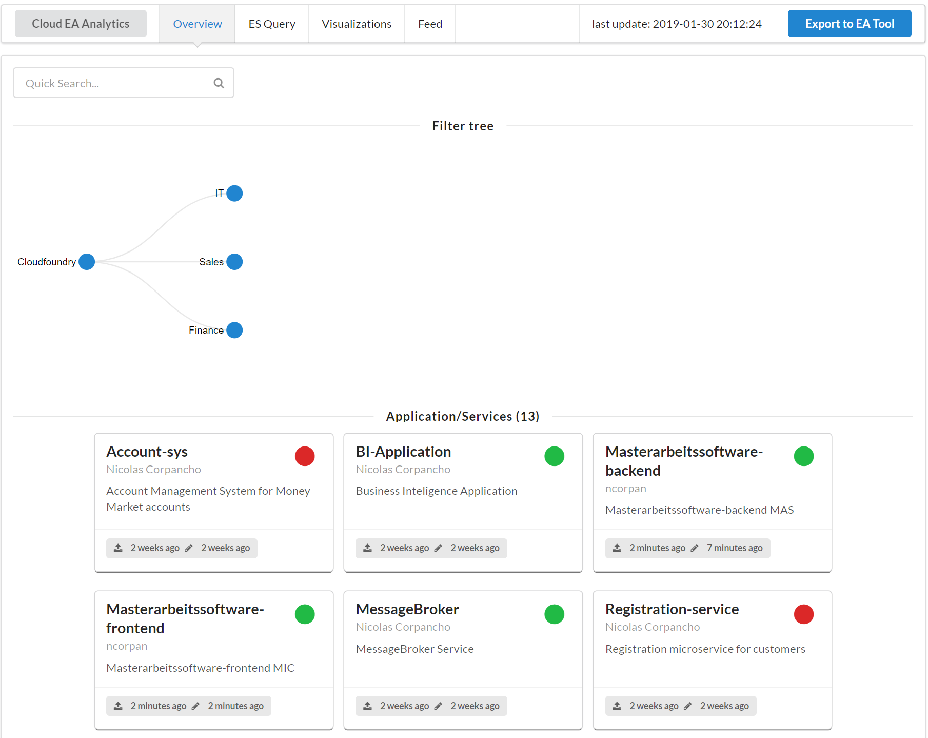
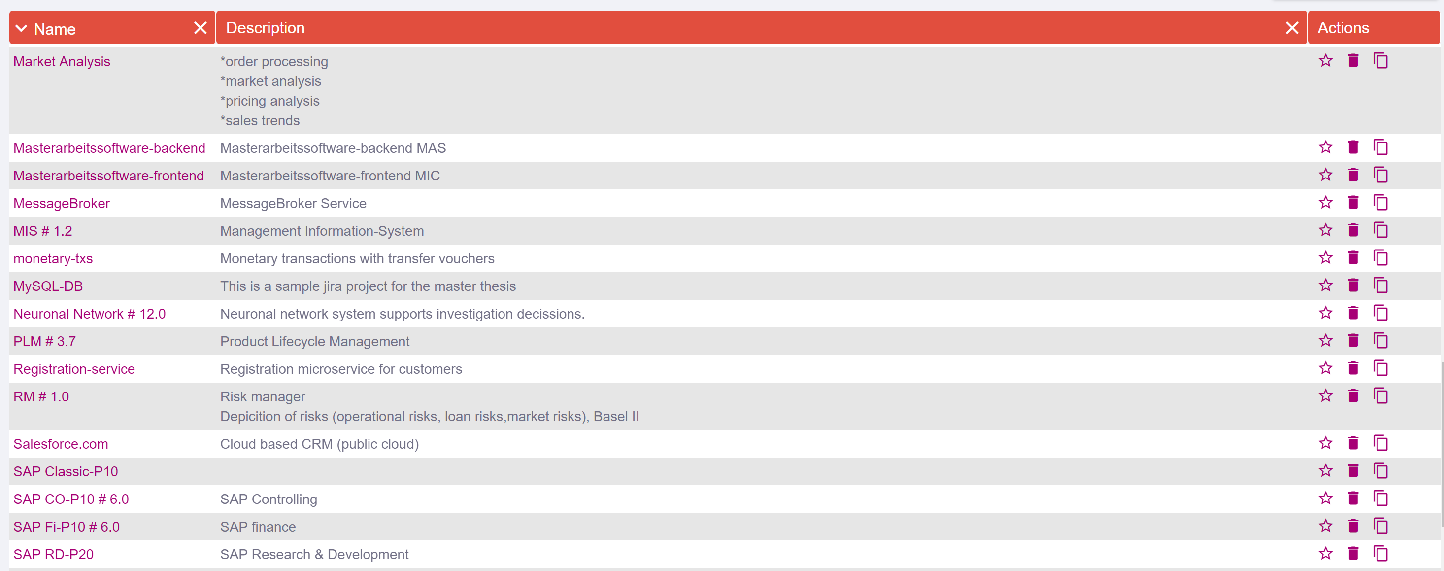
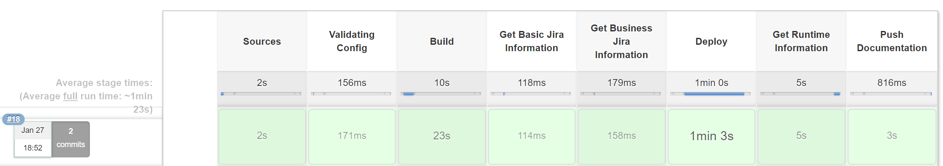
3.5 Live Demo
Get Sources
Validate configuration
Get Jira information
Deploy
Get runtime information
Push documen-tation
Cloud crawler
EA Tool integra-tion
Build
CI/CD Tool
EAD Tool
Pipeline Script

Slide 14
Agenda
1. Motivation
2. Research
2.1 Research questions
2.2 Existing tools with related functionality
2.3 Literature review
3. Solution
3.1 Solution architecture
3.2 Concept
3.3 Sample scenario
3.4 Class diagram
3.5 Live Demo
4. Evaluation
5. Conclusion
Notes:
Introduce my research topic,

Slide 15
4. Evaluation (1/5)
Goal:
Evaluate literature findings (requirements and challlenges)
Evaluate the approach to see if it is a valuable solution for improving the automation of Enterprise Architecture Documentation
Evaluate the implemented prototype
Identify improvements for the prototype
ID | Role | Exp. years | Enterprise
EA1 | Enterprise Architect and Chief Architect | 20 | E1
EA2 | Enterprise Architect | 2 | E1
EA3 | Enterprise Architect | 17 | E1
EA4 | Enterprise Architect and Product Owner | 10 | E1
EA5 | Enterprise Architect | 3 | E1
EA6 | Enterprise Architect and IT Management Expert | 20 | E2
EA7 | Enterprise Architect | 18 | E1
PO1 | Product Owner and Head of Product Architecture | 11 | E1
PO2 | Product Owner | 1 | E1
PO3 | Product Owner | 3 | E1
EA8 | Enterprise Architect and Chief Architect | 16 | E3
EA9 | Enterprise Architect and Chief Architect | 30+ | E4
Experts with different roles and from different enterprises were interviewed to eliminate bias

Slide 16
4. Evaluation (2/5) - Enterprise Architecture
Literature findings were validated in case study

Slide 17
4. Evaluation (3/5) - Approach
All experts stated that the presented process automates the EAD of applications running on a cloud-based environment
Notes:
Definition of monitoring technologies is not clear to people

Slide 18
4. Evaluation (4/5) – Prototype sections
Useful
General section
General section
Services section
Services section
Software dependencies
Software dependencies
Jenkins section
Runtime section
Governance section
Governance section
Runtime section
Github section
Jenkins section
Github section
Jira section
Jira section
Not useful
Enterprise Architects
Product Owners
Jira section
Different sections are perceived as valuable regarding the roles of the user

Slide 19
4. Evaluation (5/5) - Prototype
Not expected results:
How can enterprise architects decide if changes are outdated if changes are not considered useful?
All interviewed industry partners showed a high interest in software dependencies for management of software frameworks.

Slide 20
Agenda
1. Motivation
2. Research
2.1 Research questions
2.2 Existing tools with related functionality
2.4 Literature review
3. Solution
3.1 Solution architecture
3.2 Concept
3.3 Sample scenario
3.4 Class diagram
3.5 Live Demo
4. Evaluation
5. Conclusion
Notes:
Introduce my research topic,

Slide 21
5. Conclusion (1/3) – Summary
Research questions:
RQ1: How to obtain EA relevant information from the runtime behavior of cloud based environments?
RQ2: How to assign the application landscape to business domains?
RQ3: How to automate the assignment process with an integrated toolchain?
RQ4: How does a prototype implementation of the automated documentation process of cloud applications look like?
Most cloud infrastructures provide runtime information without agents, shadow IT is prevented.
However installing agents unveil further information like API requests.
Either add information in config file or integration of PPM tool in Build-Deployment pipeline. Assumption: PPM tool provides domain information
Assignment through configuration file or name mapping
Result: Config file produces further overhead. Mapping via name is more popular, however name needs to be stable!

Slide 22
5. Conclusion (2/3) – Limitations and key findings
Limitations:
Web-browser does not support ECMAScript 6
Database component was not supported (MongoDB and ElasticSearch6)
Server component adaptation for MySQL database component
No fully EA cloud discovery possible due to access rights
Key findings:
Several possibilites to (semi-)automate the EAD process
IT Governance is needed to enable automated EAD (project structure definition, toolchain definition, etc.)

Slide 23
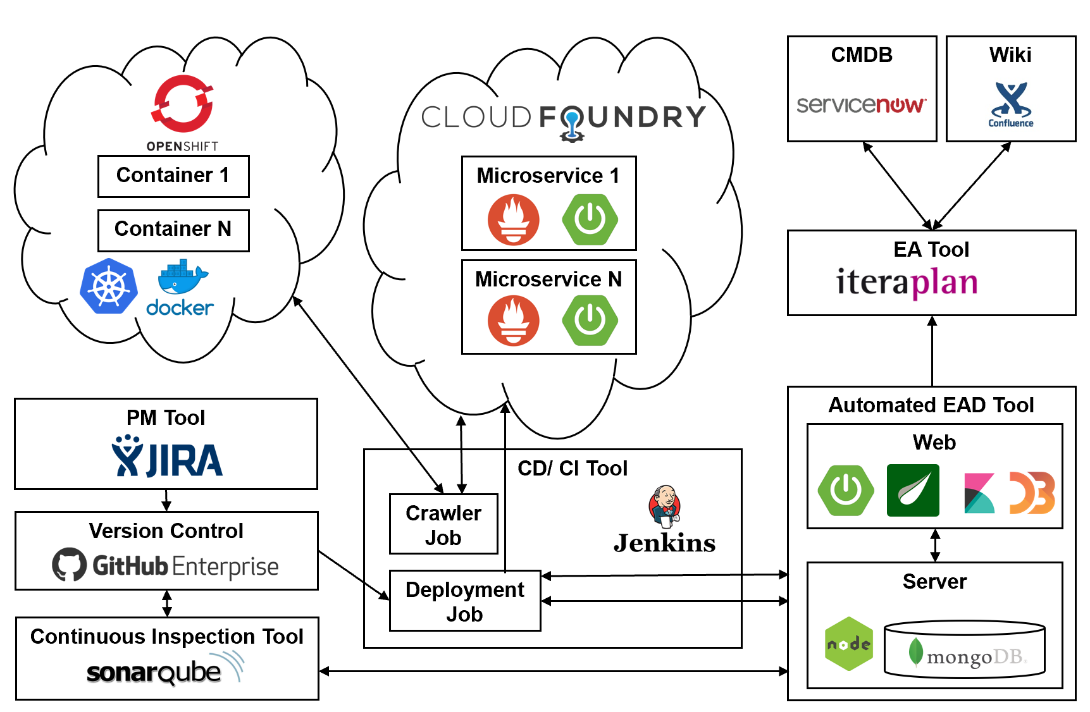
5. Conclusion (3/3) – Outlook
Outlook:
Integration of a Continuous Inspection Tool (Sonarqube)
Integration of other cloud environments
Future Use Cases:
Cloud readiness verfication though a complete implementation of 12 factor app criteria
Elasticity evaluation through a complete implementation of resilience pattern
Data privacy compliance (GDPR compliance): analysis of stored information
Business Impact Analysis (BIA) of applications via mapping of Business Process and Business Capabilities

Slide 24
References (1/2)
[1] M. Hauder, F. Matthes, and S. Roth. “Challenges for automated enterprise archi-tecture documentation.” In: Lecture Notes in Business Information Processing 131 LNBIP (2012), pp. 21–39. ISSN: 18651348. DOI: 10.1007/978-3-642-34163-2_2.
[2] M. Farwick, R. Breu, M. Hauder, S. Roth, and F. Matthes. “Enterprise architecture documentation: Empirical analysis of information sources for automation.” In: Proceedings of the Annual Hawaii International Conference on System Sciences(2013), pp. 3868–3877. ISSN: 15301605. DOI: 10.1109/HICSS.2013.200.
[3] S. Roth, M. Hauder, M. Farwick, R. Breu, and F. Matthes. “Enterprise architecture documentation: Current practices and future directions.” In:Wi2013 (2013),pp. 912–925. ISSN: 00219673. DOI:10.1148/rg.327125019.
[4] M. Farwick, B. Agreiter, R. Breu, M. Häring, K. Voges, and I. Hanschke. “Towards living landscape models: Automated integration of infrastructure cloud in En-terprise Architecture Management.” In:Proceedings - 2010 IEEE 3rd InternationalConference on Cloud Computing, CLOUD 2010(2010), pp. 35–42. ISSN: 2159-6182. DOI:10.1109/CLOUD.2010.20.
[5] M. Buschle, S. Grunow, F. Matthes, M. Ekstedt, and S. Roth. Automating Enterprise Architecture Documentation using an Enterprise Service Bus Americas Conference onInformation Systems Automating Enterprise Architecture Documentation using anEnterprise Service Bus. Tech. rep. 1. 2012.
[6] H. Holm, M. Buschle, R. Lagerström, and M. Ekstedt. “Automatic data collection for enterprise architecture models.” In:Software and Systems Modeling13.2 (2014),pp. 825–841.issn: 16191374.doi:10.1007/s10270-012-0252-1.

Slide 25
References (2/2)
[7] M. Välja, R. Lagerström, M. Ekstedt, and M. Korman. “A requirements based approach for automating enterprise IT architecture modeling using multiple datasources.” In:Proceedings of the 2015 IEEE 19th International Enterprise DistributedObject Computing Conference Workshops and Demonstrations, EDOCW 2015(2015),pp. 79–87. ISSN: 2325-6583. DOI:10.1109/EDOCW.2015.33.
[8] M. Farwick, C. M. Schweda, R. Breu, and I. Hanschke. “A situational methodfor semi-automated enterprise architecture documentation (SoSyM abstract).”In:2015 ACM/IEEE 18th International Conference on Model Driven EngineeringLanguages and Systems, MODELS 2015 - Proceedings(2015), p. 448. ISSN: 16191374. DOI:10.1109/MODELS.2015.7338278.
[9] P. Johnson, M. Ekstedt, and R. Lagerstrom. “Automatic Probabilistic Enterprise IT Architecture Modeling: A Dynamic Bayesian Networks Approach.” In:Proceedings- IEEE International Enterprise Distributed Object Computing Workshop, EDOCW2016-Septe (2016), pp. 122–129. ISSN: 15417719. DOI:10.1109/EDOCW.2016.7584351.
[10] J. Landthaler, Ö. Uluda ̆g, G. Bondel, A. Elnaggar, S. Nair, and F. Matthes. “Amachine learning based approach to application landscape documentation.”In:Lecture Notes in Business Information Processing335 (2018), pp. 71–85. ISSN:18651348. DOI:10.1007/978-3-030-02302-7_5.
[11] J. Bogner and A. Zimmermann. “Towards Integrating Microservices with Adapt-able Enterprise Architecture.” In:Proceedings - IEEE International Enterprise Dis-tributed Object Computing Workshop, EDOCW2016-Septe (2016), pp. 158–163. ISSN:15417719. DOI:10.1109/EDOCW.2016.7584392.

Slide 26
Thank you for your attention!
Do you have any questions?

Slide 27
Backup

Slide 28
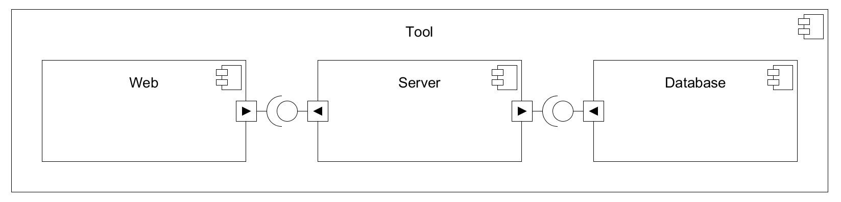
Component diagram

Slide 29
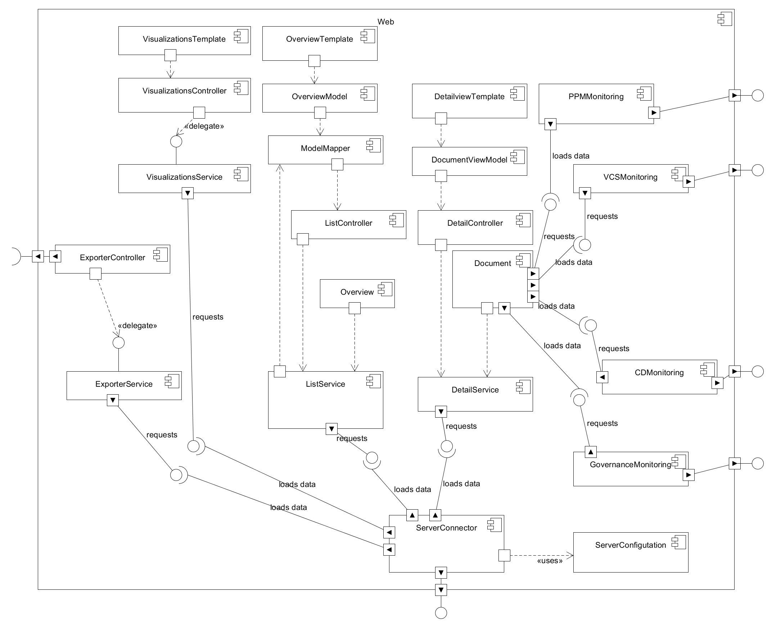
Web component

Slide 30
Web component
New components

Slide 31
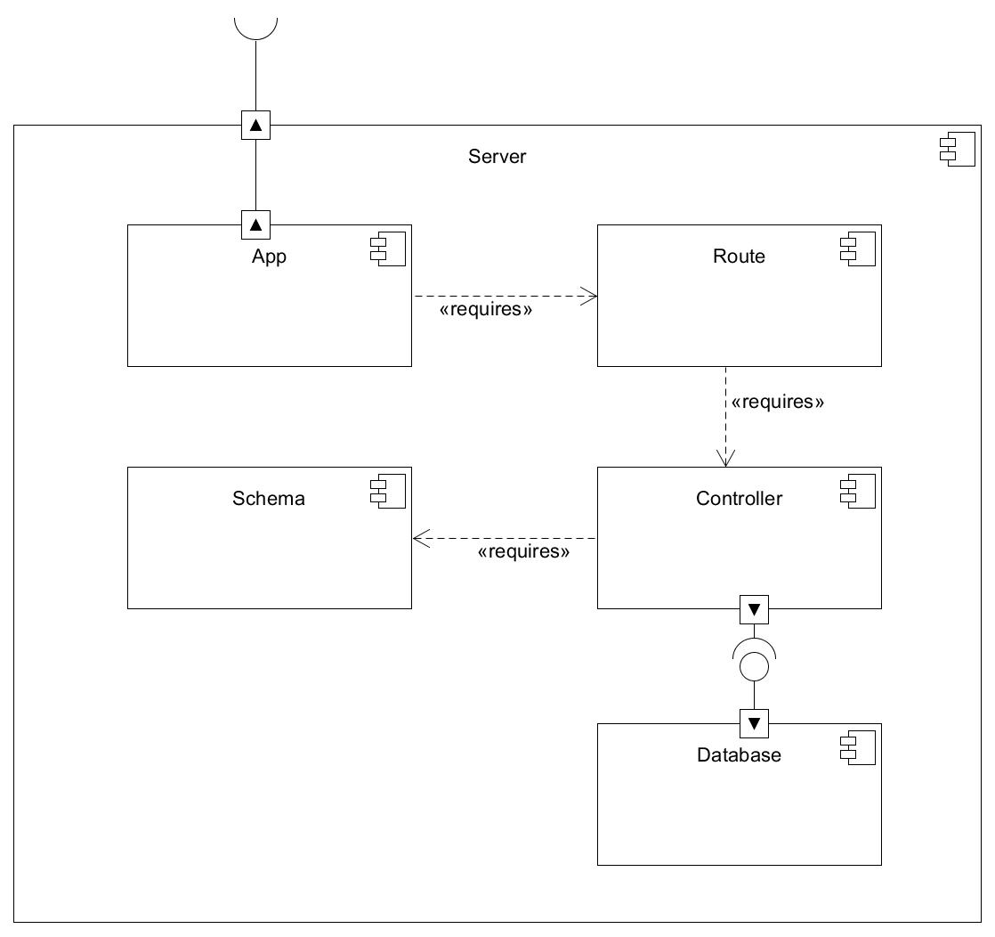
Server component

Slide 32
Optional Prerequisites
Configuration file containing link to different tools
Groovy script in repository to enable build pipeline
Jira project complaince
Links.config
jira: http://www....
cmdb:http://www….
wiki: http://www...
pipeline.groovy
node {
def xxx =
stage(‘Sources’) {…}
stage(‘Validate…’){…}
…
}
Project
Business Application
Component 1
Component N
Application component
Application component

Slide 33
Definitions mapping
Archimate | Allianz | Jira | Pivio | Iteraplan
Product/Services
Application
component
Business
Applications
Project
Product
Information System
Application component
Application component
Components
Services
Information System
Issue 1
Issue N
Application component
Application component
Components
Services
Information System
Issue 1
Issue N

Slide 34
Groovy script
def callPost(String urlString, String queryString) {
def url = new URL(urlString)
def connection = url.openConnection()
connection.setRequestMethod("POST")
connection.doInput = true
connection.doOutput = true
connection.setRequestProperty("content-type", "application/json;charset=UTF-8")
def writer = new OutputStreamWriter(connection.outputStream)
writer.write(queryString.toString())
writer.flush()
writer.close()
connection.connect()
new groovy.json.JsonSlurper().parseText(connection.content.text)
}
node {
deleteDir()
stage('Sources') {
checkout([
$class : 'GitSCM',
branches : [[name: "refs/heads/master"]],
extensions : [[$class: 'CleanBeforeCheckout', localBranch: "master"]],
userRemoteConfigs: [[
credentialsId: 'cbf178fa-56ee-4394-b782-36eb8932ac64',
url : "https://github.com/Nicocovi/MS-Repo"
]]
])
}
dir("") {
stage("Build"){
sh "gradle build"
}
stage("Get Jira Information"){
//TODO
}
stage('Deploy') {
def branch = ['master']
def name = "sping-microservice1"
def path = "build/libs/gs-spring-boot-0.1.0.jar"
def manifest = "manifest.yml"
if (manifest == null) {
throw new RuntimeException('Could not map branch ' + master + ' to a manifest file')
}
withCredentials([[
$class : 'UsernamePasswordMultiBinding',
credentialsId : '98c5d653-dbdc-4b52-81ba-50c2ac04e4f1',
usernameVariable: 'CF_USERNAME',
passwordVariable: 'CF_PASSWORD'
]]) {
sh 'cf login -a https://api.run.pivotal.io -u $CF_USERNAME -p $CF_PASSWORD --skip-ssl-validation'
sh 'cf target -o ga72hib-org -s masterarbeit'
sh 'cf push sping-microservice1 -f '+manifest+' --hostname '+name+' -p '+path
}
}
stage("Push Documentation"){
try {
callPost("http://192.168.99.100:9123/document", "{\"id\": \"0987654321\", \"name\": \"Kick-off-App\", \"owner\": \"Nico\", \"description\": \"bla\", \"short_name\": \"serviceAZ12\", \"type\": \"service\"}") //Include protocol
} catch(e) {
// if no try and catch: jenkins prints an error "no content-type" but post request succeeds
}
}//stage
}
}

Slide 35
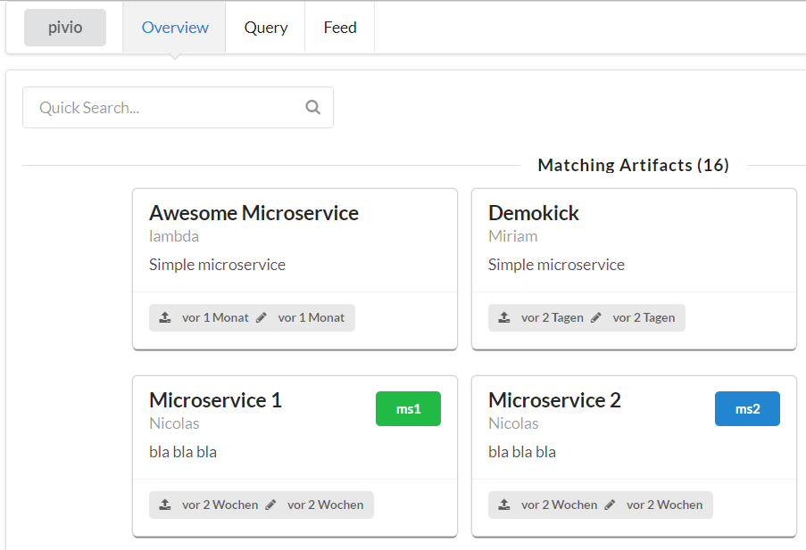
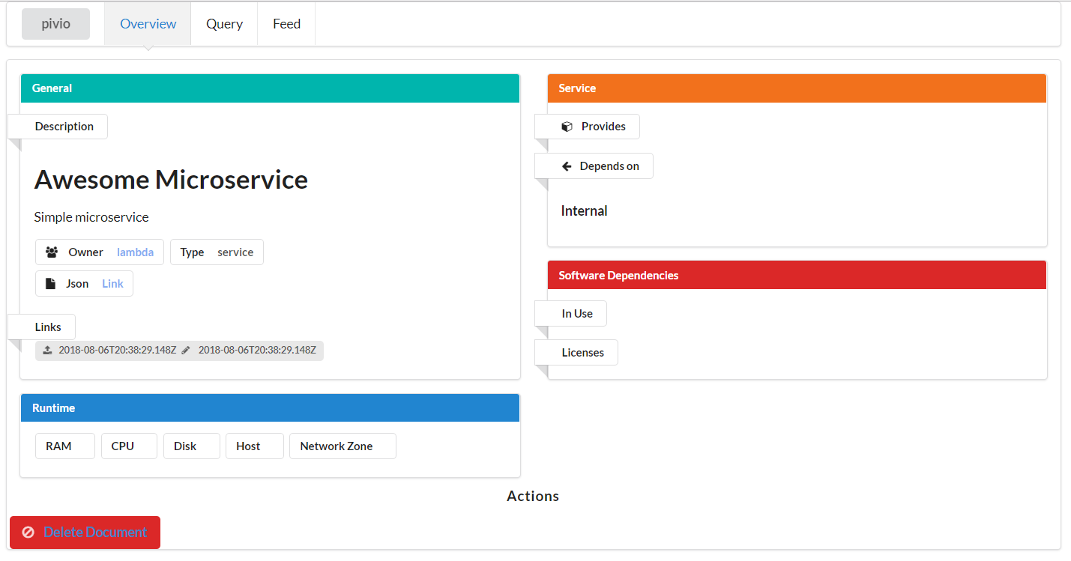
2.3 Open source project - Pivio
Pivio:
Service registry for humans
To have a catalogue of the available services
Running in cloud environments
Developed by Chief Architect of E-Post Development GmbH
Integration of discovery
Metamodel focus on microservices
Dynamic metamodel enabled via schemaless
Runtime information integration
No Continuous Delivery Integration
No support of EA discovery
Notes:
Fussnote
Geschichte zu Pivio
CD fehlt,
Prüfung von architecture principles

Slide 36
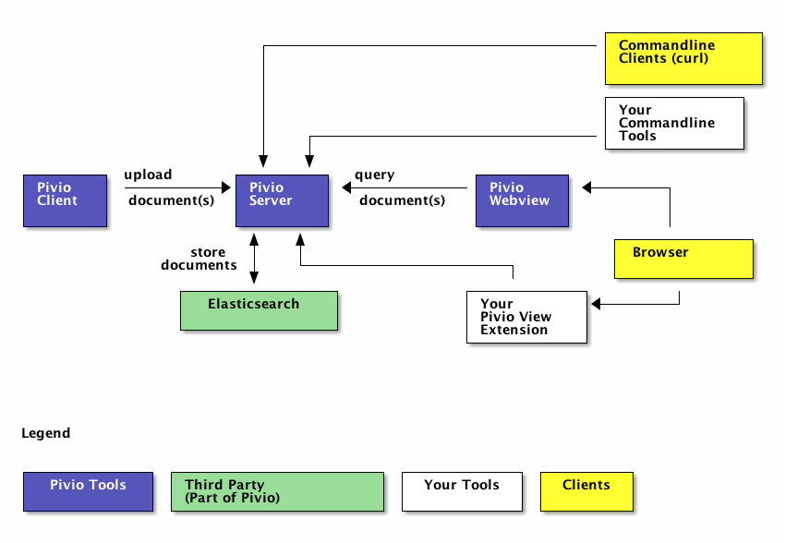
Pivio.io
What is Pivio ?
Pivio is a service registry for humans.
Why Pivio ?
  Overview for platforms, especially for microservice environment.
  Reusability of services
  A growing number of services means also a challenge not only for developers.
  Which service runs where? What does it do? Who is responsible for that?
Concept of pivio:

Slide 37
Pivio data model
Pivio needs certain mandatory fields:
id: Unique id in pivio.
name: The name of the artefact.
short_name: A very brief name for the service.
type: The type of this artefact. Values could be service, library or mobile_app.
owner: Which team is responsible for this artefact.
description: What does this service do?

Slide 38
4. Derived EAD requirements from the literature review and case study (1/3)
ID | Description | Source
Data Quality Requirements
DC1 | No maintenance of data. The data is not considered uptodate. The system must provide mechanisms to ensure data actuality. | [1], [2], [3], [4], [6], [7], [9], [10], [11]
DC2 | The data granularity of the integrated information sources is too granular. The system must provide mechanisms to align the granularity of data. | [1], [2], [3], [6], [7]
DC3 | Data completeness: EA information is scarce | [1], [2], [3], [6], [7]
DC4 | Data correctness: Error proned data due to manual gathering | [1], [2], [3], [6] , [7], [9], [10]
DC5 | The system must be able to provide relationship information between and within the EA layers | Case study evaluation
Functional System Requirements
FR1 | The system must be able to calculate the defined KPIs from runtime information | [4], [8], [11]
ADR5 | Additional KPIs calculation: TCO, MTBF, MMTR, MTTF and real time data of users on the individual applications | Case study evaluation
FR2 | Integration of different information sources | [4], [8], [11]
FR3 | EA Tool needs an public API for an integration of several information sources | [1], [3], [6], [8]
FR4 | Dynamic metamodel: Adaptable metamodel of system | [1], [2], [3], [4],[5], [6], [7], [8], [11]

Slide 39
4. Derived EAD requirements from the literature review and case study (2/3)
ID | Description | Source
Organizational Requirements
ADR1 | Business Impact Analysis of applications | Case study evaluation
OR1 | Business added value: The system must provide a added value for the business (e.g. ROI) | [1], [3], [4]
ADR2 | Data privacy compliance (GDPR compliance) | Case study evaluation
Integration/Data Source Requirements
ADR6 | Integration of cloud environments (PaaS and SaaS) | [4], [8], [11]
ADR3 | Automated verification of the 12 factor app | Case study evaluation
ADR4 | Automated verification of a resilience pattern | Case study evaluation

Slide 40
2. Additional requirements from literature
ID | Description | Source
Architectural Requirements
AR1 | The collection of EA data must be federated from the repositories of the data owners (departments etc.) | Fischer et al., 2007; Farwick et al., 2010
Organizational Requirements
OR2 | An organizational process must be in place that regulates the maintenance of EA Models | Fischer et al., 2007; Moser et al., 2009; Hanschke, 2009
OR3 | Each data source must have an owner | Fischer et al., 2007; Hanschke, 2009,
Integration/Data Source Requirements
IR1 | The system must be able to detect changes in the real world enterprise architecture | Moser et al., 2009; ter Doest and Lankhorst, 2004
IR2 | The system must have a machine understandable internal data structure | Tanner and Feridun, 2009
Non-functional Requirements
NFR1 | The system must scale for large data input | Hafner and Winter, 2008
Data Quality Requirements
DC4 | The system must provide mechanisms that allow for the automated propagation of changes | Dam et al., 2010
DC5 | The system must be able to identify and resolve data identity conflicts from different sources via identity reconciliation | Fischer et al., 2007
DC6 | The system must provide mechanisms that help the QA team to ensure data consistency | Hafner and Winter, 2008

Slide 41



2.1 Research methodology
EA
EAM
Automated EAD
Cloud Computing
Continuous Delivery/ Integration
Microservices
Application Performance Monitoring
RQ1
RQ2
RQ3
RQ4
Research Topics
1. Scope of Research
Deliverable: RQs on automated documentation of Business Domain assignments and cloud application information
2. Topic conceptualization
Deliverable: Relevant search terms
3. Literature search
Deliverable: Relevant sources
4. Literature analysis
Deliverable: Comparison of different approaches on automated EAD
1. Solution suggestion
Deliverable: Approach of an automated EAD
2. Imple-mentation
Deliverable: Development of a prototype
3. Evaluation
Deliverable: Feedback of the appraoch and feedback
4. Results
Deliverable: Improved Prototype for an automated EAD

Slide 42
Screenshots

Slide 43
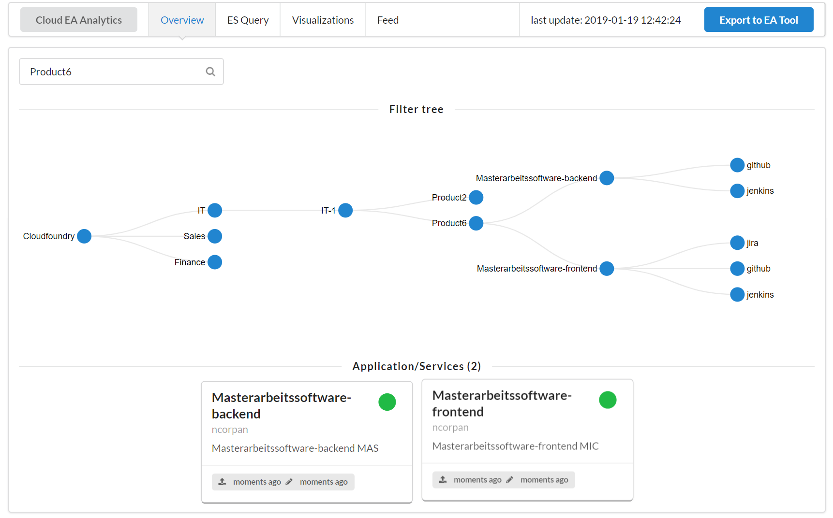
Pivio overview

Slide 44
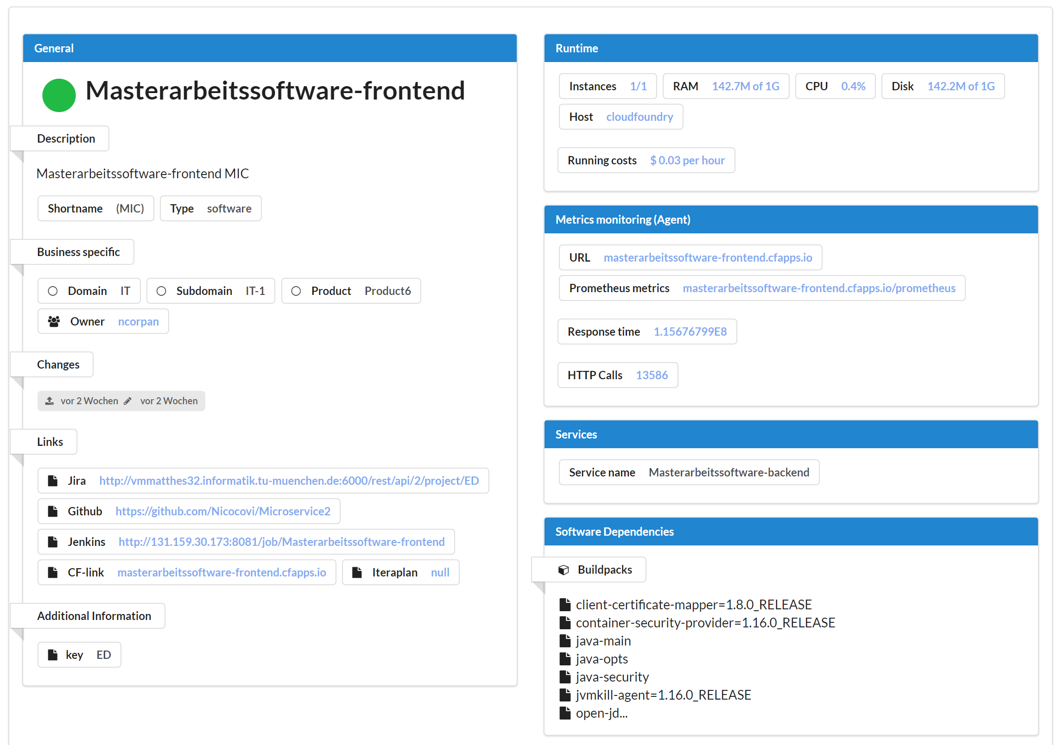
Detailed View (1/7)

Slide 45
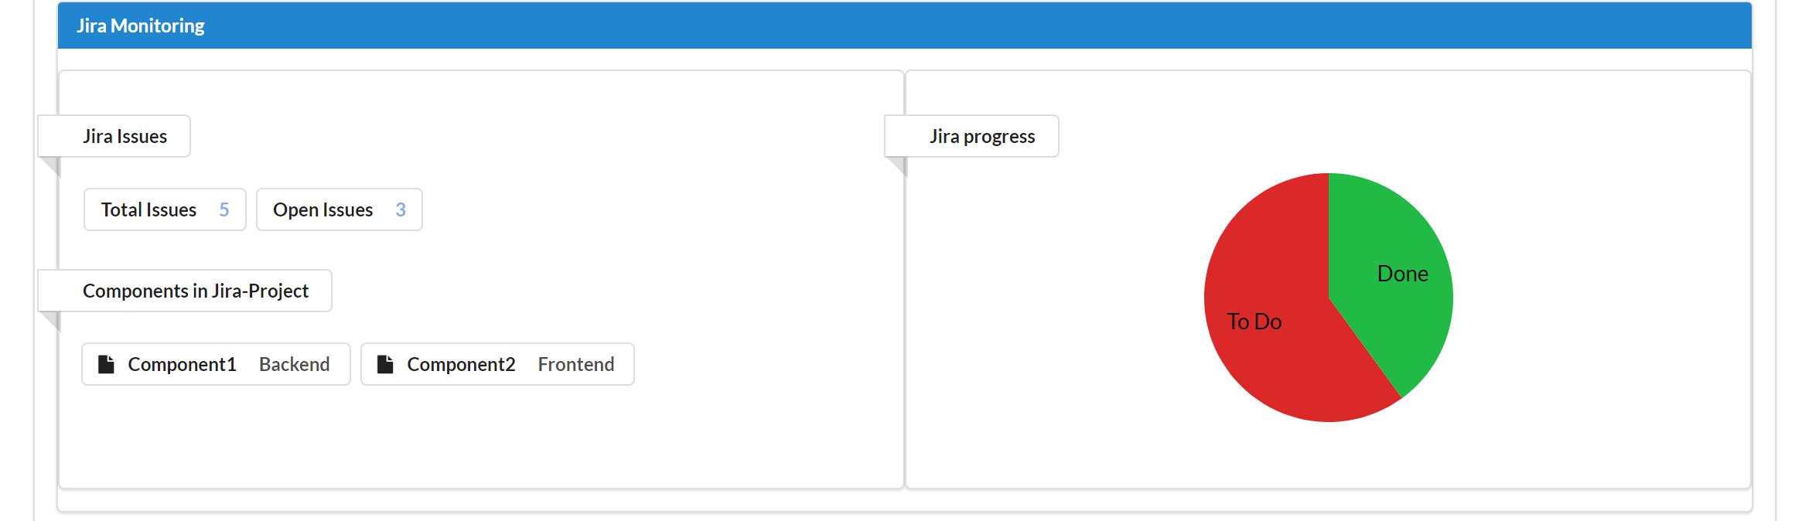
Detailed View (2/7)

Slide 46
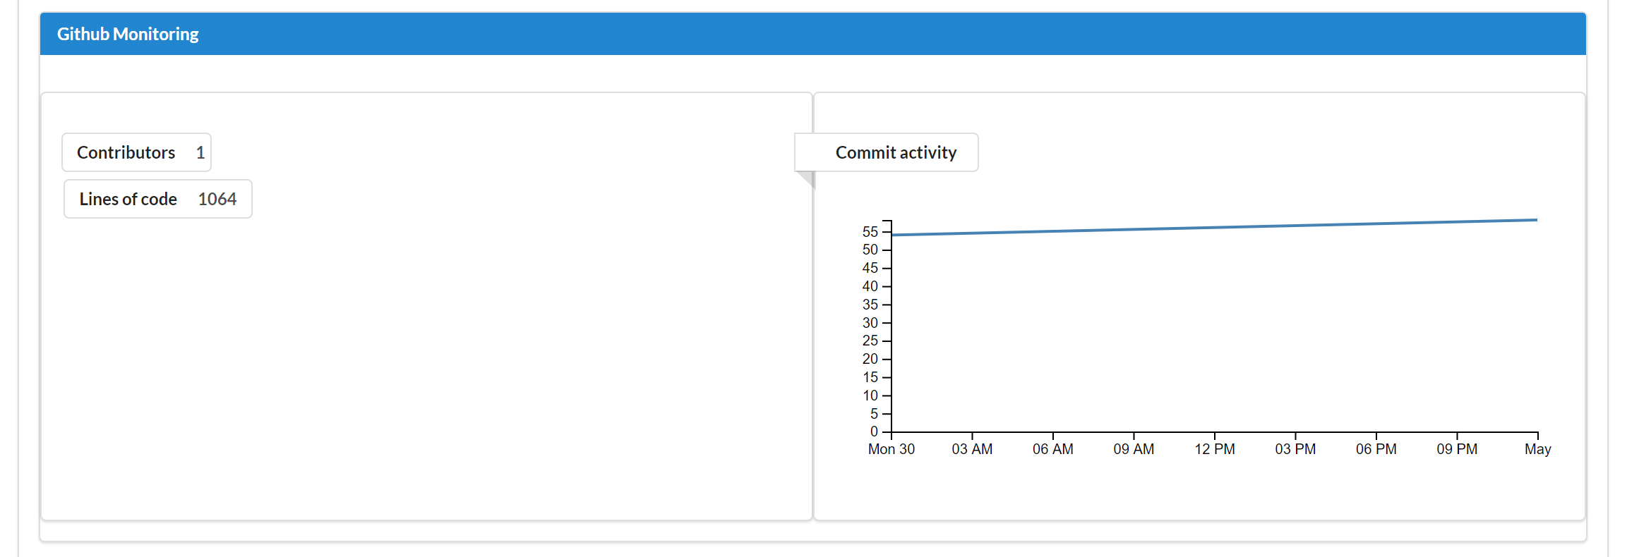
Detailed View (3/7)

Slide 47
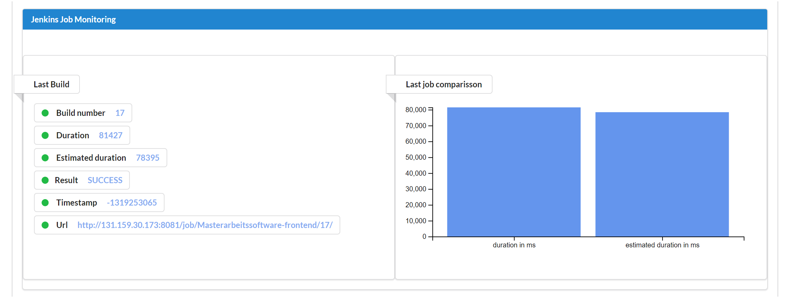
Detailed View (4/7)

Slide 48
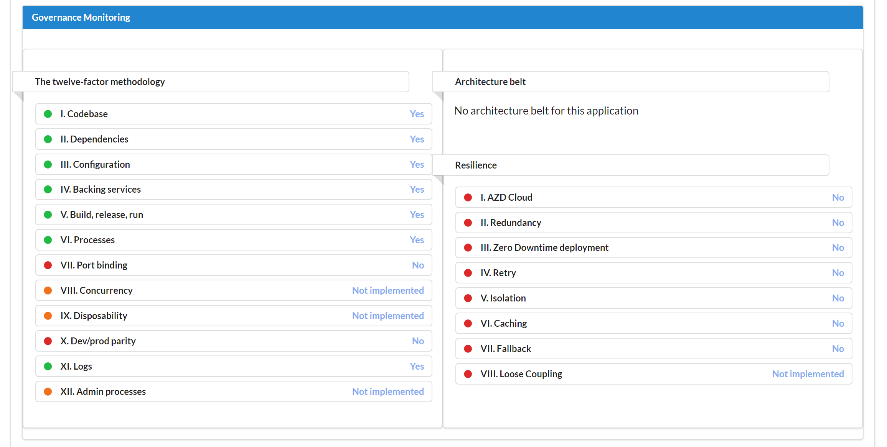
Detailed View (5/6)

Slide 49
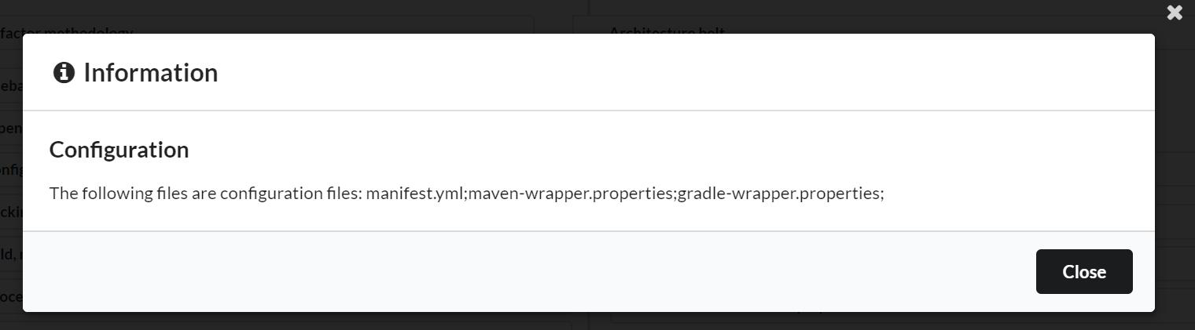
Detailed View (6/7)

Slide 50
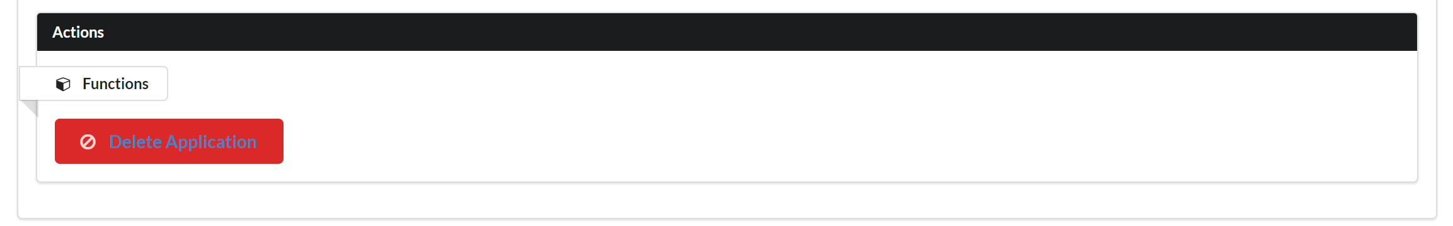
Detailed View (7/7)

Slide 51
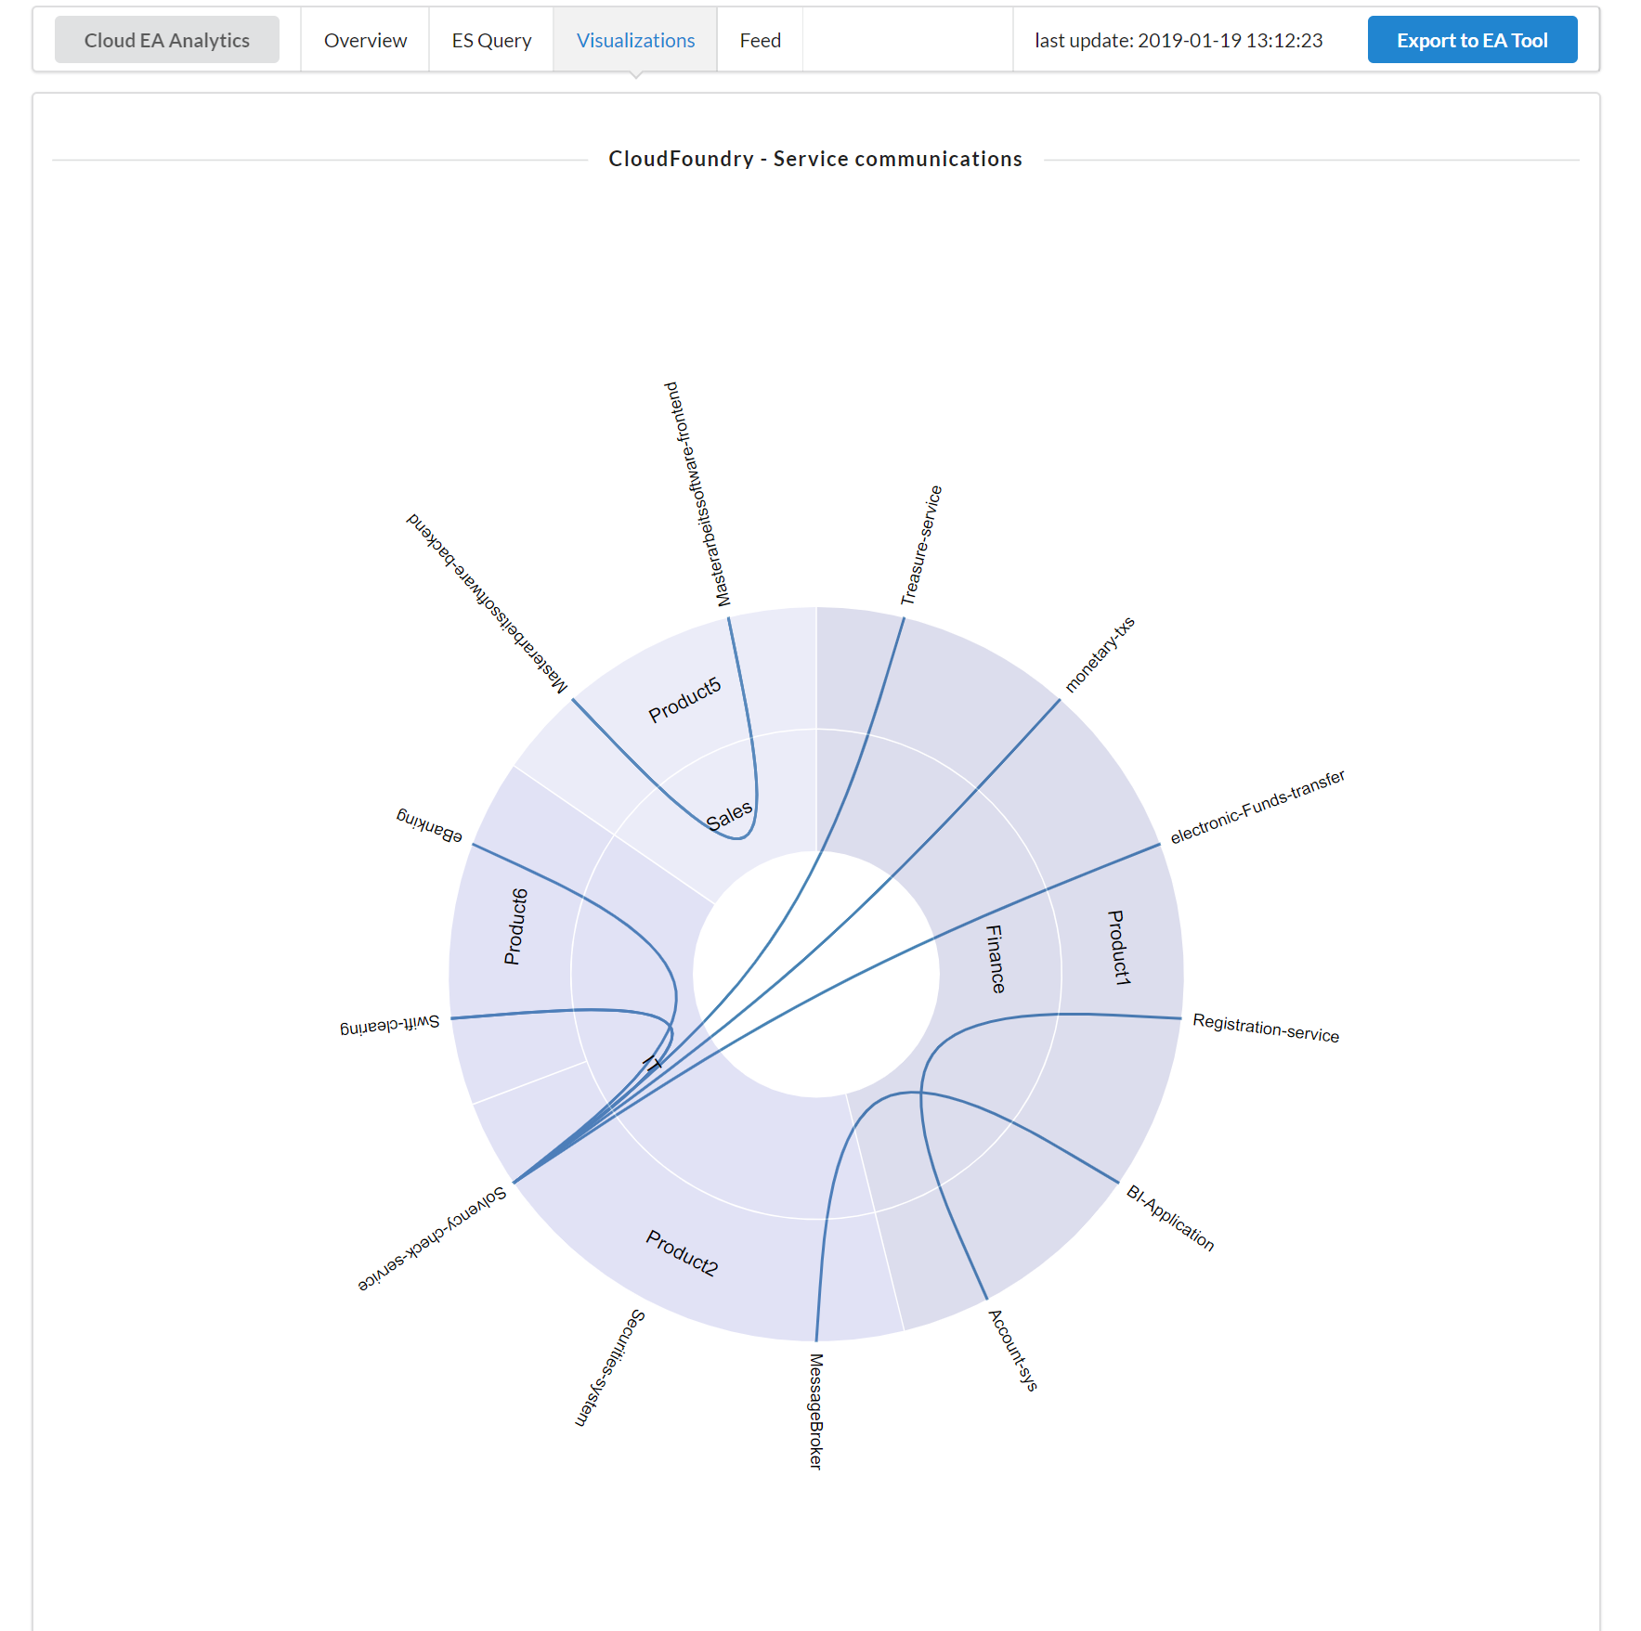
Visualizations View (1/3)

Slide 52
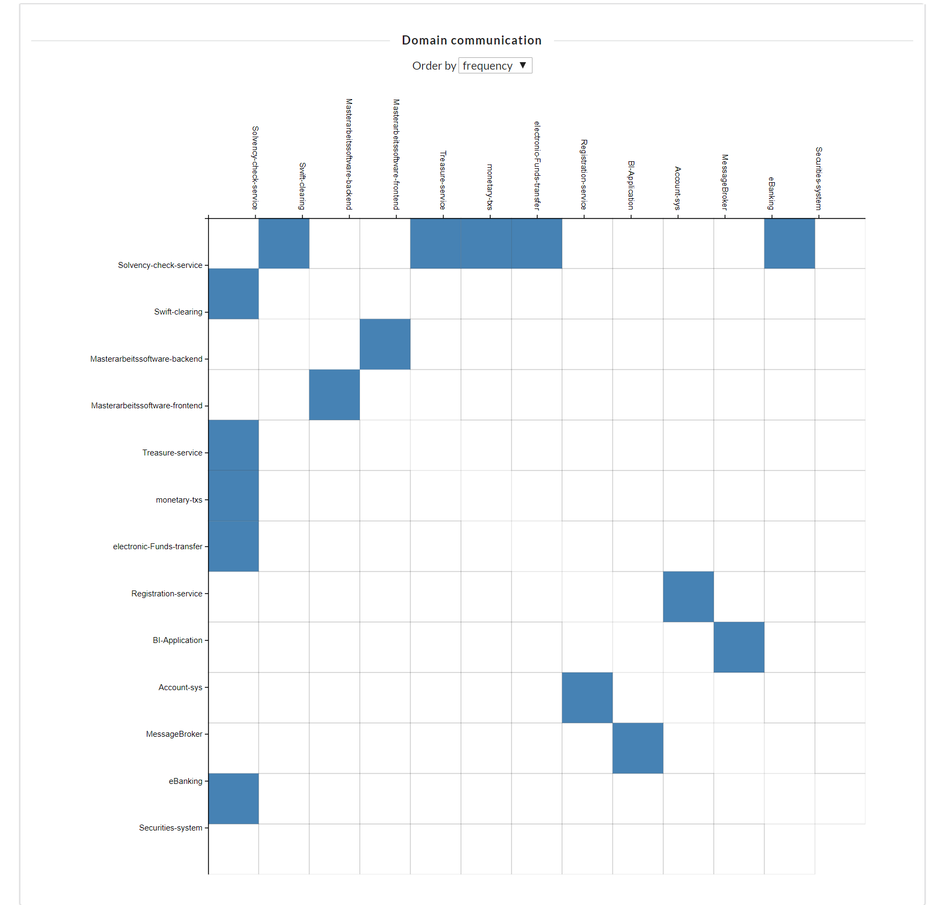
Visualizations View (2/3)

Slide 53
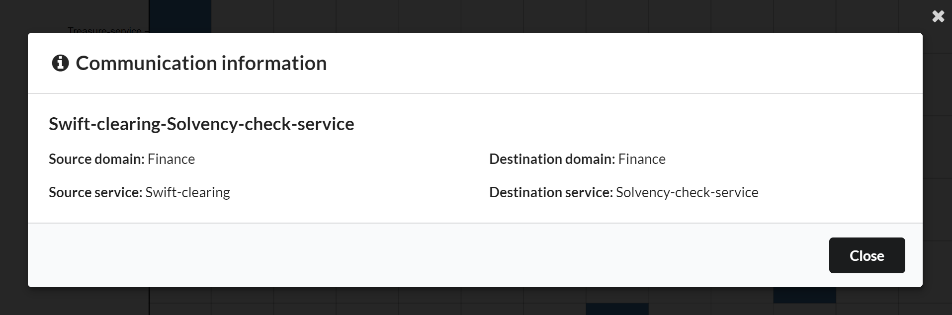
Visualizations View (3/3)

Slide 54
Monitoring KPIs
Cloud clustering as additional visualization
Backlog-items KPI: How many items are missing. Application portfolio purposes
Status of applications: running, stopped or crashed.
Number of deployments per time unit: Which applications change frequently?
Traffic KPI: Decommission purposes
Traffic heatmaps: Which applications are important. Relevant for planification and costs. Ratio costs maintenance and costs
LOC: Maintenance vs Complexity (related to maintenance costs)
Additional KPIs

Slide 55


3.1 Solution (1/2) - Concept
Automated EAD Tool
Enterprise Architect
EA Tool
verifies
Webview
Crawler
job
takes strategic
decisions
Schemaless
database
Cloud infra-structure
CIO
VCS
Enterprise
Architects
KPIs
PPM Tool*
CD/CI Tool
Config.
File*
Pipeline
script*
Plan
Build
Docu-ment
Develop
Deploy
Run
IT Governance
Monitor
Analyse
Evaluate
Execute
controls
DevOps
PO
DevOps
Enterprise Architect
PPM: Project Portfolio Management, CD: Continuous Delivery, CI: Continuous Integration, EA: Enterprise Architecture, EAD: Enterprise Architecture Documentation, optional*

Slide 56
1. Derivation for EAM
Challenges of current EA documentation
No single automated EA documentation standard
Many documenting approaches exist, mostly manual data collection
Helps to manage information complexity due to higher number of applications in different environments
Increases support fast changing environments (multi environments) and technologies
Integration of technology trends
Automated EA Documentation
Cloud
EAM Use cases
Application Portfolio Management
Information Management
Technology and Risk Management
Consequences
High error rate documenting and collecting EA information
Time consuming collection of information
Expensive tasks maintaining and gathering information of the EA
IT Controlling
Business/ IT Transformation
Decommission
based on usage metrics
Improved EAM use cases can be derived from an automated EA documentation process
Improved EAM Use Cases
Notes:
In Addition to the technology trends, challenges fo EAD.
Ttechnology trends would enable an automated EAD
It controlling: was kostet die app. PlanningIT, software ag,
VERBESSERTE
Bisiness IT Transformation: Easier planification of target architecture with an accurate as is landscape.

Slide 57
4. Evaluation (4/4) - Prototype
Challenges:
Web-browser does not support ECMAScript 6
Database component was not supported (MongoDB and ElasticSearch6)
Server component adaptation for MySQL database component
No fully EA cloud discovery possible due to access rights
Not expected results:
Changes were not considered relevant
Software dependencies section: Management of software frameworks
ID | Requirement
AR1 | Business Impact Analysis of applications
AR2 | Data privacy compliance (GDPR compliance)
AR3 | Automated verification of the 12 factor app
AR4 | Automated verification of a resilience pattern
AR5 | Additional KPIs: TCO, MTBF, MMTR, MTTF and real time data of users on the individual applications
Prototype can be extended by many requirements for further automated verifications
Notes:
Challenges during the establishment of the prototype
Surprises:
Changes: How can an EA know if the data is outdated...?

Slide 58
2.5 Derived EAD requirements and challenges from the literature review
ID | Requirement | Sources
RL1 | Integration of different information sources | [1],[2],[3],[4],[5][6],[7],[8],[9], [10],[11]
RL2 | Dynamic metamodel: Adaptable metamodel of EA tools | [1],[2],[3],[4],[5][6],[7],[8],[11]
RL3 | Business added value: Several stake | [1], [3], [4]
RL4 | EA Tool support: EA Tool needs an public API for RL1 | [1], [3], [6], [8]
RL5 | Integration of cloud environments (PaaS and SaaS) | [4], [8], [11]
RL6 | Integration of runtime KPIs and monitoring information e.g.Prometheus | [4], [8], [11]
ID | Data challenge | Sources
DC1 | Data granularity: Data too granular for EA | [1], [2], [3], [6], [7]
DC2 | Data actuality: Data is not maintained, therefore no uptodate | [1], [2], [3], [4], [6], [7], [9], [10], [11]
DC3 | Data completeness: EA information is scarce | [1], [2], [3], [6], [7]
DC4 | Data correctness: Error proned data due to manual gathering | [1], [2], [3], [6] , [7], [9], [10]
Future automated EAD solutions should cover the above mentioned requirements and challenges
Notes:
Erkärung der einzelnen Requirements and chanllenges
Legende:
Gruen gibts schon,
Orange verbessert,
Rot beigetragen

