Slide 1
Enhancing enterprise architecture models using application monitoring data
Christopher Janietz, 2018/04/23, Advanced Seminar (Advisor: Martin Kleehaus)

Slide 2

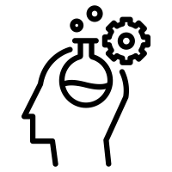








Agenda
Motivation
Research Topic
Research Questions
Architecture Overview
Project Timeline

Slide 3
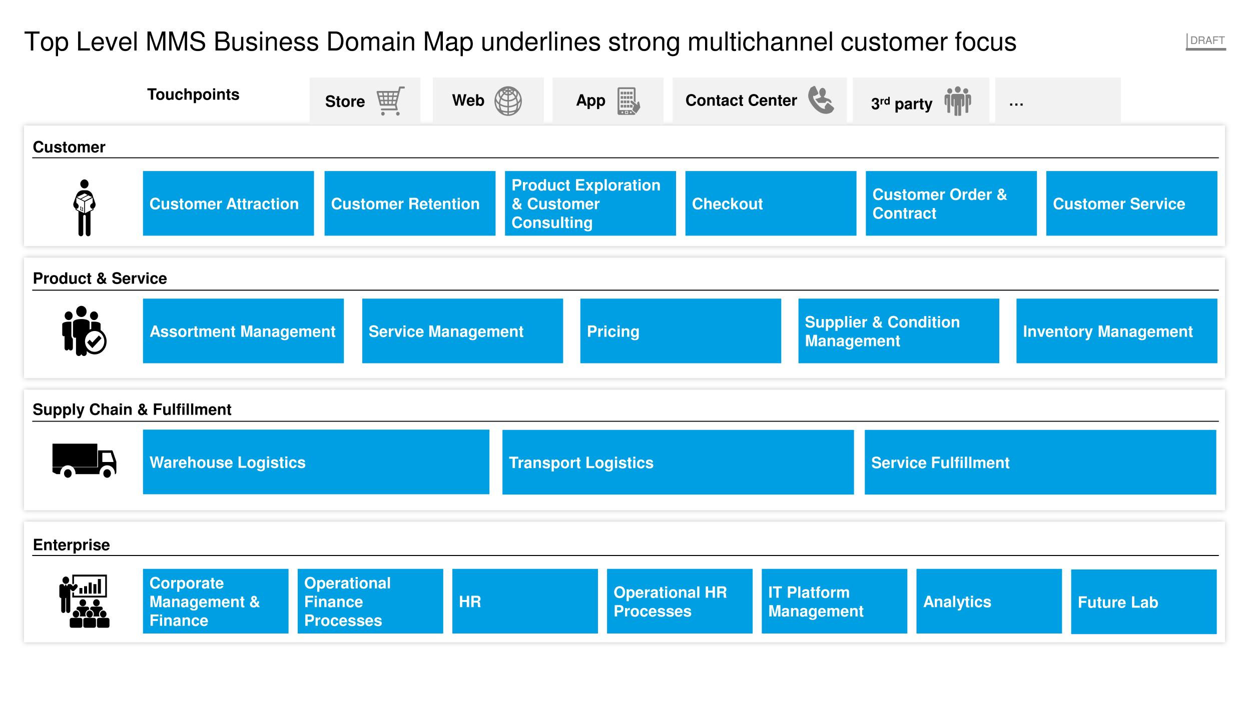
Example: BDM of retailer
Online Shop
GMS
Source: MediaMarktSaturn BDM 04/2018

Slide 4





Example: BDM of retailer
Inspire
Promotion
Search
Basket
myAccount
Source: MediaMarktSaturn BDM 04/2018

Slide 5


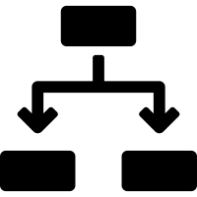



Driving forces
Microservices/Products change the application landscape
High frequency of changes
Increasing granularity
Team decisions
Emergent architecures
Bottom-Up
Documentation outdated
Consolidation potential

Slide 6
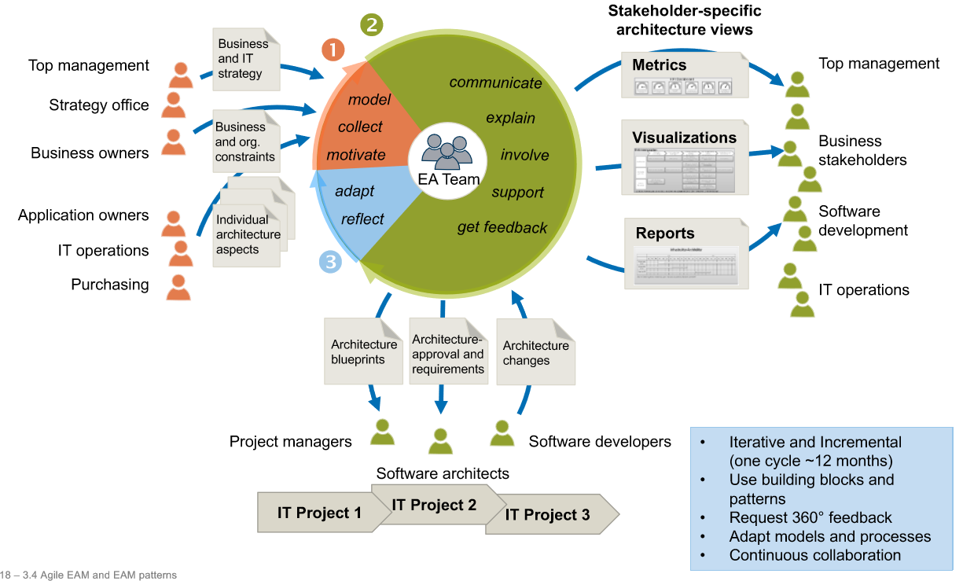
EAM lifecycle
Source: IT Strategy WS 17/18

Slide 7
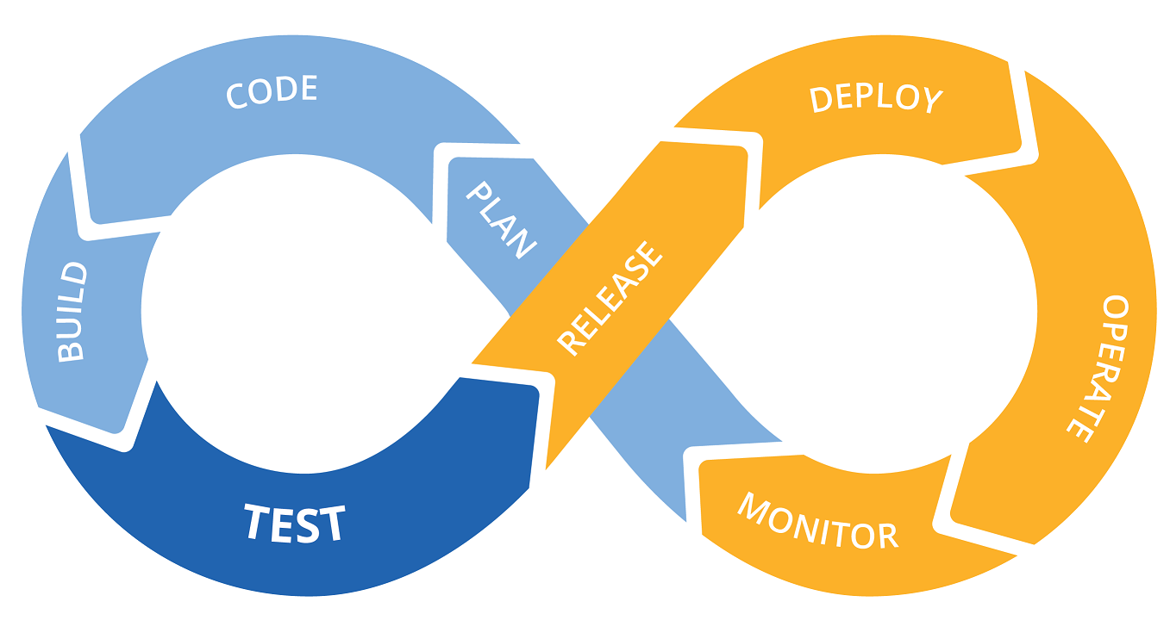


DevOps: Continuous Monitoring
APM Application Performance Monitoring
Service discovery
Dependencies
Source: Open Web Technology (openwt.com)

Slide 8
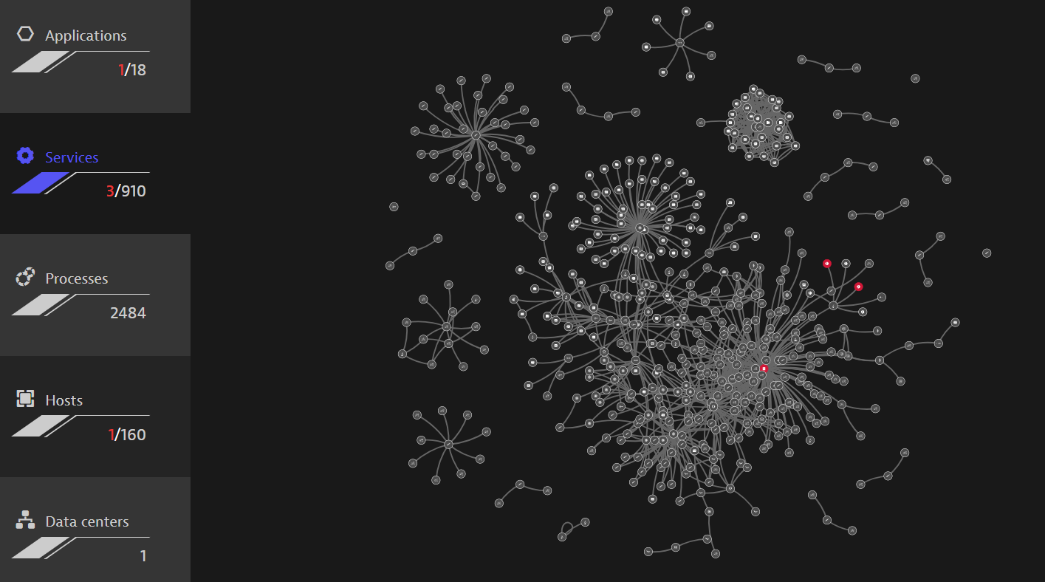
Service Discovery/Dependencies
Source: MediaMarktSaturn dynatrace Smartscape

Slide 9













Research topic
Runtime architecture
Architecture documentation
Synthesis of both
APM Tool
EAM Tool
Stakeholders
Stakeholders
Stakeholders
Developers
IT Operations
IT Management
Enterprise architects

Slide 10
The goal
...give actionable live information of enterprise architecure
...reduce wasteful architecture reverse engineering
...increase understanding of microservice domain design

Slide 11




Application
APM Tool
Implementation partner:
EAM Tool

Slide 12

Research questions
1
How to extract and map coherent service and infrastructure topologies from enterprise architecture management and monitoring systems?
2
How can this new feedback channel be sufficiently integrated into the software and architecture lifecycle?
3
How can architecture differences be sufficiently presented to gain knowledge on apparent problems?

Slide 13




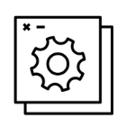

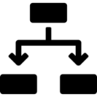




Data architecture
Service Information (Runtime)
Artifact name
Artifact changes
Exposed services
Dependencies
EAM Information (Static)
Business domains
Applications
Dependencies
Mapping Information
Artifact<->Microservices
Microservices<->Applications
Microservices<->Domains

Slide 14
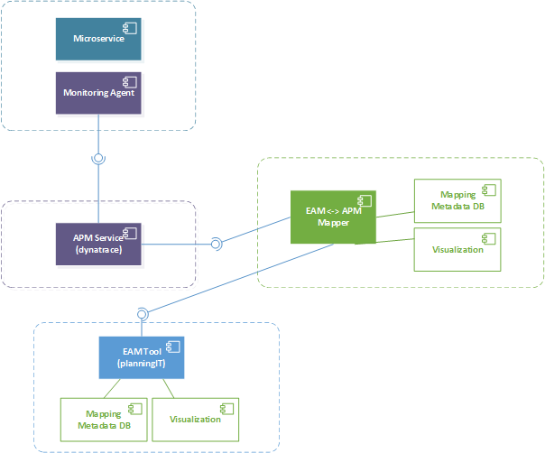

System overview

Slide 15
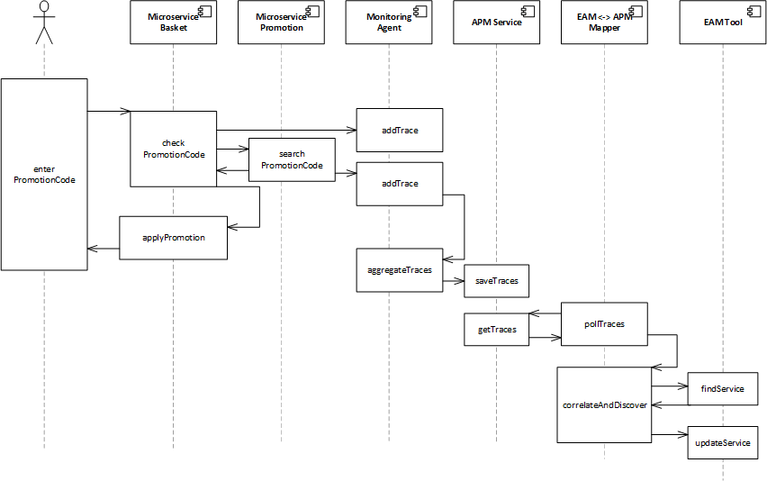
Lifecycle integration

Slide 16

Timeline
Research
Definition of use case
Data evaluation
Model
Prototype Implementation
Synthesis
Evaluation
Thesis
April | Mail | June | July | August

Slide 17
B.Sc.
Christopher Janietz
17132
christopher@janietz.eu

