Slide 1
Enhancing enterprise architecture models using application monitoring data
Christopher Janietz, 2018/10/12, Advanced Seminar (Advisor: Martin Kleehaus)

Slide 2










Agenda
Motivation
Research Questions & Approach
Conceptualization
Implementation
Evaluation & Outlook

Slide 3
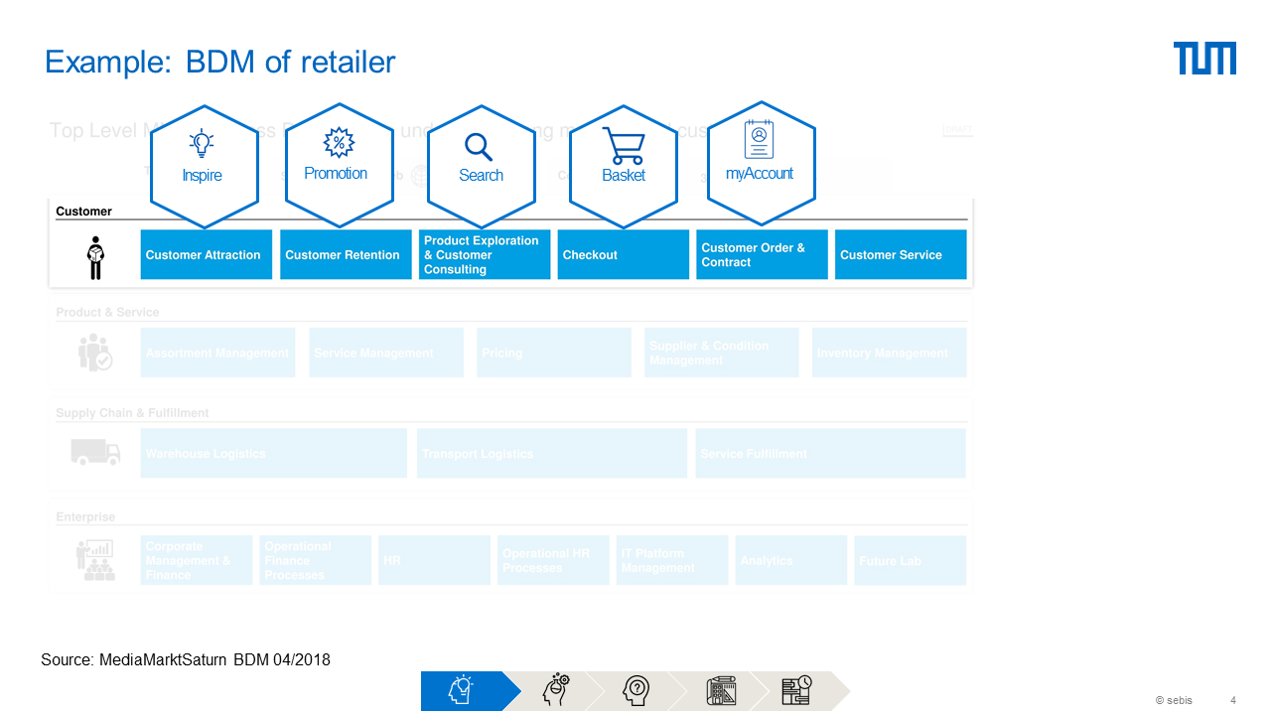
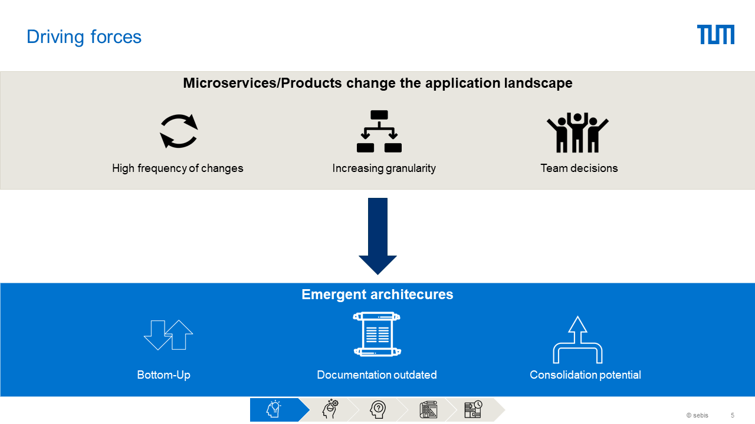
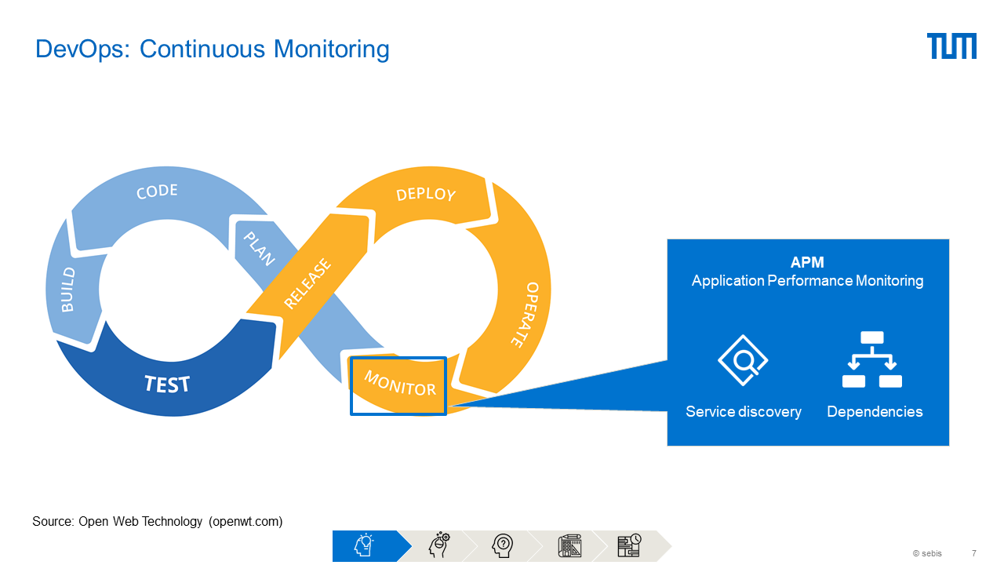
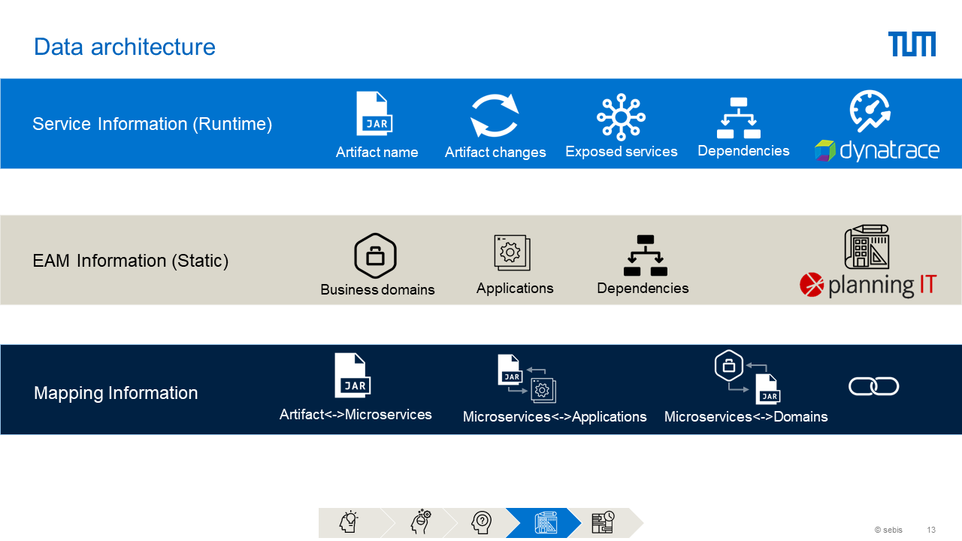
Motivation

Slide 4






Application
APM Tool
Implementation partner:
EAM Tool

Slide 5







Research questions
1
How to extract and map coherent service and infrastructure topologies from enterprise architecture management and monitoring systems?
Literature study
Metamodel
Requirement matrix
APEAM
GraphQL Layer
API integration
Sync

Slide 6

Research questions
2
How can this new feedback channel be sufficiently integrated into the software and architecture lifecycle?
Literature study
Sync concept
Field studies

Slide 7

Research questions
3
How can architecture differences be sufficiently presented to gain knowledge on apparent problems?
Literature study
Sync concept
Workflow concept
Field studies

Slide 8












Literature study
31 Papers → 13 Papers (Filter of related works, incorrect assumptions, …)
Approaches / Goals
Artifact/Service discovery
Problems / Open questions
EaaM (Everything as a Model)
Discipline
Code Annotation
Code Analysis
Complexity
Enterprise Topology Graph
Don’t use existing information
(Cloud) Migration /
Cleanup
Network Monitoring
Scripts
Neglect existing EAM Tools
Specific to Software Stack
Microservice Architecture Discovery
CMDB
Software Integration
CMDB

Slide 9
Literature challenges
...unrealistic Model driven approaches
...either very generic or too narrow (Network / Software Integration)
...do not make use of existing data

Slide 10

Metamodel
Runtime architecture (APM)
Architecture documentation (EAM)
UI
Synthesis of both
Domain
APM Service
EAM Service
UnifiedService
Product (Team)
ServiceReferences
Infrastructure
Backings

Slide 11
Domain Model Assumption / Product Organization
Remarks:
Typically teams/products determine the domain
Out of domain services (OOD) might occur nevertheless
Standard software can be handled in a similar manner when broken into APIs

Slide 12
Metamodel: UnifiedService
<Team/Product>-<Domain/Abbreviation>-<Function?>-<Type?>
bt
basket
calculation
service
inspire
product
data
service
Domain / Assignment

Slide 13
Metamodel challenges
...APM tools have a different understanding of a service
...EAM tools are lacking the microservice granularity level
...drift between idealistic product organization and reality

Slide 14




APEAM
Architecture
Requirements:
Live data
Integration infrastructure for other tools
Abstraction from APM and EAM tool
Recognition of changes

Slide 15
APEAM Implementation
Remarks:
Timestamp treshold
Abstraction of APM and EAM
GraphQL independent interface

Slide 16
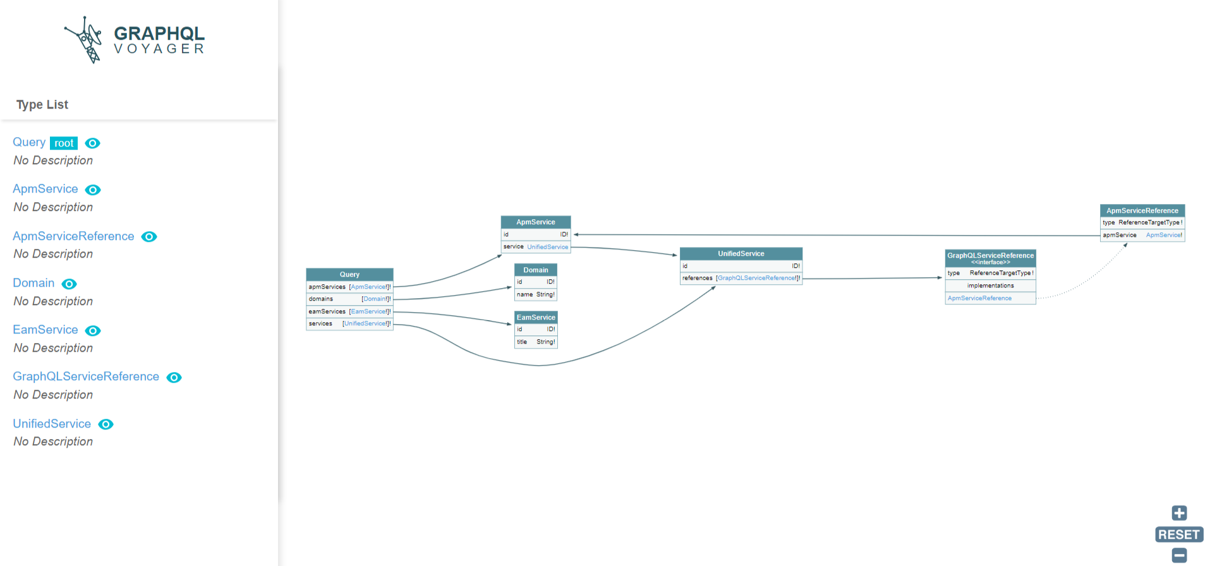
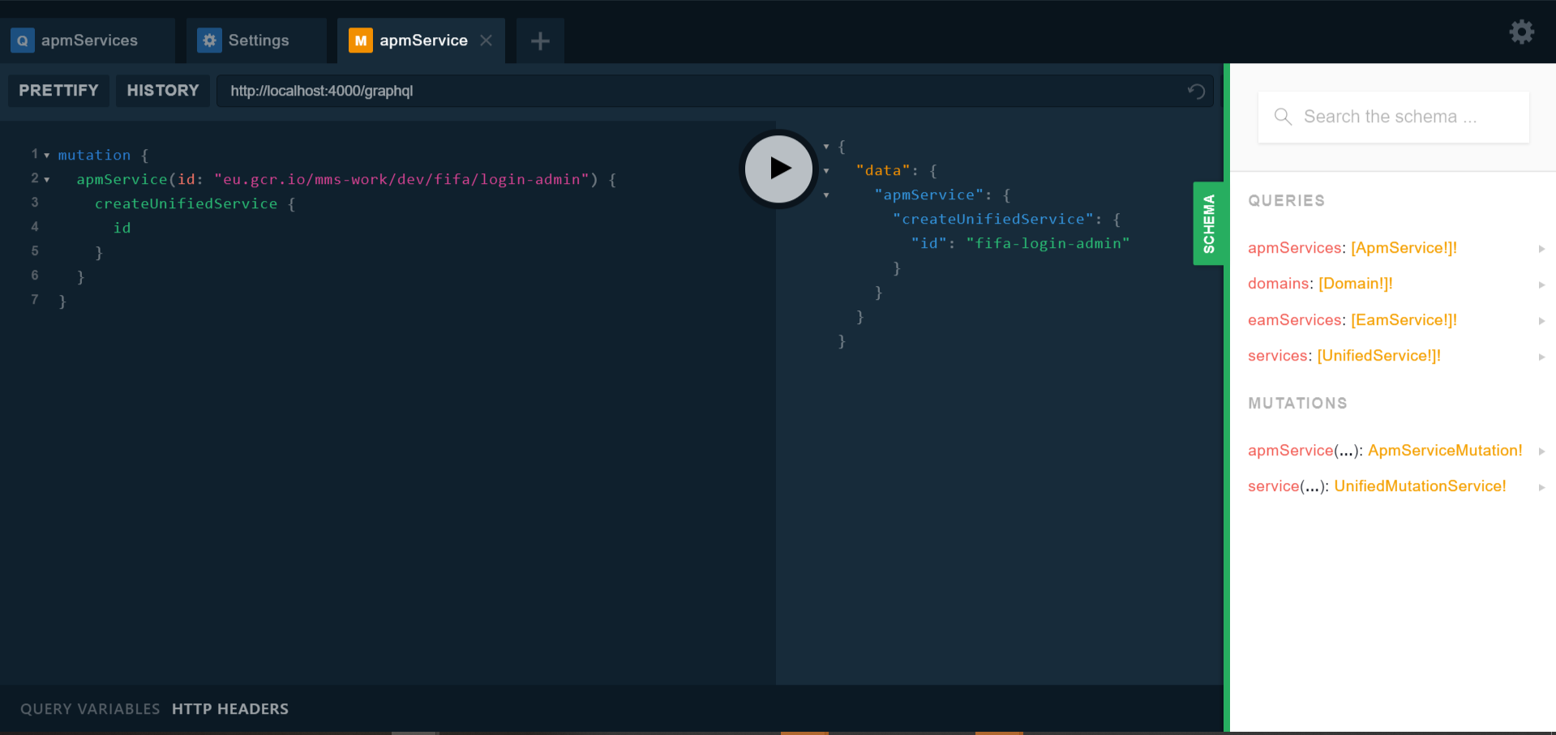
APEAM GraphQL
Model Visualization
Data Exploration

Slide 17



Sync concept
Event Feed
CI / CD Pipeline
Trigger
APEAM
Manual

Slide 18
Workflow: Creation

Slide 19
Sync inferencing concept

Slide 20
DockerIdAssociationInferencer
EamProductToDomainInferencer
Product
eu.gcr.io/mms-work/dev/fifa/login-admin

Slide 21
APEAM GraphQL
Demo

Slide 22
APEAM Challenges
...planningIT API is essentially executing SQL
...dynatrace has a better frontend API than public API
...getting the right level of abstraction

Slide 23
Requirements
APM Tool
EAM Tool
External API | REST | REST (via SQL)
Organization | Artifact Recognition (e.g. Docker Images) (Service Dependency Recognition) | Microservices / Product Organization
Sync | Event Feed or Artifact Hashing / Versioning | State Model (Approved / Draft / …) Versioning Concept
Workflow | Automatic recognition of services (Avoid agent integration) | Workflow Approval Model

Slide 24

Evaluation
Enterprise architects
Developers / Software architects
Ops (SRE)
+ | - | + | - | + | -
Increased transparency Automation Naming convention Enterprise graph = New EAM? basis | No UI Still adapting to the product org. model | Naming convention Enterprise graph API | No specific interest in pIT | Naming convention Enterprise graph API | No UI pIT is “waste”
Improvements: Analytics on domain interdependencies Document connections automatically |  | Improvements: Identification of dependents |  | Improvements: Integration with incident management

Slide 25


Outlook and Learnings
Extension of the enterprise graph
Drawing conclusions from the graph/monitoring data

Slide 26
Thank you
Martin Kleehaus (TUM)
Stefan Weiskopf (MMS SRE)
Dominik Pusch (MMS EA)
Andreas Geroe (MMS Dev)
All other participants…

Slide 27
B.Sc.
Christopher Janietz
17132
christopher@janietz.eu

