Slide 1
Final Presentation Master’s Thesis: Exploration of Ride-sharing Opportunities at the TUM Garching Campus
Lukas Mohs, 16th April 2018, scientific advisors: Anne Faber and Manoj Mahabaleshwar, supervisor: Prof. Florian Matthes

Slide 2
Agenda
Introduction / Motivation
Research Questions
Methods
State-of-the-art Analysis
Empirical Research
Modeling as Optimization Problem
Price Formation
Software Implementation and Evaluation
Questions / Feedback

Slide 3
Introduction
Ride-sharing classification
Ad hoc /
dynamic^{1,4}
Casual
ride-sharing /
slugging^{4,5,6}
Ridehailing
(Uber)
Ride-sharing /
carpooling^{1,3}
Daily
commute
to work^{4,7}
Carsharing^{3,6}
(DriveNow)
Pre-
arranged
Long-distance
ride-sharing
(BlaBlaCar)
Mobility services
1: Chan and Shaheen (2012) 2: Casey et al. (1998) 3: Ghoseiri et al. (2011) 4: Agatz et al. (2012) 5: Kelly (2007) 6: Amey et al. (2011) 7: Siddiqi and Buliung (2013)

Slide 4
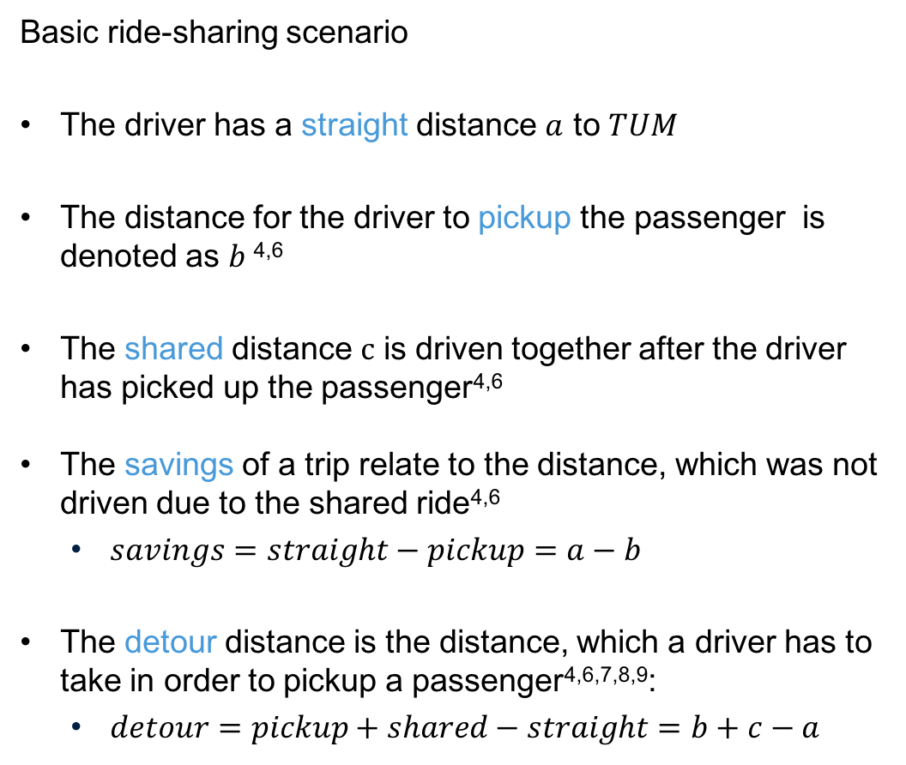
Introduction
Basic ride-sharing scenario
The driver has a straight distance $a$ to $TUM$
The distance for the driver to pickup the passenger is denoted as $b$^{4,6}
The shared distance $c$ is driven together after the driver has picked up the passenger^{4,6}
The savings of a trip relate to the distance, which was not driven due to the shared ride^{4,6}
$savings=straight−pickup=a−b$
The detour distance is the distance, which a driver has to take in order to pickup a passenger^{4,6,7,8,9}:
$detour=pickup+shared−straight=b+c−a$
4: Agatz et al. ( 2012) 6: Amey et al. (2011) 7: Siddiqi and Buliung (2013) 8: Calvo et al. (2004) 9: Baldacci et al. (2004)

Slide 5
Motivation
Advantages of ride-sharing
Congestion in Germany accounts for €100 billion annually¹¹
approximately 3% of the gross domestic product¹¹
The majority of vehicles in Germany have a capacity of 5 seats¹⁰
1.5 of them are used on an average trip¹⁰
1.2 passengers on the commute to work¹⁰
A matching platform for commuters creates win-win-win situation^{1,6,7}:
Passengers can save travel time
Drivers can split the fare and might share their driving effort
Institutions / companies benefit from decreased infrastructure and car usage as well as from networking effect between passengers
1: Chan and Shaheen (2012) 6: Amey et al. (2011) 7: Siddiqi and Buliung (2013) 10: Umweltbundesamt (2016) 11:Köhler-Rama et al. (2018)

Slide 6
Agenda
Introduction / Motivation
Research Questions
Methods
State-of-the-art Analysis
Empirical Research
Modeling as Optimization Problem
Price Formation
Software Implementation and Evaluation
Questions / Feedback

Slide 7



Research Questions
What are the existing strategies and approaches to solve ride-sharing?
How to formalize the commuter matching problem for the TUM Garching Campus?
How to design and implement a platform for daily ride-sharing at the TUM Garching Campus?

Slide 8
Agenda
Introduction / Motivation
Research Questions
Methods
State-of-the-art Analysis
Empirical Research
Modeling as Optimization Problem
Price Formation
Software Implementation and Evaluation
Questions / Feedback

Slide 9

Methods: State-of-the-art Analysis of Existing Approaches
The history of ride-sharing
WWII ride-sharing
clubs^{1,13}
Save resources
Bulletin boards
Early organized
ride-sharing schemes^{1,15}
Address traffic situation and air quality issues
Traffic Management Organizations
1942-1945
1980-2000
1940
1960
1980
1990
2000
1950
1970
1960-1980
> 2000
Responses to
the energy crisis^{1,12,14}
Slugging
HOV lanes
Park & ride facilities
Technology-enabled
ride-sharing^{1,16}
WWW
GPS
Smartphones
1: Chan and Shaheen (2012) 6: Amey et al., 2011 12: Burris & Stockton (2004) 13: Albinsson & Perera (2018) 14: Reno et al. (1989) 15: Beroldo (1991) 16: Furuhata et al. (2013)

Slide 10










Methods: State-of-the-art Analysis of Existing Approaches
Germany
Technology-enabled ride-sharing^{1,4,6,16,17,18}
Elsewhere
2000
2007
2007
2009
2012
2013
2000
2005
2010
2015
2020
2001
2002
2009
2010
2010
2017
2017
1: Chan and Shaheen (2012) 4: Agatz et al., (2012) 6: Amey et al. (2011) 16: Furuhata et al. (2013) 17: Bruglieri et al. (2011) 18: Handke and Jonuschat (2012)

Slide 11
Agenda
Introduction / Motivation
Research Questions
Methods
State-of-the-art Analysis
Empirical Research
Modeling as Optimization Problem
Price Formation
Software Implementation and Evaluation
Questions / Feedback

Slide 12
Methods: Empirical Research
Survey design
Survey I
Random students:
@Magistrale FMI
Total = 112
Public transport: 93
Car drivers: 10
Bike: 5
Car + public transport: 3
Walking: 1
Survey II
Only drivers:
@Parking lot
Total = 24
Car drivers: 24

Slide 13
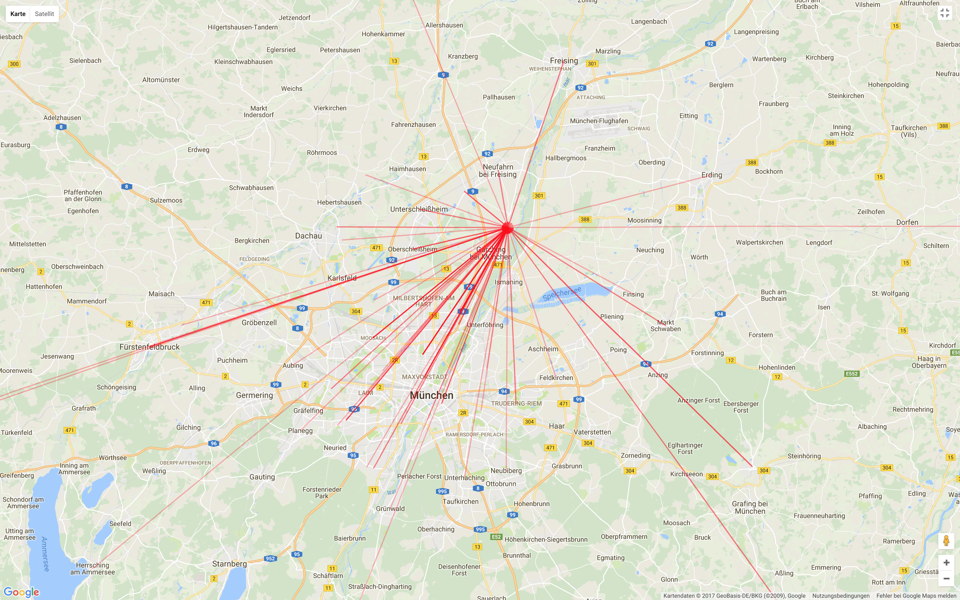
Methods: Empirical Research
Survey findings (n=136): commuting directions

Slide 14
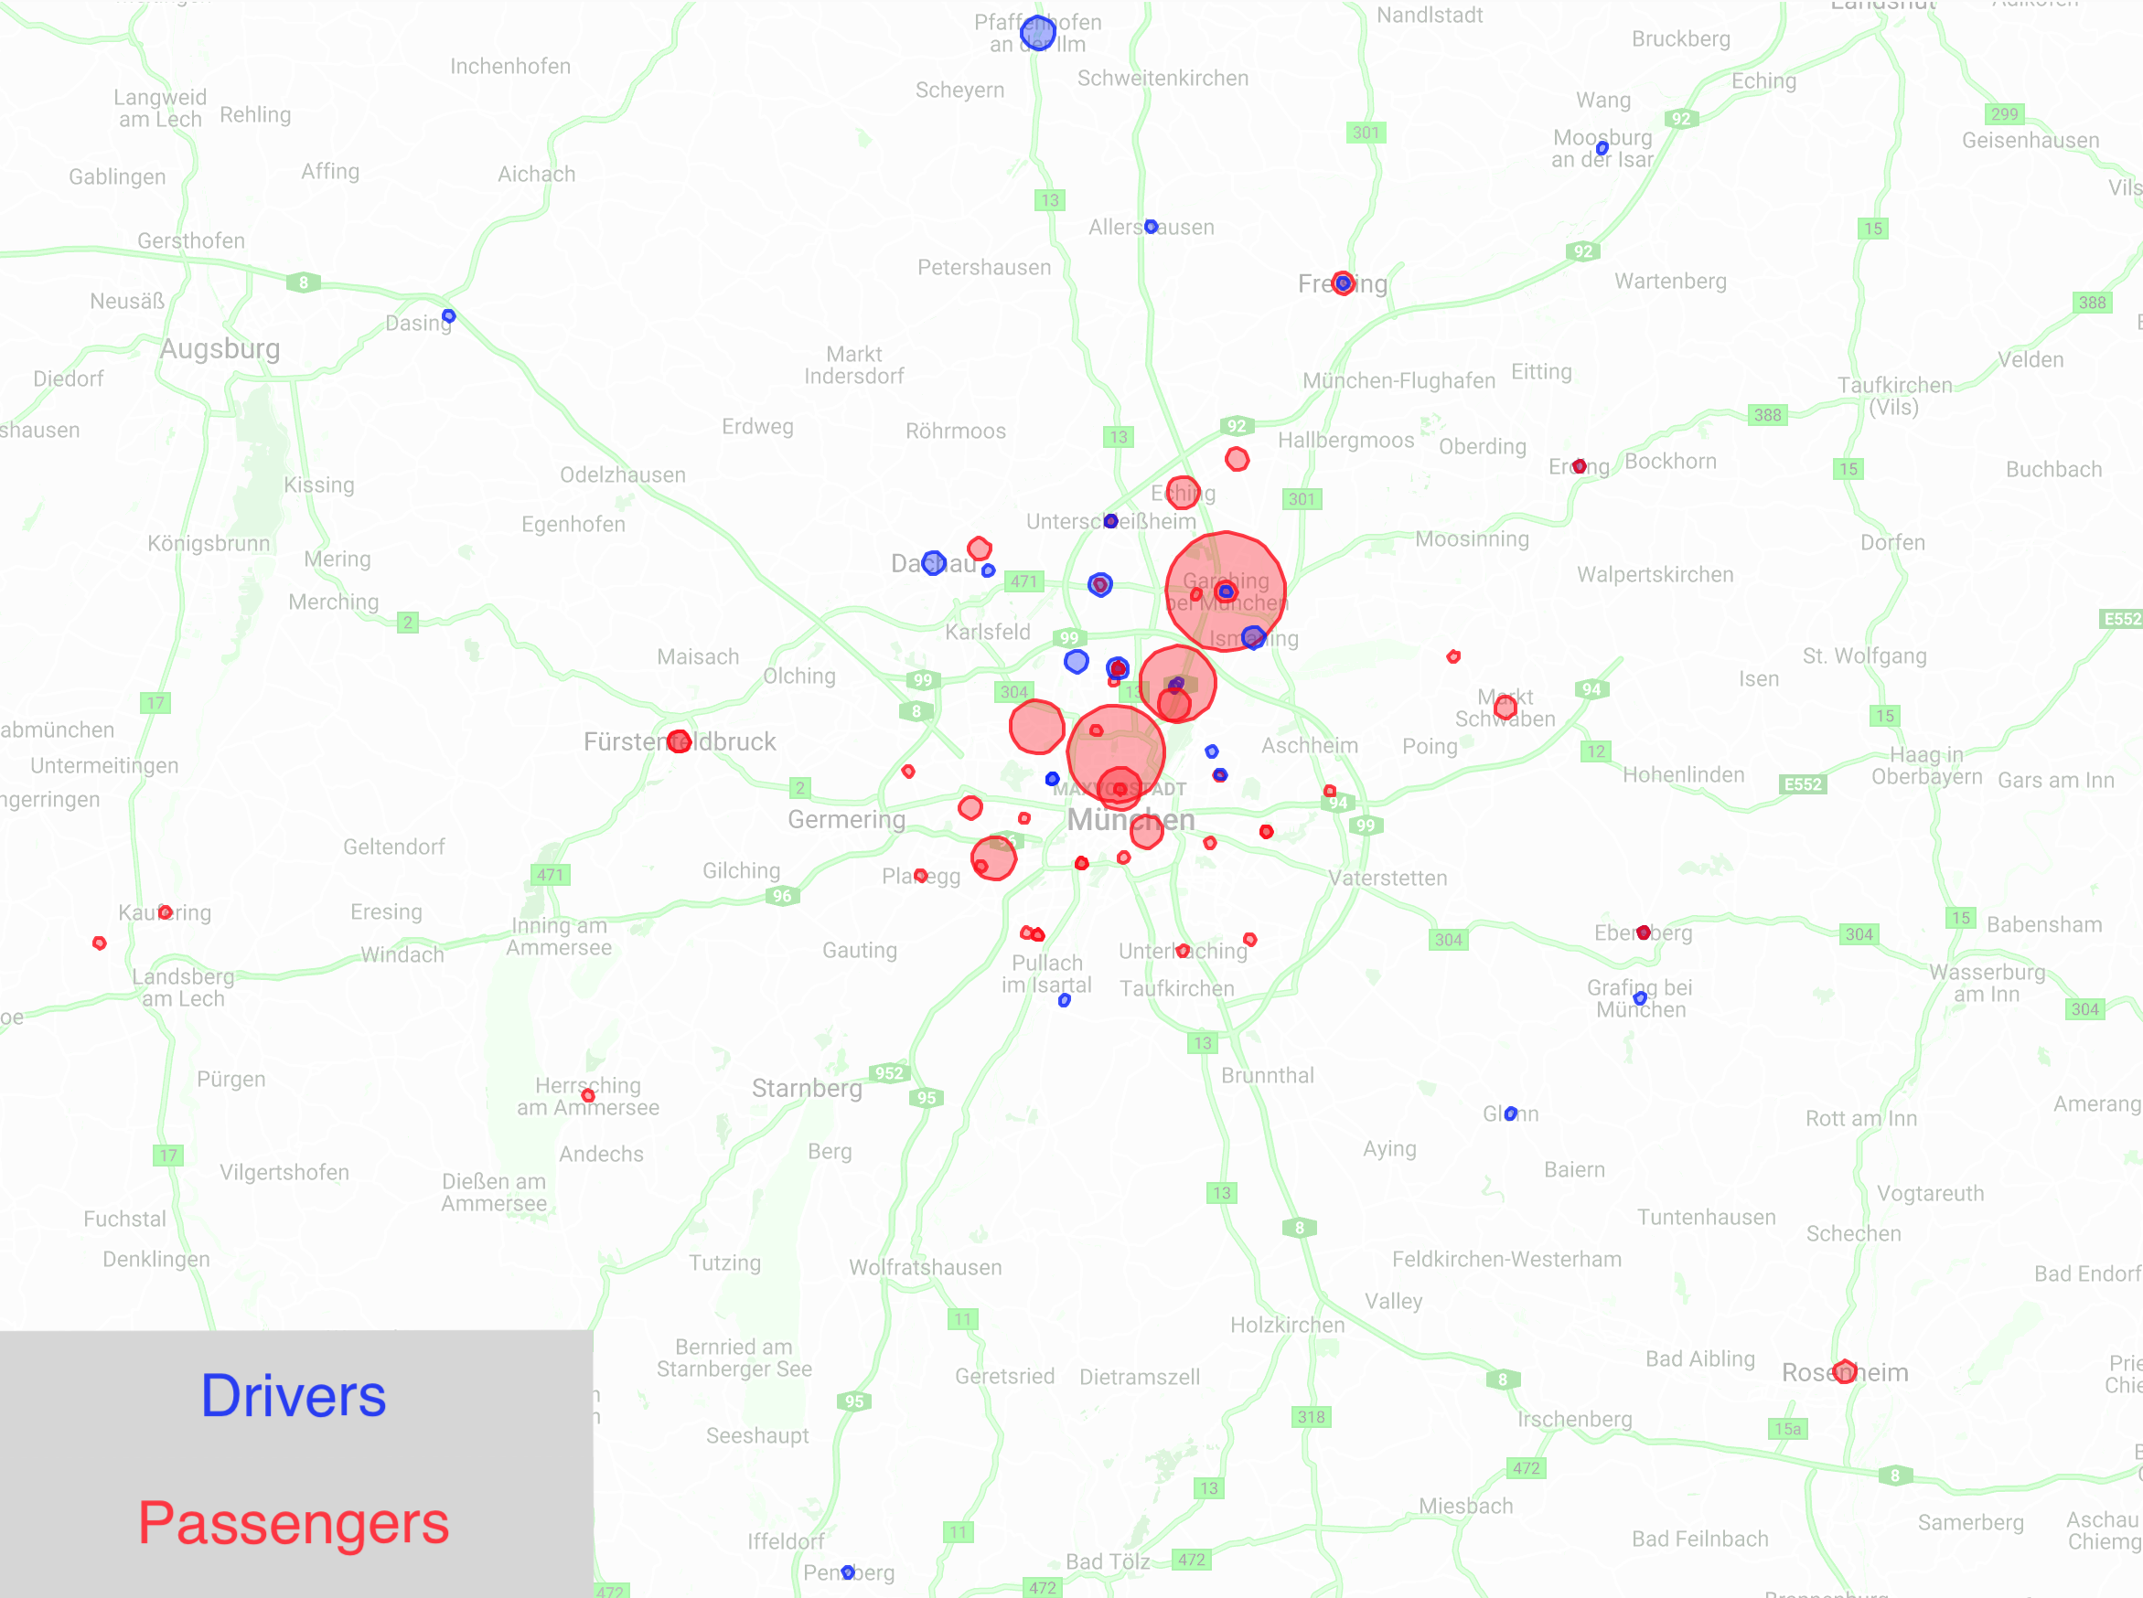
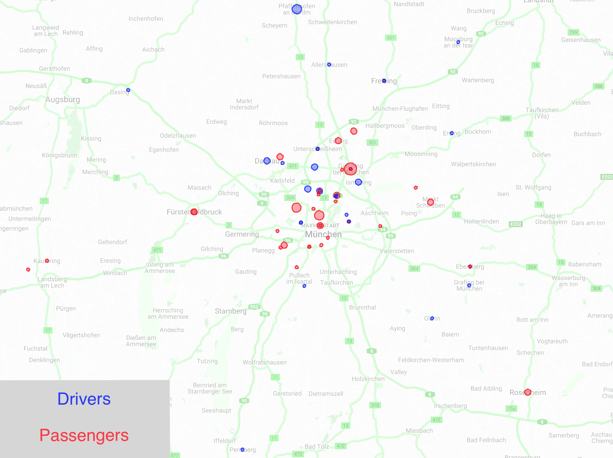
Methods: Empirical Research
Survey findings (n=136): commuting directions
All respondents Interested respondents

Slide 15
Methods: Empirical Research
Survey findings (n=136): commuting distance
the longer the travel distance, the more interested is the individuals
the longer the travel distance, the higher the interest in ride-sharing

Slide 16
Methods: Empirical Research
Survey findings (n=136): travel times
lecture hours
lecture hours

Slide 17
Methods: Empirical Research
Survey findings (n=136): time flexibility
option to spent further time studying

Slide 18
Methods: Empirical Research
Survey findings (n=136): price elasticity
Comparison of price expectations for the shared distance of driver and passenger¹⁹
Driver:
9ct / kilometer
Passenger:
13ct / kilometer
strong variance
strong variance
19: Diesendorf (2002 )

Slide 19
Methods: Empirical Research
Survey findings (n=136): price elasticity
Visualization of the price expectations of the detour distance of just the drivers
50ct / kilometer

Slide 20
Agenda
Introduction / Motivation
Research Questions
Methods
State-of-the-art Analysis
Empirical Research
Modeling as Optimization Problem
Price Formation
Software Implementation and Evaluation
Questions / Feedback

Slide 21

Methods: Modeling as an Optimization Problem
Route feasibility^{4,6,20,21,22,34}
Ride-sharing objective: reduce total distance driven
PASSENGER
$savings=straight distances −shared distance$
$savings=\left(a+c\right)−\left(b+c\right)$
$savings=a−b$
PASSENGER‘
$savings=a−b$’
→ Savings(PASSENGER) > savings (PASSENGER’)
4: Agatz et al. (2012) 6: Amey et al. (2011) 20: Stiglic et al. (2015) 21: Baldacci et al. (2004) 22: Calvo et al. (2004) 23: Dantzig and Ramser (1959)

Slide 22
Methods: Modeling as an Optimization Problem
Problem Complexity: bipartite matching vs. maximum matching
(without flexible role) (with flexible role)
Car capacity of two
Problem in graph theory
Both: polynomial complexity^{4,21,24}
Car capacity larger than two: NP-hard^{4,21,24}
4: Agatz et al. (2012) 21: Baldacci et al. (2004) 24: Edmonds and Johnson (2003)

Slide 23

Methods: Modeling as an Optimization Problem
Formalization as an integer linear program based on the Vehicle Routing Problem (VRP)^{21,22,23,25}
Using the decision variables:
optimizing the target function:
Where:
$D$ is the set of all driver start locations
$P$ is the set of all passenger pickup locations
$L$ is the set of all driver and passenger pickup locations
$p_{i}$ is the penalty for not picking up a passenger
21: Baldacci et al. (2004) 22: Calvo et al. (2004) 23: Dantzig and Ramser (1959) 25: Toth and Vigo (2002)

Slide 24
Methods: Modeling as an Optimization Problem
Limited by the following constraints:
the number of passengers assigned to a driver is equal to the number of passenger locations, which are passed by the driver
the number of passengers assigned to a driver is equal to the number of passenger locations, which are passed by the driver
a passenger can just be assigned to one or less drivers
each driver has to arrive at TUM
each driver has to leave from home
no car capacity can be exceeded

Slide 25
Methods: Modeling as an Optimization Problem
Stability of matches: central-assignment vs. agent-based^{4,26}
(car capacity = 2) (instable matches) (stable matches)
→ An agent-based matching approach is more suitable for the daily commuter matching problem
4: Agatz et al. (2012) 26: Agatz et al. (2011)

Slide 26
Agenda
Introduction / Motivation
Research Questions
Methods
State-of-the-art Analysis
Empirical Research
Modeling as Optimization Problem
Price Formation
Software Implementation and Evaluation
Questions / Feedback

Slide 27

Methods: Price Formation
Fair distribution of commuting costs between driver and passengers^{27,28,29}
Comparison of price expectations: drivers and passengers
allocate drivers’ detour price to shared kilometer price
$10\%$ expected portion of detour as part of total distance
$10\%∗€0.5+€0.09=€0.14$
compare with passengers willingness to pay
$€0.14 ≅€0.13$
shared price expectations
Use Shapley Value to distribute detour costs between passengers
Distance function $d(P)$
A set of passengers: $P=\{PASSENGER1, PASSENGER2,…\}$
A subset of passengers: $S⊆P$
27: Shapley (1953) 28: Naor (2005) 29: Fatima et al. (2008)

Slide 28
Methods: Price Formation
Shapley Value example calculation

Slide 29
Agenda
Introduction / Motivation
Research Questions
Methods
State-of-the-art Analysis
Empirical Research
Modeling as Optimization Problem
Price Formation
Software Implementation and Evaluation
Questions / Feedback

Slide 30
Methods: Software Implementation and Evaluation
Use-case overview^{1,4,30,31,32}
1: Chan and Shaheen (2012) 4: Agatz et al., (2012) 30: Choudary et al. (2017) 31: Cooper et al. (2004) 32: Fowler (2004)

Slide 31
Methods: Software Implementation and Evaluation
System design^{32,33,34}
32: Fowler (2004) 33: Dickey (2014) 34: Dayley (2014)

Slide 32
Methods: Software Implementation and Evaluation
Entity modeling^{32,33,34,35}
32: Fowler (2004) 33: Dickey (2014) 34: Dayley (2014) 35: Yourdon and Constantine (1979)

Slide 33
Methods: Software Implementation and Evaluation
Live Demo!
Registration / login
Offer / request creation
Matching
Massaging
Rating
https://ridebee.me/

Slide 34
Methods: Software Implementation and Evaluation
Evaluation: application of centralized matching to test search parameter sensitivity^{15,21,23,25}
Matching results time flexibility
detour ratio
→ Save 380km one-way with 136 students
1 min
120 min
1%
30%
15: Beroldo (1991) 21: Baldacci et al. (2004) 23: Dantzig and Ramser (1959) 25: Toth and Vigo (2002)

Slide 35
Agenda
Introduction / Motivation
Research Questions
Methods
State-of-the-art Analysis
Empirical Research
Modeling as Optimization Problem
Price Formation
Software Implementation and Evaluation
Questions / Feedback

Slide 36
Thank you for your attention!
Questions?
Suggestions?
Start ride-sharing to Garching at:
https://ridebee.me/

Slide 37
Sources
1: Chan and Shaheen (2012)
2: Casey et al. (1998)
3: Ghoseiri et al. (2011)
4: Agatz et al. (2012)
5: Kelly (2007)
6: Amey et al.( 201)
7: Siddiqi and Buliung (2013)
8: Calvo et al. (2004)
9: Baldacci et al. (2004)
10: Umweltbundesamt (2016)
11:Köhler-Rama et al. (2018)
12: Burris and Stockton (2004)
13: Albinsson and Perera (2018)
14: Reno et al. (1989)
15: Beroldo (1991)
16: Furuhata et al. (2013)
17: Bruglieri et al. (2011)
18: Handke and Jonuschat (2012)
19: Diesendorf (2002 )
20: Stiglic et al. (2015)
21: Baldacci et al. (2004)
22: Calvo et al. (2004)
23: Dantzig and Ramser (1959)
24: Edmonds and Johnson (2003)
25: Toth and Vigo (2002)
26: Agatz et al. (2011)
27: Shapley (1953)
28: Naor (2005)
29: Fatima et al. (2008)
30: Choudary et al. (2017)
31: Cooper et al. (2004)
32: Fowler (2004)
33: Dickey (2014)
34: Dayley (2014)

Slide 38
Master of Science
Lukas Mohs
17135
lukas.mohs@tum.de

