Slide 1
Supporting the Legal Reasoning Process by Classification of Judgments Applying Active Machine Learning
Linus Boehm, 20.11.17 Kick Off Presentation

Slide 2
Outline
Key Facts
Motivation
Legal Reasoning Process
Challenges
Data Set
Active Learning
Research Approach & Timeline

Slide 3
Key Facts
Chair: Software Engineering for Business Information Systems
Title: Supporting the Legal Reasoning Process by Classification of Judgments Applying Active Machine Learning
Author: Linus Boehm (linus.boehm@tum.de)
Advisor: M.Sc. Ingo Glaser (ingo.glaser@tum.de)
Supervisor: Prof. Dr. Florian Matthes (matthes@in.tum.de)
Start: 15th of November, 2017
End: 15th of April, 2017

Slide 4
Motivation
Legal Documents
are growing and changing: 2013-2017 period more than 550 adopted laws [1]
getting more complex
Document Discovery
often done manually
very time-consuming and costly [2]
knowledge-intensive
Technology Progress
Computing power increases
New algorithms and approaches like Machine Learning
Data storage is becoming cheaper
→ Digitalisation and automated processing is becoming more important

Slide 5




Legal Reasoning Process – Status quo: Lawyer
Lawyer examines legal documents e.g. contracts

Slide 6


Legal Reasoning Process – Status quo: Lawyer
Lawyer reviews sources of law for relevant predicates
That includes:
Laws
Legislative comments
judgments

Slide 7


Legal Reasoning Process – Status quo: Lawyer
Seeking for evidence that improves the legal reasoning
Lawyer includes identified predicates into the legal reasoning process

Slide 8

Legal Reasoning Process – Target
At this point a new version of Lexia can support the lawyer by:
Automatic recognition of relevant predicates
e.g. including predicates about unlawfulness of tenancy contracts

Slide 9



Legal Reasoning Process – Status quo
Judge examines legal documents e.g.:
Legal reasoning of the lawyer
Contracts

Slide 10
Legal Reasoning Process – Status quo
Judge reviews sources of law for relevant predicates
That includes:
Laws
Legislative comments
judgments

Slide 11
Legal Reasoning Process – Status quo
Judge incorporates identified predicates into the legal reasoning process
Characteristics of the legal reasoning process:
Striving for consistency
Further development of the law
Attempts to regulate social relations by applying the legislature’s intention

Slide 12
Legal Reasoning Process – Status quo
Opportunity for Lexia to support the legal reasoning process of a judge:
Automatic recognition of relevant predicates
Characteristics of the legal reasoning process of a judge:
Striving for consistency
Further development of the law
Attempts to regulate social relations by applying the legislature’s intention

Slide 13

Challenges for the implementation
Jurisdiction is constantly being adapted and extended
Quantity of information increases
New judgements can possibly replace older ones
Unstructured plain text
Purpose and meaning of documents, paragraphs and sentences often unknown [3]
What is a predicate in the context of law?
Frequent use of abstract formulations
E.g. Should it be annotated?
Sentences without significance in judgments for the usecase
E.g. Opinion of the previous court

Slide 14
Data Set
Raw Documents
BGH judgements of the VIII. Civil Senate
Subjects are limited to tenancy law
More than thousand documents
Only use of primary sources, everything else isn’t legally binding (e.g. articles)
Text classification
Using different ML and AML Approaches
Annotating predicates in judgments that say something about unlawfulness of clauses in tenancy contracts
Training Data
Pre-labeled Data from Ruta Rules/human expert
Verified and extended by human expert

Slide 15




Active Learning – Overview
Select query instances which have the least label certainty under the current
trained model (most meaningful)
→ Reduces size of needed training data
Machine Learning
Model
Labeled training set
Unlabeled pool
$$ℒ$$
$$U$$
Oracle
(human annotator)

Slide 16
Active Machine Learning as Solution
Why is active learning more suitable than machine learning for Text Classification in jurisdiction?

Slide 17
Research Questions
How can ML support the legal reasoning process of lawyers and judges?
What are the functional and non-functional requirements (evaluation criteria) of a software for the classification of judgments?
What is the most suitable classifier of BTC in context of jurisdiction?
Which is the best query strategy for the purpose of BTC in context of jurisdiction?

Slide 18
Research Method
Design Science as most fitting method
Focus is on the creation of an effective IT solution
Description of the design problem
Development an new IT artefact
Strict evaluation of the IT artefact to measure the utility
Environment
IS Research
Knowledge Base
People/Organizations
Develop/Build
Foundations/
Methodologies
Software Developers
Legal Experts
Extended Version of LexML
Adaptions to Lexia
(Active) Machine Learning
Binary Text Classification in jurisdictions
Rule-based Approaches
ML Frameworks
Business Needs
Applicable Knowledge
Assess Refine
Technology
Justify/Evaluate
Lexia
LexML
Document Classification
Sentence Classification
Binary Text Classification
Application in the Appropriate Environment
Additions to the Knowledge Base

Slide 19
Expected Outcome
IT-Artifact
Extended Version of LexML with BTC
Optional choice of AML Algorithm and Query Strategy
Any imported document to Lexia can be used as Training Data
AML Model can be applied to any Document imported to Lexia
Suitable UI for Lexia
ML Model that classifies judgements including predicates about unlawfulness
Knowledge based
AML vs. ML vs. Ruta
New insights for the use of BTC and ML in the legal domain

Slide 20
Research Approach
1. Research
Literature Research
5. Evaluation
Validate Requirements
2. Machine Learning for Binary Text Classification
3. Requirements Engineering
4. Implementation
Finding state of the art solutions
What are viable AML concepts for Binary Text Classification?
Which is the best query strategy for the purpose of BTC in context of jurisdiction?
What is the most suitable classifier of BTC in context of jurisdiction?
What are the functional and non-functional requirements (evaluation criteria) of a software for the classification of judgments?
Identify stakeholders and understand their needs
What challenges occur when using BTC in jurisdiction?
Expand Lexia`s UI
Implement a protypical solution within LexML
Evaluate the use case and different scenarios

Slide 21
Timeline
Approach: | November | December | January | February | March | April
Literature Research
Requirements Engineering
Concepting
Implementation
Evaluation
Thesis:
Writing
Review

Slide 22
References
https://www.bundestag.de/blob/194870/7c8a01e16c98fc9c32ddb203d7bd88e0/gesetzgebung_wp18-data.pdf
Gruner, Ronald H. "Anatomy of a lawsuit." (2008).

Slide 23
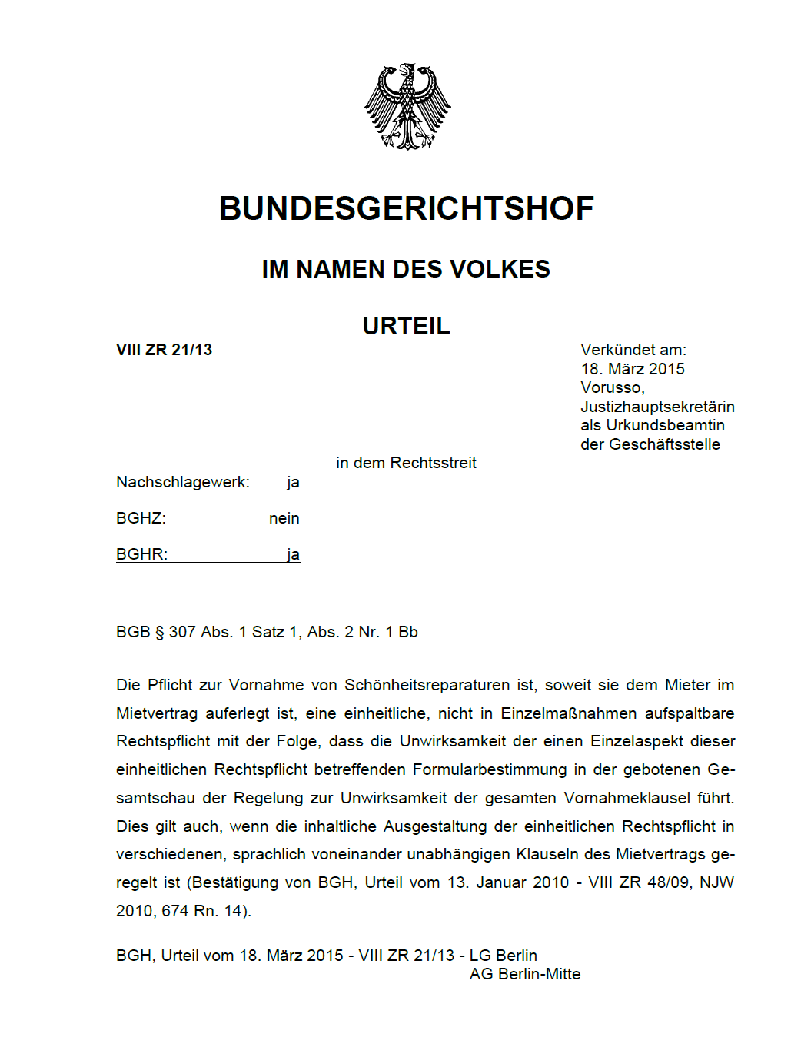
Structure of a German civil judgment
Preamble (Rubrum)
Guiding principle (depends on art of the judgment)
Operative provisions (Tenor)
Element of an offense (Tatbestand)
Reasons for the decision (Entscheidungsgründe)
Explanation on rights of appeal (Rechtsmittelbelehrung)

Slide 24
Structure of a German civil judgment
Preamble (Rubrum)
Guiding principle (depends on art of the judgment)
Operative provisions (Tenor)
Element of an offense (Tatbestand)
Reasons for the decision (Entscheidungsgründe)
Explanation on rights of appeal (Rechtsmittelbelehrung)

Slide 25
Structure of a German civil judgment
Guiding principle (depends on art of the judgment)

Slide 26
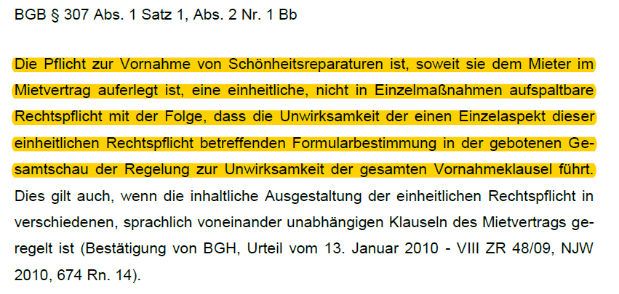
Structure of a German civil judgment
Guiding principle (depends on art of the judgment)

Slide 27
Structure of a German civil judgment
Reasons for the decision (Entscheidungsgründe)
Opinion of the previous court
Recognizable by the indirect speech
Not relevant for our use case
Opinion of the current court (in our case from the BGH)
Recognizable by the direct speech
Highly relevant for our use case

Slide 28
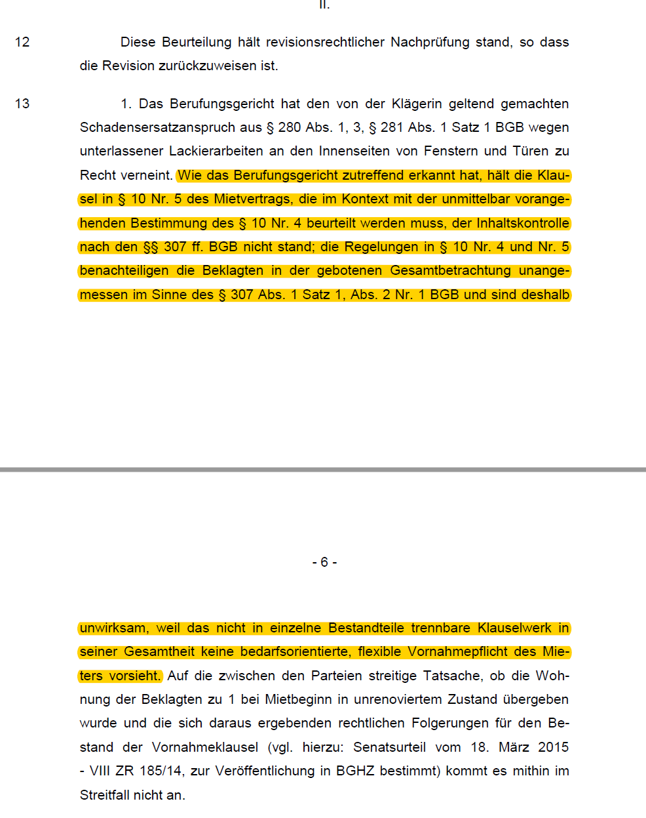
Example Annotation off a Judgment

Slide 29
Prof. Dr.
Florian Matthes
17132
matthes@in.tum.de

Slide 30
Stick to the good sebis traditions
Provide action links at the bottom of the slide to guide the audience to our web pages or publications (see below). (Select the text, press CTRL-K)
Use a file name according to our sebis conventions which helps us and our audience to find the file of your presentation on our web site with Google search:
YYMMDD Author Short Title
Include this string in the footer (Einfügen -> Kopf- und Fusszeile -> Fusszeile)
The unusual date format simplifies the search for the latest version of a slide in an alphabetical directory listing (Dropbox, Explorer, Tricia, Sky-Drive)
[Ha13g]Hauder, M., Roth, S., Matthes, F.: Current Tool support for Metrics in Enterprise Architecture Management
For more information visit BEAMS , EAM Pattern Catalog and EAM KPI Catalog (http://wwwmatthes.in.tum.de)

Slide 31
Use the sebis visual language (shapes, fonts, colors, sizes)
Default
Line Style
Default Rectangle
Default
Rounded R.
Text
Default
Text
User
Store
Information
Arrow
Cloud
Process
Box
Explanation
Fast Form 1
Fast Form 2
Fast Form 3
Fast Form 4
Fast Form 5
Fast Form 6
Fast Form 6
Fast Form 1
Fast Form 2
Fast Form 3
Fast Form 4
Fast Form 5
Fast Form 6
Fast Form 6

