Slide 1
Master Thesis Kick-off presentation
Using Distributed Traces to Detect Anomalies
Lukas Steigerwald, 22.05.2017, Munich

Slide 2
Outline
Background and Motivation
  Microservices
  Distributed Traces
  Anomaly Detection
  Root Cause Analysis
Research Context
Problem Statement
Research Questions
Anomaly Detection Architecture
Roadmap

Slide 3
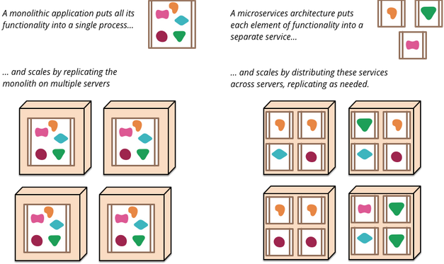
Microservices
“The business organization needs to be able to respond to disruptions quickly, they need to bring agility to their IT systems and infrastructure, at the same time business also craves stability.” – Yu et al. 2016
“[…]the microservice architectural style is an approach to developing a single application as a suite of small services, each running in its own process and communicating with lightweight mechanisms, often an HTTP resource API.” – Fowler, Lewis 2014
Fowler, Lewis 2014

Slide 4
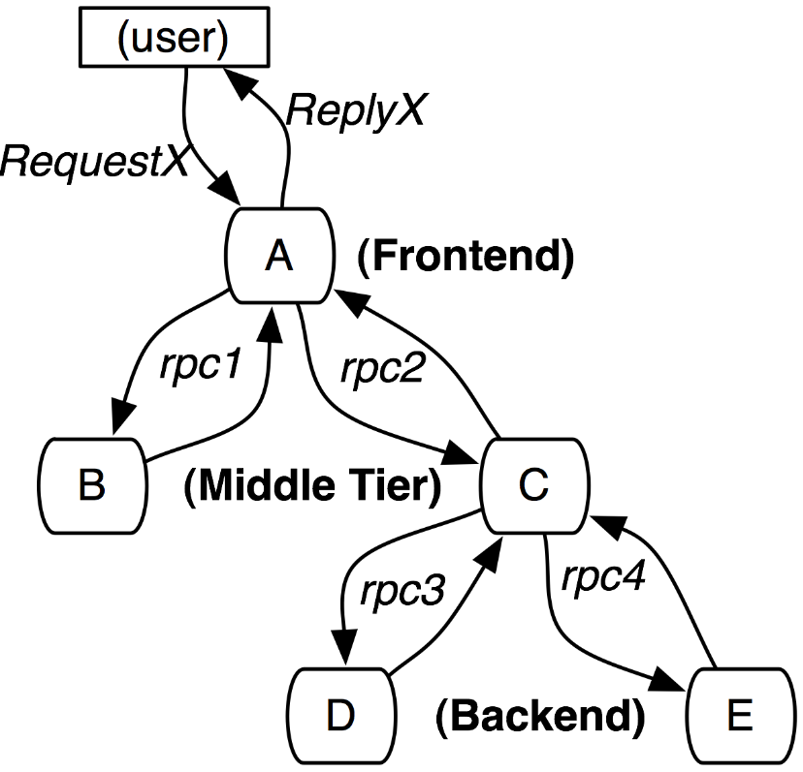
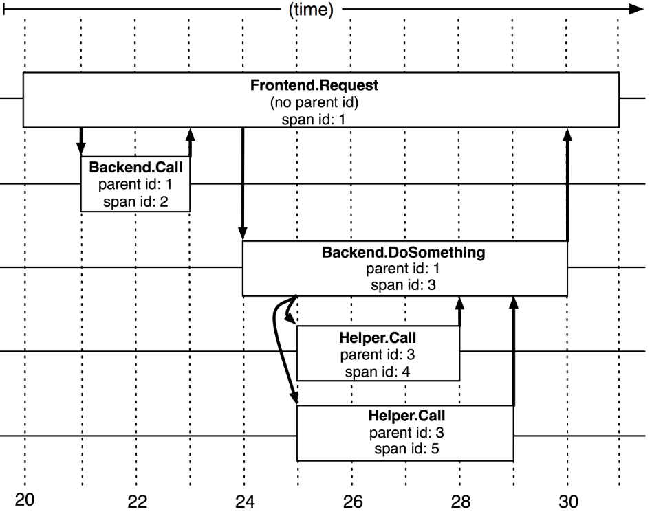
Distributed Traces
In distributed Systems information about function calls is first stored locally and later combined to a complete trace (Reynolds et al 2006, Sigelman et al 2010)
Services are instrumented (e.g. by Adapting a library that is commonly used for communication calls among services) and report information regarding incoming and outgoing communication to central repository (Sigelman et al 2010)
Alternative to instrumentation: passive network tracing in the form of port mirroring or packet sniffing (Aguilera et al 2003)
Sigelmann et al. 2010
Sigelmann et al. 2010
Notes:
Port mirroring , which is supportedbymanyswitchvendors, allows a switch to be configured to copy (“mirror”)someor all packets to a dedicated monitoring port. It allows us to treat application hosts entirely as black boxes (we need not install any software on those hosts) and should not perturb the system under test.
Packet sniffing at each participant host applies when the hosts support programs such as tcpdump [14]. After trace capture, the traces are merged in post-processing (see Section 6.5).

Slide 5
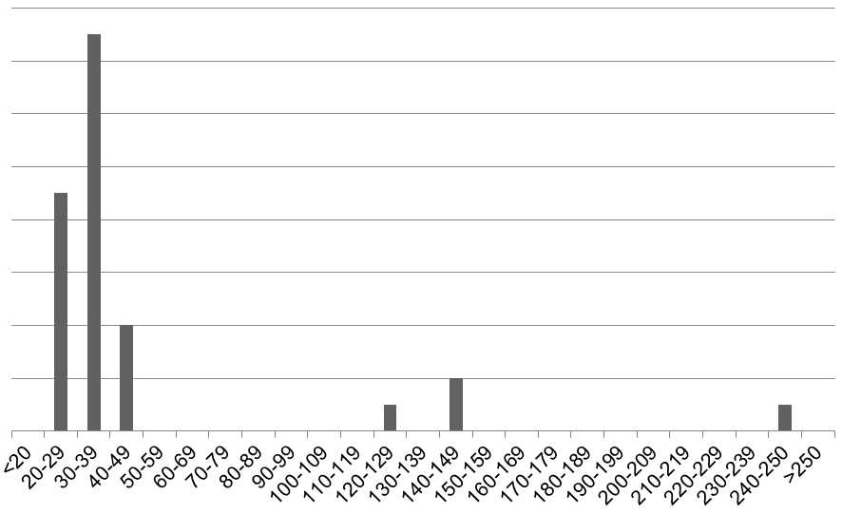
Anomaly Detection
Motivation
The revenue of a business that is running a large web page is directly impacted by the performance of this system (Kim et al 2013)
An increase in latency of web pages directly impacts the conversion rate (Linden 2006, Shalom 2008, Almossawi 2010)
# of Requests
Response time (ms)
Notes:
Motivation
The revenue of a business that is running a large web page is directly impacted by the performance of this system (Kim et al 2013)
An increase in latency of web pages directly impacts the conversion rate (Linden 2006, Shalom 2008, Almossawi 2010)
Approach
In unsupervised anomaly detection first an algorithm is trained with a set of normal examples – outliers are then detected by a distance measure that exceeds a certain threshold from the baseline
Possibility of Machine Learning or Statistical Approaches to detect Outliers (Solaimani et al 2014)
Challenge
“To retain trust in the automatic detection and alerting, a high classification quality (e.g., in terms of precision, recall, and related measures) is desired.” - Heger et al 2017

Slide 6
Root Cause Analysis
Performance anomalies will propagate themselves along the call hierarchy
Operations team needs to react quickly to anomalies
Use contextual information to point out the root cause of the detected anomalies
Sigelmann et al. 2010
Notes:
Little or no support for root cause analysis of performance problems in current APM tools for distributed systems (Heger et al 2017)
It is desirable to follow the call graph of the application to identify the root cause of the anomaly to enable the Operations team to quickly identify and deal with the issue at hand.

Slide 7
Problem Statement
Currently there is little or no support for root cause analysis of performance problems in current APM tools for distributed systems (Heger et al 2017), hence for this thesis the goal is to:
Implement a prototype to monitor distributed traces from an instrumented microservices environment for anomalies
Use a static architectural model of the services structure to identify the root cause of anomalies
Create a simple visualisation of the identified root cause in the context of the structure of the microservices

Slide 8
Research Questions
RQ1:
What is a valid architecture for supporting anomaly detection in a service oriented and distributed environment?
RQ2:
What are features required to detect performance anomalies?
RQ3:
Which algorithms for anomaly detection are most suitable for the chosen environment?
RQ4:
How can a root-cause analysis be performed based on the discovered anomalies and the component dependencies?

Slide 9
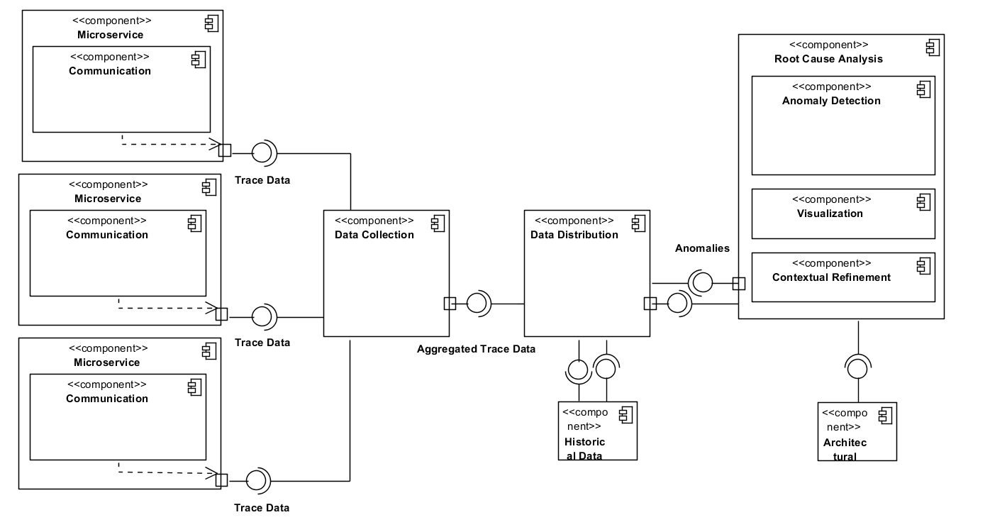




Anomaly Detection Architecture
Historical Data
Microservices Architecture Information
…
Notes:
Lab Micro Services Application based on Spring
Instrumented with zipkin to gather distributed traces
Kafka to collect the zipkin data
MySQL Database to store the gathered traces
The Application to build – based on Apache Spark and connected Libraries
Apache Spark supports streaming of data compared to e.g. hadoop that is ony offering batch (but Spark can use hadoop)
Spark has better performance than Apache Storm and Apache S4(Reference??? – evtl Matei et al 2012)
Discover structure of distributed services (or get information from Patricks project)
Streaming distributed traces data with kafka
Training Anomaly detection algorithm with the normal behaviour of the application
Running Anomaly detection algorithm on the streamed data
Compare anomalies to architecture model to identify the root cause of the anomalies
Alert message with service(s) that is(are) the root cause for the detected anomalies
Visualize result by updating a view of the already existing zipkin web-cockpit for browsers (collaborating with Daniel – maybe highlighting root cause in the visualized model of the application)

Slide 10
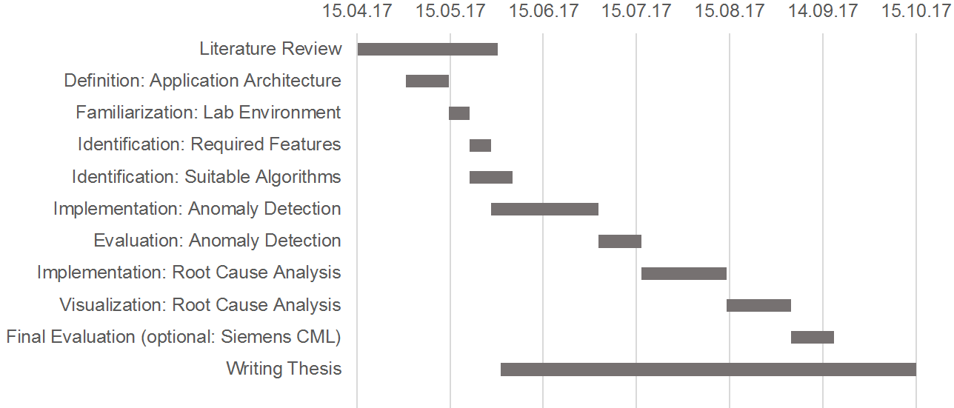
Roadmap
Notes:
Literature Review on state of the art architectures for a anomaly detection pipeline
Literature review on algorithms for anomaly detection
Implementation of a working prototype to identify anomalies from distributed traces generated by zipkin
Evaluation of different algorithms for anomaly detection
Use of contextual information to narrow down anomalies to a potential root cause
Simple visualisation of the results
Optional: Testing the model together with Siemens CML platform

Slide 11
References
Aguilera, Marcos K.; Mogul, Jeffrey C.; Wiener, Janet L.; Reynolds, Patrick; Muthitacharoen, Athicha (2003): Performance debugging for distributed systems of black boxes. In Michael L. Scott (Ed.): Proceedings of the nineteenth ACM symposium on Operating systems principles. the nineteenth ACM symposium. Bolton Landing, NY, USA. ACM Special Interest Group on Operating Systems. New York, NY: ACM, pp. 74–89.
Almossawi, Ali (2010): Firefox & Page Load Speed – Part I | Blog of Metrics. Available online at https://blog.mozilla.org/metrics/2010/03/31/firefox-page-load-speed-part-i/, checked on 5/5/2017.
Fowler, Martin; Lewis, James (2014): Microservices. Available online at https://martinfowler.com/articles/microservices.html, updated on 4/25/2017, checked on 5/2/2017.
Heger, Christoph; van Hoorn, Andre; Mann, Mario; Okanovic, Dusan (2017): Application Performance Management: State of the Art and Challenges for the Future. In ICPE’17, April 22-26, 2017, L’Aquila, Italy. DOI: 10.1145/3030207.3053674.
Kim, Myunghwan; Sumbaly, Roshan; Shah, Sam (2013): Root cause detection in a service-oriented architecture. In ACM SIGMETRICS Performance Evaluation Review 41 (1), pp. 93–104. DOI: 10.1145/2494232.2465753.
Linden, Greg (2006): Marissa Mayer at Web 2.0. Available online at http://glinden.blogspot.de/2006/11/marissa-mayer-at-web-20.html, updated on 4/30/2017, checked on 5/5/2017.
Reynolds, Patrick; Wiener, Janet L.; Mogul, Jeffrey C.; Aguilera, Marcos K.; Vahdat, Amin (2006): WAP5: Black-box Performance Debugging for Wide-Area Systems. In Leslie Carr, David de Roure, Arun Iyengar, Carole Goble, Mike Dahlin (Eds.): Proceedings of the 15th international conference on World Wide Web. the 15th international conference. Edinburgh, Scotland. The 15th International World Wide Web Conference 2006; ACM Special Interest Group on Hypertext, Hypermedia, and Web. New York, NY: ACM, pp. 347–356.
Shalom, Nati (2008): Amazon found every 100ms of latency cost them 1% in sales. | GigaSpaces Blog. Available online at http://blog.gigaspaces.com/amazon-found-every-100ms-of-latency-cost-them-1-in-sales/, checked on 5/5/2017.
Sigelman, Benjamin H.; Barroso, Luiz André; Burrows, Mike; Stephenson, Pat; Plakal, Manoj; Beaver, Donald et al. (2010): Dapper, a Large-Scale Distributed Systems Tracing Infrastructure (Google Technical Report dapper-2010-1). Available online at https://static.googleusercontent.com/media/research.google.com/de//pubs/archive/36356.pdf, checked on 3/31/2017.
Solaimani, Mohiuddin; Iftekhar, Mohammed; Khan, Latifur; Thuraisingham, Bhavani (2014): Statistical technique for online anomaly detection using Spark over heterogeneous data from multi-source VMware performance data. In Jimmy Lin (Ed.): IEEE International Conference on Big Data (Big Data), 2014. 27 - 30 Oct. 2014, Washington, DC, USA. 2014 IEEE International Conference on Big Data (Big Data). Washington, DC, USA. Institute of Electrical and Electronics Engineers; Computer Society; IEEE International Conference on Big Data; IEEE BigData; IEEE Big Data Conference. Piscataway, NJ: IEEE, pp. 1086–1094.
Yu, Yale; Silveira, Haydn; Sundaram, Max (2016): A microservice based reference architecture model in the context of enterprise architecture. In Bing Xu (Ed.): Proceedings of 2016 IEEE Advanced Information Management, Communicates, Electronic and Automation Control Conference (IMCEC 2016). October 3-5, 2016, Xi'an, China. 2016 IEEE Advanced Information Management, Communicates, Electronic and Automation Control Conference (IMCEC). Xi'an, China, 3/10/2016 - 5/10/2016. Institute of Electrical and Electronics Engineers; IEEE Advanced Information Management, Communicates, Electronic and Automation Control Conference; IMCEC. Piscataway, NJ: IEEE Press, pp. 1856–1860.

Slide 12
B. Sc.
Lukas Steigerwald
Master Student Information Systems
Lukas.steigerwald@tum.de

