Slide 1
Master Thesis - final presentation Using Distributed Traces for Anomaly Detection
Lukas Steigerwald, 18.09.2017, Munich

Slide 2
Outline
Motivation and Problem Statement
Research Questions
Background
Definition of an Anomaly
Metrics used in Anomaly Detection
Algorithms for Anomaly Detection
Distributed Tracing
Implementation
Architecture
Anomaly Detection Pipeline
Root Cause Analysis
Live Demo
Evaluation
Conclusion

Slide 3

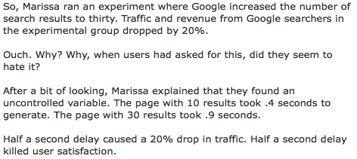
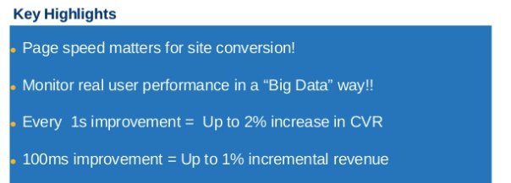

Motivation – Performance Matters
[1]: https://blog.mozilla.org/metrics/2010/03/31/firefox-page-load-speed-part-i/
[2]: http://glinden.blogspot.de/2006/11/marissa-mayer-at-web-20.html
[3]: https://www.slideshare.net/devonauerswald/walmart-pagespeedslide (Slide 46)
[1]
[2]
[2]
[3]
Notes:
Amazon: 100ms improvement in page response -> +1% revenue
Google: 10 to 30 results per page -> 0.4 to 0.9 load time -> 20% drop in traffic
Mozialla Firefox: 1 Second increase in page load time -> -2.7% in conversion rate for downloading the browser

Slide 4
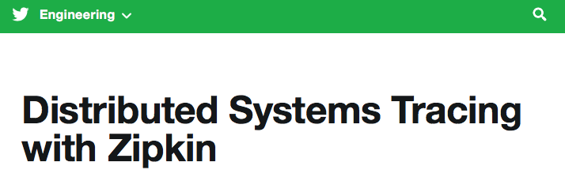

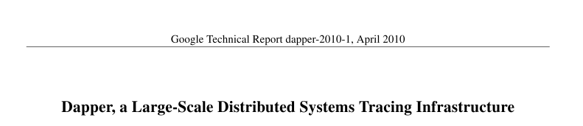


Motivation – distributed tracing is everywhere
[1]
[1]: https://blog.twitter.com/engineering/en_us/a/2012/distributed-systems-tracing-with-zipkin.html
[2]: https://static.googleusercontent.com/media/research.google.com/de//pubs/archive/36356.pdf
[3]: https://engineeringblog.yelp.com/2016/04/distributed-tracing-at-yelp.html
[4]: https://eng.uber.com/distributed-tracing/
[5]: https://medium.com/@Pinterest_Engineering/distributed-tracing-at-pinterest-with-new-open-source-tools-a4f8a5562f6b
[3]
[2]
[5]
[4]

Slide 5
Problem Statement
Use distributed tracing data to detect anomalies
Detect performance anomalies and system errors
Use distributed tracing data to derive information about the dependencies between the services and use those to detect the root cause of a set of anomalies

Slide 6
Research Questions
RQ1: What is a valid architecture for supporting anomaly detection in a service oriented and distributed environment based on distributed traces?
RQ2: What are features required to detect performance anomalies?
RQ3: Which algorithms for anomaly detection are suitable for the chosen environment?
RQ4: How can a root-cause analysis be performed based on the discovered anomalies and the component dependencies derived from distributed traces?
?
?
?
?
Notes:
Old rq:
RQ1: What is a valid architecture for supporting anomaly detection in a service oriented and distributed environment?
RQ2: What are features required to detect performance anomalies?
RQ3: Which algorithms for anomaly detection are most suitable for the chosen environment?
RQ4: How can a root-cause analysis be performed based on the discovered anomalies and the component dependencies?

Slide 7
What is an anomaly?
“Change in the variable characterizing the behavior of the system caused by specific and non-random factors”

Slide 8
What is an anomaly?
There are different views on the scope of an anomaly. Laptev et al 2015 define three different categories in their work:
An Outlier is a single data point in a time-series. Its value deviates significantly from the value that is expected at this point.
An anomalous time-series deviates in its behavior significantly from others in a set of time-series that are expected to display similar behavior.
A Changepoint is a point in a time-series that marks the border where afterwards the behavior of a time-series is significantly different than before that point

Slide 9
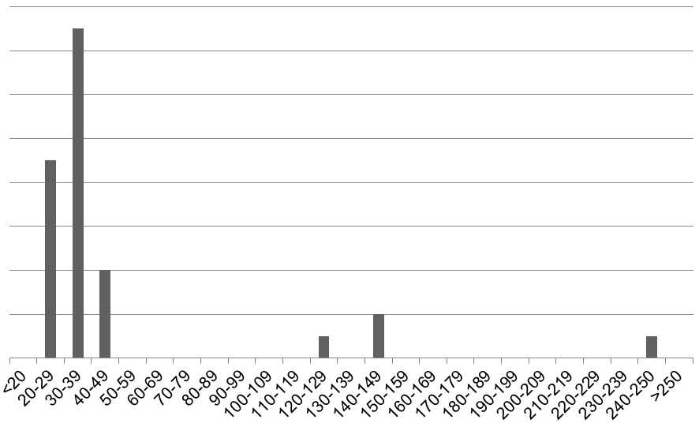


Anomalies to detect
Increased
Response Time
Fixed Threshold
Violation
Errors
Notes:
Systemoverload
Memory Leak
The anomalies detected in this thesis have the following characteristics:
Detection on a data point basis – Outlier detection
Three categories:
Deviating from a calculated normal baseline by a certain threshold that is measured through a distance function
Exceeding a fixed threshold
Displaying a known set of attributes that are identifying them as anomalous

Slide 10
Metrics used to detect anomalies in distributed systems
Found in literature:
Response time
CPU utilization
Memory utilization
Throughput in Requests/minute
I/O operations
Service reachability
Data throughput

Slide 11
Metrics used to detect anomalies in distributed systems
Used in the prototype:
Information on
Host
Service Name
Port
Endpoint URI
HTTP method
Controller Class and Method names
Response Time
Heap Utilization
CPU utilization
HTTP status codes
Error messages
(Request/Minute)

Slide 12
Algorithms for anomaly detection
Clustering (e.g. KMeans)
LOF (Local Outlier Factor)
Statistical distribution comparisons (e.g. Chi Squared)
Neural Networks (e.g. Long Short Memory Network)
Pattern recognition
Fixed Thresholds
ARIMA (Autoregressive integrated moving average)
Seasonality Predictors (e.g. Seasonal Trend Decomposition based on Loess)

Slide 13
Distributed Tracing
A trace is the tree of spans that are required to serve a request.
A span represents a unit of work. This could be for example a sent HTTP request from a client or the processing of such a request in a controller class.

Slide 14
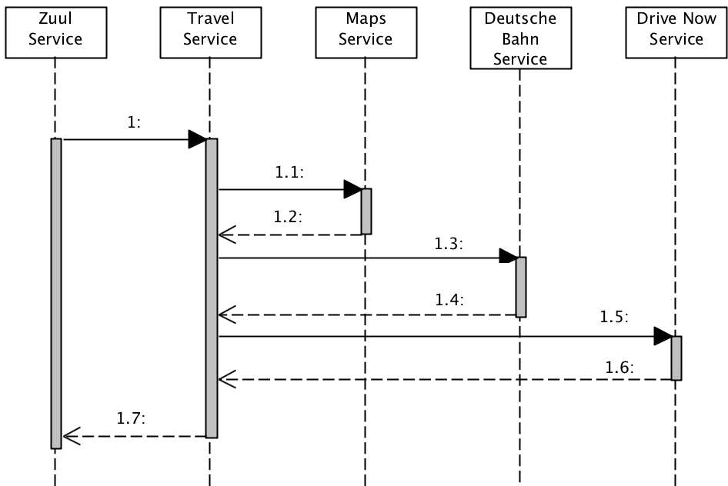
Distributed Tracing – example sequence

Slide 15
Distributed Tracing – Simplified Trace Tree
Span ID:
Trace ID:
Parent ID:
Begin:
End:
Service:
3
999
2
1015
1020
Map
Span ID:
Trace ID:
Parent ID:
Begin:
End:
Service:
1
999
Null
1000
1100
Zuul
Span ID:
Trace ID:
Parent ID:
Begin:
End:
Service:
2
999
1
1010
1090
Travel
Span ID:
Trace ID:
Parent ID:
Begin:
End:
Service:
4
999
2
1030
1050
Dt. Bahn
Span ID:
Trace ID:
Parent ID:
Begin:
End:
Service:
5
999
2
1065
1085
Drive Now

Slide 16
Approach
For this thesis the goal is to:
Enhance the tracing instrumentation to get additional metrics
Create a prototype to monitor distributed traces for anomalies
Use the trace data to identify the dependency structure of the service calls and use this information to identify the root cause of a set of anomalies
Create a simple visualization of the identified root cause in the context of the structure of the microservices
Evaluate whether the predefined target anomalies can be detected

Slide 17
Instrumented Architecture – Book your journey
Drive Now Mobility
Maps Helper
Deutsche Bahn Mobility
Business Core
Travel Companion Mobility
Accounting Core
Eureka
zuul
Config
service
uses
service

Slide 18
The Pipeline
Extract Information
Prepare Data
Detect Anomalies
Find the Root Cause
Visualize
Notes:
Import from Kafka
Run various types of anomaly detection
Aggregate the occurrences of anomalies
Separate into Anomalies and warnings depending on the architecture/call hierarchy

Slide 19
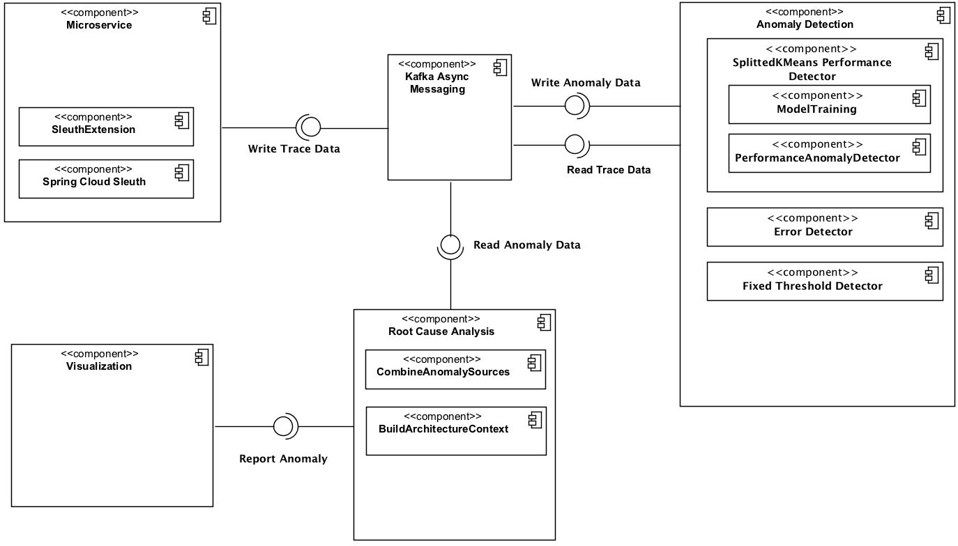





Anomaly Detection Architecture
Notes:
Additional Instrumentation for retrieving data from the application
Anomaly detection with different plugin detectors
Root Cause Analysis based only on the information retrieved from the application instrumentation
Visualization of the results
Asynchronous Communication between the modules → Modules interchangeable as long as they speak the same message language or the imports are adjusted accordingly

Slide 20
Anomaly Detection Pipeline
Span
Import
Error Detection
Report
Anomaly
Fixed Threshold
Increased
Response Time
Notes:
Additional Instrumentation for retrieving data from the application
Anomaly detection with different plugin detectors
Root Cause Analysis based only on the information retrieved from the application instrumentation
Visualization of the results
Asynchronous Communication between the modules → Modules interchangeable as long as they speak the same message language or the imports are adjusted accordingly

Slide 21
Root Cause Analysis
Service A
Service B
Service C
Service E
Service D
Notes:
Assumption:
If an anomaly happens further down the call hierarchy, it could affect the calling services
Performance: If a service further down the call stack takes longer than usual, all the calling services will take longer as well
Exceptions: If an uncaught exception is thrown in a service fruther down the call stack, this exception will propagate through the call stack.
The anomalies down the call trace should be emphasised the most when reporting/viewing them
As there could be anomalies additionally to the propagated effects, the detected anomalies should be reported with lower emphasis than the potential root causes

Slide 22
Root Cause Analysis
Service A
Service B
Service C
Service E
Service D
Notes:
Assumption:
If an anomaly happens further down the call hierarchy, it could affect the calling services
Performance: If a service further down the call stack takes longer than usual, all the calling services will take longer as well
Exceptions: If an uncaught exception is thrown in a service fruther down the call stack, this exception will propagate through the call stack.
The anomalies down the call trace should be emphasised the most when reporting/viewing them
As there could be anomalies additionally to the propagated effects, the detected anomalies should be reported with lower emphasis than the potential root causes

Slide 23
Root Cause Analysis
Import
Anomalies
Merge by
Span ID
Group by
Trace ID
Build
Trace
Tree
Report leaves as
anomalies and their
path to the root as
warnings
Degrade
Warnings
Notes:
Importing Anomaly Data from Kafka
Combine errors if different Detectors have reported the same Span
Group by TraceId
Create an anomaly tree for each Trace based on parent/child relationships (if those are present – not necessarily as not the whole trace but only the anomalous spans are available) or the assumption that a child spans begin and end is between the begin and end of its parent.
The leaves of the tree are classified as real anomalies and the anomalies in the path to the root are classified as warnings as they might be just the result of the anomaly further down the call hierarchy
Write each anomaly and its related warnings to a database
In this step the architecture discovery developed by Patrick Schäfer in his master thesis could be integrated to build the trees as well.

Slide 24
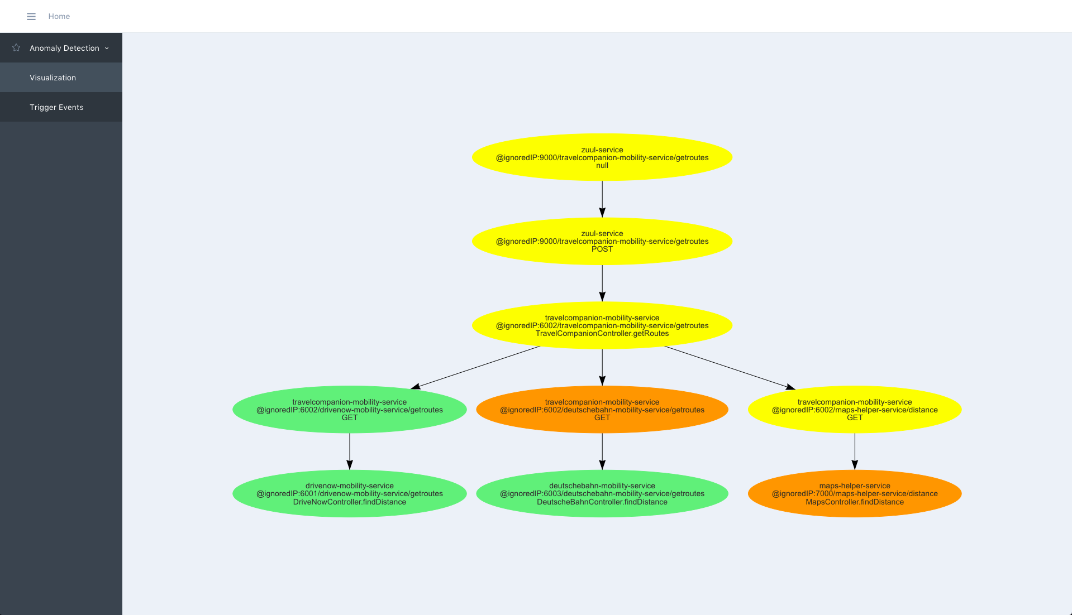
Live Demo

Slide 25
Evaluation
The evaluation is performed using JMeter as a tool to generate calls to an endpoint
Selected Endpoint involves 4 business services (+ zuul) into processing the request
The training set is generated by calling the endpoint 20k times resulting in a set of 180k spans – 9 spans per trace.
The application is started and trained with the generated data
5 Tests are performed:
No injections (Testing for false postives) – 500 calls
100ms delay injected to a 10ms request - 100 calls
50ms injected to a 10ms request – 100 calls
Nullpointer exception injected – 100 calls
High CPU Utilization values injected – 100 calls
During the process of checking 500 normal and 400 anomalous requests, 395 of those anomalies were detected and 25 False Positives were reported
Notes:
The information from a open source distributed tracing library can be used to detect anomalies in regards of performance, errors and Service Level Agreements
Including system level measures instead of relying only on distributed traces could improve the quality of the tracked performance measures and decrease the impact of the distributed tracing environment (e.g. CPU tracking can be very expensive)
Advantage: You could plug in any anomaly detection algorithm that can be implemented for a Spark Streaming Application – even several performance anomaly algorithms in parallel – and combine those reported spans in the root cause analysis step

Slide 26
Results
Prototype is capable of detecting all the targeted anomaly types
Capable of creating a dependency context between reported anomalies and report a root cause based on this information
Highly adaptable through modular approach – “plug in” new detection algorithms, exchange stages as long as the message format is kept similar
Algorithms are only using information from distributed tracing
Built completely on open source frameworks
+
+
+
+
+
Notes:
The information from a open source distributed tracing library can be used to detect anomalies in regards of performance, errors and Service Level Agreements
Including system level measures instead of relying only on distributed traces could improve the quality of the tracked performance measures and decrease the impact of the distributed tracing environment (e.g. CPU tracking can be very expensive)
Advantage: You could plug in any anomaly detection algorithm that can be implemented for a Spark Streaming Application – even several performance anomaly algorithms in parallel – and combine those reported spans in the root cause analysis step

Slide 27
Limitations
Evaluated on a small scale demo application
Decisions on Anomalies and Warnings are made on a trace basis – there is no “big picture” for validation
Access to system level metrics sometimes painful or not possible from within the tracing instrumentation
Visualization very basic
!
!
!
!

Slide 28
B. Sc.
Lukas Steigerwald
Master Student Information Systems
Lukas.steigerwald@tum.de

Slide 29
Backup Slides

Slide 30
Building Hierarchy from Span Information
Case 2
Case 3
Controller
Controller
HTTP-Request
HTTP-Request
Controller
HTTP-Request
Case 1

Slide 31
Evaluation – the approach
The evaluation is performed using JMeter as a tool to generate calls to an endpoint
Selected Endpoint involves 4 business services (+ zuul) into processing the request
The training set is generated by calling the endpoint 20k times resulting in a set of 180k spans – 9 spans per trace.
The application is started and trained with the generated data
5 Tests are performed:
No injections (Testing for false postives) – 500 calls
100ms delay injected to a 10ms request - 100 calls
50ms injected to a 10ms request – 100 calls
Nullpointer exception injected – 100 calls
High CPU Utilization values injected – 100 calls
The anomalies are injected by setting a parameter that activates the anomalies in the instrumented application
For all tests, results are analyzed after the anomaly detection and after the root cause analysis
Notes:
The information from a open source distributed tracing library can be used to detect anomalies in regards of performance, errors and Service Level Agreements
Including system level measures instead of relying only on distributed traces could improve the quality of the tracked performance measures and decrease the impact of the distributed tracing environment (e.g. CPU tracking can be very expensive)
Advantage: You could plug in any anomaly detection algorithm that can be implemented for a Spark Streaming Application – even several performance anomaly algorithms in parallel – and combine those reported spans in the root cause analysis step

Slide 32
Evaluation – the result
During the process of checking 500 normal and 400 anomalous requests, 395 of those anomalies were detected and 25 False Positives were reported
Except for the 50ms injection (95% detection rate), all anomalies were detected
1.4% FP after root cause analysis for requests without injected anomalies
500 positives detected on injecting 100 requests with a 100ms delay:
100 are true positives
400 are propagated errors
When applying root cause analysis 175 anomalies are reported to the database – when removing all that have been identified as warnings before, the 100 real anomalies remain
For 50ms all anomalies are recorded on anomaly detection level together with 107 propagated errors – due to sorting problems of the root cause analysis, 5 of those were lost – 95% detection rate.
When injecting an exception, all those exceptions are detected – 278 positives before the root cause analysis (100TP, 100 propagated errors, 78 increased response time anomalies) – after the root cause analysis 15 reported anomalies remain, that are not eliminated as warnings
Injecting an increased CPU utilization (just as a number – not pushing up CPU in real) results in a 100% detection rate without any false positives before and after the root cause analysis
Notes:
The information from a open source distributed tracing library can be used to detect anomalies in regards of performance, errors and Service Level Agreements
Including system level measures instead of relying only on distributed traces could improve the quality of the tracked performance measures and decrease the impact of the distributed tracing environment (e.g. CPU tracking can be very expensive)
Advantage: You could plug in any anomaly detection algorithm that can be implemented for a Spark Streaming Application – even several performance anomaly algorithms in parallel – and combine those reported spans in the root cause analysis step

Slide 33
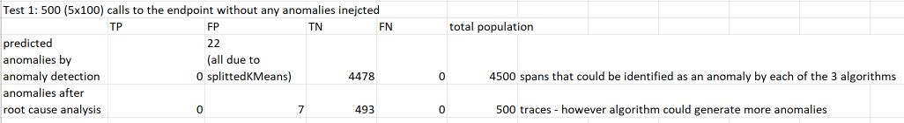
Evaluation – Test 1
Notes:
Additional Instrumentation for retrieving data from the application
Anomaly detection with different plugin detectors
Root Cause Analysis based only on the information retrieved from the application instrumentation
Visualization of the results
Asynchronous Communication between the modules → Modules interchangeable as long as they speak the same message language or the imports are adjusted accordingly

Slide 34
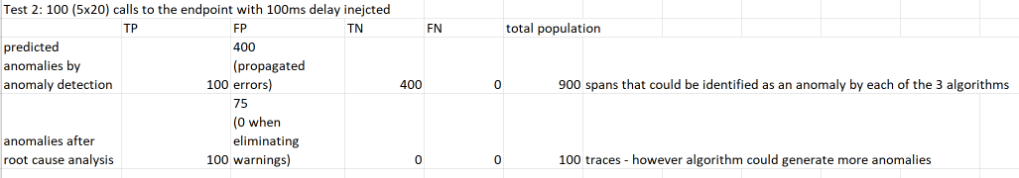
Evaluation – Test 2
Notes:
Additional Instrumentation for retrieving data from the application
Anomaly detection with different plugin detectors
Root Cause Analysis based only on the information retrieved from the application instrumentation
Visualization of the results
Asynchronous Communication between the modules → Modules interchangeable as long as they speak the same message language or the imports are adjusted accordingly

Slide 35
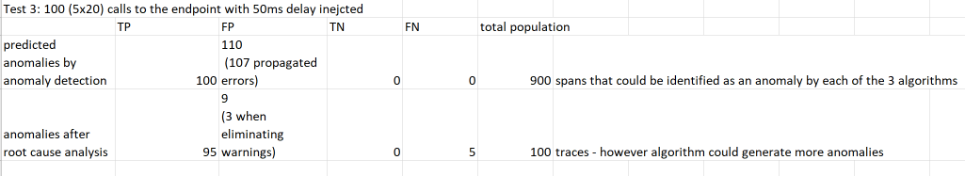
Evaluation – Test 3
Notes:
Additional Instrumentation for retrieving data from the application
Anomaly detection with different plugin detectors
Root Cause Analysis based only on the information retrieved from the application instrumentation
Visualization of the results
Asynchronous Communication between the modules → Modules interchangeable as long as they speak the same message language or the imports are adjusted accordingly

Slide 36
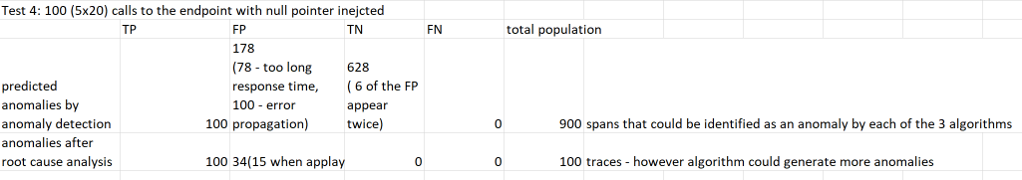
Evaluation – Test 4
Notes:
Additional Instrumentation for retrieving data from the application
Anomaly detection with different plugin detectors
Root Cause Analysis based only on the information retrieved from the application instrumentation
Visualization of the results
Asynchronous Communication between the modules → Modules interchangeable as long as they speak the same message language or the imports are adjusted accordingly

Slide 37
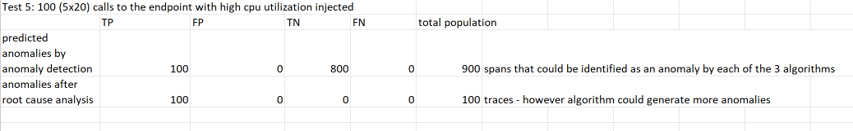
Evaluation – Test 5
Notes:
Additional Instrumentation for retrieving data from the application
Anomaly detection with different plugin detectors
Root Cause Analysis based only on the information retrieved from the application instrumentation
Visualization of the results
Asynchronous Communication between the modules → Modules interchangeable as long as they speak the same message language or the imports are adjusted accordingly

Slide 38
Anomaly Detection –SplittedKMeans
Apache Spark
Import Span Information as JSON from Kafka and convert to easy to use objects
Enhance information with request per minute/second information
Count on sliding window on timestamps of historical data
Splitting of data set using the categorical Tags – one data set per endpoint of the application
Using the lower 99.9% regarding span duration of the dataset as training set
Scaling duration values
Training KMeans model for each of the endpoints with k=1
Prediction model based on resulting centroid as reference point and the 99 percentile of the distances to this centroid as threshold
Open stream of incoming data for prediction
Enhance information with rpm/rps information through real sliding window on incoming data
Predict per incoming span whether it is an anomaly or not
Report anomalies to a separate kafka topic

Slide 39
Anomaly Detection – Error Detection
Import
Spans
Remove
Spans with
HTTP
Status Code
200 and 201
and without
Error tag
Remove Spans
with HTTP
Status Code
404
Remove
Spans with
HTTP
Status Code
400 and 500
and without
Error tag
Report
Anomaly
Notes:
Filter stream of incoming data for error tags set by Sleuth instrumentation
Filter for http status codes that are seen as not normal
Write the resulting anomalies to the same kafka topic as the other anomaly detection modules
➔ Identify the existence and the causing service of an exception

Slide 40
Anomaly Detection – Error Detection
Import
Spans
Remove Spans
without error
Remove error
Spans due to
users calling
nonexistent
endpoints
Remove error
Spans without
useful
information
Report
Anomaly
Notes:
Filter stream of incoming data for error tags set by Sleuth instrumentation
Filter for http status codes that are seen as not normal
Write the resulting anomalies to the same kafka topic as the other anomaly detection modules
➔ Identify the existence and the causing service of an exception

Slide 41
Anomaly Detection – Fixed Threshold for specific Tag
Import
Spans
Remove Spans
without
monitored tag
Compare tag
value against
threshold
Report
Anomaly
Notes:
Filter stream of incoming data for spans with the monitored tag
Compare the values of the tag to a predefined threshold
Write the resulting anomalies to the same kafka topic as the other anomaly detection modules
➔ Monitor adherence to Service Level Agreements (SLA)

Slide 42
Anomaly Detection and Root Cause Analysis Pipeline
Span
Import
Error Detection
Report
Anomaly
Root Cause
Analysis
Fixed Threshold
Splitted KMeans
Notes:
Additional Instrumentation for retrieving data from the application
Anomaly detection with different plugin detectors
Root Cause Analysis based only on the information retrieved from the application instrumentation
Visualization of the results
Asynchronous Communication between the modules → Modules interchangeable as long as they speak the same message language or the imports are adjusted accordingly

Slide 43
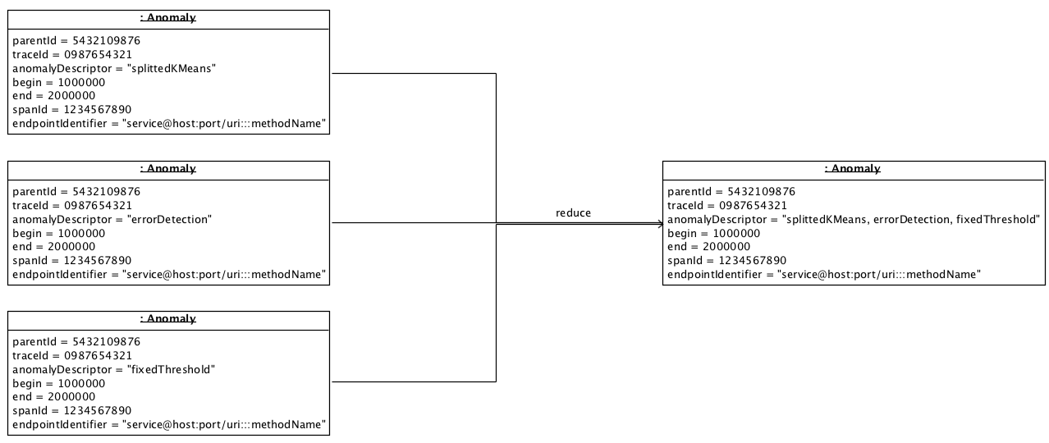
Reducing multiple times reported anomalies
Notes:
Additional Instrumentation for retrieving data from the application
Anomaly detection with different plugin detectors
Root Cause Analysis based only on the information retrieved from the application instrumentation
Visualization of the results
Asynchronous Communication between the modules → Modules interchangeable as long as they speak the same message language or the imports are adjusted accordingly

Slide 44
Microservice Instrumentation
Spring Cloud Sleuth enhanced with SleuthExtension
Filter → mvc spans
Interceptor → http spans
SpanAdjuster → all spans
Adds memory and CPU information to the spans
Include to Spring Boot Application as Maven Dependency and instantiate the beans in the configuration class of the application
Potential to add all the information that can be accessed from within the JVM
Ask Marcin which Logo to use when he is back from
holidays

Slide 45
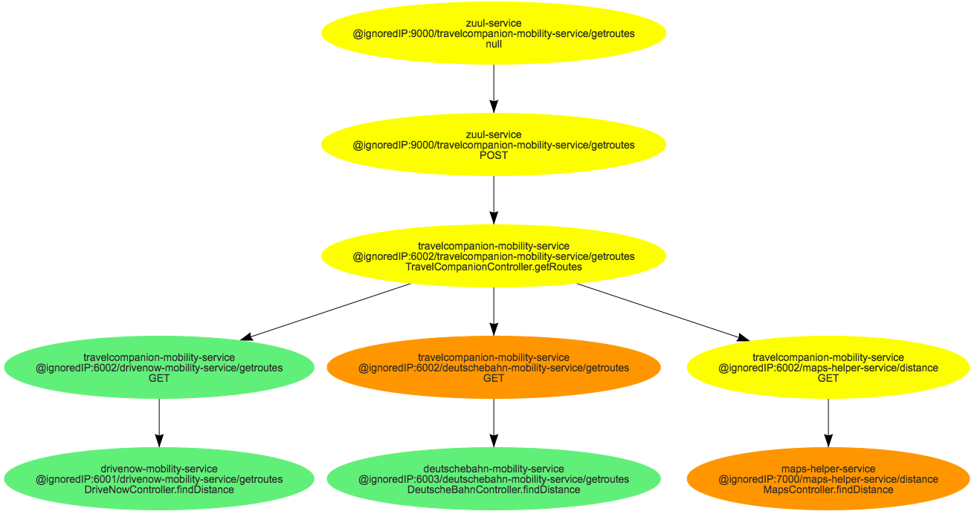
Basic Visualization
Render a static display of the application’s endpoint dependencies
Retrieve the anomalies from database through a simple REST API on a node.js server
Use this information to display anomalies in red, warnings in yellow and not affected endpoints in green

Slide 46

Asynchronous Communication between modules
Asynchronous communication through kafka topics
One topic for reporting data from Sleuth instrumentation from apps
One topic for detected anomalies
Can be accessed in two ways:
Read all the information that is currently in a topic → historical data
Read only the information that is just published → streamed data
MySQL database for reported anomalies

Slide 47
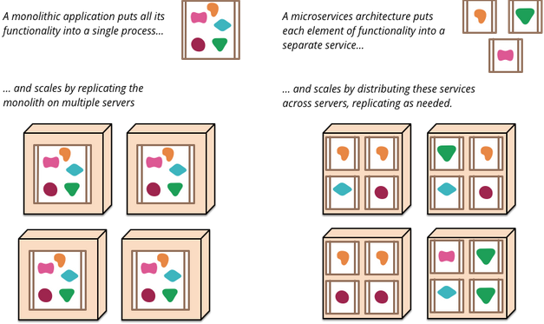
Microservices
“The business organization needs to be able to respond to disruptions quickly, they need to bring agility to their IT systems and infrastructure, at the same time business also craves stability.” – Yu et al. 2016
“[…]the microservice architectural style is an approach to developing a single application as a suite of small services, each running in its own process and communicating with lightweight mechanisms, often an HTTP resource API.” – Fowler, Lewis 2014
Fowler, Lewis 2014

Slide 48
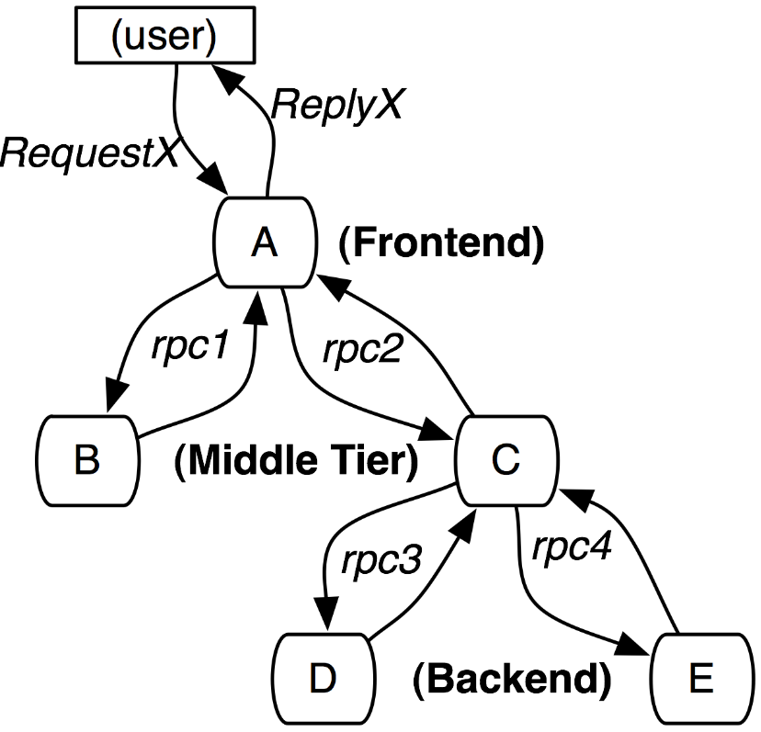
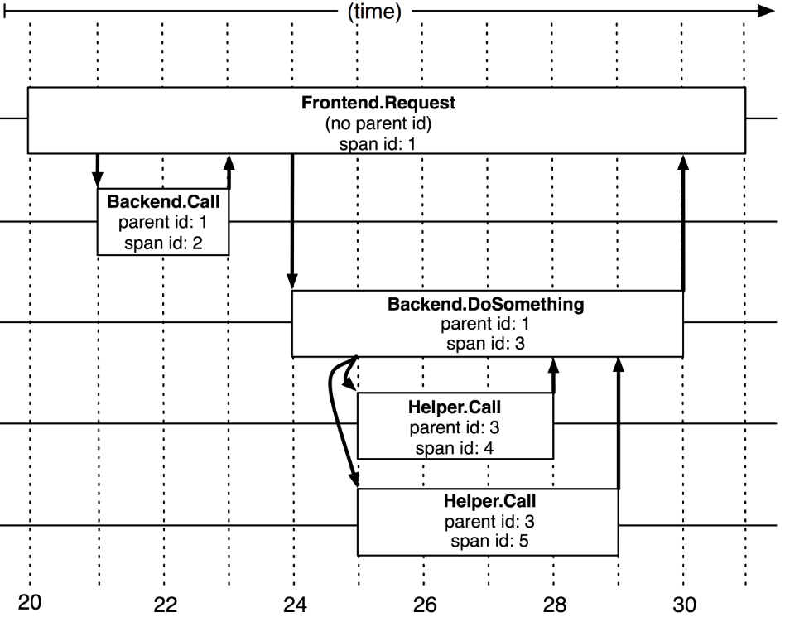
Distributed Traces
In distributed Systems information about function calls is first stored locally and later combined to a complete trace (Reynolds et al 2006, Sigelman et al 2010)
Services are instrumented (e.g. by Adapting a library that is commonly used for communication calls among services) and report information regarding incoming and outgoing communication to central repository (Sigelman et al 2010)
Alternative to instrumentation: passive network tracing in the form of port mirroring or packet sniffing (Aguilera et al 2003)
Sigelmann et al. 2010
Sigelmann et al. 2010
Notes:
Port mirroring , which is supportedbymanyswitchvendors, allows a switch to be configured to copy (“mirror”)someor all packets to a dedicated monitoring port. It allows us to treat application hosts entirely as black boxes (we need not install any software on those hosts) and should not perturb the system under test.
Packet sniffing at each participant host applies when the hosts support programs such as tcpdump [14]. After trace capture, the traces are merged in post-processing (see Section 6.5).

Slide 49
Anomaly Detection
Motivation
The revenue of a business that is running a large web page is directly impacted by the performance of this system (Kim et al 2013)
An increase in latency of web pages directly impacts the conversion rate (Linden 2006, Shalom 2008, Almossawi 2010)
# of Requests
Response time (ms)
Notes:
Motivation
The revenue of a business that is running a large web page is directly impacted by the performance of this system (Kim et al 2013)
An increase in latency of web pages directly impacts the conversion rate (Linden 2006, Shalom 2008, Almossawi 2010)
Approach
In unsupervised anomaly detection first an algorithm is trained with a set of normal examples – outliers are then detected by a distance measure that exceeds a certain threshold from the baseline
Possibility of Machine Learning or Statistical Approaches to detect Outliers (Solaimani et al 2014)
Challenge
“To retain trust in the automatic detection and alerting, a high classification quality (e.g., in terms of precision, recall, and related measures) is desired.” - Heger et al 2017

Slide 50
Root Cause Analysis
Performance anomalies will propagate themselves along the call hierarchy
Operations team needs to react quickly to anomalies
Use contextual information to point out the root cause of the detected anomalies
Sigelmann et al. 2010
Notes:
Little or no support for root cause analysis of performance problems in current APM tools for distributed systems (Heger et al 2017)
It is desirable to follow the call graph of the application to identify the root cause of the anomaly to enable the Operations team to quickly identify and deal with the issue at hand.

Slide 51
Basic Visualization
2107
2484
2677
2914
3157
3388
Maps - mvc
DN - mvc
DB - mvc
1639
2476
2489
2949
2952
3396
TC - http
TC - http
TC - http
1304
TC- mvc
3436
0669
3425
zuul - http
0666
zuul - none
3444

Slide 52
Building Hierarchy from Span Information
Map Service
Span ID: 3
Trace ID: 999
Parent ID: 2
DB Service
Span ID: 4
Trace ID: 999
Parent ID: 2
DN Service
Span ID: 5
Trace ID: 999
Parent ID: 2
Travel Service
Span ID: 2 – Trace ID: 999 – Parent ID: 1
Zuul Service
Span ID: 1 – Trace ID:999 – Parent ID: null
Time in ms

