Slide 1
Towards Understanding the User Interface Designer's Environment: An Empirical Approach
Peter Mortimer, 19.06.2017, Munich

Slide 2
Outline
Motivation
Research Questions
Approach
Current Progress
Notes:
Here’s the overview of my presentation.

Slide 3

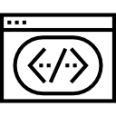

Motivation
Design
Development
Customer
UI Designer
Developer
Manager
Notes:
My Guided Research topic is motivated by the fact that there are many innovations in how data is represented to the user, for example if you consider the many frontend frameworks developed for the web.
And in the grander scheme of prototype-driven development, User Interface Mockups are essential to convert the ideas from the User Experience Designers to concrete user interfaces.
The common bottleneck in the design of user interfaces is the constant communication required between the UI Designer and the Developer.
But so far the is very little research on the current professional practices of UI designers in terms of their workflow and the development tools.
This is where my Guided Research fits in and I am going to focus on answering the following research questions.

Slide 4



Motivation
Design
?
Development
Customer
UI Designer
Developer
?
Manager
Notes:
My Guided Research topic is motivated by the fact that there are many innovations in how data is represented to the user, for example if you consider the many frontend frameworks developed for the web.
And in the grander scheme of prototype-driven development, User Interface Mockups are essential to convert the ideas from the User Experience Designers to concrete user interfaces.
The common bottleneck in the design of user interfaces is the constant communication required between the UI Designer and the Developer.
But so far the is very little research on the current professional practices of UI designers in terms of their workflow and the development tools.
This is where my Guided Research fits in and I am going to focus on answering the following research questions.

Slide 5
Research Questions
How do UI designers create UI mockups?
What are currently the state of the art UI design tools?
How does the communication between the developer and the UI designer work?
What are the main artifacts created in the UI design process?
Notes:
In general the research question are focused on understanding the workflow of UI Designers in able to come up with methods to improve the design and development process.
So the first research question is “How do UI Designers create UI mockups?”, which is closely linked with the second research question “What are currently the most popular User Interface Design tools?” both focus and understanding what type of tools are used by UI designers to create mockups. Knowing what tools the designers use enables us to come up with methods how to extend these tools to improve the overall process.
The next research question “How does the communication between the Developer and the UI Designer work?” focuses more on the workflow of the UI designer than his tools. Here the claim in the previous slide concerning the constant communication required between the UI Designer and Developer should be further analyzed and compared with current professional practices. We would better understand how great the communication bottleneck slows down the process and could come up with methods to solve these problems in the future.
The last two research questions “Do the current design tools offer useful export formats for developers?” and “What does an export file format require to easily be converted into a functioning User Interface?” focus on discovering the possibilities on how to automate the conversion of mockups to UI prototypes and to which degree the commonly used design tools discovered in the previous research questions lend themselves to automate some development steps.
Now that the we stated our research questions I will present the methodology I will apply during my Guided Research to answer these questions...

Slide 6
Approach
Exploratory Research
Gain deeper knowledge on the UI design process
Conduct a survey with a mix of open question types and quantitative questions
Empirical Research
Target audience: UI Designers working in Web & Mobile Design (customer-facing UI)
Questions are focused towards the respondent’s UI design process
[1] Claes Wohlin, Per Runeson, Martin Höst, Magnus C. Ohlsson, Bjöorn Regnell, and Anders Wesslén. 2000. Experimentation in Software Engineering: An Introduction. Kluwer Academic Publishers, Norwell, MA, USA.
Notes:
I am going to conduct my research using the Contextual Design methodology. Contextual Design is a user-centered design process developed by Karen Holtzblatt and Hugh Beyer. The Contextual Design approach is broken upon into many steps as I will present to you in the next slides, but I will first go through the following key principles that accurately describe the essence of what Contextual Design in based on.
“System design must support and extend users’ work practice” signifies that the new design should not hinder the user’s existing work practice, but build upon it.
“People are experts at what they do – but are unable to articulate their own work practice” shows that the user does know best what he wants, but this can only be discovered by communicating with the user directly
“Good design requires partnership and participation with users” adds to the second key principle, that as researcher applying Contextual Design means participating with the user and to critically question steps in the user’s workflow.
.

Slide 7












Approach – Target Audience
Online Survey (created in QuestBack)
11 Questions, 15 minutes to complete
Send to handpicked companies and freelancers (customer-facing Web & Mobile Design)
Companies
Freelancers
…
…

Slide 8
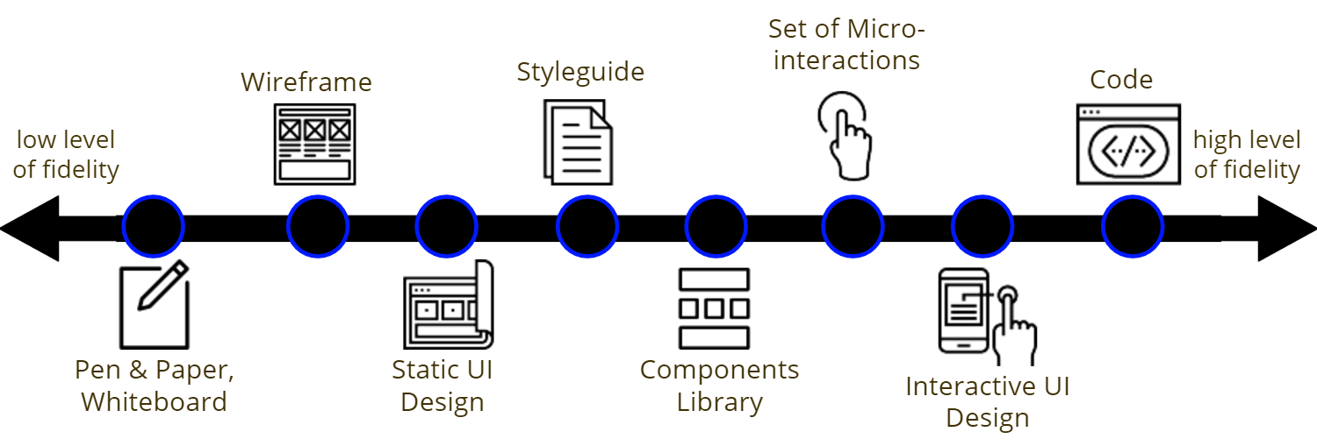
Approach – Prototype Scale
Artifact-driven view of the UI design process
Allows for a shared understanding of the possible design artifacts
Respondents then use these terms consistently throughout the survey

Slide 9
Current Progress
low response rate (5%)
Contact more companies/freelancers
Increase the response rate (phone, meetings,…)
Respondents are willing to describe their design process
Prototype scale is well understood by the respondents
Shortcomings in the design tools and the communication process are being mentioned

Slide 10
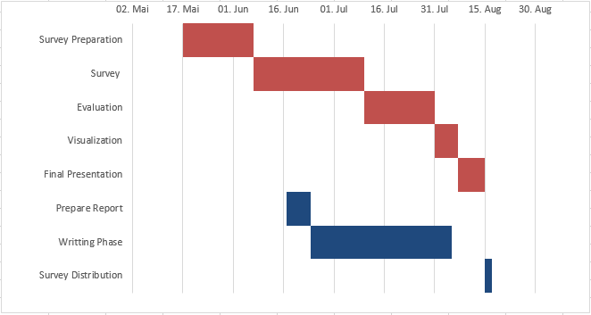
Current Progress
Task | Start | End
Survey Preparation | May 17 | June 7
Survey | June 7 | July 9
Evaluation | July 10 | July 31
Visualization | August 1 | August 7
Final Presentation | August 8 | August 15
Prepare Report | June 17 | June 24
Writing Phase | June 25 | July 29
Survey Distribution | August 15 | August 17

Slide 11
Peter Mortimer
17132
peter.mortimer@tum.de

