Slide 1
Master thesis: Automatic Extraction of Design Decision Relationships from a Task Management System Kick-Off
Matthias Ruppel, 8th of May 2017, Munich

Slide 2
Outline
Motivation and Theoretical Background
Research Questions
Observations
Research Approach
Timeline

Slide 3
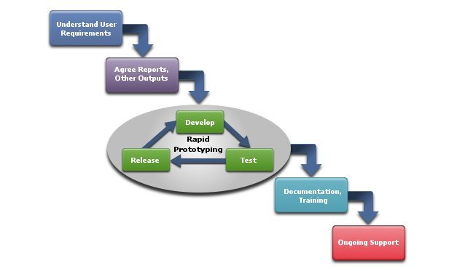
Introduction | Motivation
Many architectural design decisions are made during development & maintenance
Documenting takes a lot of effort, time & costs
Architectural design decisions are hard to capture
Current design decisions may interfere with previous design decisions
Implicitly taken, not explicitly captured & documented
Rational / Cause / Concern is not evident in the documentation
Source: http://www.bmtools.com/services/overview.html

Slide 4
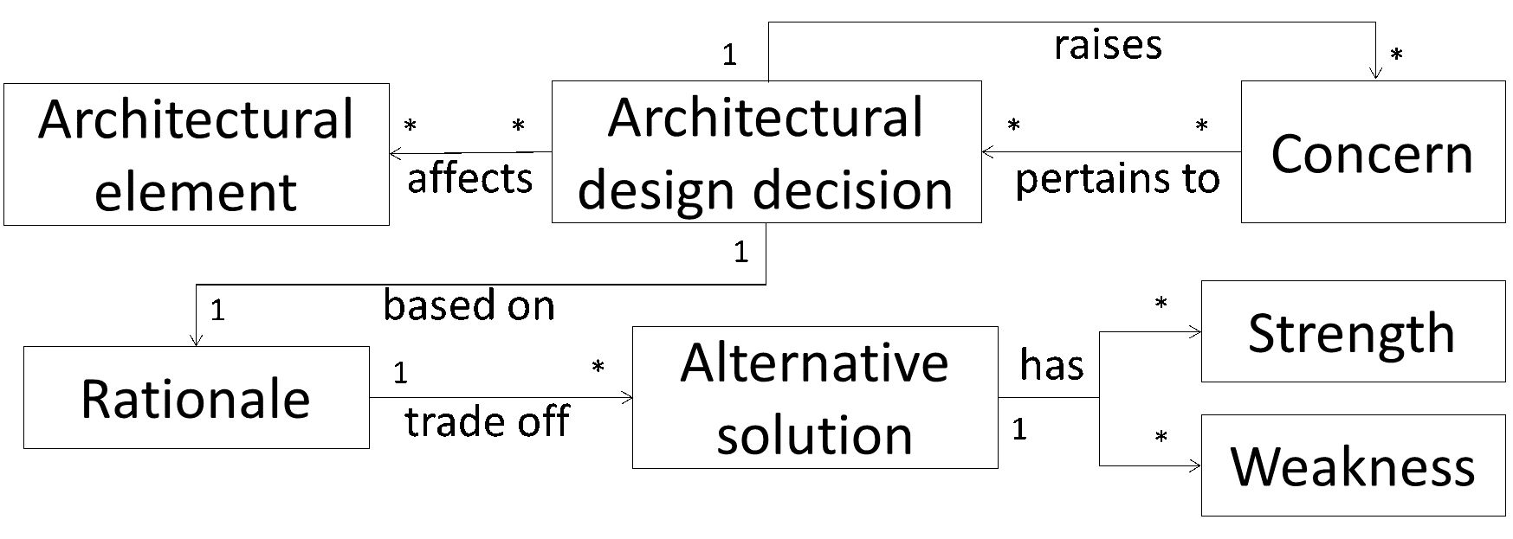
Architectural Design Decision
Definition
A description of the choice and considered alternatives that (partially) realize one or more requirements. Alternatives consist of a set of architectural additions, subtractions and modifications to the software architecture, the rationale, and the design rules, design constraints and additional requirements.
Source: Jansen, A. G. J. (2008). Architectural design decisions s.n.
Source: Zimmermann et. al. (2009). Managing architectural decision models with dependency relations, integrity constraints, and production rules
Notes:
design decision, which couples rationale with software architecture.
Design decisions are integrated with the software architecture design.
Design decisions only exist in the heads of the designers, which leads to the following problems:
Typical design decisions affect multiple parts of the design.
During the evolution of the system, designers can easily violate design rules and constraints arising from previously taken design decisions. Violations of these rules and constraints lead to architectural drift
When obsolete design decisions are not removed, the system has the tendency to erode more rapidly.
Also, the reusability of the architectural artifacts is limited if design decision knowledge vaporizes into the design.
Design decisions can also be classified according to different abstraction levels. Jansen [11] proposes a funnel of decision-making model to classify decisions at different abstraction levels such as software architecture, detailed design, and implementation. Van der Ven and Bosch relate to these abstraction levels as high-level, medium-level, and realization-level decisions.
=> Decisions extracted from the issue management systems belong to either medium-level or realization-level decisions.
An architectural design decision is defined as (follows: http://www.rug.nl/research/portal/files/2724654/c3.pdf)
A description of the choice and considered alternatives that (partially) realize one or more requirements. Alternatives consist of a set of architectural additions, subtractions and modifications to the software architecture, the rationale, and the design rules, design constraints and additional requirements.
The given architecture is a set of earlier made design decisions, which represent the architectural design at the moment the design decision is taken.
The rationale represents the reasons behind an architectural design decision.

Slide 5
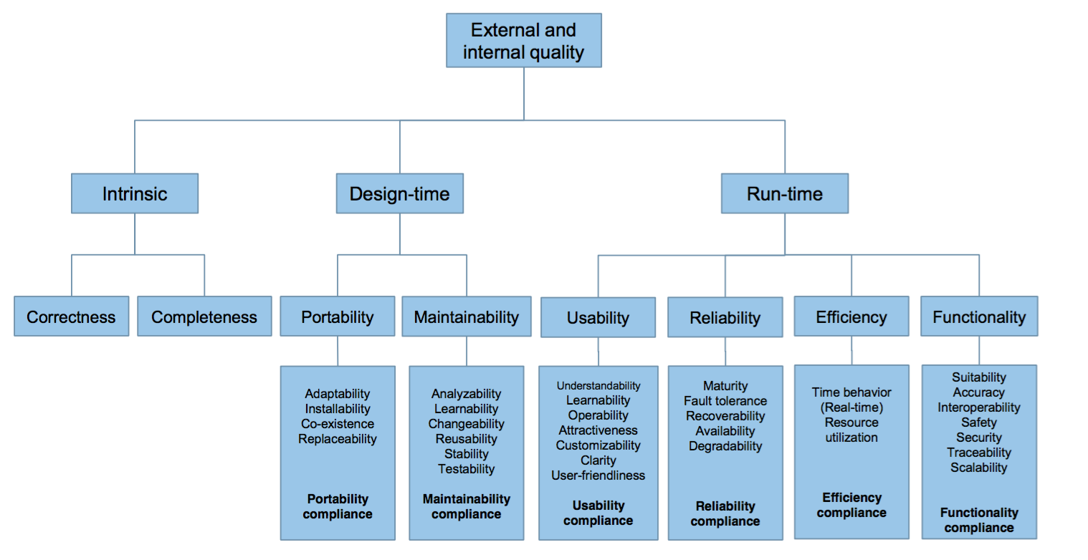
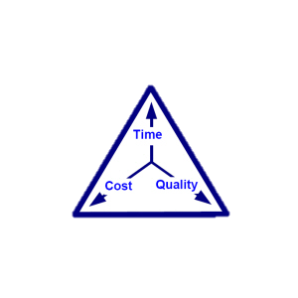
Non-Functional Requirements: ISO 9126-1 – Types of Quality
ISO 9126-1 classifies software quality in a structured set of characteristics and sub-characteristics. Each quality sub-characteristic is further divided into attributes.
But: Be aware of Tradeoffs
Source: SO/IEC 9126-1:2001 Software engineering - Product quality - Part 1: Quality model.

Slide 6
Observation: Keyword classification method
NFR type | Extracted Keywords
Security | Confidentiality, integrity, completeness, accuracy, perturbation, virus, access, authorization, rule, validation, audit, biometrics, card, key, password, alarm, encryption, noise
Performance | Space, time, memory, storage, response, throughput, peak, mean, index, compress, uncompress, runtime, perform, execute, dynamic, offset, reduce, fixing, early, late
Results
Dependent on Context
Only for a few NFRs
Relatively poor performance:
Security recall: 70%, precision: 32%
Performance recall 44%, precision: 21%
Source: Cleland-Huang et. Al. (2007). Automated classification of non-functional requirements

Slide 7
Observation: NFR-Classifier
NFR type | Selected Indicator terms from training set
Availability | Available, achieve, daily, time, hour, pm, year, downtime, long, product
Security | Online, access, author, user, inform, ensure, data, authentication, security, system, incorrect, product
Usability | Use, easy, user, train, product, able, understand, intuitive, learn, product
Results
“The product shall …”
Better performance for some NFRs:
Availability recall: 89%, precision: 11%
Security recall 81%, precision: 19%
Usability recall 98%, precision: 14%
Source: Cleland-Huang et. Al. (2007). Automated classification of non-functional requirements

Slide 8
Research Questions
Research Question 1
Research Question 2
How to automatically identify the rationale of an architectural design decision
What is the influence of an architectural design decision on the quality attributes

Slide 9
Research Approach
Literature review of previous work
Analysis of data set regarding Quality Attributes
Deviation and formalization of patterns
Implement a System to automatically extract the rational of the design decision
Evaluate the System with an unknown project

Slide 10
Timeline
May
June
July
August
September
Literature review
Analysis Dataset
Patterns | Classification
System Design & Implementation
Evaluation
Submission
Master
Thesis
Writing of Master Thesis

Slide 11
Matthias Ruppel
matthias.ruppel@tum.de

