Slide 1
Design and Implementation of a Templated based Task Board Bachelor Thesis Kick-Off Presentation
Langlechner, Lukas | 28.11.2016
Notes:
Supervisor : Manoj
CoSupervisor: Andreas Kipf from database chair

Slide 2
Agenda
Motivation
Key Requirements
Current Solutions
Idea
Mock-Up
Timeline

Slide 3
Motivation
Processes usually are not completely structured:
parts can be reused
deviations from schema still common
Goal: Developing a Task Board that supports templates as well as ad-hoc changes
Using templates to quickly start processes
Giving User freedom to change process instances

Slide 4
Key Requirements
Goal: Developing a template based Task Board
Key Requirements:
Templates for repeat Tasks
A way to sort Tasks
Changing Tasks on instance level
Support diversified Attributes
Allow free-form text in Tasks

Slide 5






Current Solutions

Slide 6
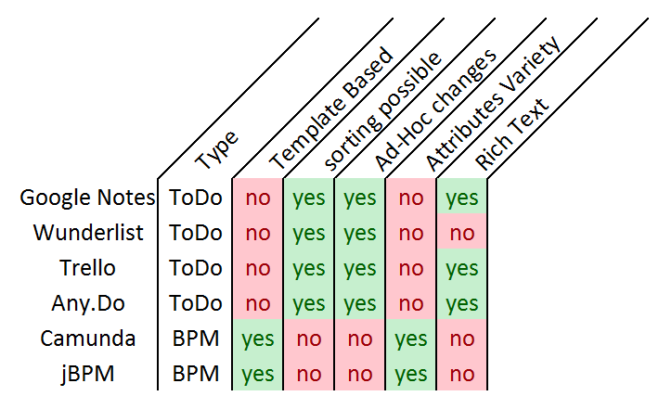
Current Solutions
Clear difference between BPM Systems and ToDo-Lists
→ Creating a Solution in-between

Slide 7
Idea
Using SocioCortex as the backend for this application
Tasks are already implemented
Different Attribute Types are supported
Rich Text is supported
EntityTypes can be used as Templates
→ Template creation can be outsourced to modeler

Slide 8
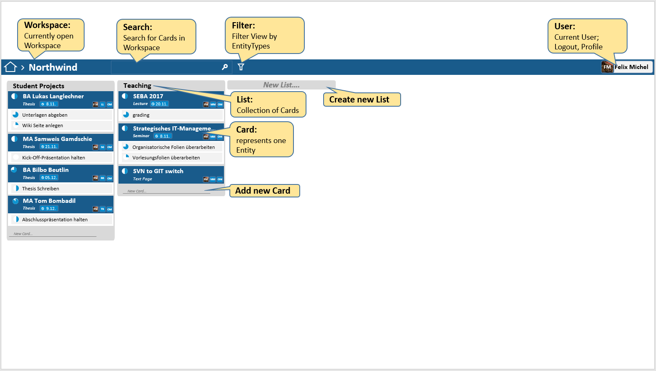
Mockup
Overview

Slide 9
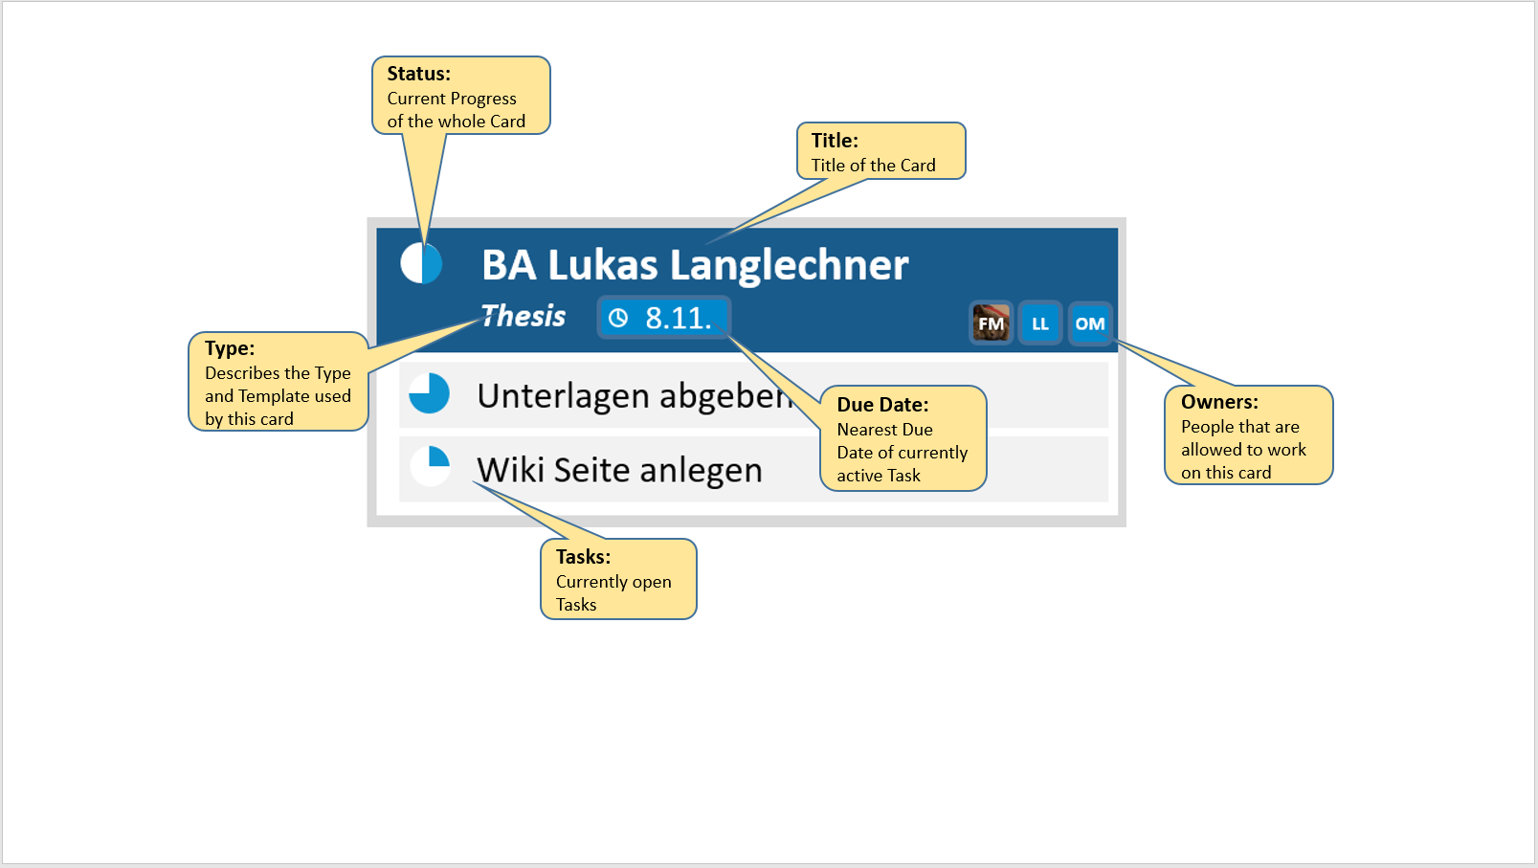
Mockup
Card – Small Version

Slide 10
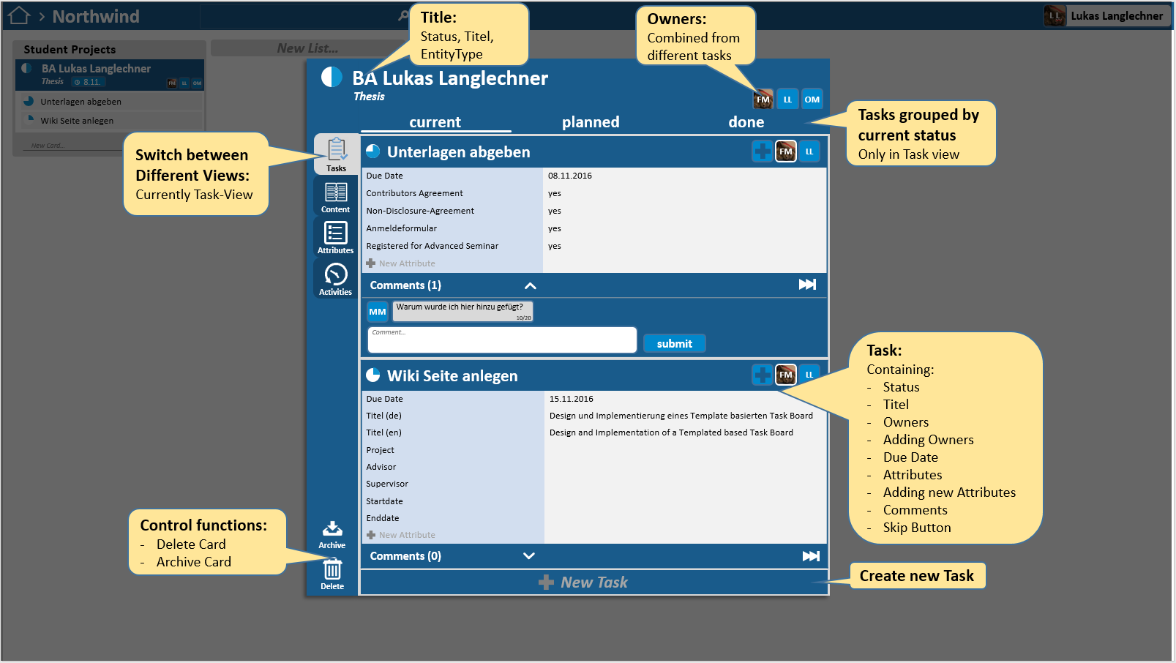
Mockup
Card - Task View

Slide 11
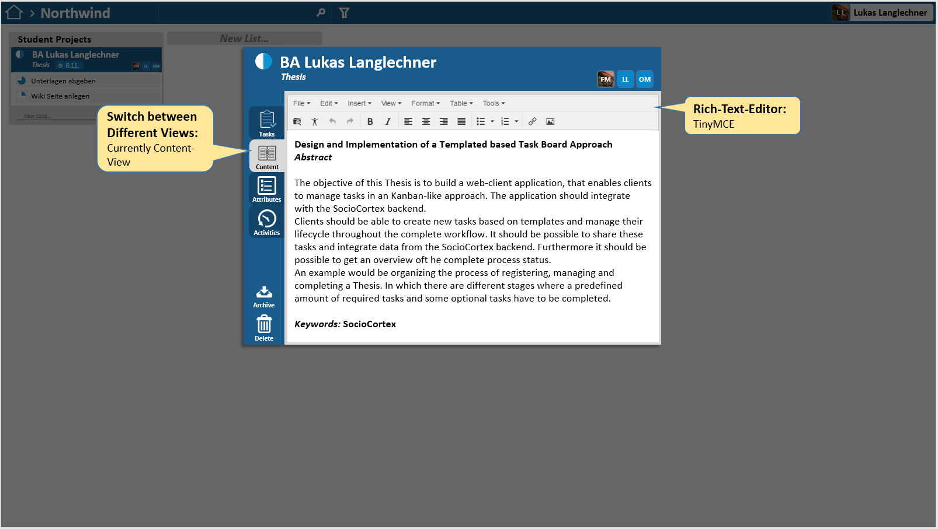
Mockup
Card – Content View

Slide 12
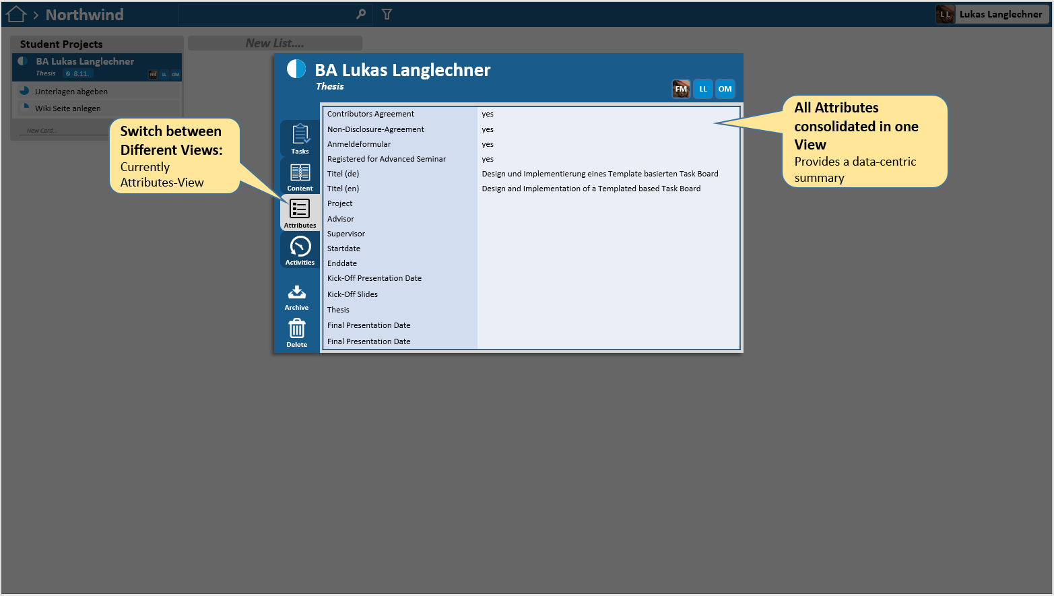
Mockup
Card – Attributes View

Slide 13
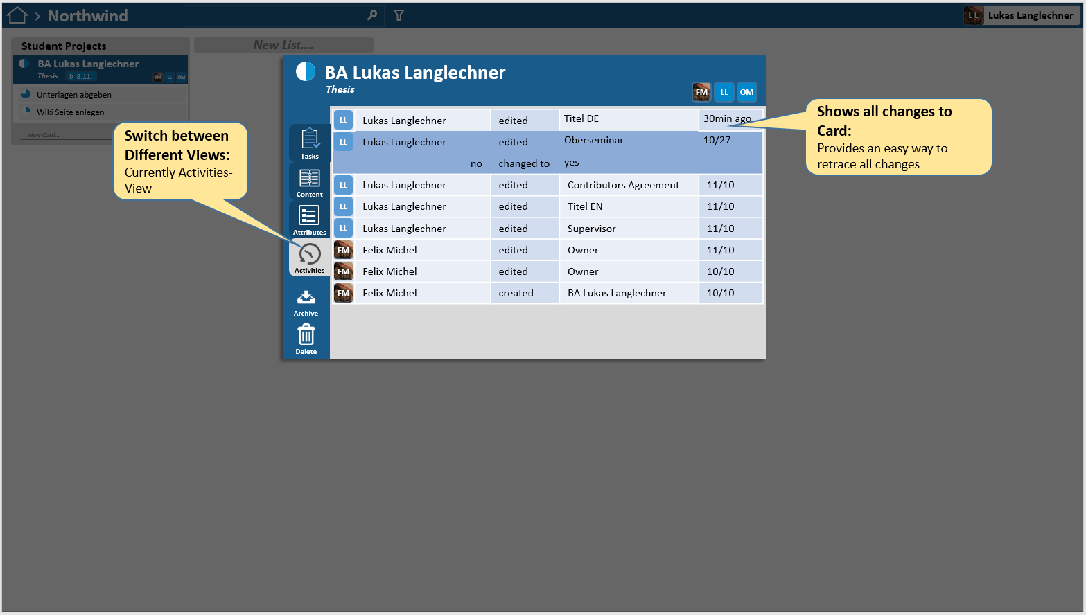
Mockup
Card – Activities View

Slide 14
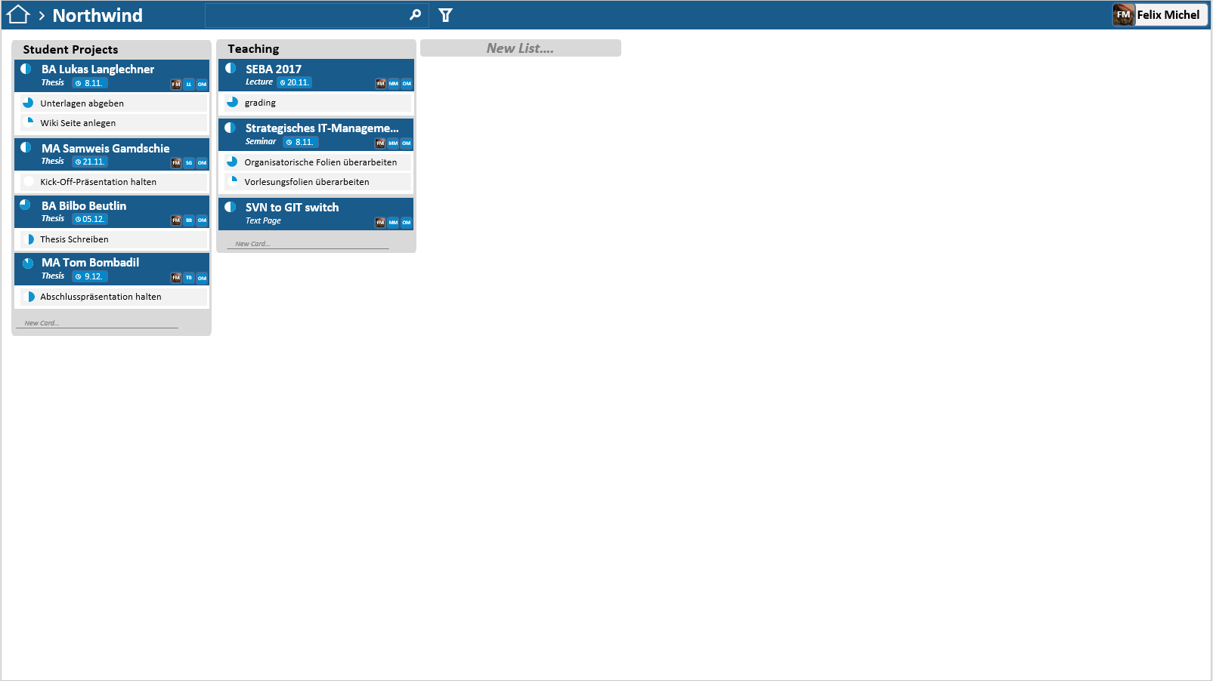
Mockup
Overview

Slide 15
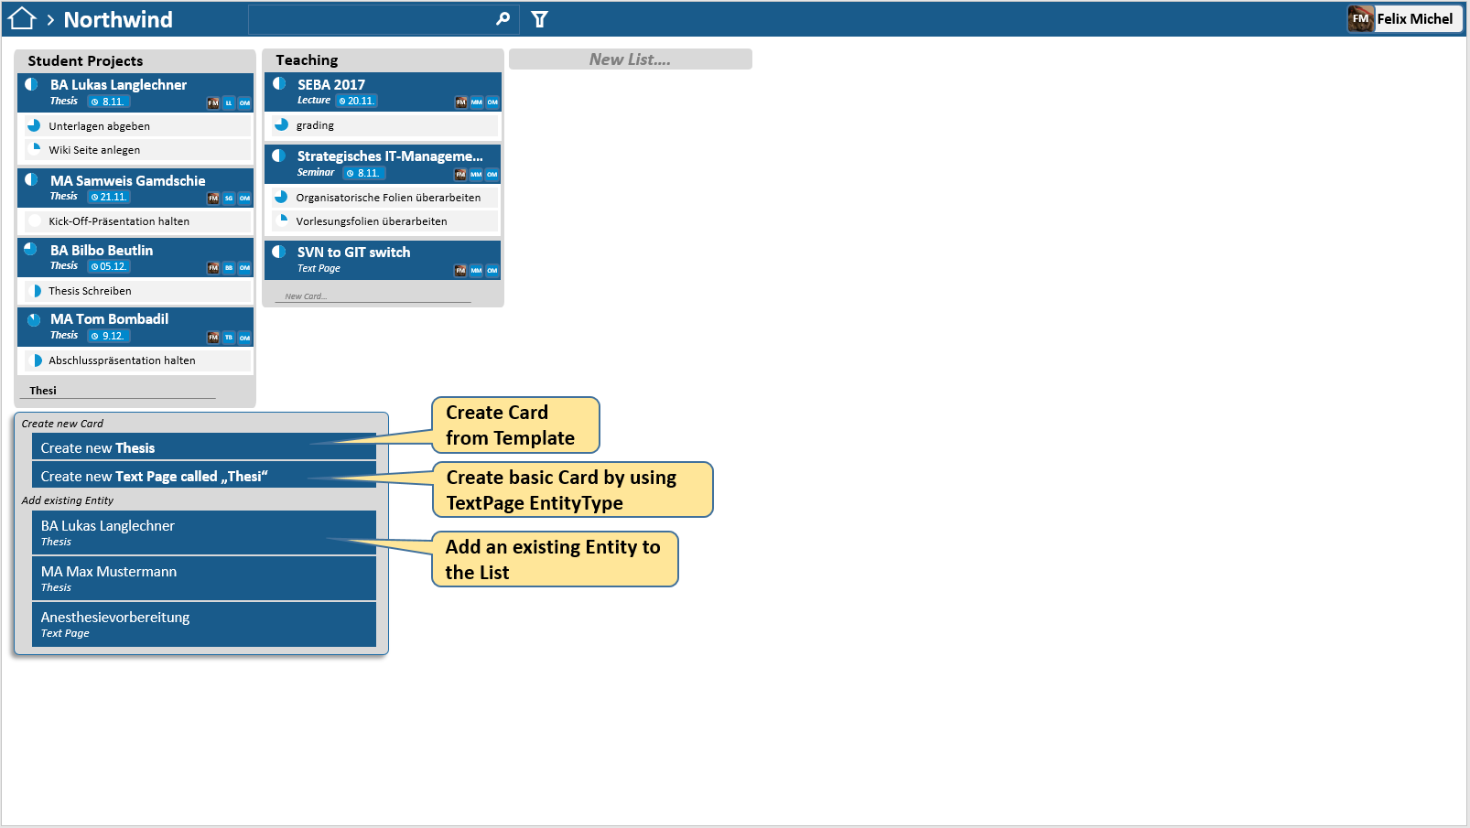
Mockup
Adding new Card

Slide 16
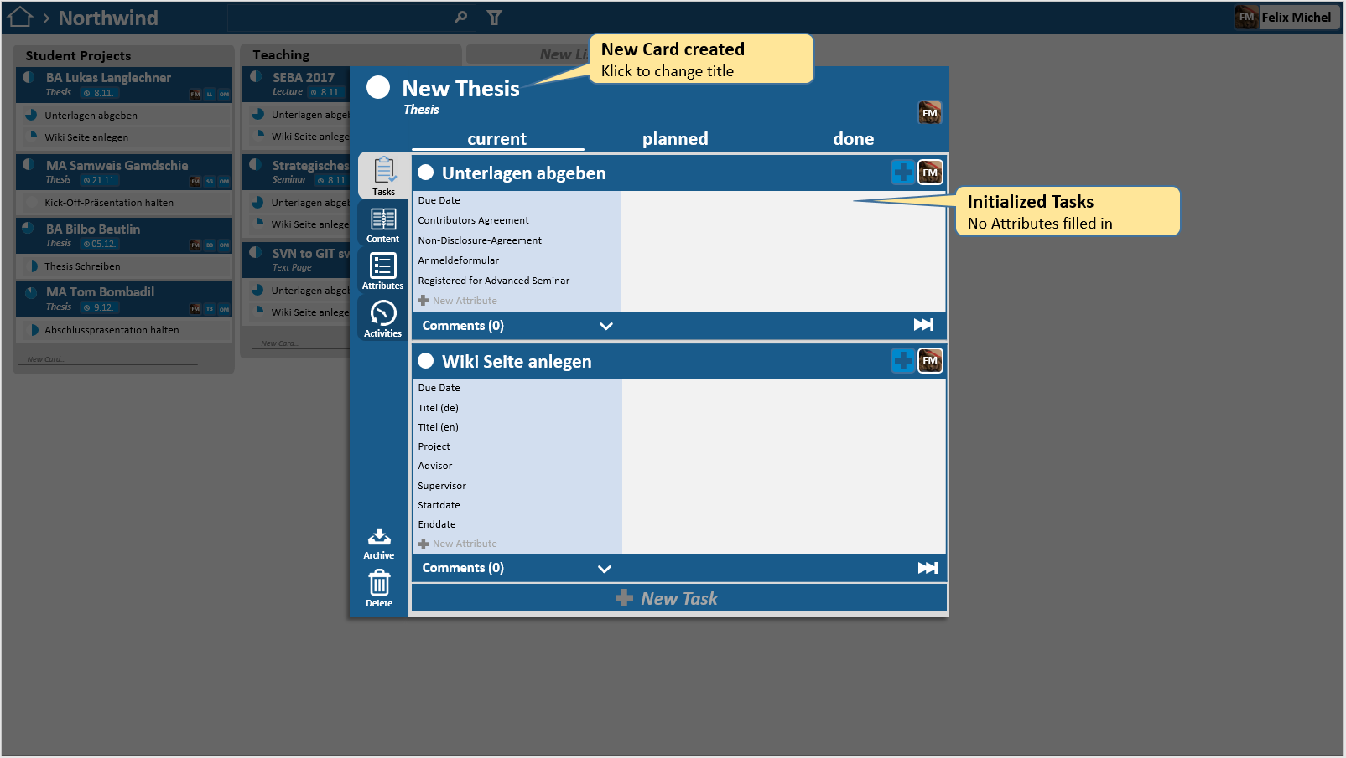
Mockup
Empty Card

Slide 17
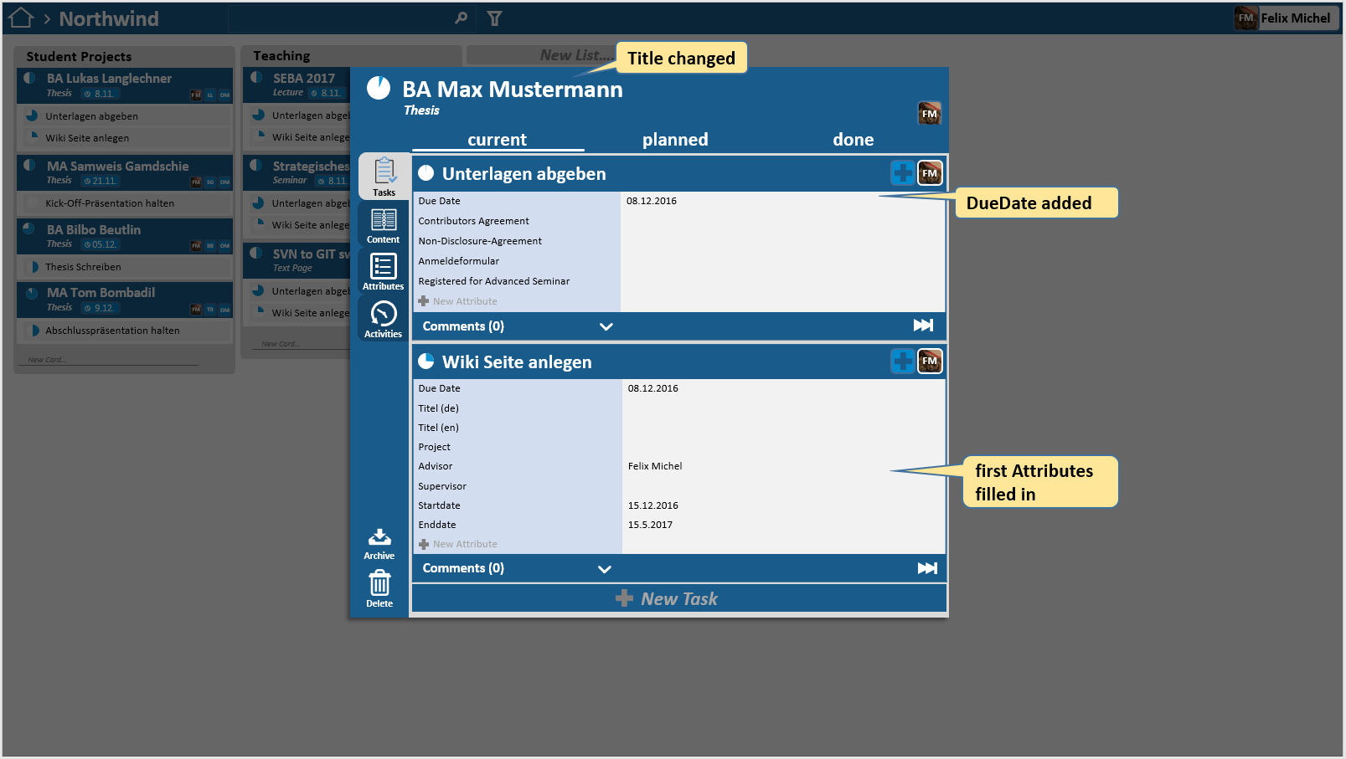
Mockup
New Name

Slide 18
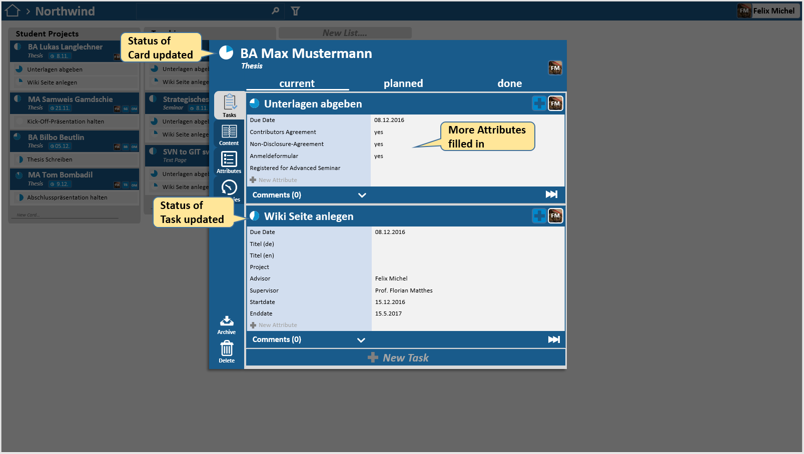
Mockup
Edited Attributes

Slide 19
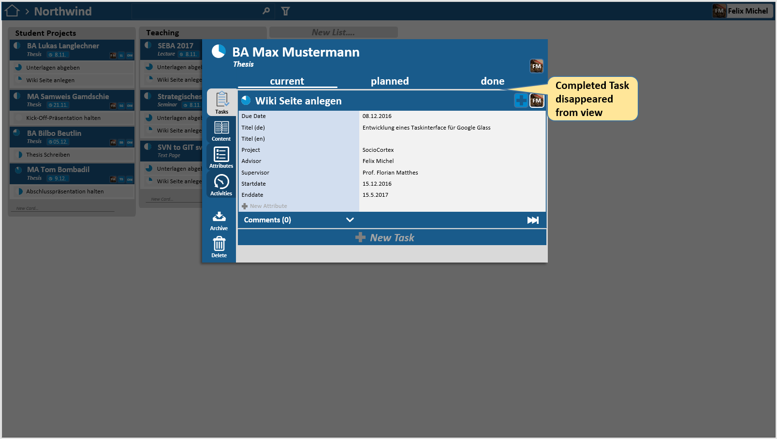
Mockup
Task Completed

Slide 20
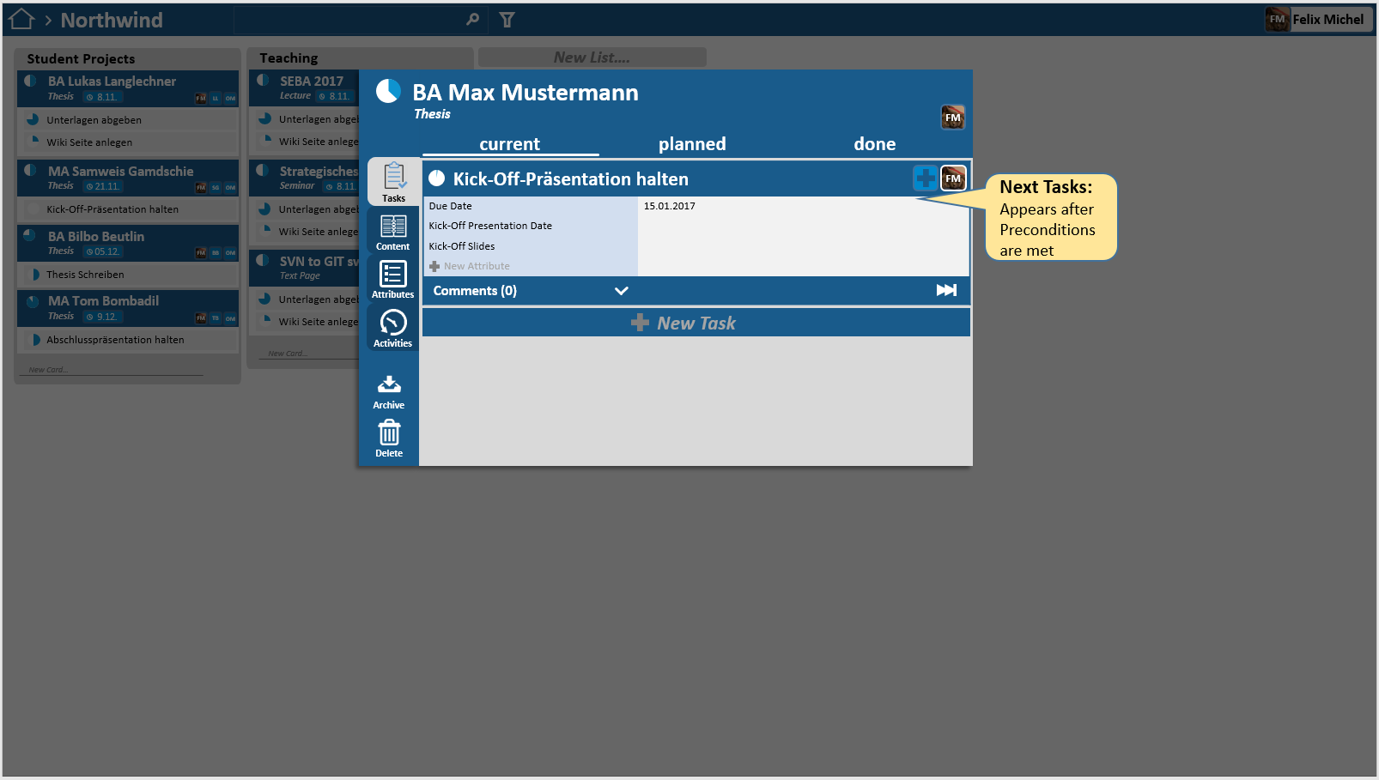
Mockup
Next Task

Slide 21
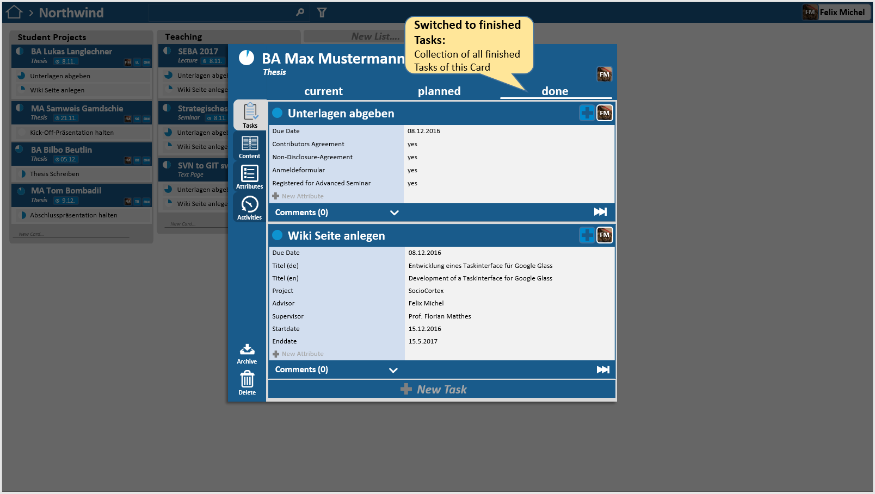
Mockup
Finished Tasks

Slide 22
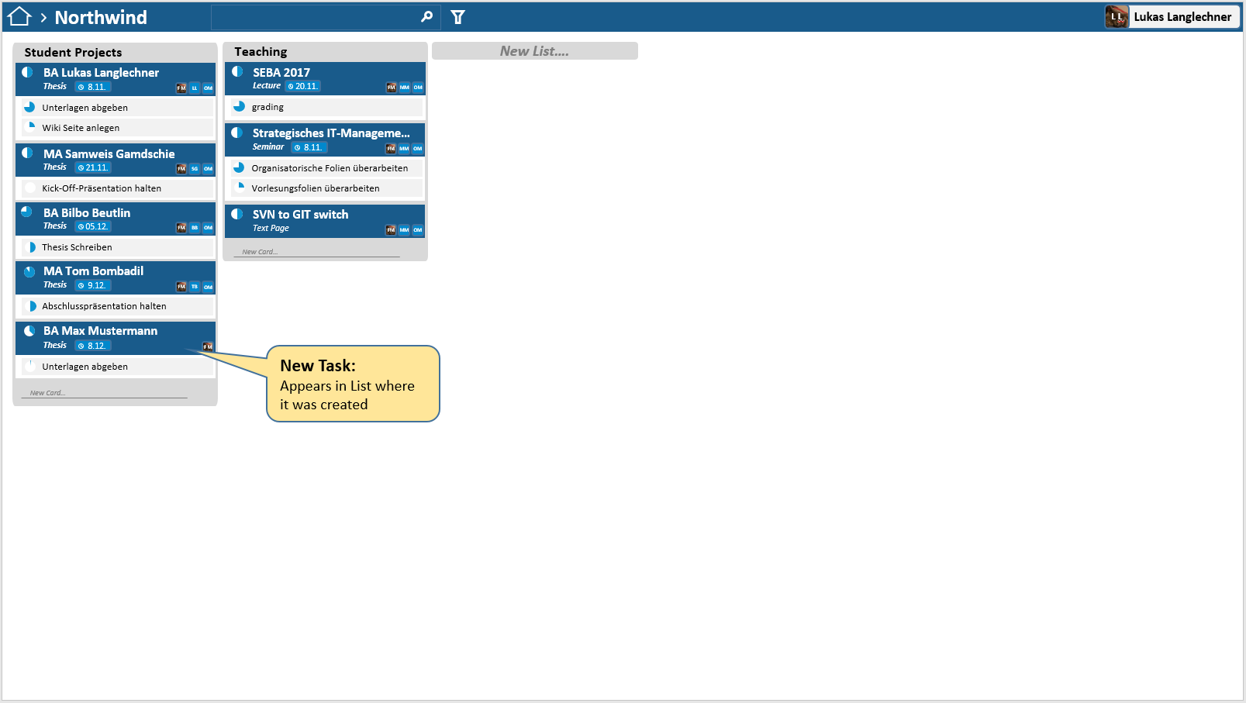
Mockup
New Overview

Slide 23
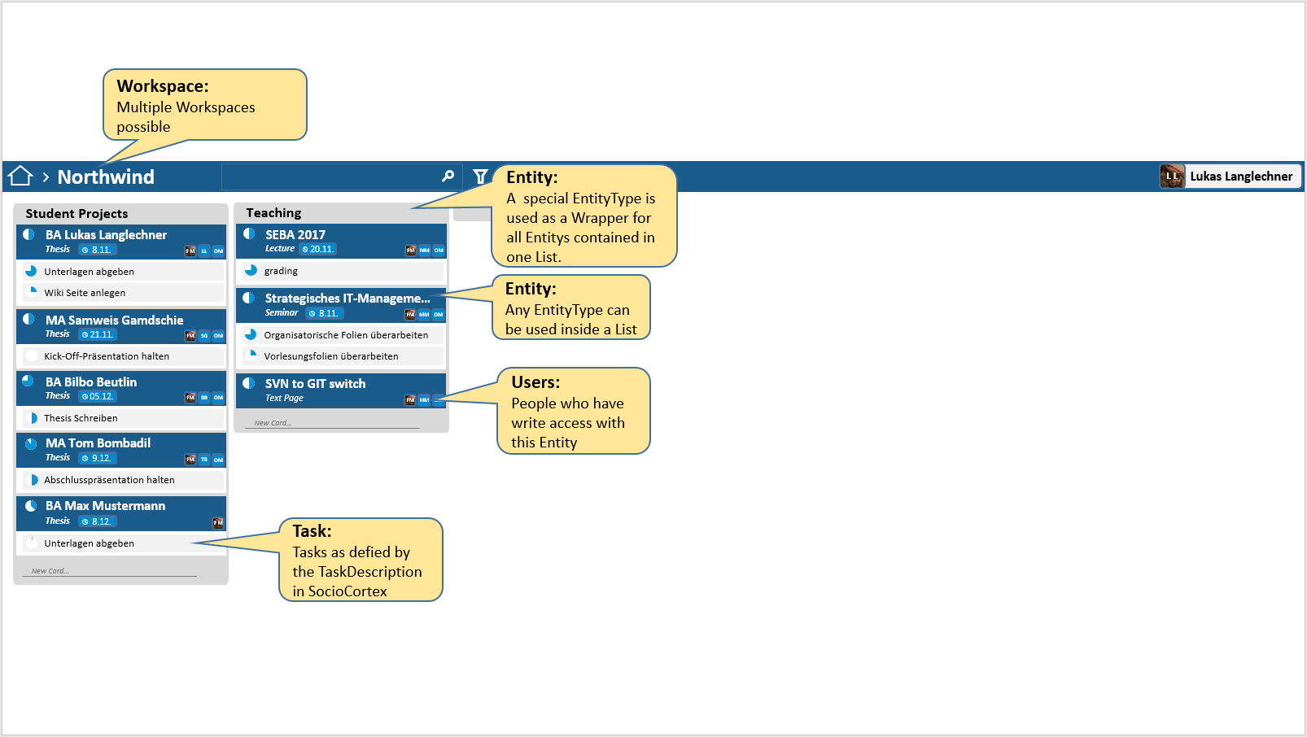
Mockup
Mapping to SocioCortex

Slide 24
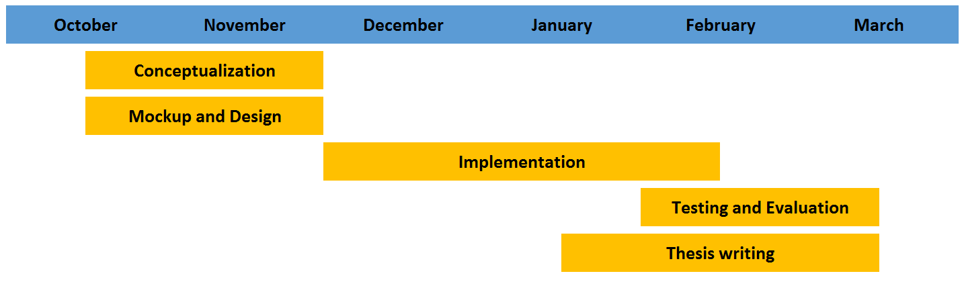
Timeline

Slide 25
Thank you for your attention!
Lukas Langlechner
BSc. Informatics Student
rose@in.tum.de

