Slide 1
Designing a business platform using Microservices
Rajendra Kharbuja, Master Thesis - Initial Presentation

Slide 2


Prof. Dr. Florian Matthes [Supervisor]
Manoj Mahabaleshwar [Advisor]
Andrea Stubbe
[Advisor]
Rajendra Kharbuja- Master Thesis

Slide 3
Agenda
1. Introduction
Motivation
Research Strategy
2 Basic Principles to identify good microservices
3. Basic Quality Metrics
4. Modeling microservices using Domain Driven Design
5. Modeling Microservices at SAP Hybris using interviews
6. Challenges of Microservices Architecture and ways to tackle them
7. Guidelines for implementing microservices
Rajendra Kharbuja- Master Thesis

Slide 4
Motivation
Key Terms from Definitions
small, granular services
developed and deployed independently
collaborating services
build around business capabilities
Questions
Question | Type
How small should a microservice be? | Modeling
How do microservices interact and coordinate with each other? | Operation
How to deploy and maintain microservices independently when there are dependencies among microservices? | Operation
How to derive and map microservices from business capabilities? | Modeling
What are the challenges when implementing microservices and how to tackle these challenges? | Operation
4
Rajendra Kharbuja- Master Thesis
4

Slide 5
Research Questions
1. How to define the boundry and size of a microservice?
2. How to map business capabilities to microservices?
3. What are the best practices to tackle the challenges introduced by microservices?
a) How does the collaboration among microservices happen?
b) How to deploy and maintain microservices independently when there are dependencies among them?
c) How to monitor microservices?
Rajendra Kharbuja- Master Thesis
5

Slide 6
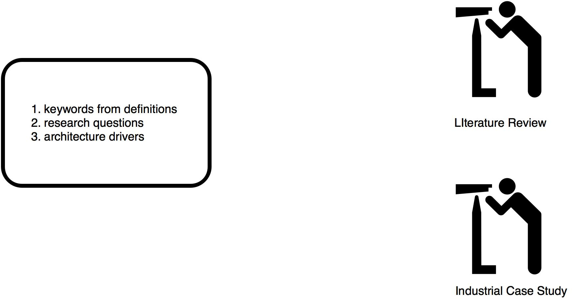
Research Strategy
Architecture Drivers
1. Quality Attributes
2. Constraints / Challenges
3. Principles
Rajendra Kharbuja- Master Thesis
Rajendra Kharbuja- Master Thesis
6

Slide 7
“Good” Microservice
Single Responsibility Principle
Microservices should be small and focused on doing one thing well [S.Newman and M. Stine]
“Gather together those things that change for the same reason, and separate those things that change for different reasons.” [16]
Single Responsibility Principle closely related to Coupling and Cohesion. [18, 19]
Autonomy [8, 20, 21, 22]
“The logic governed by a service resides within an explicit boundary” [24]
“ The service has control within this boundary and does not
depend on other services to execute its governance.
It also frees the service from ties that could inhibit its deployment and evolution” [23]
Infrastructure Capability
The right value of granularity for an organization is highly influenced by its IT infrastructure. The organization should be capable of handling the complexities such as communication, runtime, infrastructure etc if they choose low granularity. [25, 26]
Rajendra Kharbuja- Master Thesis
7

Slide 8
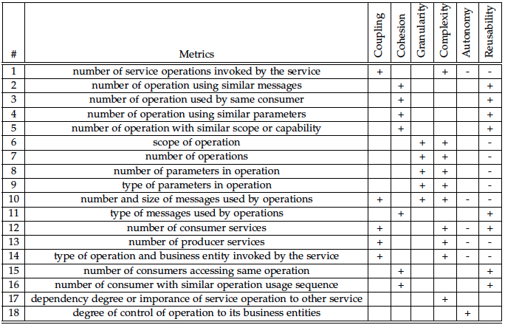
Basic Quality Metrics for Microservices
Rajendra Kharbuja- Master Thesis
8

Slide 9
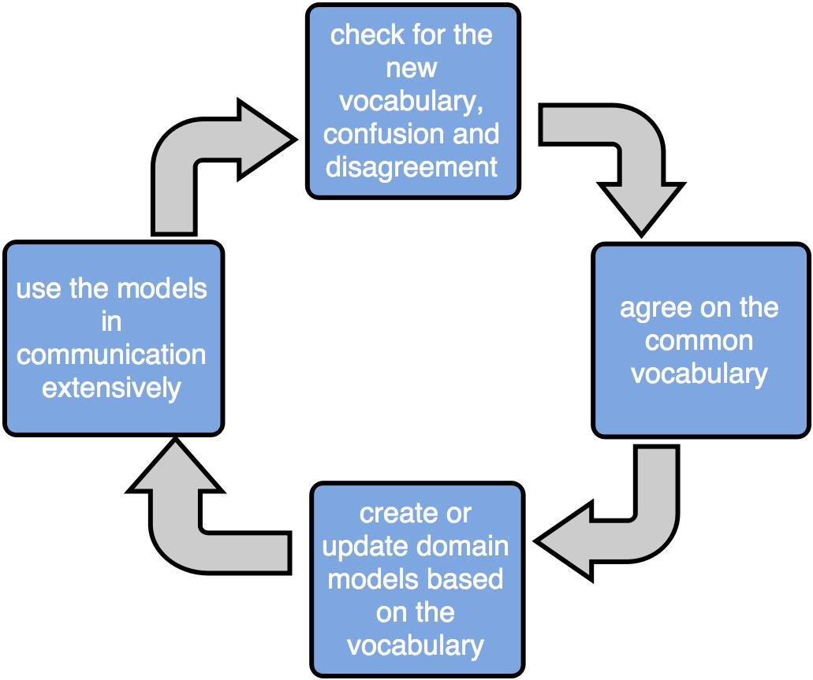
Modeling Microservices
Domain Driven Design
Ubiquitous Language
- common language agreed by domain experts and developers
- vocabularies, concepts and domain models
Rajendra Kharbuja- Master Thesis

Slide 10
Modeling Microservices
Domain Driven Design
Strategical Design
all cohesive unified domain models do not reflect contextual differences in vocabularies and concepts
divide the system into modular and manageable parts which work together
Step 1: Divide the problem domain into subdomains
- identify core business functionalities and map them into subdomains
- identify supporting and generic subdomains
- divide the resulting domains along multiple strategies
Rajendra Kharbuja- Master Thesis

Slide 11
Modeling Microservices
Domain Driven Design
Step 2: Identify Bounded Contexts
" A Bounded Context delimits the applicability of a particular model so that team members have a clear and shared understanding of what has to be consistent and how it relates to other contexts. A bounded context has specific functionality and explicitly defines boundary around team organization, code bases and database schemas". [ E.Evans]
Hints
1. assign individual bounded context to the subdomains identified in step 1
2. identify polysemes
3. identify independent generic functionality supporting the subdomain
Rajendra Kharbuja- Master Thesis

Slide 12
Modeling Microservices at SAP Hybris
Interview
Hypothesis 1
The correct size of microservices is determined by:
1. Single Responsibility Principle
2. Autonomy, and
3. Infrastructure Capability
Hypothesis 2
Domain driven design is an optimum approach to design microservices.
Questions Group
1. Granularity
2. Quality Attributes
3. Process to identify microservices

Slide 13
Modeling Microservices at SAP Hybris
Interview Approach
Name | Position | Experience in Years
John Doe | Product Manager | 20
Ivan Horvat | Senior Developer | 15
Jane Doe | Product Manager | 15
Mario Rossi | Product Manager | 17
Nanashi No Gombe | Product Manager | 6
Hans Meier | Architect | 16
Otto Normalverbraucher | Product Manager | 15
Jan Kowalski | Senior Developer | 8
Rajendra Kharbuja- Master Thesis

Slide 14
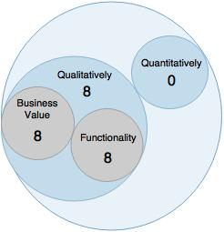
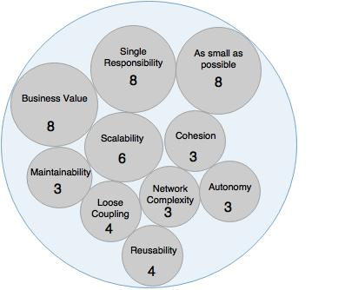
Modeling Microservices at SAP Hybris
Interview
Question 1
Question 2
"How do you measure the size of a microservice?"
"What factors do you consider when you decide the size of a microservice?”
Rajendra Kharbuja- Master Thesis

Slide 15
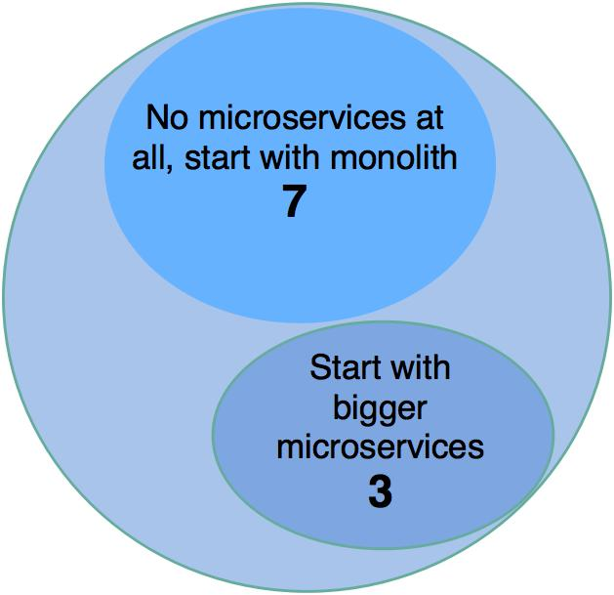
Modeling Microservices at SAP Hybris
Interview
Question 3
"Suppose that you do not have the agile culture like continuous integration and
delivery automation and also cloud infrastructure. How will it affect your decision
regarding microservices and their size?"
Rajendra Kharbuja- Master Thesis

Slide 16
Modeling Microservices at SAP Hybris
Interview
Question 4
"Are you facing any complexities because of microservices architecture and the size you have chosen?"
 | Challenges | Frequency
1. | Communication overhead in network | 2
2. | Complexity in failure handling | 1
3. | Monitoring is difficult | 1
4. | Operational support is costly | 2
5. | Difficult to trace a request | 2
6. | Updates can be difficult due to dependencies among microservices | 1
Rajendra Kharbuja- Master Thesis

Slide 17
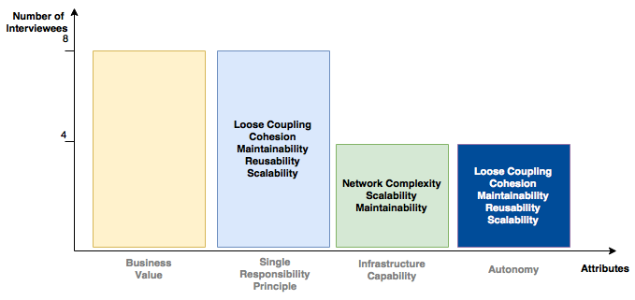
Modeling Microservices at SAP Hybris
Interview Compilation
Hypothesis 1
The correct size of microservices is determined by:
1. Single Responsibility Principle
2. Autonomy, and
3. Infrastructure Capability
Rajendra Kharbuja- Master Thesis

Slide 18
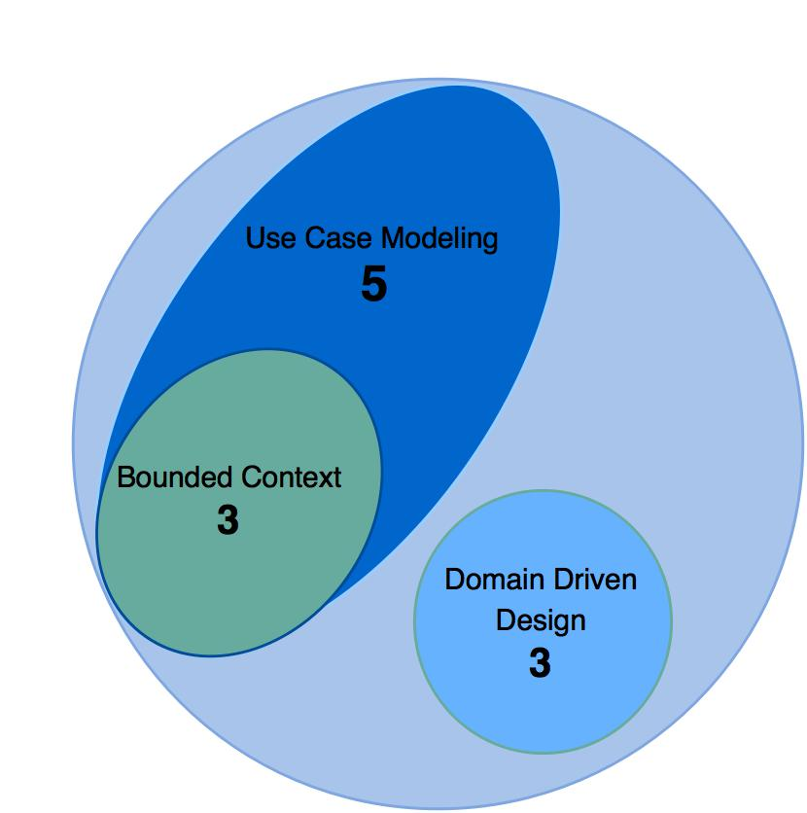
Modeling Microservices at SAP Hybris
Interview Compilation
Hypothesis 2
Domain driven design is an optimum approach to design microservices.
Rajendra Kharbuja- Master Thesis

Slide 19
Challenges of Microservices
Advantages
Challenges
Strong Modular Boundaries
Distributed System Complexity
Monolith easier to turn into big ball of mud as system gets bigger
Each microservice is a cohesive unit with explicit boundary, can only be accessed using API
8 fallacies
Remote calls are slow, network unreliable, difficult to handle failures
Independent Deployment
Integration
Automony property of microservices support independent deployment
Deployment easier than monolith where small change needs deployment of whole system
Each microservice is autonomous, collaboration is yet necessary
Deployment without breaking other APIs
Agile
Operational Complexity
Changes are easy to release by continuous deployment of each microservice
Independent deployment of microservice
Managing release is complex due to number of microservices and frequency of change
Monitoring and debugging is also difficult
[M. Fowler [44], Interview at SAP Hybris]
Rajendra Kharbuja- Master Thesis

Slide 20
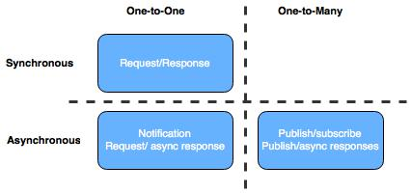
Challenges of Microservices
Integration
1. Sharing Data
Avoid | Recommendation
Shared Datasource | 1. access directly using resource owner's API 2. duplicate data along microservices
Distributed business transaction | Eventual Consistency
Queries to join from multiple databases | a separate mashup service
2. Inter-Service Communication
 | Advantages | Disadvantages
Synchronous | simple to understand and implement | increases temporal and location coupling
Asynchronous | decouples microservices, improves latency | flow not straightforward to understand, additional component such as message broker need to be managed.
Rajendra Kharbuja- Master Thesis

Slide 21
Challenges of Microservices
Distributed System Complexity
1. Breaking Change
Avoid as much as possible | - appropriate integration technology like REST rather than shared database - Tolerant Reader Pattern
Catch breaking change early | - consumer-driven contracts in build process
Use semantic versioning | - MAJOR.MINOR.PATCH
Coexist different endpoints and coexist concurrent service versions | - give consumers enough time to react
2. Handling Failures
Timeouts | - a threshold value of waiting time is set
Circuit Breakers | - fails fast - saves network congestion
Bulk Head | - segregate various resources
Provide Fallbacks | - provide alternative logic along with timeouts or circuit breakers
Rajendra Kharbuja- Master Thesis

Slide 22
Challenges of Microservices
Operational Complexity
1. Monitoring
Log Aggregation and Visualization | - use ELK stack
Synthetic Monitoring | - check various health status using uptime, smoke tests, etc.
Correlation ID | - assign unique ID to each request to make it traceable and easy to visualize
2. Deployment
Continuous Integration | - assign separate sourcecode repository and separate build for each microservice
Continuous Deployment | - independent build pipeline for each microservice
Rajendra Kharbuja- Master Thesis

Slide 23
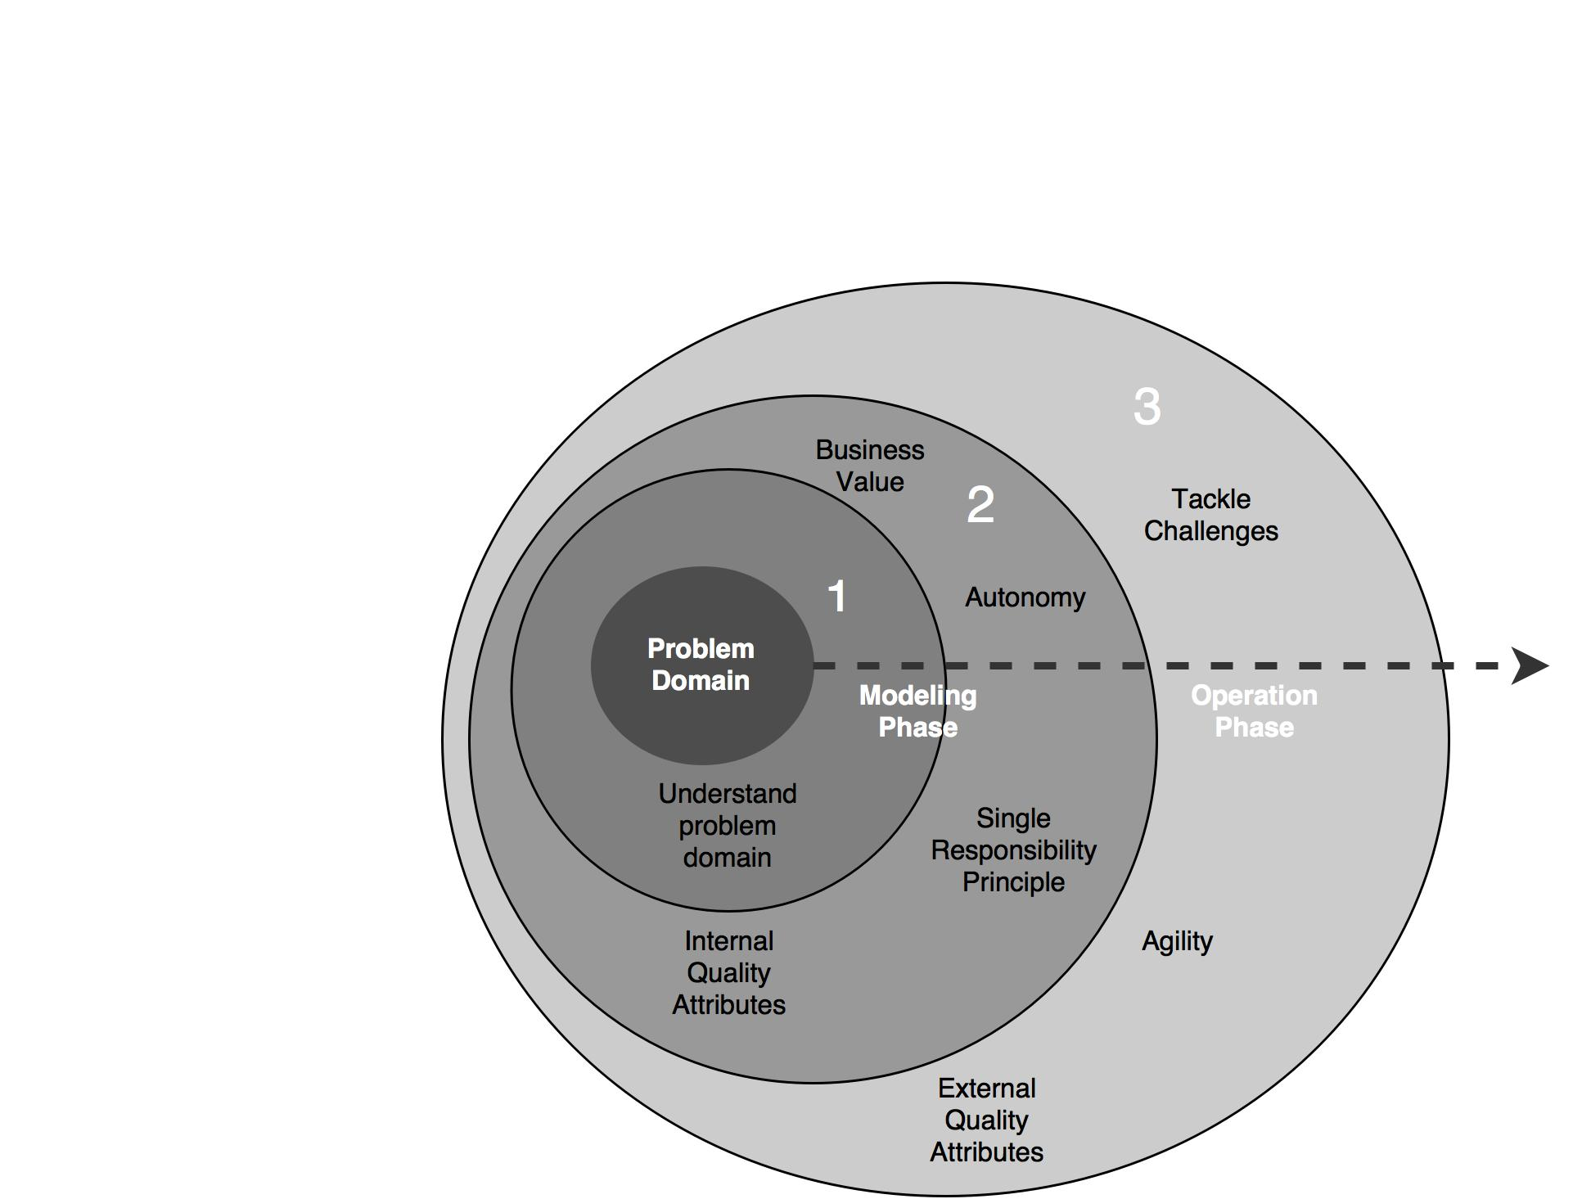
Guidelines
Process to implement microservices
Rajendra Kharbuja- Master Thesis

Slide 24
Guidelines
Principles
Guidelines
1. Correct Granularity | Factors - Single Responsibility Principle - Autonomy - Infrastructure Capability - Business Value
2. Consider Quality Attributes as early as possible | - control internal quality attributes to get hold of external quality attributes - basic metrics table can be helpful
3. Understand the problem domain | - apply Domain Driven Design or Use case modeling based on your requirement
4. Culture of Automation | - Automated Continuous Delivery - Automated Continuous Testing - Infrastructure Automation and Provisioning
5. Hide Internal Implementation Details | use bounded context to define clear APIs REST to make APIs technology agnostic rather than shared database
Rajendra Kharbuja- Master Thesis

Slide 25
Guidelines
Principles
Guidelines
6. Decentralize | - autonomous teams - decentralized business logic to avoid god services and heavy integration logic - prefer choreography than orchestration when appropriate
7. Deploy Independently | - avoid breaking changes using appropriate integration technology and tolerant reader pattern - use consumer-driven contracts in delivery pattern to detect breaking change - manage co-existing endpoints or microservices with different version to give consumer enough time - decouple release and deployment using bluegreen deployment and canary release
8. Consumer First | - APIs should be easy to understand, use and extend. - documentation should be provided - use tools such as swagger, RAML, etc.
9. Isolate Failures | - maintain appropriate timeouts - implement bulkhead to avoid leaking failures - use circuit breaker to reduce latency and save network resources - fallback mechanisms
10. Highly Observable | - semantic monitoring to check health status - log aggregation and visualization to trace and visualize requests - correlation ID to get semantic picture of a request
Rajendra Kharbuja- Master Thesis

Slide 26
Thank you for your attention!
Any questions?
Rajendra Kharbuja- Master Thesis

Slide 27
Bibliography
C. Richardson. Microservices: Decomposing Applications for Deployability and Scalability. May 2014
C. Richardson. Pattern: Monolithic Architecture. 2014. url: http://microservices.io/patterns/monolithic.html
R. Annett. What is a Monolith? Nov. 2014
M. Fowler and J. Lewis. Microservices. Mar. 2014. url: http://martinfowler.com/articles/microservices.html
Gupta. Microservices, Monoliths, and NoOps. Mar. 2015
S. Abram. Microservices. Oct. 2014. url: http://www.javacodegeeks.com2014/10/microservices.html
D. Namiot and M. Sneps-Sneppe. On Micro-services Architecture. Tech. rep.Open Information Technologies Lab, Lomonosov Moscow State University,2014
S. Newman. Building Microservices. O’Reilly Media, 2015
C. Richardson. Pattern: Microservices Architecture. 2014.
B. Wootton. Microservices - Not A Free Lunch! Apr. 2014. url: http://highscalability.com/blog/2014/4/8/microservices- not- a- freelunch.html.
A. Cockcroft. State of the Art in Mircroservices. Feb. 2015. url: http://www.slideshare.net/adriancockcroft/microxchg-microservices.
G. Radchenko, O. Taipale, and D. Savchenko. Microservices validation: Mjolnirrplatformcase study. Tech. rep. Lappeenranta University of Technology,2015
R. Sindhgatta, B. Sengupta, and K. Ponnalagu. Measuring the Quality of Service Oriented Design. Tech. rep. IBM India Research Laboratory
B. Shim, S. Choue, S. Kim, and S. Park. A Design Quality Model for Service-Oriented Architecture. Tech. rep. Sogang University, 2008
S. Alahmari, E. Zaluska, and D. C. D. Roure. A Metrics Framework for Evaluating SOA Service Granularity. Tech. rep. School of Electronics and Computer Science University Southampton, 2011.
http://programmer.97things.oreilly.com/wiki/index.php/The_Single_Responsibility_Principle
M. Stine. Jun. 2014. url: http://www.mattstine.com/2014/06/30/microservices-are-solid
E. Cobham Brewer url: http://www.objectmentor.com/resources/articles/srp.pdf
http://deviq.com/single-responsibility-principle/
J. Cramon. Feb. 2014 url: https://www.tigerteam.dk/2014/micro-services-its-not-only-the-size-that-matters-its-also-how-you-use-them-part-1/
Rajendra Kharbuja- Master Thesis

Slide 28
Bibliography
J. Stenberg. Feb. 2015 url: http://www.infoq.com/news/2015/02/characteristics-microservices-ap
A. Rostampour, A. Kazemi, F. Shams, P. Jamshidi, and A. Azizkandi. Measures of Structural Complexity and Service Autonomy. Tech. rep. Shahid Beheshti University GC, 2011.
Y. Ma, H.X. Li, and P. Sun, "A Lightweight Agent Fabric for Service Autonomy," Springer, 2007, pp. 63-77.
P. Reldin and P. Sundling. Explaining SOA Service Granularity– How IT strategy shapes services. Tech. rep. Linköping University, 2007.
P. Herzum and O. Sims. Business Components Factory: A Comprehensive Overview of Component-Based Development for the Enterprise. John Wiley Sons, 2000
W. Xiao-jun. Metrics for Evaluating Coupling and Service Granularity in Service Oriented Architecture. Tech. rep. Nanjing University of Posts and Telecommunications
Q. Ma, N. Zhou, Y. Zhu, and H. Wang1. Evaluating Service Identification with Design Metrics on Business Process Decomposition. Tech. rep. IBM China Research Laboratory and IBM T.J. Watson Research Center, 2009
G. Feuerlicht and J. Lozina. Understanding Service Reusability. Tech. rep. University of Technology, 2007
Guidelines for performing Systematic Literature Reviews in Software Engineering.Tech. rep. Keele University, 2007
D. Foody. Getting web service granularity right. 2005.
A. Goeb and K. Lochmann. A software quality model for SOA. Tech. rep. Technische Universität München and SAP Research, 2011.
A. Gupta. Microservices, Monoliths, and NoOps. Mar. 2015.
R. Haesen, M. Snoeck, W. Lemahieu, and S. Poelmans. On the Definition of Service Granularity and Its Architectural Impact. Tech. rep. Katholieke Universiteit Leuven.
J. K. Lee, S. J. Jung, S. D. Kim, W. H. Jang, and D. H. Ham. Component Identification Method with Coupling and Cohesion. Tech. rep. Soongsil University and Software Quality Evaluation Center, 2001.
Q. Ma, N. Zhou, Y. Zhu, and H. Wang1. Evaluating Service Identification with Design Metrics on Business Process Decomposition. Tech. rep. IBM China Research Laboratory and IBM T.J. Watson Research Center, 2009.
M. Mancioppi, M. Perepletchikov, C. Ryan, W.-J. van den Heuvel, and M. P. Papazoglou. Towards a Quality Model for Choreography. Tech. rep. European Research Institute in Services Science, Tilburg University.
Y.-F. Ma, H. X. Li, and P. Sun. A Lightweight Agent Fabric for Service Autonomy. Tech. rep. IBM China Research Lab and Bei Hang University, 2007.
V. D. Naveen Kulkarni. The Role of Service Granularity in A Successful SOA Realization – A Case Study. Tech. rep. SETLabs, Infosys Technologies Ltd, 2008.
Rajendra Kharbuja- Master Thesis

Slide 29
Bibliography
M. Perepletchikov, C. Ryan, K. Frampton, and Z. Tari. Coupling Metrics for Predicting Maintainability in Service-Oriented Designs. Tech. rep. RMIT University, 2007.
M. Perepletchikov, C. Ryan, and K. Frampton. Cohesion Metrics for Predicting Maintainability of Service-Oriented Software. Tech. rep. RMIT University, 2007.
C. Richardson. Microservices: Decomposing Applications for Deployability and Scalability. May 2014.
B. Shim, S. Choue, S. Kim, and S. Park. A Design Quality Model for Service-Oriented Architecture. Tech. rep. Sogang University, 2008.
E. Evans. Domain-Driven Design: Tackling Complexity in the Heart of Software.
Addison-Wesley Professional, 2003
44. M. Fowler. Microservice Trade-Offs. July 2015. url: http://martinfowler.com/articles/microservice-trade-offs.html.
Rajendra Kharbuja- Master Thesis

Slide 30
Backup Slides
Rajendra Kharbuja- Master Thesis

Slide 31
Research Process
Phase 1
Data Collection Phase
1. Search Term Selection Strategy
keywords from research questions
synonyms of keywords
accepted terms from academics and industry
reference discovered from papers selected
2. Resources Used
google scholar (scholar.google.de)
IEEExplore
ACM Digital Library
Researchgate
Books
Technical Articles
Materials Found : 123
3. Study Filteration Criteria
Is the study relevant to answer the research question?
Does the study have good base in terms of source as well as references of the past studies?
Are there any case studies provided to verify the research result derived in the study?
Materials Selected: 64
1. Select Search Terms
3. Filter the papers
2. Search and Gather Studies
Figure: Data Collection Phase
Rajendra Kharbuja- Master Thesis

Slide 32
Research Process
Phase 2
Data Synthesis Phase
2. Data Synthesis Strategy
Qualitative approach applied
Comparision of the data achieved from papers
Similaritiies and differences studied
1. Extract data from selected papers individually
Topic | Found | Selected
Granularity | 17 | 9
Service Attributes | 26 | 10
Service Identification | 22 | 16
Microservices | 32 | 19
Domain Modeling | 26 | 10
3. Create Draft
2. Synthesize Data
Figure: Data Synthesis Phase
Rajendra Kharbuja- Master Thesis

Slide 33
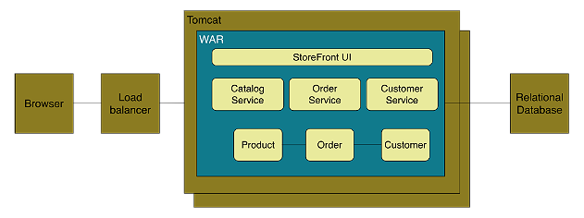
Context
Monolith Architecture Style
Definition
application deployed as a single artifact irrespective of internal structure
One of three cases:
All code share the same codebase and need to be compiled together
All deployment share same versioned code
The whole application is run under single server process
Figure: Online Store Example of Monolith Architecture
Rajendra Kharbuja- Master Thesis

Slide 34
Context
Monolith Architecture Style
Advantages
Easy to develop and test
Deployment is easy
Scaling is clear and simple
Prompt reuse of components and functionalities
Disadvantages
Limited Agility due to difficult continuous delivery
Single codebase, deployment of small change needs whole application to be deployed
Affects continuous delivery, especially when multiple deployment per day
May lack of clear modular boundary and changes get relayed
Decrease in Productivity due to understandability
Understanding of application is difficult due to overwhelming volume of codebase, esp for new developer
Difficult Team Structure
Common ways by technology and geography
Communication and ownership not straight forward
Long-term Commitment to Technology Stack
Technology chosen during analysis phase
Limited Scalability due to unavailable option for scaling of individual units
Only one option ie, Horizontal Scaling
Independent scaling of components not possible
Rajendra Kharbuja- Master Thesis

Slide 35
Context
Microservice Architecture style
Definition
“decompose an application functionally into a set of collaborating services, each with a set of narrow, related functions, developed and deployed independently, with its own database.”
“a style of software architecture that involves delivering systems as a set of very small, granular, independent collaborating services.”
[C. Richdson. 2014]
[B. Wootton, 2014]
Catalog Service
“Loosely coupled service oriented architecture with bounded contexts.”
Checkout Service
Customer Service
Order Management
Order Service
[A. Cockcroft, 2015 ]
Figure: Functional Decomompostion into microservices
Rajendra Kharbuja- Master Thesis

Slide 36
Context
Microservice Architecture style
Definition
“Microservices are SOA done right”
M. Fowler and J. Lewis, 2014
A. Cockcroft, 2015
G. Radchenko, O. Taipale, and D. Savchenko, 2015
“is an approach to developing a single application as a suite of
small services, each running in its own process and communicating with lightweight mechanisms, often an HTTP resource API. These services are built around business capabilities and independently deployable by fully automated deployment machinery. There is a bare minimum of centralized management of these services, which may be written in different programming languages and use different data storage technologies.”
[M. Fowler and J. Lewis, 2014]
Rajendra Kharbuja- Master Thesis

Slide 37
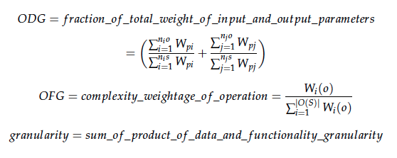




Size of a Microservice
Articles Found: 9
Selected: 3
Granularity of a service is determined by the number of operations, type of parameters of operations and size of messages.
Rajendra Kharbuja- Master Thesis

Slide 38
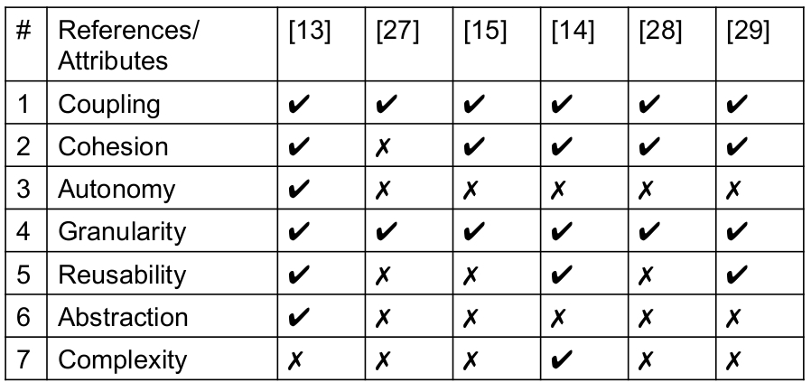
Quality Attributes for Services
Rajendra Kharbuja- Master Thesis

Slide 39
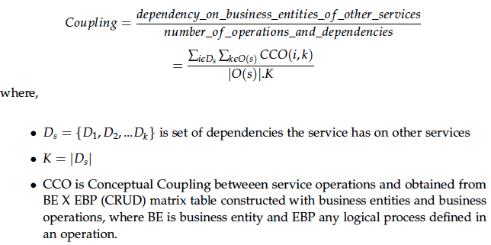

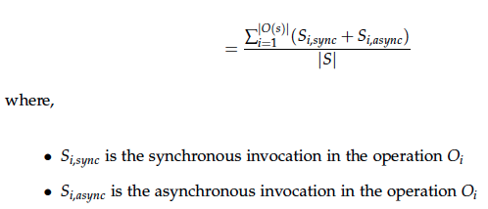
Quality attributes of a microservice
Coupling
Rajendra Kharbuja- Master Thesis

Slide 40
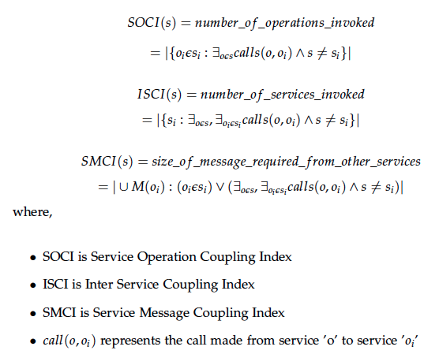
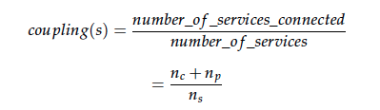
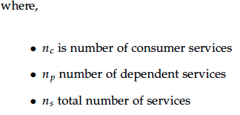
Quality attributes of a microservice
Coupling
Coupling in a service increases with the number of service invocations, number of dependent services and number of messages used.
Rajendra Kharbuja- Master Thesis

Slide 41
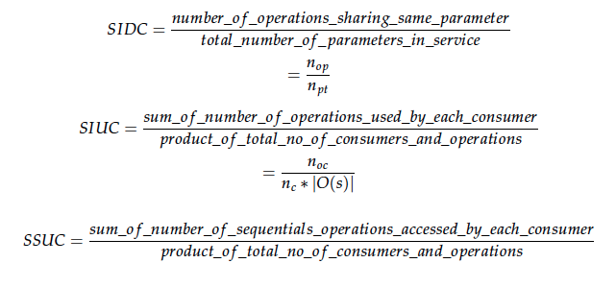
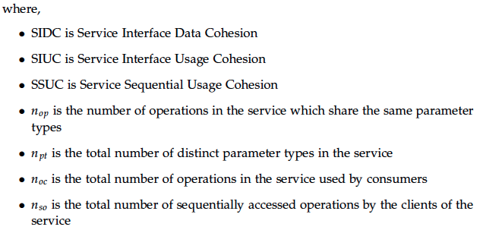
Quality attributes of a microservice
Cohesion
Rajendra Kharbuja- Master Thesis

Slide 42
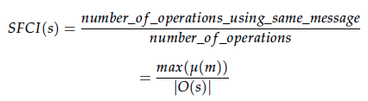
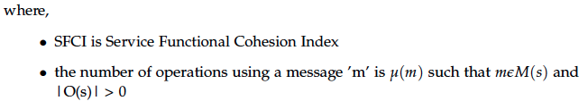
Quality attributes of a microservice
Cohesion
Cohesion is given by the number of operations sharing same messages, parameters and consumer.
Rajendra Kharbuja- Master Thesis

Slide 43
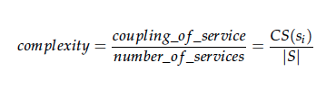
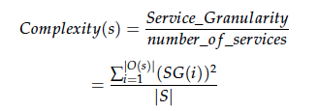


Quality attributes of a microservice
Complexity
Complexity of the service increases with granularity and coupling.
Rajendra Kharbuja- Master Thesis

Slide 44
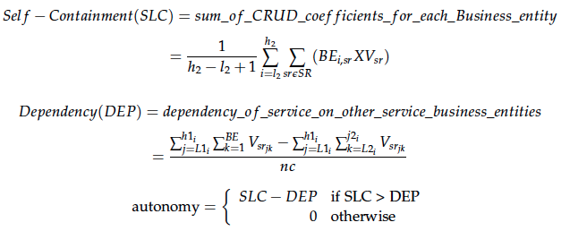
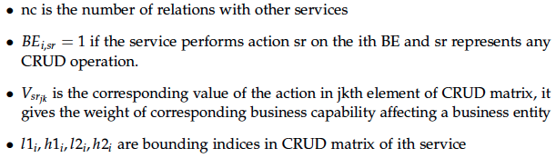
Quality attributes of a microservice
Autonomy
Autonomy of a service gives the degree of control of a service upon its business entities.
Rajendra Kharbuja- Master Thesis

Slide 45


Quality attributes of a microservice
Reusability
Reusability is increases with cohesion and consumers but decreases with granularity and coupling.
Rajendra Kharbuja- Master Thesis

Slide 46
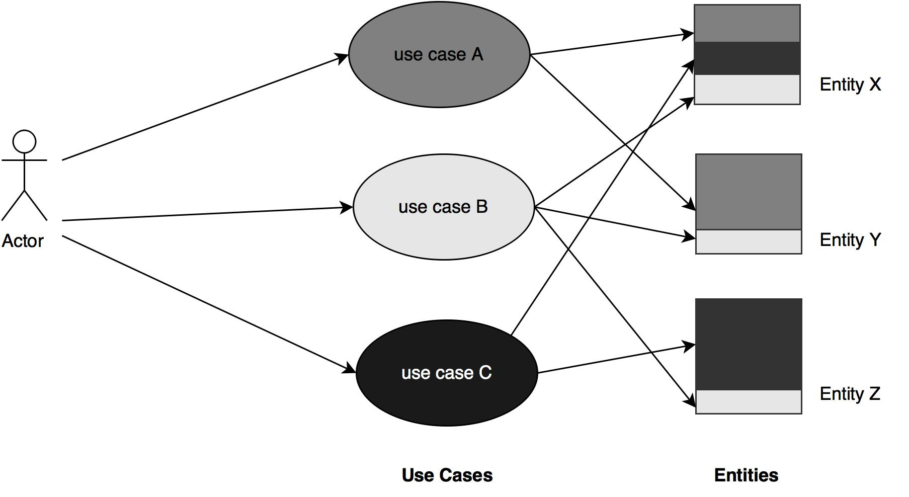
Modeling Microservices
Use cases Refactoring
Problems with Usecases
1. A use case consists of various cross-cutting concerns
2. The cohesive set of functionalities on a single entity are distributed across multiple use cases.
Solution: Use Cases Refactoring
1. segregate cohesive functionalities into separate use cases
2. identify correct level of abstractions of the use cases
Rajendra Kharbuja- Master Thesis

Slide 47
Modeling Microservices
Process to Use cases Refactoring
steps
1. Task Tree Generation
2. Use cases Refactoring
3. Service Identification
Rules
No. | Rule | Precondition | Postcondition
1 | Decomposition | Subtask tree independent of usecase | Subtask tree is assigned a new usecase
2 | Equivalence | Task trees of both use cases u1 and u2 have same behavior | u1 is replaced by u2 All relationships of u1 handled by u2
3 | Composition | Task trees t1 and t2 of two different use cases are functionally related | A new use case is created with task tree u1 U u2
4 | Generalization | Subtask trees t1 and t2 of different use cases are functionally same | A new use case with task tree t1 is created along with the relationship with the existing use cases
5 | Merge | use case u' is the only customer of use case u | u' is merged into u
Rajendra Kharbuja- Master Thesis

Slide 48
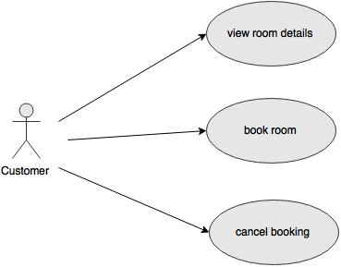
Modeling Microservices
Use cases Refactoring
Case Study: Hotel Reservation
Rajendra Kharbuja- Master Thesis

Slide 49
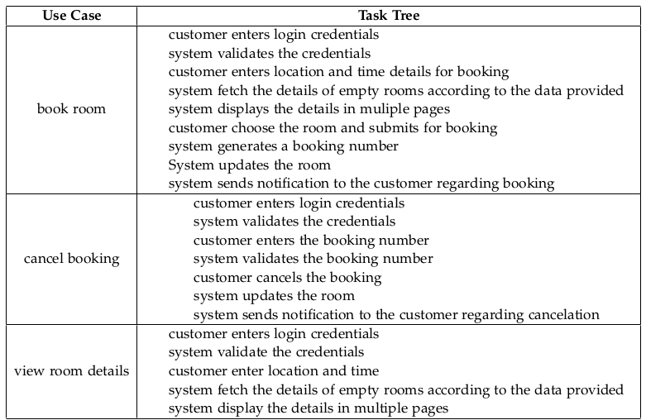
Modeling Microservices
Use cases Refactoring
Step 1: Task Tree Generation
Rajendra Kharbuja- Master Thesis

Slide 50
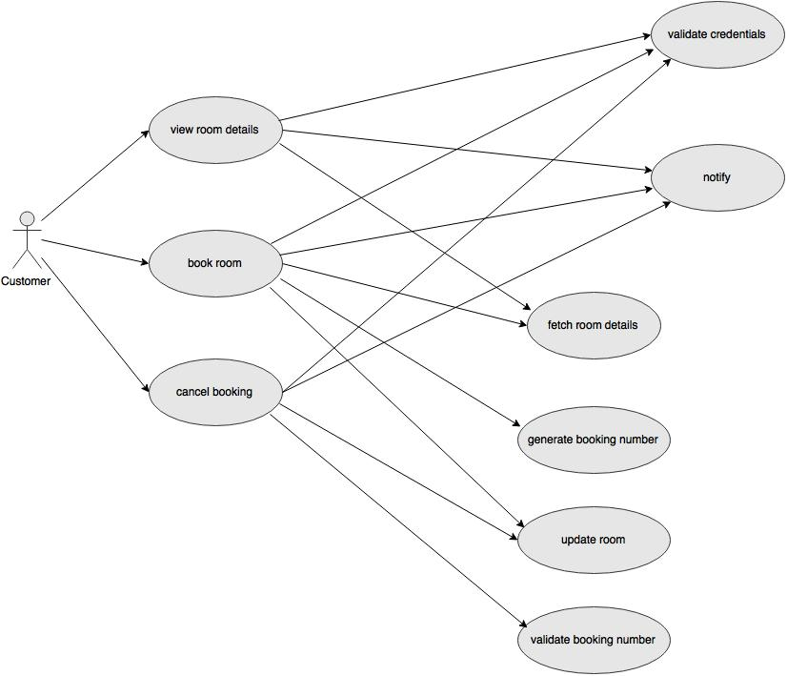
Modeling Microservices
Use cases Refactoring
Step 2: Apply Decomposition and Generalization Refactoring
Rajendra Kharbuja- Master Thesis

Slide 51
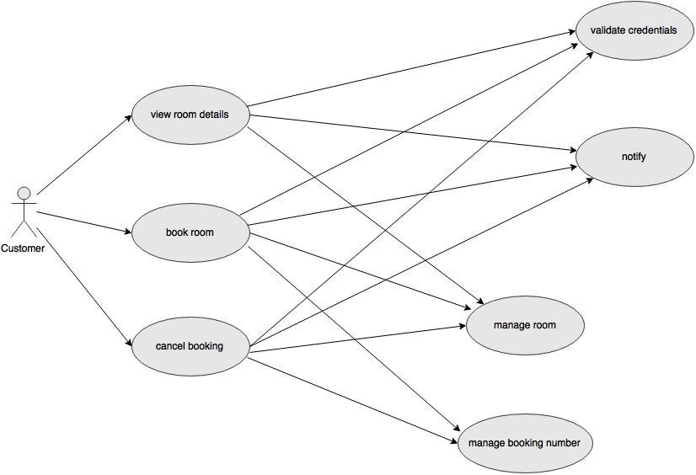
Modeling Microservices
Use cases Refactoring
Step 3: Use Composition Refactoring
Rajendra Kharbuja- Master Thesis

Slide 52
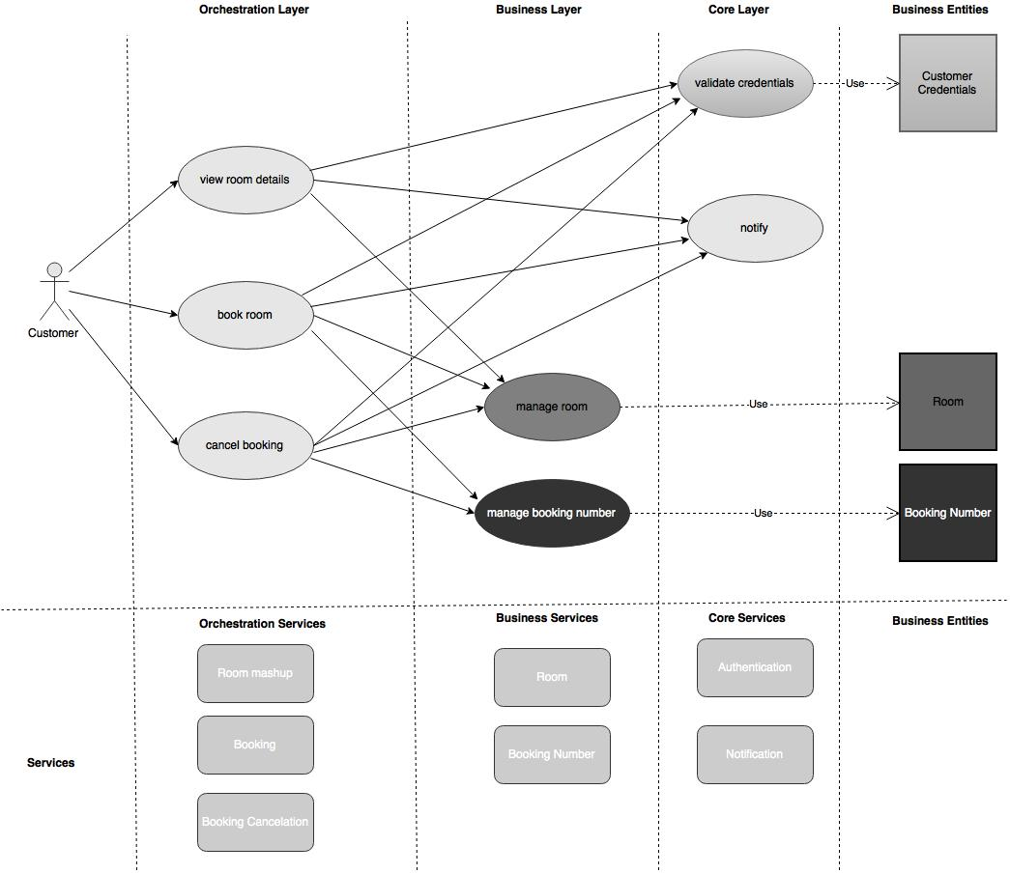
Modeling Microservices
Use cases Refactoring
Step 4: Identify microservices
Rajendra Kharbuja- Master Thesis

Slide 53
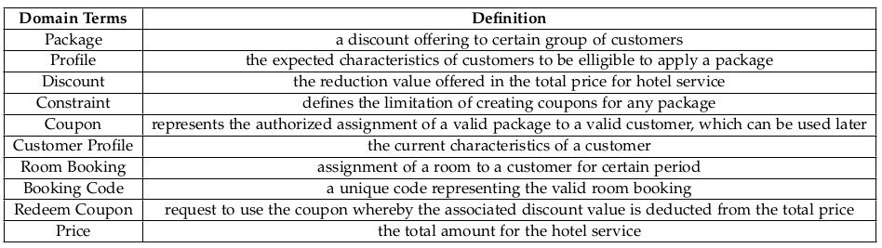
Modeling Microservices
Domain Driven Design
Case Study: Hotel Reservation
- various discount packages offered to certain customers as a new business model
Step 1: Domain Vocabularies
Rajendra Kharbuja- Master Thesis

Slide 54
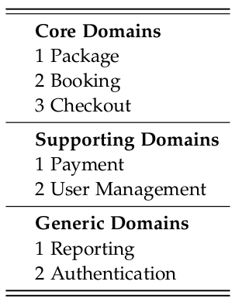
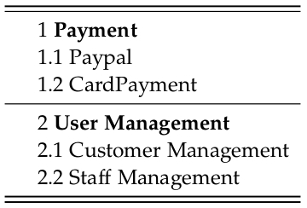
Modeling Microservices
Domain Driven Design
Step 2: identify core , supporting and generic domains
Step 3: identify subdomains
Rajendra Kharbuja- Master Thesis

Slide 55
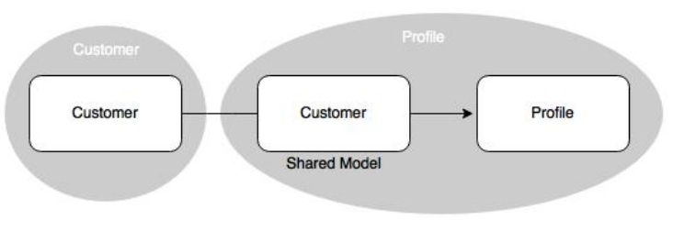
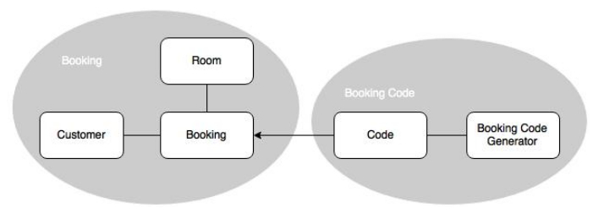
Modeling Microservices
Domain Driven Design
Step 4: identify bounded contexts in each subdomains
Customer Management
Booking
Rajendra Kharbuja- Master Thesis

Slide 56
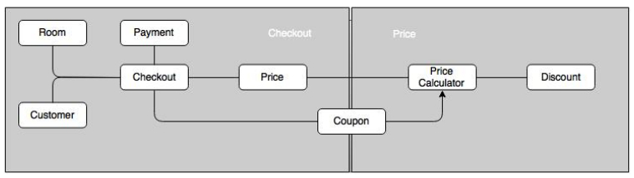
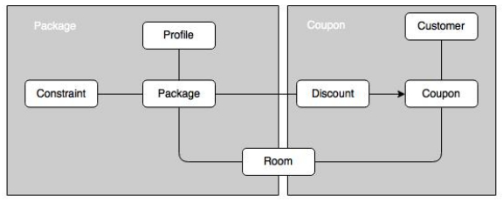
Modeling Microservices
Domain Driven Design
Step 4: identify bounded contexts in each subdomains
Checkout
Package Management
Rajendra Kharbuja- Master Thesis

Slide 57
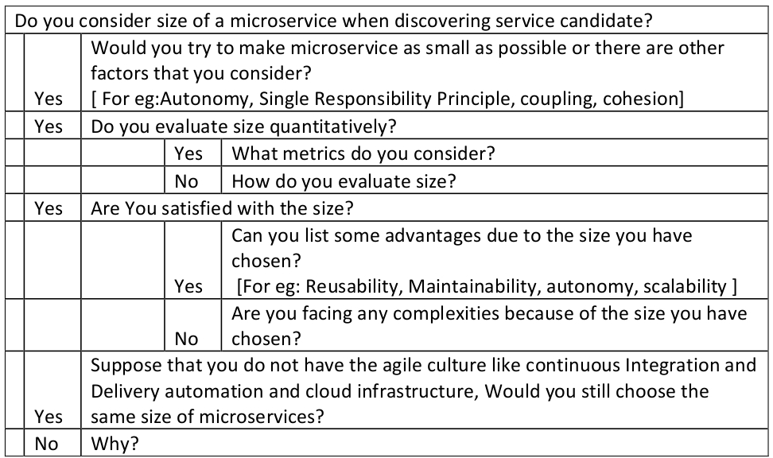
Modeling Microservices at SAP Hybris
Using Interview
Granularity
Rajendra Kharbuja- Master Thesis

Slide 58
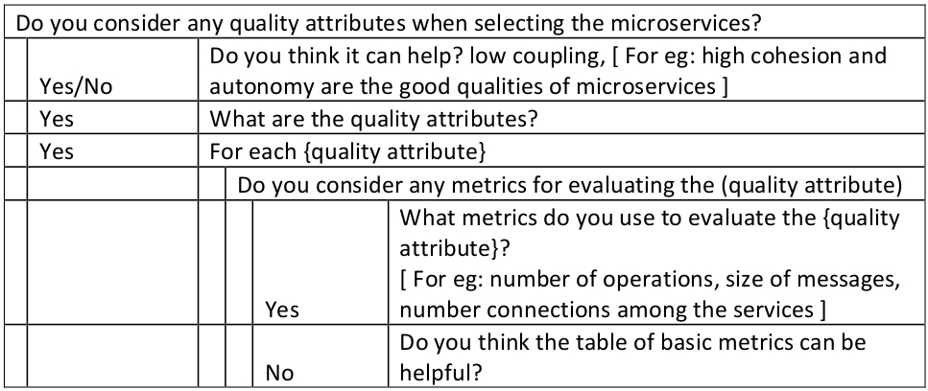
Modeling Microservices at SAP Hybris
Using Interview
Quality Attributes
Rajendra Kharbuja- Master Thesis

Slide 59
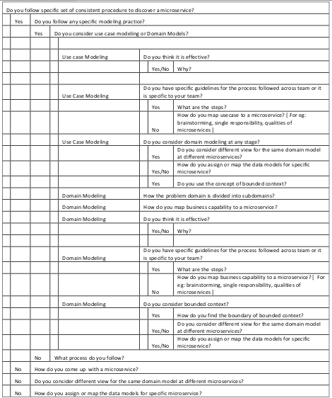
Modeling Microservices at SAP Hybris
Using Interview
Process to identify microservices
Rajendra Kharbuja- Master Thesis

Slide 60
Research Strategy
Keywords from definitions
Topics Keywords | Size | Quality of good Microservice | Communication | Process
Collaborating services |  |  | ✓
Communicating with lightweight mechanism HTTP |  |  | ✓
Loosely coupled, related functions |  | ✓ | ✓
Developed and deployed independently |  |  |  | ✓
Own database |  | ✓ |  | ✓
Different database technologies |  |  |  | ✓
Service Oriented Architecture |  | ✓ |  | ✓
Bounded Context | ✓ | ✓ |  | ✓
Build around business capabilities | ✓ | ✓ |  | ✓
Different programming languages |  |  |  | ✓
Rajendra Kharbuja- Master Thesis
60

Slide 61
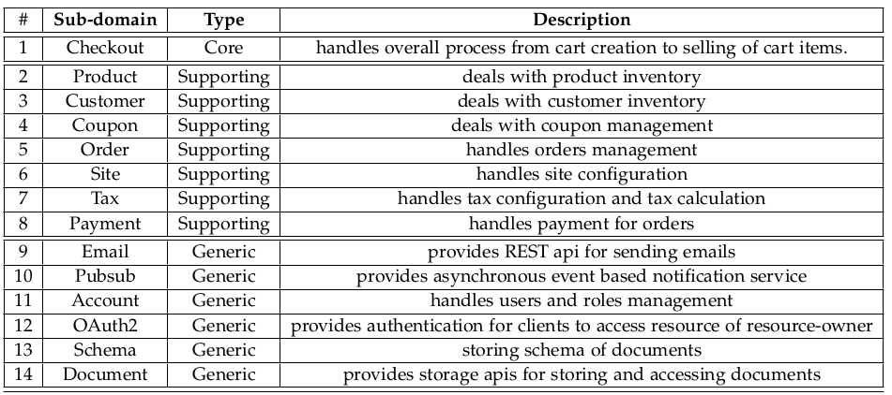
Modeling Microservices at SAP Hybris
Case Study: YaaS
Step 1: Identify core, supporting and generic domains
Rajendra Kharbuja- Master Thesis

Slide 62
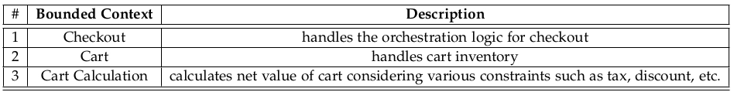
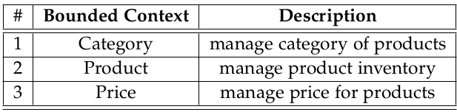
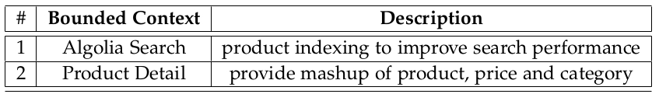
Modeling Microservices at SAP Hybris
Interview Compilation
Step 2: Identify bounded context
Checkout subdomain
Product subdomain
Rajendra Kharbuja- Master Thesis

Slide 63
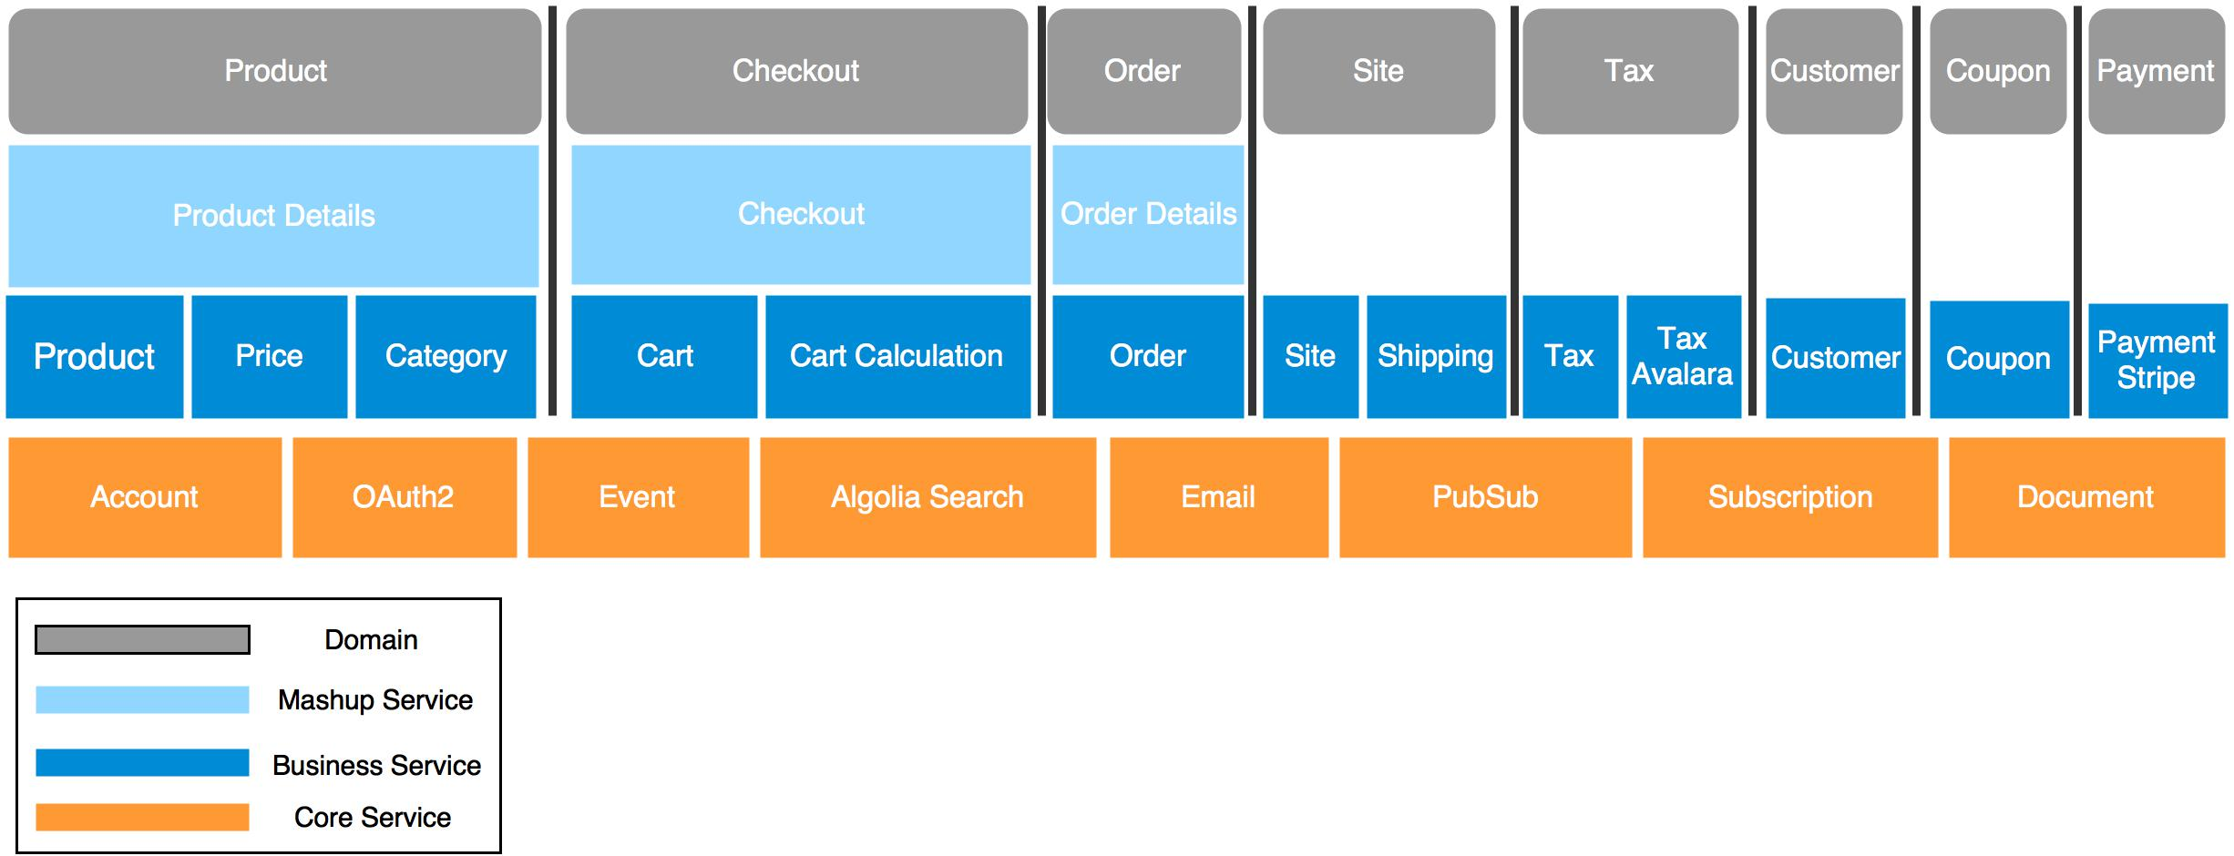
Modeling Microservices at SAP Hybris
Case Study: YaaS
Step 3: Applying Step 2 in all subdomains
Rajendra Kharbuja- Master Thesis

Slide 64
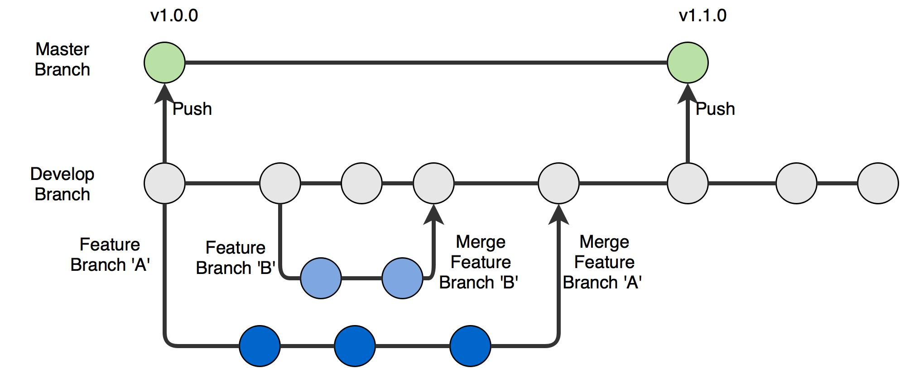
Deployment Workflow at SAP Hybris
SourceCode Management
Rajendra Kharbuja- Master Thesis

Slide 65
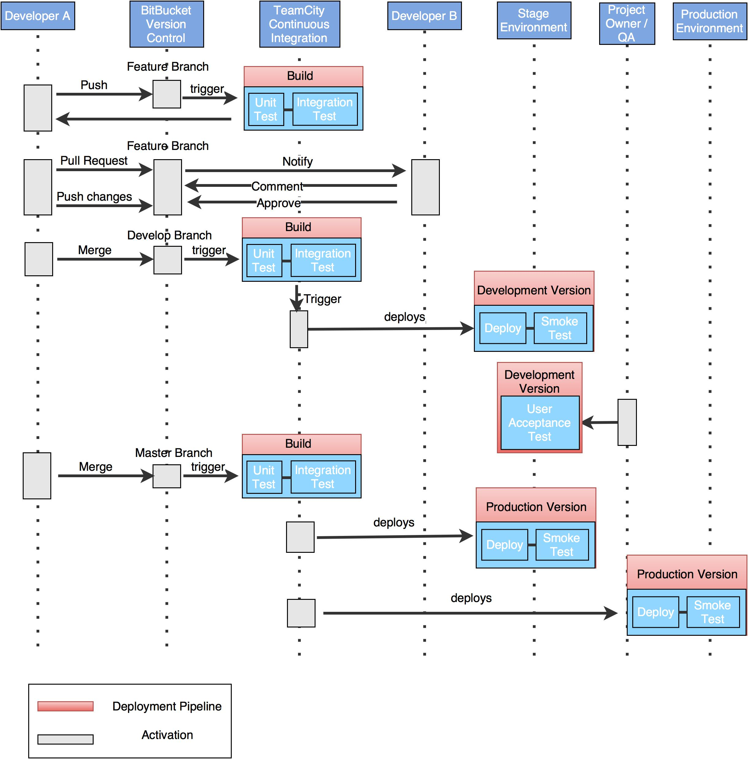
Deployment Workflow at SAP Hybris
Continuous Deployment
Rajendra Kharbuja- Master Thesis

Slide 66
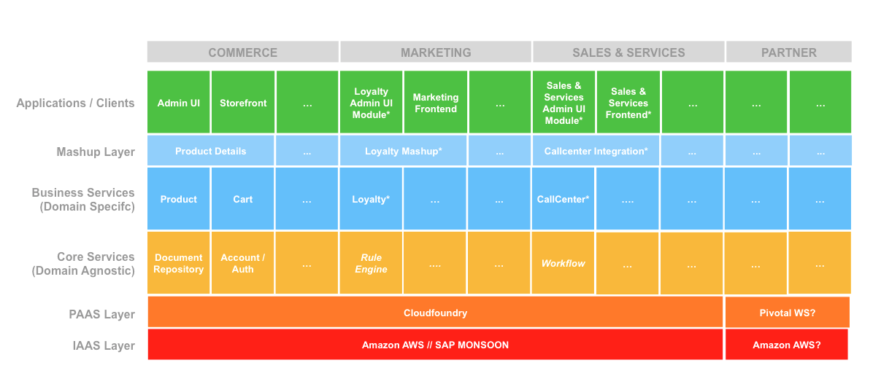
Architecture at SAP Hybris
Rajendra Kharbuja- Master Thesis

Slide 67

Challenges of Microservices
Integration
2. Inter-Service Communication
Example: Order Creation
Rajendra Kharbuja- Master Thesis

