Slide 1
Factors influencing the database selection for B2C web applications. Master Thesis Kick-Off Presentation
Al-Saeedi, Bilal | 30.11.2015
Notes:
Supervisor : Manoj
CoSupervisor: Andreas Kipf from database chair

Slide 2
Agenda
1
2
3
Introduction
Research Approach
Road Plan
Motivation ?
Research questions ?
Research plan ?
Present what has been done ?
Progress ? Future plan ?

Slide 3
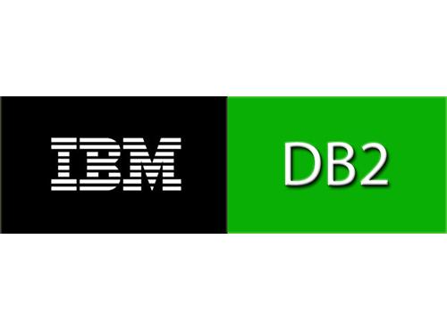

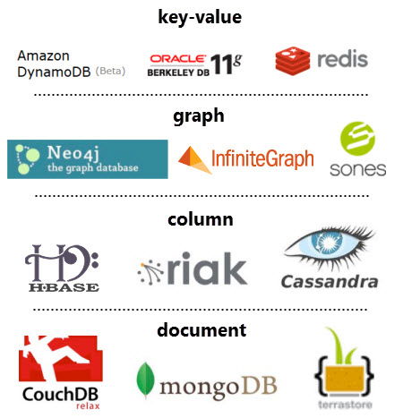




Introduction – Motivation
NOSQL Databases
Relational DBMS
© sebis
3
Notes:
For any application, a good database needs to be chosen to store, retrieve and analysis our data.
Selecting the database system is important and we might impact the whole application if we made wrong selection.
Previously there was only the RDBMS solutions and it was even then a difficult decision for the system architect and software designer.
Now after NOSQL emerged to offer high performance (both in terms of speed and size) and high availability and now we have over 120 such solutions.
it is even more confusing decision to make.
After this Thesis, we hope we can provide some guidelines and tips and some influencing factors that can help users to know if the are selecting the right database or not.

Slide 4
Introduction – Research Questions
What are the benefits and shortcomings of the database in terms of B2C application scenarios ?
What are the challenges in terms of query expressiveness and complexity of the database ?
What are the influencing factors for the selection of a database for a B2C application ?
© sebis
5
Notes:
Note: You should say that you are targeting developers.

Slide 5
Research Approach
DB selection
Constructs identification
Use cases identification
Literature review
Use cases implementation
Results documentation
© sebis
6

Slide 6
Databases Selection
Community Strength
Maturity
Popularity
Availability
Scalability
Open Source Support
Reliability
140122 Matthes Slides sebis 2014
© sebis
7
Notes:
We have used DB-Engine for popularity index and Gartner magic quadrant for other stuff

Slide 7





Databases Selection
Database Categories
RDBMS
Full Text Search Engines
Key-Value
Document Based
Column Based
Graph
Redis
Riak
Memcached
….....
MongoDB
Couchbase
Cloudant
….....
Cassandra
HBase
Accumulo
….....
Neo4j
Titan
OrientDB
….....
Elasticsearch
Apache Solr
BaseX
….....
MySQL
Postgres
Oracle
….....
140122 Matthes Slides sebis 2014
© sebis
9
Notes:
Key-value: which is a unique identifier to retrieve or store some data
Document based: to store, retrieve data as documents
Column based: that stores data tables as sections of columns of data rather than as rows of data
Graph: nodes, edges and properties to represent and store data.
Full text search engine: are some engines that index your data in such a way that you can do full text search easily and fast

Slide 8
Constructs
Introduction
Installability
Basic Concepts
Searching Data
Full Text Search Support
Regular Expressions Support
Basic Features
Query Language
Data Modeling
Data Layout
Possible Use cases
Transaction Support
Pipeline Support
Relational Data Support
Referential Integrity
Normalization
Data Evolution
Nested Data Support
Query Options
Indexing
Queries
Filtering and Grouping data
Sorting
Special Features
Any Database Specific Features
Administration and Maintenance
Configuration
Scalability
Persistence, and ACID Support
Handling failure
Backup and Upgrade
Security
Availability
Data migration
© sebis
10
Notes:
Constructs are divided into 6 categories.
Installability: how to install your data , how easy it is
Basic Concepts: what are the underlines data structures
Possible use cases: what are the most common use cases for this database
Query Types/ Language: How do you add, get , update , or delete your data.
Pipeline , execute batch of queries at the same time
Data layout: How to design your schema.
Referential Integrity: How to enforce your relations (relational data concept)

Slide 9
B2C Use Cases
Redis
Session Management.
Cart Management.
MongoDB
Users Management.
Shipping Management
Cassandra
Analytics Service
Logging Service
Cache Service.
Product Review & Wish list Management
History Data.
Product & Category Management.
Neo4j
Recommendations System.
ElasticSearch
Product Search.
MySQL
Finance (orders & payments)
Inventory Management.
Login, Cart, and Products Analytics Service.
© sebis
11
Notes:
Work in progress till end of the Thesis , we add more concrete use case after learning and reading more about each one

Slide 10
Constructs – Redis
Introduction
Installability
Basic Concepts
Searching Data
Full Text Search Support
Regular Expressions Support
Basic Features
Query Language
Data Modeling
Data Layout
Possible Use cases
Transaction Support
Pipeline Support
Relational Data Support
Referential Integrity
Normalization
Data Evolution
Nested Data Support
Query Options
Indexing
Queries
Filtering and Grouping data
Sorting
Special Features
Pub/Sub Support
Administration and Maintenance
Configuration
Scalability
Persistence, and ACID Support
Handling failure
Backup and Upgrade
Security
Availability
Data migration
Expire
Configuring as a cache
Lua Scripting
© sebis
13
Notes:
Built-in persistence support.
Vey fast in-memory database
Variety of storage data types.
Open source

Slide 11
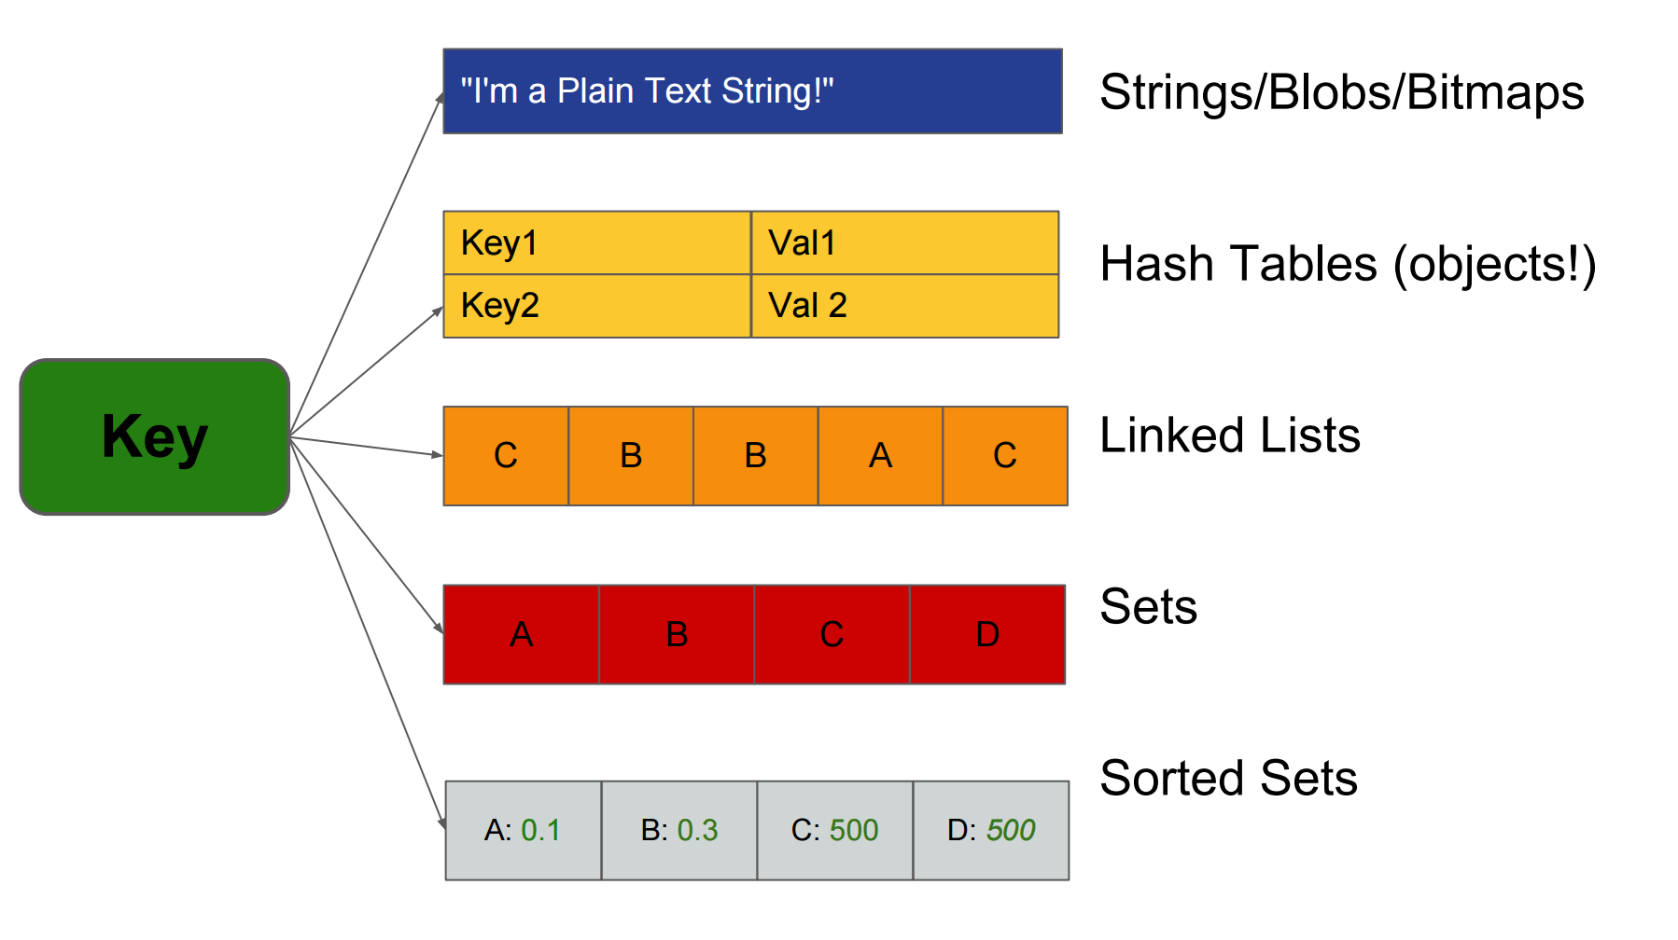
Redis – Basic Concepts
http://www.slideshare.net/dvirsky/kicking-ass-with-redis
© sebis
14
Notes:
Note: No nested structures , each value is with type String (not only sting but also integers , floating point values or even a binary data such as an image or any file)

Slide 12
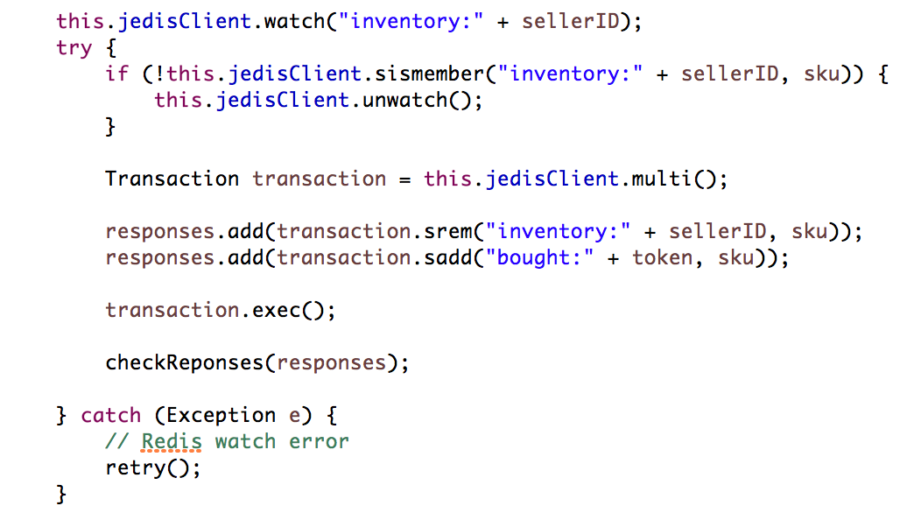
Redis – Transaction Support
Watch/Unwatch
Multi/Exec
Discard
© sebis
16
Notes:
About Watch/Unwatch , Multi/Exec , Discard
Watch/Unwatch is some kind of optimistic locking mechanism
since watch/unwatch act as optimistic locks , they don’t scale well since if you have for example more that 100k users trying to access the inventory at the same time then the retry time will increase a lot.
Then we should implement some kind of locking mechanism in the client side to improve performance.
Multi will start the transaction , exec will execute the transaction , since Redis is single threaded , it ensures that it will be executed alone.
Other note is that rollback isn’t supported by redis as relational databases.
Redis will discard the transaction in case of syntax errors, however if there is a programming error , no way for rollback.
Argument from Redis is that the programming error is likely to be detected during development and shouldn’t be in production. Due to performance concerns.
Pipeline is implemented in similar way using multi and sync commands , no watch/unwatch

Slide 13
Redis – Relational Data Support
Orders:customerID
Orders:paymentID
Set (orderIDs)
Set (orderIDs)
(Hash)
Customer
(Hash)
Order
*
1
(Hash)
Payment
1
*
*
Orders:shippingID
Shippings:orderID
Set (orderIDs)
Set (shippingIDs)
*
(Hash)
Shipping
© sebis
18
Notes:
This gets complicated as you relations grows.
You have to maintain your relations manually with each submit or delete or update

Slide 14
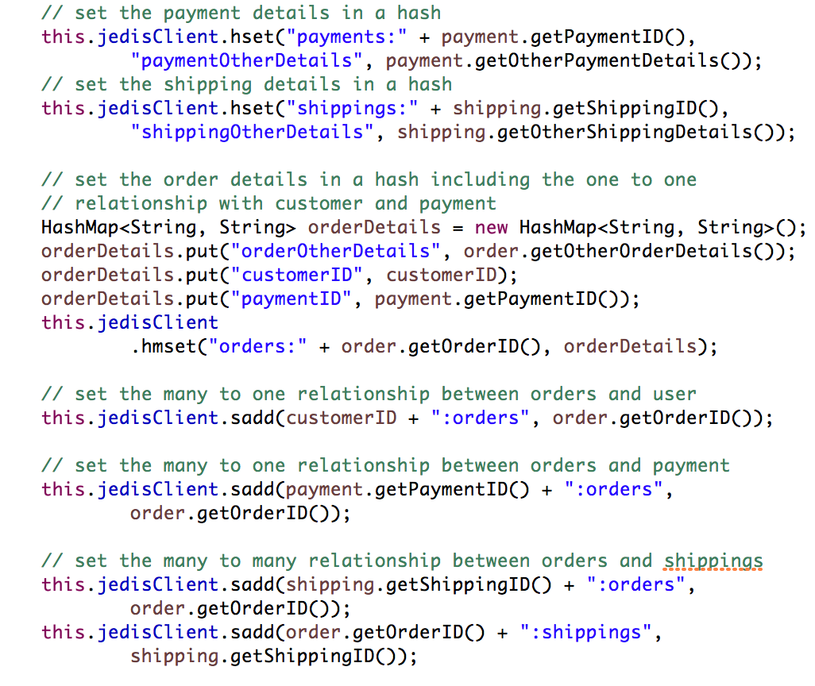
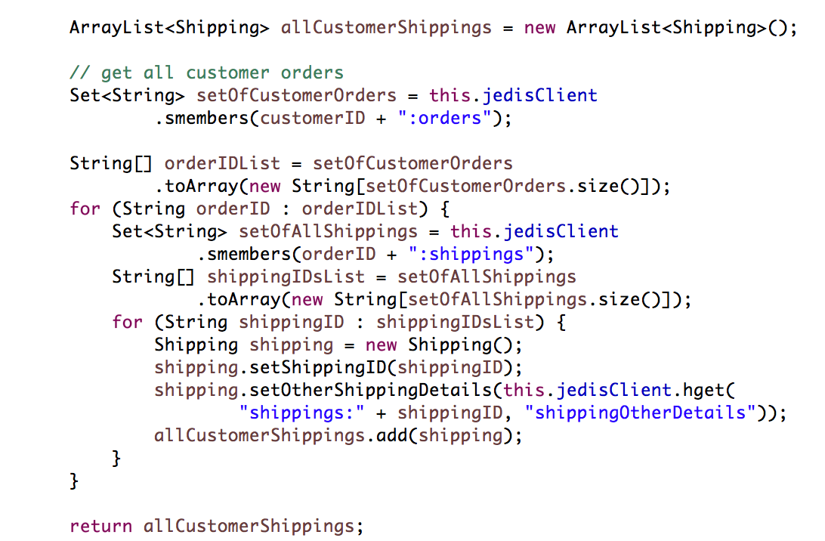
Redis – Relational Data Support
Submit an order
Get all customer Shippings
© sebis
19
Notes:
We will do 7 insert statements
To get we do all orders per customerID
Then iterate through the order id and get all shippings for each orderID
Then iterate through each shippingID to get the shipping details

Slide 15
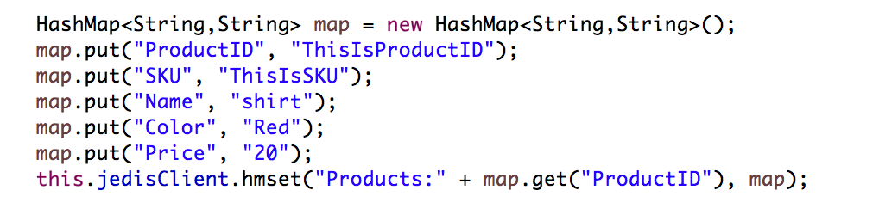
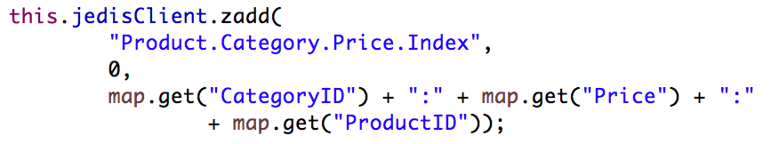
Redis – Indexing
Primary Index
Key
Products:ProductID ➔ Primary Index
Hash
{ “SKU”: “sku”, “Name”:”ProductName”, “Color”: “ProductColor” , “Price”: “ProductPrice” }
Secondary Index
Product.Color.Index: ProductColor
Set
{ProductIDs}
Product.Price.Index
Sorted Set
{ProductIDs , Price}
Composite Index
Product.Category.Price.Index
Sorted Set
{CategoryID:Price:ProductID, 0}
Retrieval
© sebis
22
Notes:
Index needs to be maintain manually which might get complex and errors can occur.

Slide 16
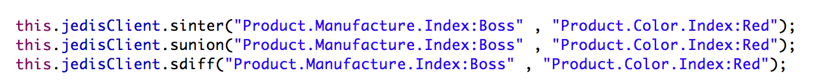
Redis – Filtering, Grouping and Sorting
Group Data
Product. Manufacture.Index: CompanyName
Set
{ProductIDs}
Product.Color.Index: ProductColor
Set
{ProductIDs}
Filter Data
Sorting Data
SORT command ➔ sorts lists, sets, and sorted sets
© sebis
23

Slide 17
Redis – Use Cases Implementations
Cart Management Service
Session Management Service
Cache Service
Analytics Service
Other Redis Examples:
Inspect Data Structures
Job Queue.
Handling Data Relation
Pipeline Support
Transaction Support
Code:
https://github.com/alronz/B2C-Database-Selection-Implementations
Documentation:
https://github.com/alronz/b2c-database-selection
© sebis
28

Slide 18
Road Plan
 |  | Sep | Oct | Nov | Dec | Jan | Feb | March
DB selection
Constructs identification
Use cases identification
Use cases implementation
Documenting results
Writing of Thesis Report
Start
Today
End
Complete
Ongoing
Not Started
Revising
© sebis
29
Notes:
Add literature review
What is the different between documenting results and writing thesis report ?

Slide 19
Thank you for your attention!
Bilal Al-Saeedi
MSc. Informatics Student
rose@in.tum.de

Slide 20
Backup slides
© sebis
3

Slide 21
Constructs – Redis
Introduction
Installability
Basic Concepts
Searching Data
Full Text Search Support
Regular Expressions Support
Basic Features
Query Language
Data Modeling
Data Layout
Possible Use cases
Transaction Support
Pipeline Support
Relational Data Support
Referential Integrity
Normalization
Data Evolution
Nested Data Support
Query Options
Indexing
Queries
Filtering and Grouping data
Sorting
Special Features
Pub/Sub Support
Administration and Maintenance
Configuration
Scalability
Persistence, and ACID Support
Handling failure
Backup and Upgrade
Security
Availability
Data migration
Expire
Configuring as a cache
Lua Scripting
© sebis
13
Notes:
Installing Redis is easy , you can either download it and build it from the source or use package managers such as brew or Port.
Basic concepts will be explained now
For the use cases, redis can be used in many scenarios such as:
Caching
Chat Server
Messaging Broker
Queues
Real time analytics and many others

Slide 22
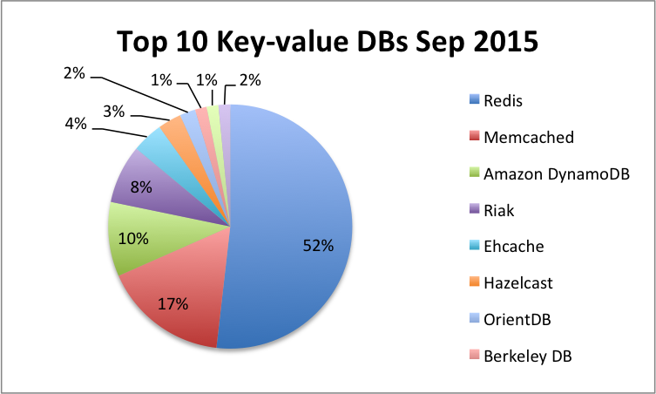
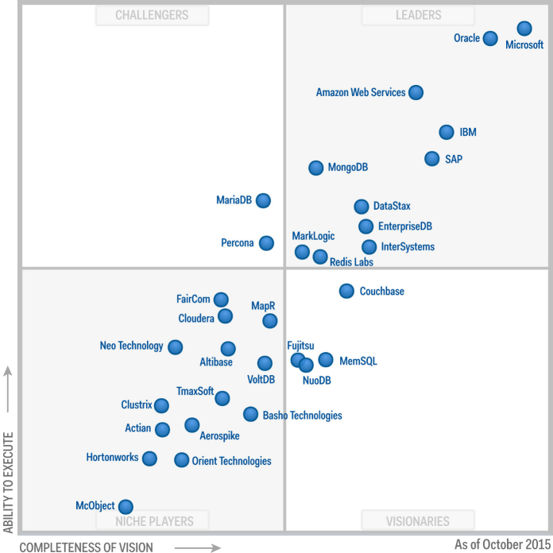
Databases Selection – Key-Value
Built-in persistence support.
Vey fast in-memory database
Variety of storage data types.
Open source
140122 Matthes Slides sebis 2014
© sebis
3

Slide 23
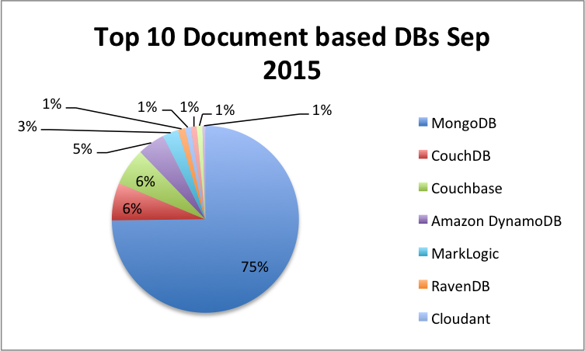
Databases Selection – Document-Based
JSON-like storage format named BSON
Great features such as ad hoc queries,
Indexing, sharding, etc.
Easy to use and has great community
Open source
140122 Matthes Slides sebis 2014
© sebis
3

Slide 24
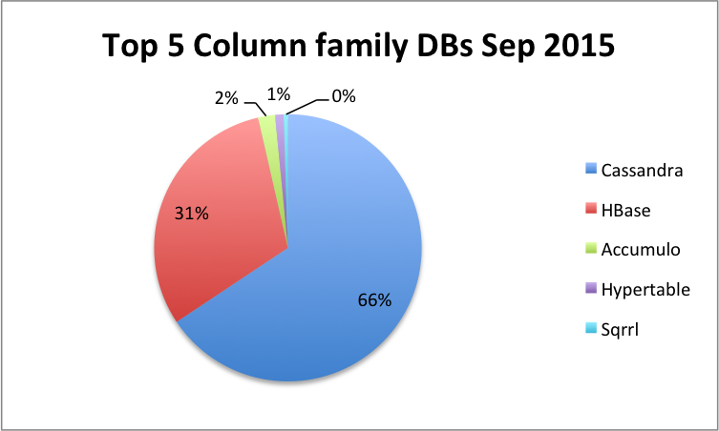
Databases Selection – Column-Based
Open source
SQL-Like Query language called CQL
Decentralized, no single point of failure
Great community
140122 Matthes Slides sebis 2014
© sebis
3

Slide 25
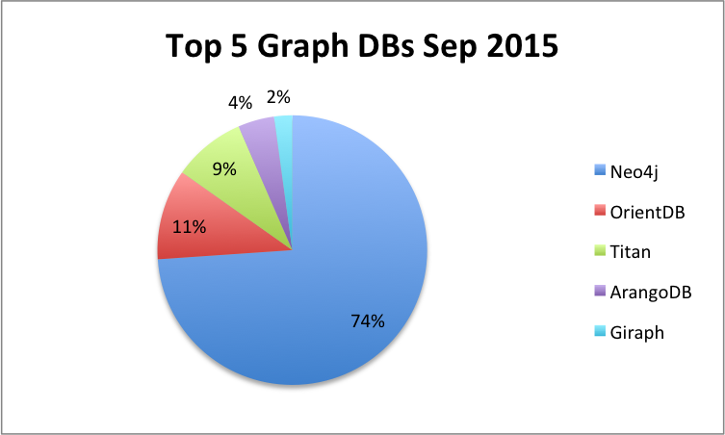
Databases Selection - Graph
Supports a powerful and easy to
use graph query language called Cypher.
Support complex data modeling.
Open source
Great community
140122 Matthes Slides sebis 2014
© sebis
3

Slide 26
Databases Selection – Full Search Engine
Scalable Map/Reduce model
Memory efficient and fast.
Open source
Great community
140122 Matthes Slides sebis 2014
© sebis
3

Slide 27
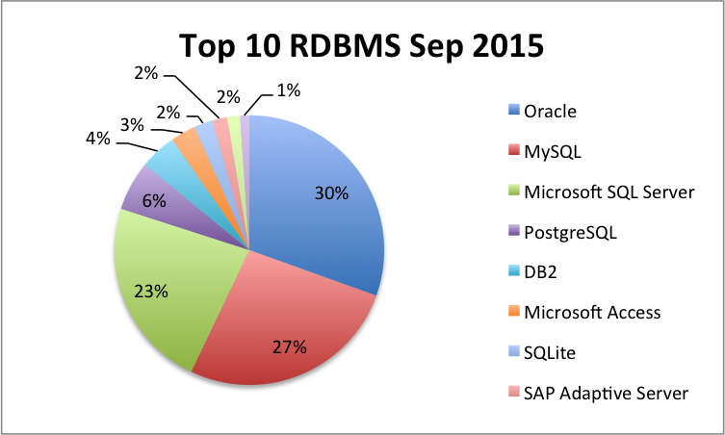
Databases Selection - RDBMS
Relational Database System
Client/Server Architecture
SQL compatibility
Open source RDBMS
Great community
140122 Matthes Slides sebis 2014
© sebis
3

Slide 28
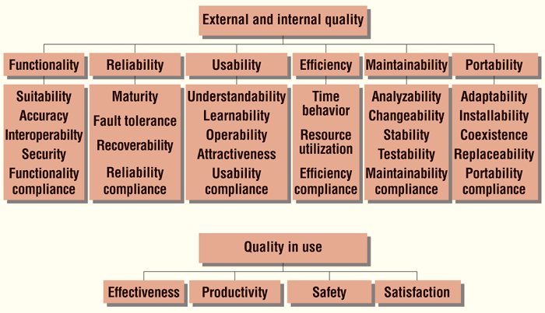
Introduction – Research Questions
System product quality model—ISO/IEC9126.
© sebis
4
Notes:
I will talk about the research questions that we are trying to answer , but before that…
There are many quality attributes for each database system , not going to cover all of them
We will focus mainly only usability factors in database selection
But also we will cover some other factors such as installability, security , scalability , availability bases on different constructs that we will discuss in more details later

Slide 29
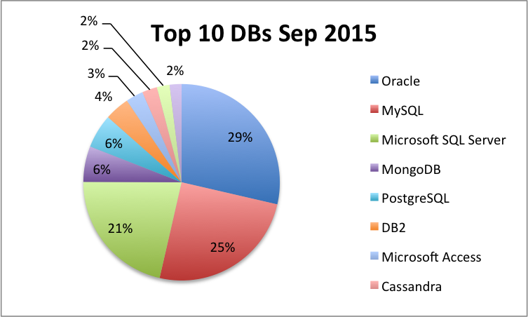
Databases Selection
http://db-engines.com/
Magic Quadrant for Operational DBMS
140122 Matthes Slides sebis 2014
© sebis
8
Notes:
Gartner Magic Quadrant is a series of research reports for a certain market section.
provide a qualitative analysis into a market and its direction, maturity and participants.
The above is for operational DBMS including open source and commercially supported, Relational and Nosql.
It divide the marked based on different qualities measures into 4 section based on completeness of vision and ability to execute:
Niche players , visionaries , challengers , leaders.
Usually leaders represent generally the lowest risk for customers in the areas of performance, scalability, reliability and support
====
DB engine it measures some popularity index based on:
The number of mentions of the DB on websites, based on the results from search engines such as Google and Bing.
The general interests in the DB using Google Trends.
The frequency of technical discussions about the DB in Q&A sites such as Stack Overflow and DBA Stack Exchange.
The number of job offers for a particular DB from leading job search engines such as Indeed, and Simply Hired.
The number of profiles in professional networks such as LinkedIn in which the DB is mentioned.
From social networks such as the number of tweets in Twitter about a particular DB.

Slide 30
Constructs – Redis
Introduction
Installability
Basic Concepts
Searching Data
Full Text Search Support
Regular Expressions Support
Basic Features
Query Language
Data Modeling
Data Layout
Possible Use cases
Transaction Support
Pipeline Support
Relational Data Support
Referential Integrity
Normalization
Data Evolution
Nested Data Support
Query Options
Indexing
Queries
Filtering and Grouping data
Sorting
Special Features
Pub/Sub Support
Administration and Maintenance
Configuration
Scalability
Persistence, and ACID Support
Handling failure
Backup and Upgrade
Security
Availability
Data migration
Expire
Configuring as a cache
Lua Scripting
© sebis
13
Notes:
Installing Redis is easy , you can either download it and build it from the source or use package managers such as brew or Port.
Basic concepts will be explained now
For the use cases, redis can be used in many scenarios such as:
Caching
Chat Server
Messaging Broker
Queues
Real time analytics and many others

Slide 31
Constructs – Redis
Introduction
Installability
Basic Concepts
Searching Data
Full Text Search Support
Regular Expressions Support
Basic Features
Data Modeling
Data Layout
Possible Use cases
Query language
Transaction Support
Pipeline Support
Relational Data Support
Referential Integrity
Normalization
Data Evolution
Nested Data Support
Query Options
Indexing
Queries
Filtering and Grouping data
Sorting
Special Features
Pub/Sub Support
Administration and Maintenance
Configuration
Scalability
Persistence, and ACID Support
Handling failure
Backup and Upgrade
Security
Availability
Data migration
Expire
Configuring as a cache
Lua Scripting
© sebis
15
Notes:
Query Language: Redis supports set of commands specific for each data type to get and set and deleted data.
Transaction and pipeline support will be explained later

Slide 32
Constructs – Redis
Introduction
Installability
Basic Concepts
Searching Data
Full Text Search Support
Regular Expressions Support
Basic Features
Data Modeling
Data Layout
Possible Use cases
Query language
Transaction Support
Pipeline Support
Relational Data Support
Referential Integrity
Normalization
Data Evolution
Nested Data Support
Query Options
Indexing
Queries
Filtering and Grouping data
Sorting
Special Features
Pub/Sub Support
Administration and Maintenance
Configuration
Scalability
Persistence, and ACID Support
Handling failure
Backup and Upgrade
Security
Availability
Data migration
Expire
Configuring as a cache
Lua Scripting
© sebis
21
Notes:
full-text search support: Redis doesn’t support full text search internally.
Regular expression support: It has two search all commands KEYS & SCAN and they support global style match patterns
Query Options (limit , count , max, min , sum, average , ect)
count supported in all data structures , min max can be done using sorted set , sum ,average needs to be done manually.
If you need to limit you returned data , there is such option when retrieving all data from a data structure using scan

Slide 33
Constructs – Redis
Introduction
Installability
Basic Concepts
Searching Data
Full Text Search Support
Regular Expressions Support
Basic Features
Data Modeling
Data Layout
Possible Use cases
Query language
Transaction Support
Pipeline Support
Relational Data Support
Referential Integrity
Normalization
Data Evolution
Nested Data Support
Query Options
Indexing
Queries
Filtering and Grouping data
Sorting
Special Features
Pub/Sub Support
Administration and Maintenance
Configuration
Scalability
Persistence, and ACID Support
Handling failure
Backup and Upgrade
Security
Availability
Data migration
Expire
Configuring as a cache
Lua Scripting
© sebis
17
Notes:
Data layout: You need to think carefully about your data and where to store it. It will be a bad decision to store a million records of elements inside a list and then trying to retrive it in order.
Relational data support will be discussed later.
Referential integrity and normalization are a relation database concepts and don’t apply here.
Data evolution: Most of the time it will be handled manually using client side code. For example if you have million records inside a list and then you want to store them in a sorted set. You will iterate through all of them and insert in the new data structure.
Nested data : not supported as we have already discussed

Slide 34
Constructs – Redis
Introduction
Installability
Basic Concepts
Searching Data
Full Text Search Support
Regular Expressions Support
Basic Features
Data Modeling
Data Layout
Possible Use cases
Query language
Transaction Support
Pipeline Support
Relational Data Support
Referential Integrity
Normalization
Data Evolution
Nested Data Support
Query Options
Indexing
Queries
Filtering and Grouping data
Sorting
Special Features
Pub/Sub Support
Administration and Maintenance
Configuration
Scalability
Persistence, and ACID Support
Handling failure
Backup and Upgrade
Security
Availability
Data migration
Expire
Configuring as a cache
Lua Scripting
© sebis
24
Notes:
Pub/Sub is a nice feature that can be used in real time applications like a chat server and others. It is based on the popular publish-subscribe pattern.
Expire and configuring redis as cache will be explained later.
Lue scripting is a useful feature where you can execute scripts written in Lua using a single command.
The good thing about this is that since Redis is single threaded , it can be used in transactions (write your transaction in a script)

Slide 35
Constructs – Redis
Introduction
Installability
Basic Concepts
Searching Data
Full Text Search Support
Regular Expressions Support
Basic Features
Data Modeling
Data Layout
Possible Use cases
Query language
Transaction Support
Pipeline Support
Relational Data Support
Referential Integrity
Normalization
Data Evolution
Nested Data Support
Query Options
Indexing
Queries
Filtering and Grouping data
Sorting
Special Features
Pub/Sub Support
Administration and Maintenance
Configuration
Scalability
Persistence, and ACID Support
Handling failure
Backup and Upgrade
Security
Availability
Data migration
Expire
Configuring as a cache
Lua Scripting
© sebis
26
Notes:
Scalability is supported using slave master configuration, you can also scale write using multiple masters with different slaves. Redis cluster can do all this automatically.
Redis Sentinel can be used to handle failure, it can check all masters and slaves and once a master is down it can automatically promote a slave
Backup and Upgrade can be done using persistence snapshotting with master slave configuration
Security , many measures such rename commands and others.
Availability using Sentinel
Data migration , a pipe mode is supported to upload a text file at once

Slide 36
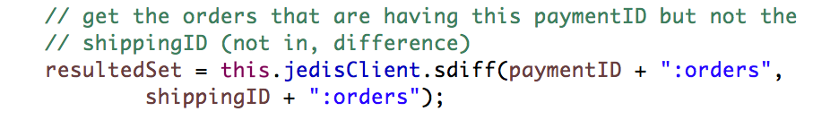
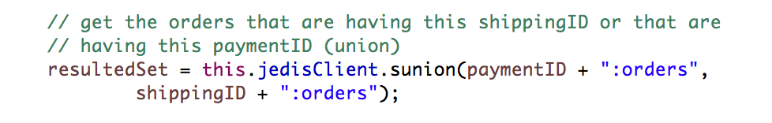
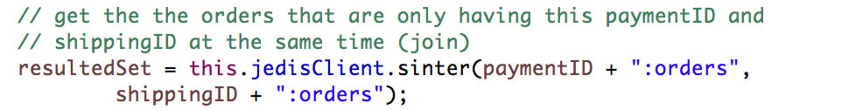
Redis – Relational Data Support
Difference
Union
Join
© sebis
20
Notes:
To get some joins , union or difference between relations , it is a easier using sets

Slide 37
Redis – Configuration & Persistence
Configuration
Can be started without configuration file.
Redis configuration is in redis.confi , format
confugirationKeyWord argument1 argument2 ... argumentN
Configured also using command line
./redis-server --port 6380 --slaveof 127.0.0.1 6379
Configuration on the fly without restarts
CONFIG SET SAVE "900 1 300 10"
Persistence
Snapshotting or RDB Persistence
Periodically and with condition
save 100 50 / BGSAVE
Append-Only File or AOF Persistence
appendonly yes / BGREWRITEAOF
fsync every , fsync every second , Never fsync ➔ fsync every for full durability
© sebis
27
Notes:
SAVE 100 50 , means take the snapshot each 100 seconds where there is at least 50 new writes
appendonly yes means any write command log it to file
Fysync is linux command used to flush data to disk , every ➔ every new write command (slow), every sec (default fast enough), never handled by OS (fast but risk)
Talk about ACID support if time available

Slide 38

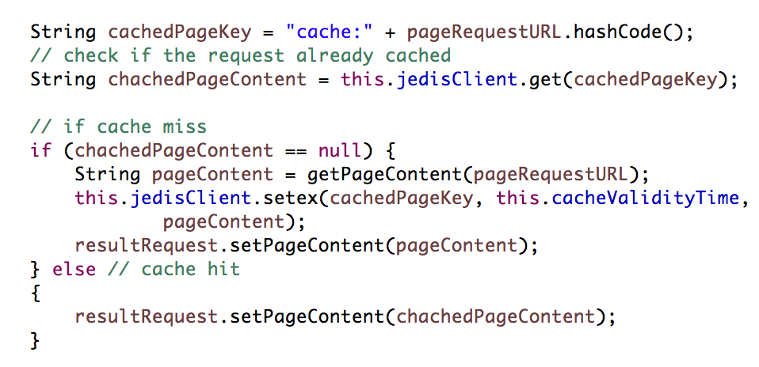
Redis – Expire
Expire
SetEx
© sebis
25
Notes:
Set a timeout on key , to be used as a cache and ect..
Mention that there is also expireAt and Pexpire (milliseconds)
You can configure Redis to act only as a cash and it can support many popular cache eviction algorithms such as least recently used and other.

Slide 39
Redis – Configuration
Can be started without configuration file.
Redis configuration is in redis.confi , format
confugirationKeyWord argument1 argument2 ... argumentN
Configured also using command line
./redis-server --port 6380 --slaveof 127.0.0.1 6379
Configuration on the fly without restarts
CONFIG SET SAVE "900 1 300 10"
© sebis
27
Notes:
SAVE 100 50 , means take the snapshot each 100 seconds where there is at least 50 new writes
appendonly yes means any write command log it to file
Fysync is linux command used to flush data to disk , every ➔ every new write command (slow), every sec (default fast enough), never handled by OS (fast but risk)
Talk about ACID support if time available

Slide 40
Redis – Indexing
Primary Index
Key
Products:ProductID ➔ Primary Index
Hash
{ “SKU”: “sku”, “Name”:”ProductName”, “Color”: “ProductColor” , “Price”: “ProductPrice” }
Secondary Index
Product.Color.Index: ProductColor
Set
{ProductIDs}
Product.Price.Index
Sorted Set
{ProductIDs , Price}
Composite Index
Product.Category.Price.Index
Sorted Set
{CategoryID:Price:ProductID, 0}
Retrieval
© sebis
22
Notes:
Index needs to be maintain manually which might get complex and errors can occur.

