Slide 1
Analysis of state of the art self-service BI Tools
Kickoff presentation
Valérianne Walter, 11.05.2015, Garching

Slide 2
Overview
Motivation
Research Questions
Timeline
Concept
Results to come

Slide 3
Motivation
  Definition of Business Intelligence (BI)
  → “Data! Data! Data! I can’t make bricks without clay!” -Sir Arthur Conan Doyle
→ “Applications, infrastructure and tools, and best practices that enable access to and analysis of information to improve and optimize decisions and performance”
- Gartner IT Glossary
Business Intelligence
Data
Staff member

Slide 4
Motivation
  Definition of Self-Service BI
→ Classical BI: focus on applications for power-users and IT-users
→ Self-service BI: focus on business users
Business users have:
  deep knowledge of their business area, of spreadsheets, of operational systems
  restrained database knowledge
  and need a lot of business information
Tools have:
  to be performant, intuitive, interactive
  To provide analytical functionalities
  huge emphasis on data visualisation

Slide 5
Research Questions
  What are the requirements to a self-service BI tool from the business user point of view?
  How do existing self-service BI tools meet these requirements?
  How do these self-service BI tools deliver in a concrete business scenario?

Slide 6
Timeline
15.03.2015
15.04.2015
15.06.2015
15.07.2015
- Selection of tools
- Define processes
- Develop scenario
- Analysis of tools
- Scenario implementation
- Refinements
- Writing

Slide 7
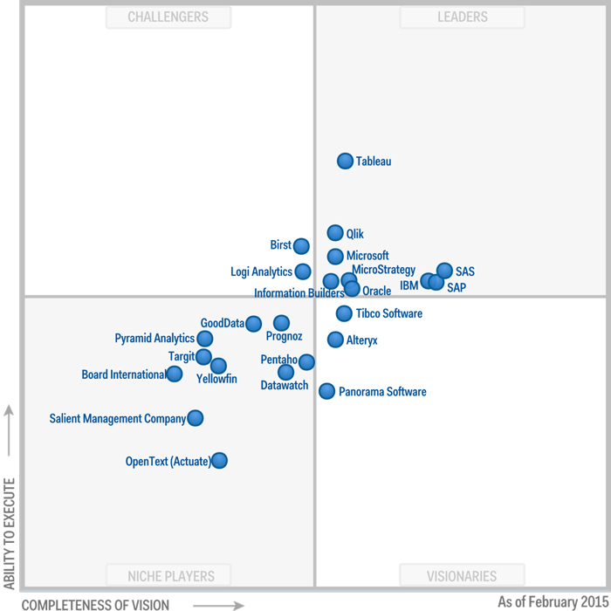
Concept
  Selection of tools
Vendor | Product
Tableau | Tableau Desktop
Qlik | QlikSense
Microsoft | Excel (with Power BI Addins)
SAS | SAS Visual Analytics
SAP | Lumira
IBM Cognos | Insights
Gartner „Magic Quadrant for Business Intelligence and Analytics Platforms“, 20. 02.2015

Slide 8
Concept
  Processes
 | Steps
1 | Importing of data
2 | Data Modelling
3 | Basic Analysis
4 | Visualisation
5 | Testability
6 | Collaboration
7 | Presenting
Usability | - Ease of learning - Ease of using
Flexibility | - Scope of functionalities - Adaption of functionalities

Slide 9
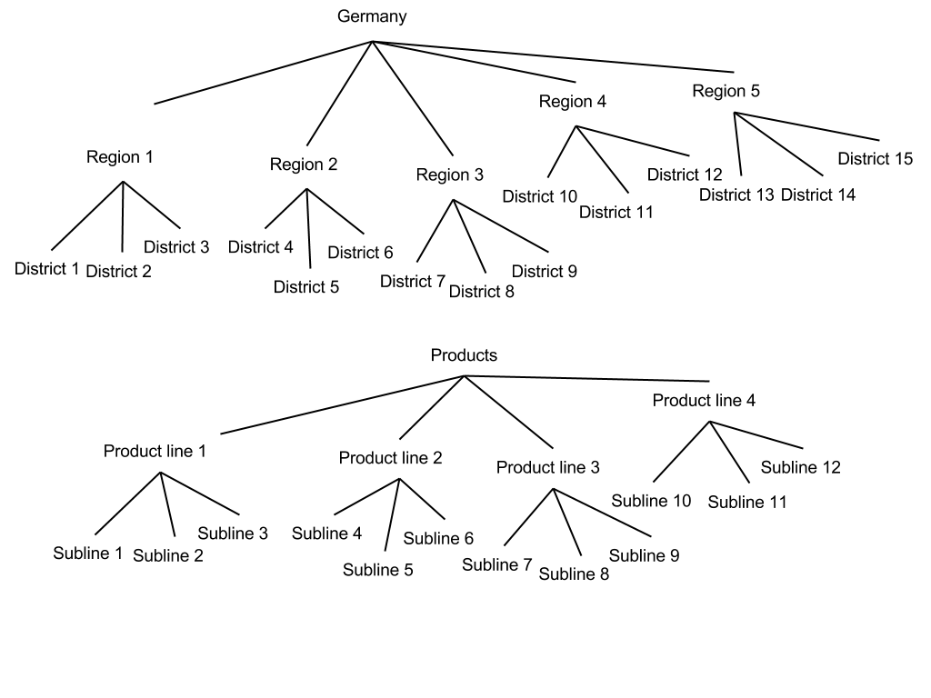
Concept
  Scenario
→ Reports for Sales-force worker
→ Must summarize the important information over the last months

Slide 10
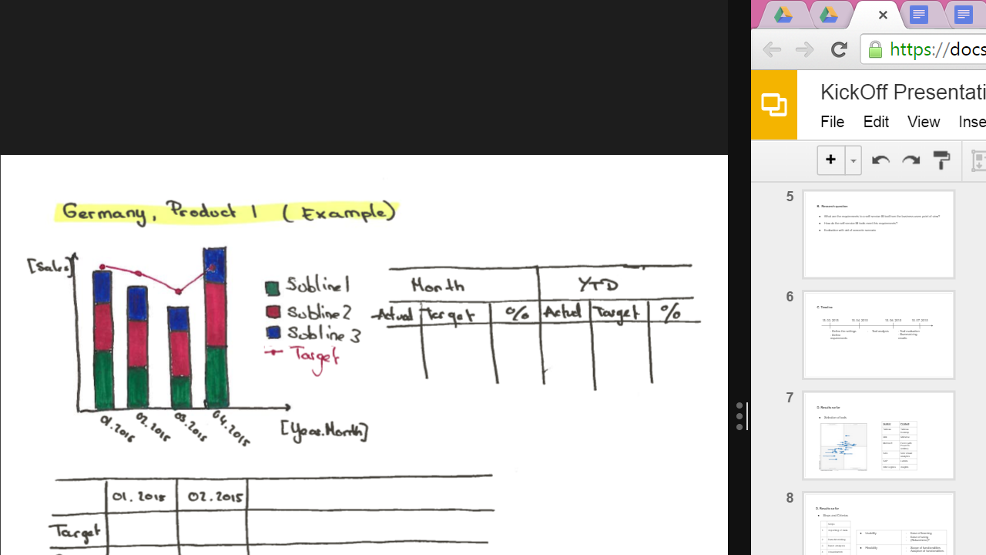
Concept
  Scenario
  → Mock-up of possible end-dashboard

Slide 11
Tasks to do
  Refinement of results on Excel, Tableau, Qliksense
  SAS, IBM, SAP
  Implementation of scenario
  Writing

Slide 12
Questions? Remarks? Criticism?
Thanks for your attention!
Valérianne Walter

