Slide 1
Analysis of state of the art self-service BI Tools Endpresentation
Valérianne Walter, 11.05.2015, Garching

Slide 2
Overview
Motivation
Scope
C. Research Questions
D. Tool Analysis
E. Business Scenario
F. Results
G. Outlook

Slide 3
Motivation
Before Self-Service BI
Issuing problems:
- Overloading of IT
- Back and forth between IT and business users
→ Demand for data goes unsatisfied
Request for report
BI Structures
Draw reports
IT/Power users
Business users
Report supply

Slide 4
Motivation
With Self-Service BI
Concept: Make BI structures accessible to users
Gain:
Process optimization
Better decision support
BI Structures
Draw reports
Business users

Slide 5
Scope
Business Users
deep knowledge of their business area
expertise with spreadsheets, operational systems
restrained database knowledge
need a lot of business information
BI data flow
Tools need:
To be performant, intuitive, interactive
To provide analytical functionalities
Have a huge emphasis on data visualisation
External sources
Operational systems
ETL processes
Data warehouse
Queries
Analysis/Reporting tools

Slide 6
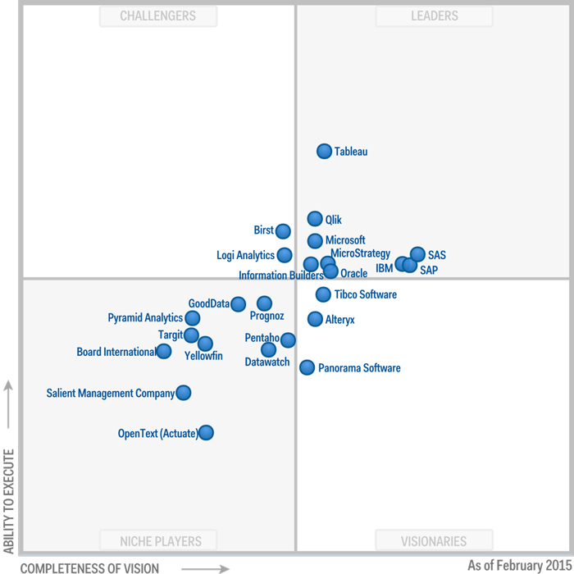
Scope
Selection of tools
Vendor | Product
Microsoft | Excel (with Power BI Addins)
Tableau | Tableau Desktop
Qlik | QlikSense
SAS | SAS Visual Analytics
SAP | Lumira
IBM | Watson Analytics
Gartner „Magic Quadrant for Business Intelligence and Analytics Platforms“, 20. 02.2015

Slide 7
Research Questions
What are relevant functionalities/ processes for business users regarding self-service BI tools?
How do existing self-service BI tools implement these functionalities/processes?
How do these self-service BI tools deliver in a concrete business scenario?

Slide 8
Tool analysis
Relevant functionalities/processes
Taxonomies defined for data visualization tools
Example:
Categorize, Associate, Compute derivate values,
Filter, Abstract, Elaborate
(Wehrend and Lewis 1990)(Stasko at. al 2004, 2007)
Catalogue of questions
Example:
What type of files are supported?
What is the data model?
What possibilities do we have to associate data objects?
What visualizations do we have?
What are possible error sources?
 | Steps
1 | Data Access
2 | Data Modelling
3 | Data set analysis
4 | Aggregate-level analysis
5 | Testability
6 | Presenting
7 | Collaboration

Slide 9
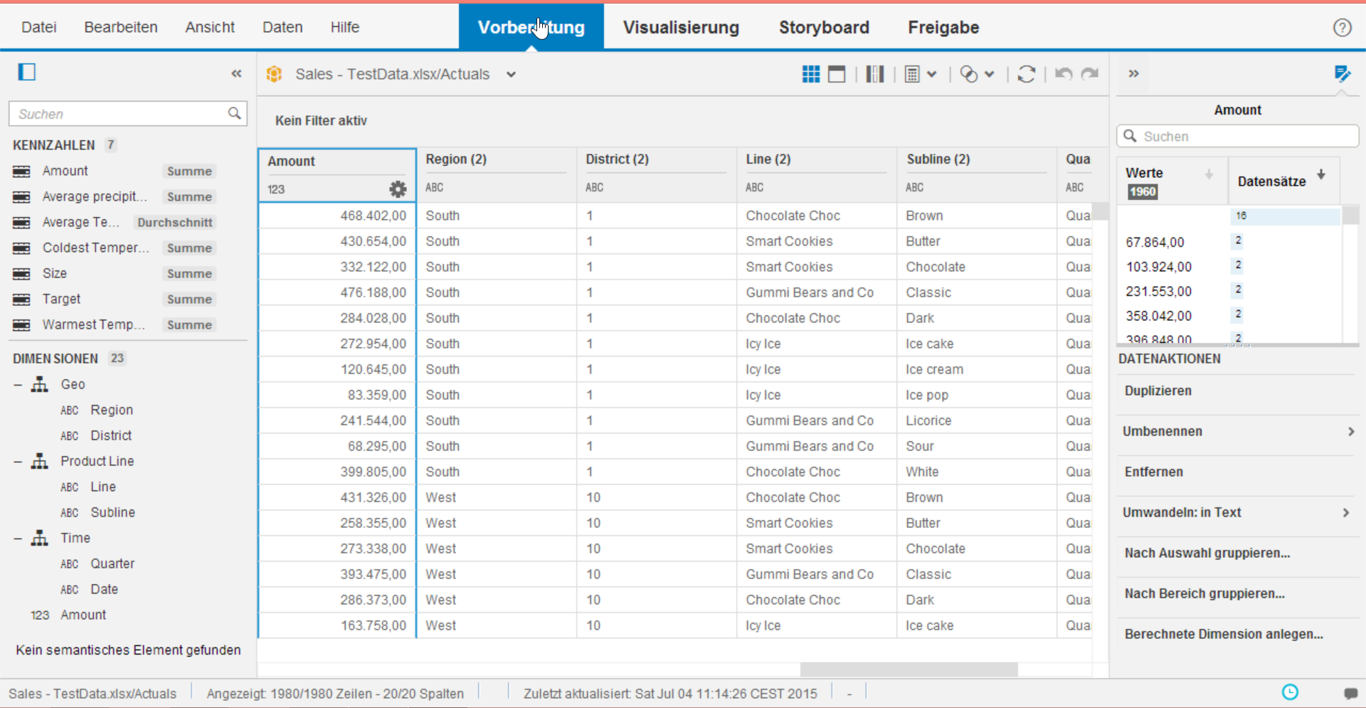
Tool analysis (Results)
General structure
Section 1: Data Access and Data Modelling

Slide 10
Tool analysis (Results)
Data access
Differences regarding:
Supported data sources
Extent of support
Extent of data shaping possibilities
Data modelling
Similar approach:
„Passive“ data objects: table with fields
„Active“ data objects: dimensions, measures
Relationship modelling: join, hierarchies, grouping

Slide 11
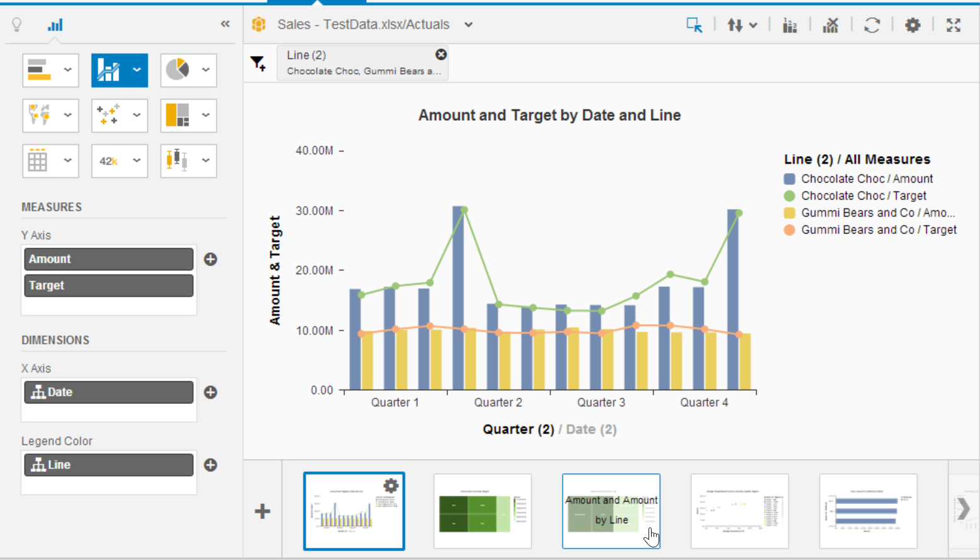
Tool analysis (Results)
General structure
Section 2: Analysis

Slide 12
Tool analysis (Results)
Plain data analysis
Only Excel enables thorough non aggregated data analysis
Aggregate level analysis
Similar approaches:
Based on visualizations mainly
Similar set of visualization options
Different roles for dimensions and measures (Rows, Columns, Filter, Legends)
Basic OLAP operations (Rollup, Drilldown, Pivot, Slice/Dice)
Differences:
Set of out of the box solution for some analysis tasks (especially trend lines, ranking etc. )

Slide 13
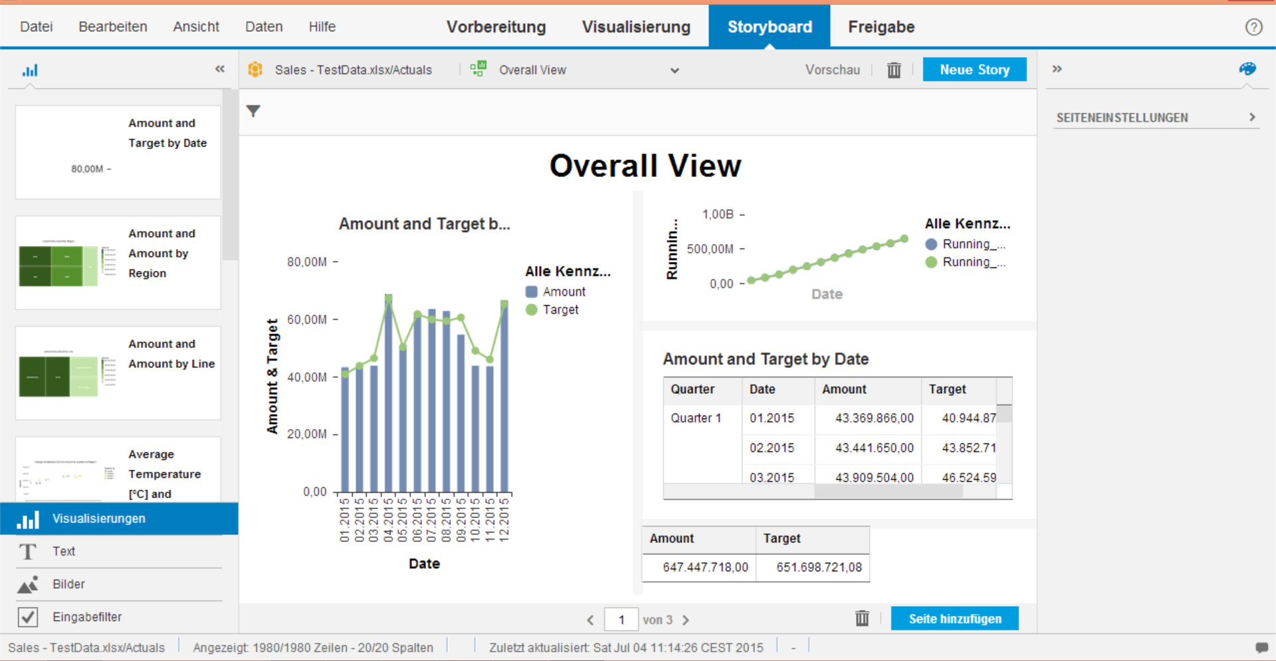
Tool analysis (Results)
General structure
Last section: Presenting

Slide 14
Tool analysis (Results)
Presenting
Similar approaches:
Dashboards
Stories
Other aspects
Testability
Similar approaches:
Avoid errors sources
Scripting is kept optional, Wizards
First attempts at automated analysis of data source errors
Sharing
Mostly platform related solutions
Out-of-scope

Slide 15
Business scenario
Scenario
→ Dashboards about sales
→ Must summarize the important information over the last months
Overall
Region 1
Region 2
District 1
District 2
District 3
Region 3
District 4
District 5
District 6
District 7
District 8
District 9
Region 4
District 12
District 10
District 11
Region 5
District 13
District 14
District 15
Products
Line 1
Line 2
Subline 1
Subline 3
Line 3
Subline 1
Subline 3
Subline 1
Line 4
Subline 2
Subline 2
Subline 2
Subline 3
Subline 1
Subline 2
Subline 3

Slide 16
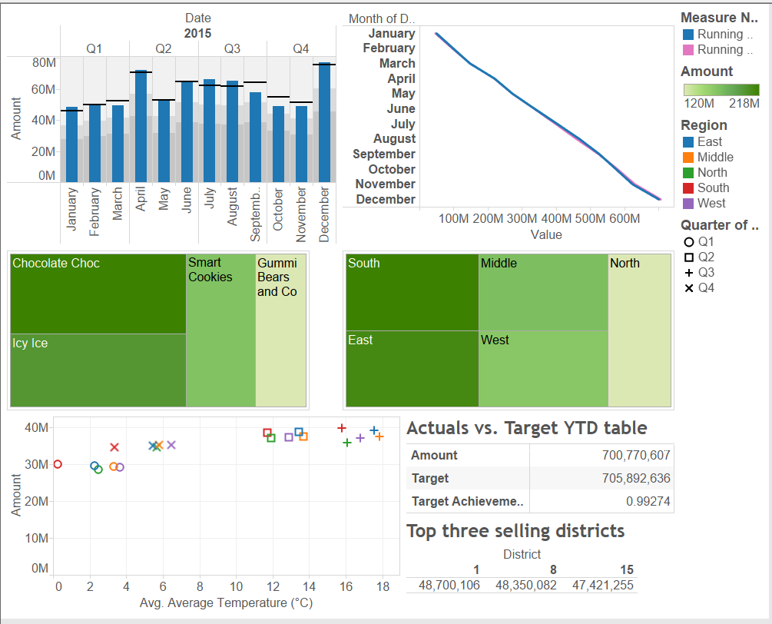
Business Scenario
Results
Steps

Slide 17
Summary
Different state of development
Main difference: Set of functionalities
Same basic principle and structure
Concepts converge towards a same standard

Slide 18
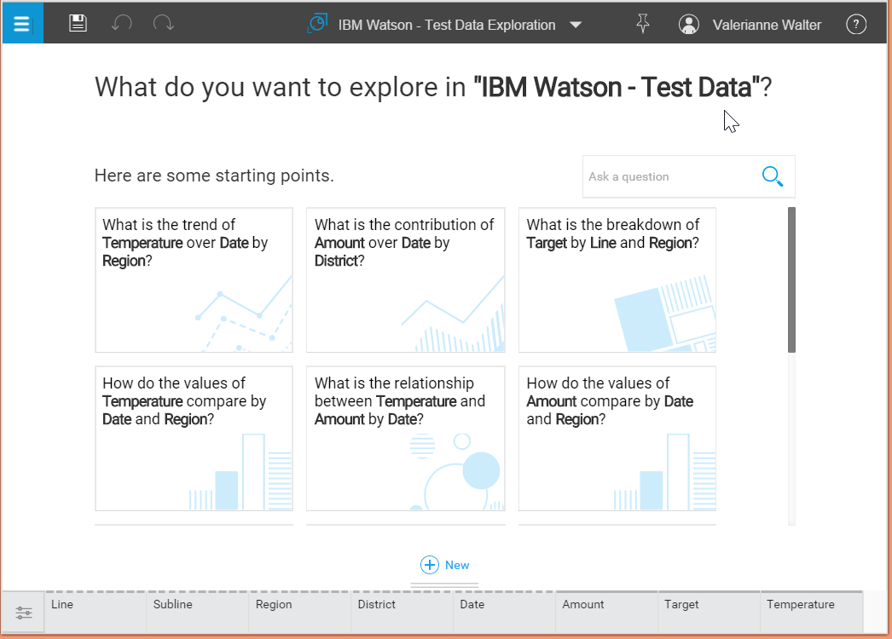
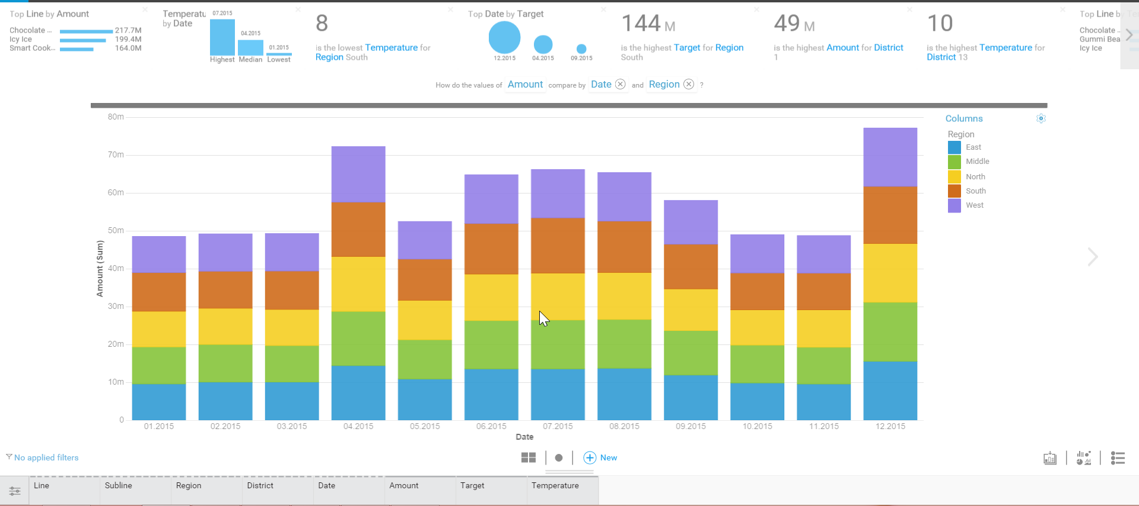
Outlook
Smart data discovery

Slide 19
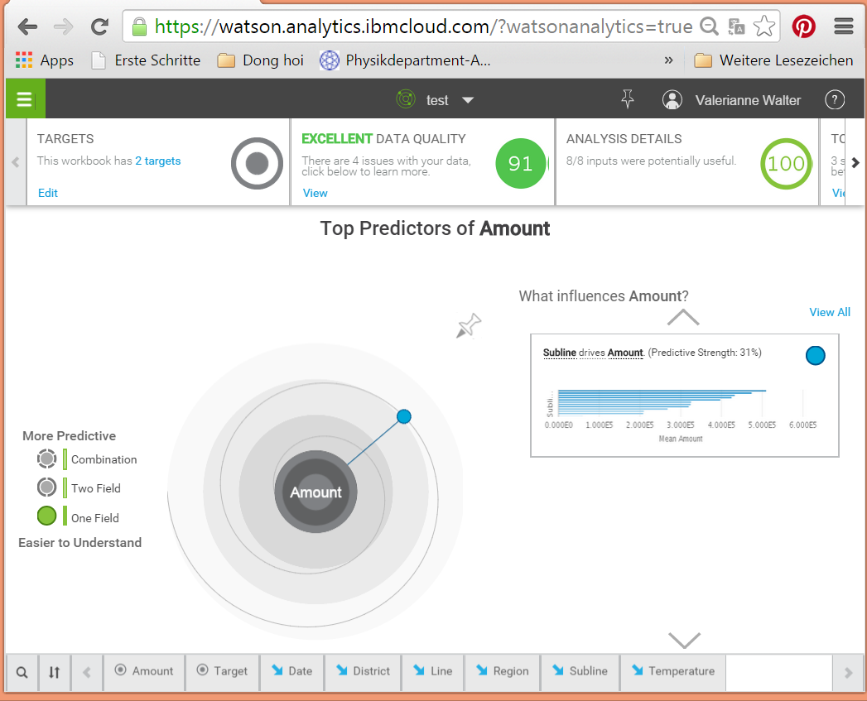
Outlook
Predictive analytics

Slide 20
Questions? Remarks? Criticism?
Thanks for your attention!
Valérianne Walter

