Slide 1
Design of an Interactive and Web-based Software for the Management, Analysis and Transformation of Time-Series
Master Thesis Kick-Off Presentation
Fawumi, Kehinde | 01.12.2014

Slide 2
Overview
1
2
3
Motivation
Objectives
Research Approach
Why this Project?
Why does it matter?
What do we intend to achieve?
How are we going to achieve our objectives?
4
5
6
Expected Output
Project Timeline
Conclusion and Outlook
What is/are the expected output?
What is the Project Timeline?
Conclusion and Outlook

Slide 3

Motivation I – Spreadsheet Usage
Spreadsheets have become an integral part of many businesses globally
They facilitate countless business functions (like data analysis, financial reporting, project management etc.)
Total: 1.2 billion users
Others
~5%
Asia
~40%
Europe
~20%
Americas
~20%
Africa
~10%
Australia
~5%
For more information visit: http://online.wsj.com/articles/do-you-really-need-microsoft-office-anymore-1407873198
© sebis
3
Notes:
Joke: Computer Scientists learn coding in school and spend their career working on Spreadsheets

Slide 4
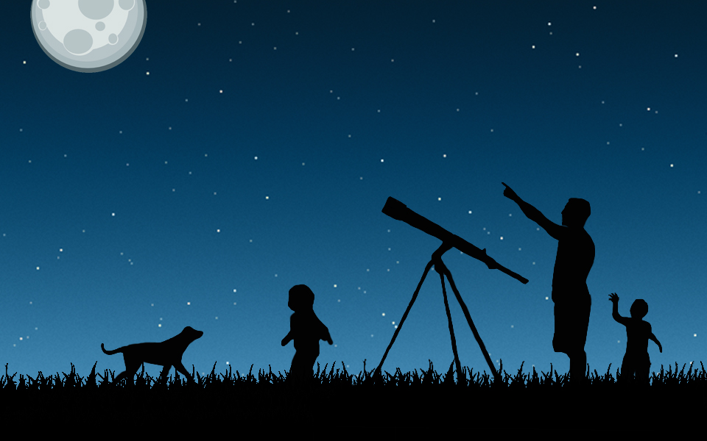
Motivation II – Why Time Series?
A Time Series is a sequence of data points, typically consisting of successive measurements or observations on quantitifiable variables, made over a time interval.
In comparison to other semantic patterns, the time-series pattern offers interesting distinct features.
  the value of a time series in a time period is often affected by the values of variables in preceding periods,
  the order in which the data occurs in the spreadsheet is very important.
140122 Matthes Slides sebis 2014
© sebis
Notes:
Examples:
Historical data on sales, inventory, customer counts, interest rates, costs, etc.
Businesses are often very interested in forecasting time series variables. In time series analysis, we analyze the past behavior of a variable in order to predict its future behavior. Time series are very frequently plotted via line charts.
Time series are used in statistics, signal processing, pattern recognition, econometrics, mathematical finance, weather forecasting, earthquake prediction, electroencephalography, control engineering, astronomy, communications engineering, and largely in any domain of applied science

Slide 5
Motivation II – Why Time Series?
Time Series Examples:
Historical data on sales, inventory, customer counts, interest rates, costs, etc.
Businesses are often very interested in forecasting time series variables.
Used in:
Statistics, signal processing, pattern recognition, econometrics...
Weather forecasting, earthquake prediction, astronomy, electroencephalography...
140122 Matthes Slides sebis 2014
© sebis
Notes:
Time series are used in econometrics, mathematical finance,
electroencephalography, control engineering,
communications engineering
largely in any domain of applied science

Slide 6

Motivation III
i
  Current tools/applications for analyzing and managing time-series are not easy to use for
  end-users
Notes:
Add-Ins for MS Excel
CB Predictor
Matlab
SAS/ETS
Aquarius Timeseries
Etc.

Slide 7

Research Questions
What are Time-series (patterns) and how are they different from other patterns in spreadsheets?
How common are time-series patterns in spreadsheets today?
Which are the current tools/applications used for managing and analyzing time-series? What are their strengths and weaknesses?
What are the best design strategies for an end-user oriented application for managing and analyzing time-series data?

Slide 8

Research Objective
Our Objective is to define requirements for, and to design a user-oriented software for the management, analysis and transformation of time-series.

Slide 9
Research Approach
Identify Time-Series Features
Step 2
Step 3
Step 4
Step 5
Identify the specific features of the time-series pattern and how it differs from other semantic patterns
© sebis
8

Slide 10
Research Approach
Identify Time-Series Features
Analyze Existing Tools for managing time-series
Step 3
Step 4
Step 5
State-of-the-art analysis of tools for managing and analyzing time-series (e.g., MS Excel, Matlab, CB Predictor etc.)
  a. Strength and weaknesses of those tools
  b. What are the concepts of these tools with respect the support of time-series
© sebis
9

Slide 11
Research Approach
Identify Time-Series Features
Analyze Existing Tools for managing time-series
Literature Review
Step 4
Step 5
Review related work on time-series in the context of spreadsheets/self-service BI.
Identify use-cases
© sebis
10

Slide 12
Research Approach
Identify Time-Series Features
Analyze Existing Tools for managing time-series
Literature Review
Design application model for time-series mgmt.
Step 5
Derive requirements and meta-model for managing time-series
Design Application Model
© sebis
11

Slide 13
Research Approach
Identify Time-Series Features
Analyze Existing Tools for managing time-series
Literature Review
Design application model for time-series mgmt.
Design Mock Ups
Design mock-ups for demonstrating how time-series can be managed and analyzed by end-users
© sebis
12

Slide 14
Research Approach
Identify Time-Series Features
Analyze Existing Tools for managing time-series
Literature Review
Design application model for time-series mgmt.
Design Mock Ups
© sebis
13

Slide 15
Expected Outcomes I
Meta-model of an interactive and web-based software for the management, analysis and transformation of time-series.
Mock-Ups for demonstrating how time-series can be managed and analyzed by end-users

Slide 16
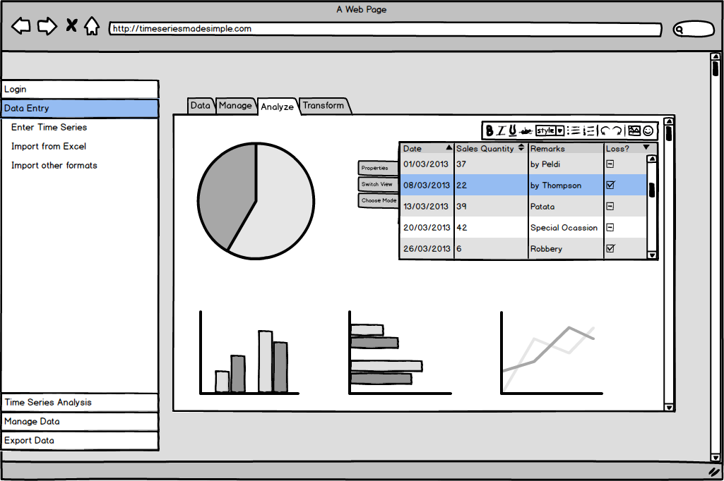
Expected Outcomes II – Mock Up

Slide 17
Project Timeline
 |  | Nov | Dec | Jan | Feb | Mar | Apr | May
Identify Time-Series Features
Analyze Existing Tools
Literature Review
Design application model
Design Mock Ups
Writing of Thesis Report
Presentation
Today
Complete
Ongoing
Not Started

Slide 18

Thank you for your attention!
Fawumi, Kehinde
MSc. Informatics Student

Slide 19
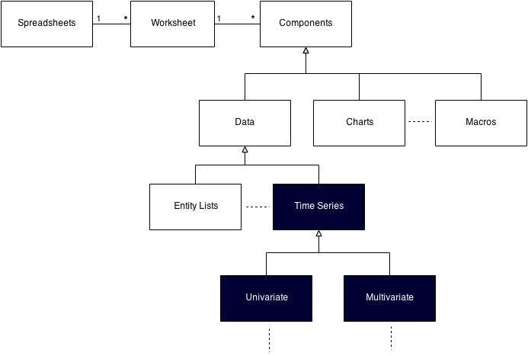
Back Up – Spreadsheets UML

Slide 20
Back Ups

Slide 21
Agenda
Specific features of time-series, differences to other semantic patterns
Quantification of Qualitative Variables
State-of-the-art analysis of tools for managing and analyzing time-series
Related work on time-series in the context of spreadsheets/self-service BI.
Identification of use-cases
Derivation of requirements
Meta-model for managing time-series

Slide 22
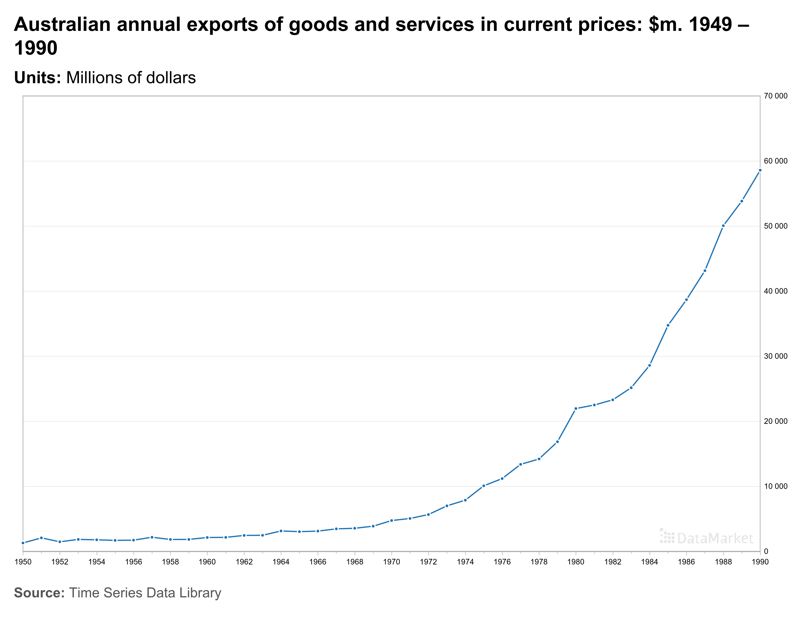

Slide 23
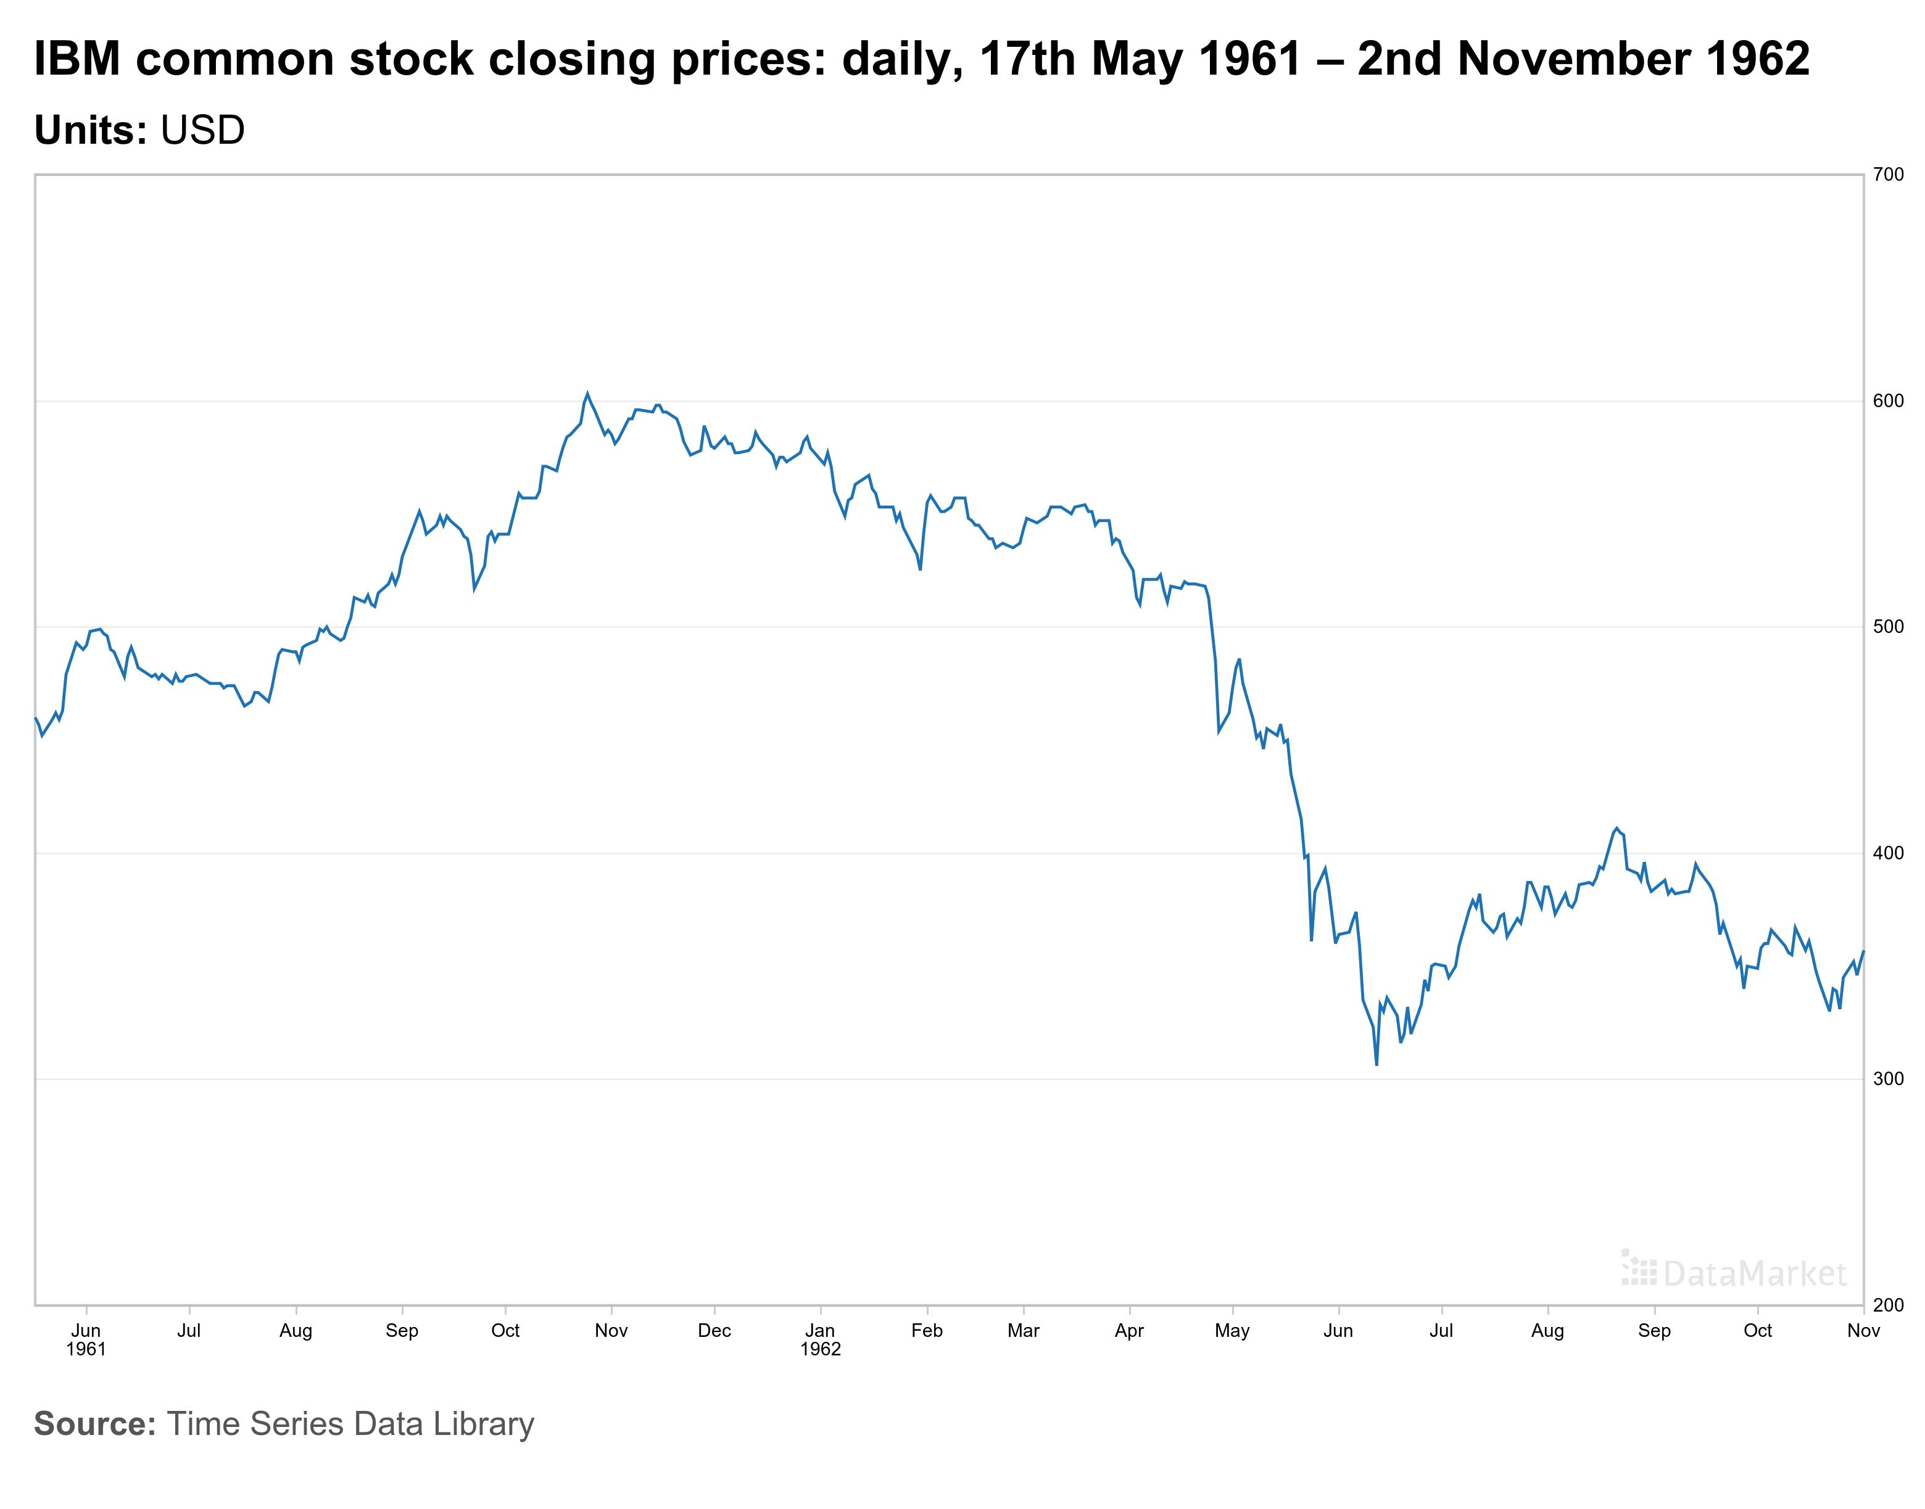

Slide 24
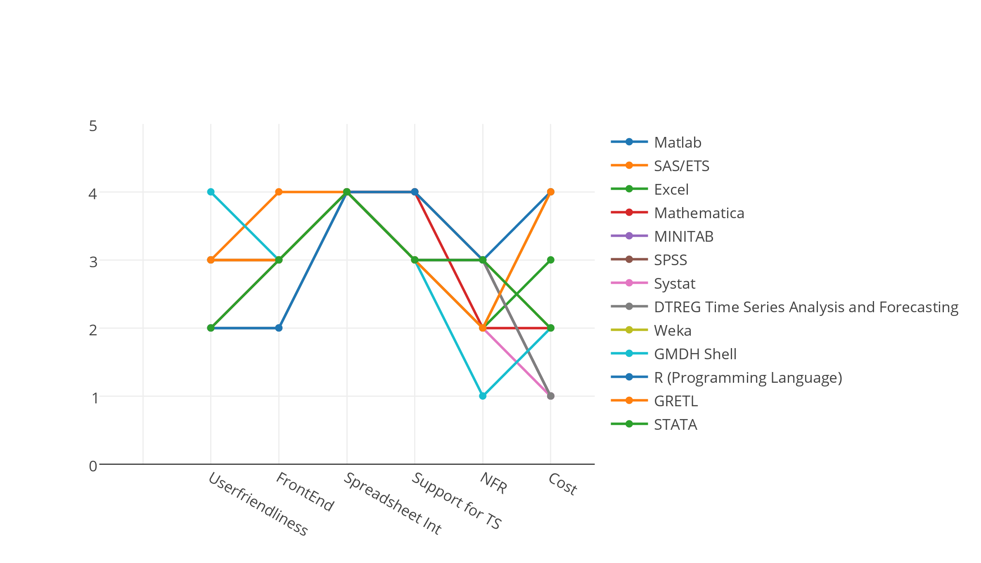
Comparative analysis of tools for managing and analyzing TS
1 | Poor | Very Difficult | No GUI |  | High
2 | Fair | Difficult | Poor | Basic | Medium
3 | Good | Moderate | Fair | Moderate | Low
4 | Excellent | Easy | Good | Advanced | Free

Slide 25
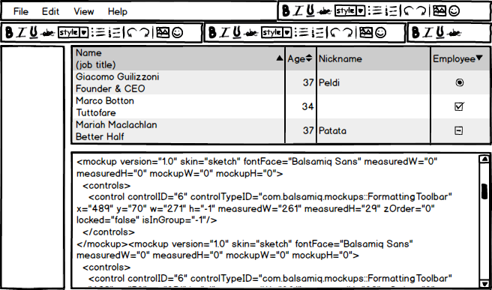
General Outlook of Software

Slide 26



Project Status
 |  | Nov | Dec | Jan | Feb | Mar | Apr | May
Time-Series Features and Theoretical Background
State-of-the-art analysis of Existing Tools
Literature Review / Related Works
Identification of Use Cases
Requirements, Mock Ups, Meta-model
Writing of Thesis Report
Presentation
Today
Complete
Ongoing
Not Started

