Slide 1
Master Thesis Final Presentation Design of an Interactive and Web-based Software for the Management, Analysis and Transformation of Time Series
Fawumi, Kehinde | 20.04.2015

Slide 2
Overview
1
2
3
Motivation
Time Series in Real-World Spreadsheets
Analysis of Existing
Time Series Tools
Why this Project?
Research Questions.
What are Time series?
How common are they?
What are the strengths and Weaknesses of existing tools?
4
5
6
Requirements for the Thesis Software
Usage Scenarios
& Mock Ups
Conclusion
What are the functional requirements of the Software?
How exactly will end users work with the software?
Conclusion

Slide 3
1
Motivation
Why this Project?
Research Questions.

Slide 4




Motivation
Large amounts of time-stamped data are being collected, processed and measured daily.
20 petabytes
of daily time-stamped data
1million customer
transactions every hour
250 billion photos
350 million photos/day

Slide 5




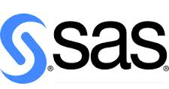
Motivation
Business Operations
Needs to analyze huge number of transaction data
No programming skills
Needs to frequently update the analysis
Available Tools are targeted at skilled professionals
End users play a key role in validating the utility and interactivity of time series tools.
Notes:
economics - e.g. monthly data for unemployment, hospital admissions, etc.
finance - e.g. daily exchange rate, share prices, etc.
environmental - e.g. daily rainfall, air quality readings.
medicine - e.g. ECG brain wave activity every 2⁻⁸ secs.

Slide 6
Motivation
Scenarios:
Wal-Mart wants to perform location-based analysis of the over 1 million hourly transactions
Facebook wants to forecast how many millions of photos users will upload in the future; etc.
A grocery store performing an analysis on daily sales of a product
A farmer tracking the number of crops harvested daily etc.
Often, ‘end-user programmers’ have a different set of requirements and should be enabled to accomplish them.

Slide 7
Research Questions
?
What are Time-series and what features distinguish them from other data types?
?
How common are time-series patterns in spreadsheets today?
?
Which are the current tools used for managing and analyzing time-series?
What are their strengths
and weaknesses?
?
What are the requirements for an
end-user oriented application for
managing, transforming and
analyzing time-series?

Slide 8
2
Time Series in Real-World Spreadsheets
?
What are Time-series and what features distinguish them from other data types?
?
How common are time-series patterns in spreadsheets today?

Slide 9
What are Time Series?
A Time Series is a sequence of data points, typically consisting of successive measurements or observations on variables, made over a time interval.
Examples:
Economics - e.g. monthly data for unemployment, hospital admissions, etc.
Finance - e.g. daily exchange rate, share prices, etc.
Environmental - e.g. daily rainfall, air quality readings.
Medicine - e.g. ECG brain wave activity every 2−8 secs.
Historical data on sales, inventory, customer counts, interest rates, costs, etc. Statistics, signal processing, pattern recognition, econometrics...

Slide 10
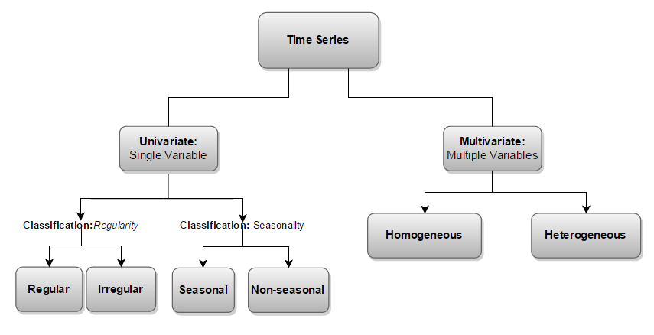
Classification of Time Series

Slide 11
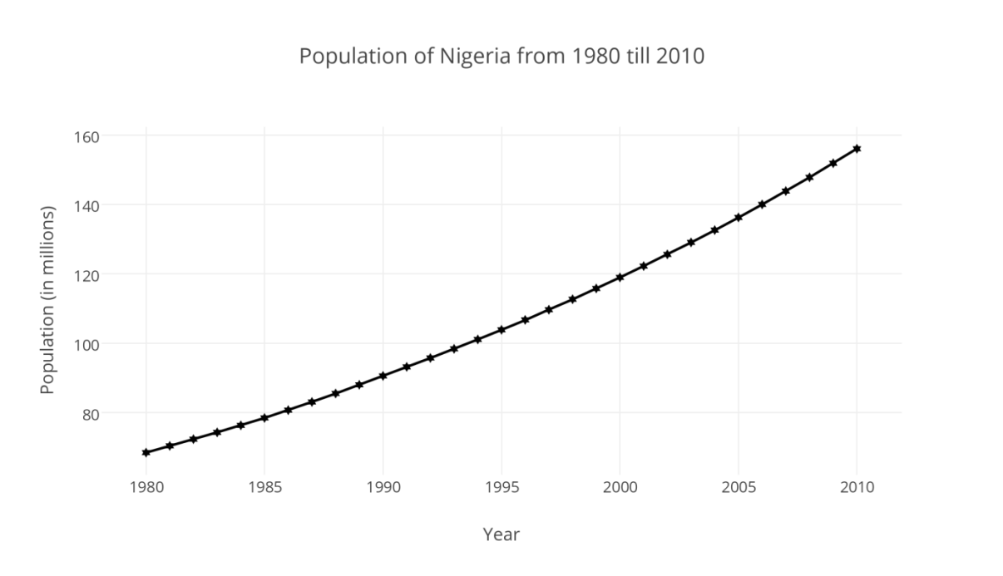
Example of a Time Series
Regular Univariate Time Series

Slide 12
Time Series Features
1
They are generally written in a predefined order or some aggregated result based on the need of the user.
2
The value of a time series in a time period is often affected by the values of variables in preceding periods
3
Time series data are usually manipulated as one single object. The ordering often represents the dependencies between the collected data.
4
Time series have a header containing all the metadata about the time series. Particularly the date-time field which defines the dataset as a time series.
5
Data in time series are not necessarily identically distributed but they are dependent.
6
The past behavior of a variable can be used to predict its future behavior

Slide 13
Time series in Real World Spreadsheets
23% Time series
found in EUSES Corpus
7% Time Series
found in Enron Spreadsheets Corpus
Overall
14% Time series
found in EUSES and Enrons Spreadsheet Corpuses
Notes:
Criteria for identifying Spreadsheets
Fields:
Date-time
Date
Year
Month
Other Formats:
Week numbers
Month numbers
Quarter Numbers

Slide 14
3
Analysis of Existing
Time Series Tools
?
Which are the current tools used for managing and analyzing time-series?
What are their strengths
and weaknesses?

Slide 15
Analysis of Existing Time Series Tools - Approach
The tools that were analyzed were chosen on the basis of their popularity and user-base (rankings and reviews by (McCullough & Vinod, 1999), (Zhu & Kuljaca, 2005) and (Zaslavsky, 2014).)
Two sets of analysis were made:
Analysis based on requirements from an end-user perspective: interviews and discussions of end-users on online forums and social media.
Analysis on the basis of their support for thesis objectives: i.e. time series management, transformation, analysis and visualization.

Slide 16
Analysis of Existing Time Series Tools – End-user perspective
Time Series Tool | User friendliness | Front-end/GUI | Support for time series analysis | Non functional requirements | Cost & Availability
MATLAB | Moderate | Fair | Advanced | Good | High
SAS/ETS | Moderate | Good | Advanced | Good | Medium
MS Excel* | Moderate | Fair | Moderate | Fair | Low
Mathematica | Difficult | Fair | Advanced | Fair | Medium
MINITAB | Moderate | Fair | Moderate | Good | High
SPSS | Moderate | Fair | Moderate | Good | High
Systat | Moderate | Fair | Moderate | Fair | High
DTREG Analysis & Forecasting | Difficult | Poor | Moderate | Fair | High
Weka | Moderate | Fair | Moderate | Fair | Free
GMDH Shell | Easy | Fair | Moderate | Poor | Medium
R Language | Difficult | Poor | Advanced | Fair | Free
GRETL | Moderate | Fair | Moderate | Fair | Free
STATA | Difficult | Fair | Moderate | Fair | Medium
OpenEpi** | Moderate | Poor | Moderate | Fair | Free
*MS Excel was analyzed based on its add-ins for time series analysis
**OpenEpi is a web-based tool

Slide 17
Analysis on the basis of their support for thesis objectives
Time Series Tool | Time series Management | Time series Transformation | Time series Analysis | Time series Visualization
MATLAB | Fair | Fair | Good | Fair
SAS/ETS | Fair | Good | Good | Good
MS Excel | Fair | Poor | Fair | Fair
Mathematica | Fair | Poor | Good | Poor
MINITAB | Fair | Poor | Good | Fair
SPSS | Fair | Poor | Fair | Poor
Systat | Good | Fair | Good | Fair
DTREG Analysis & Forecasting | Good | Fair | Good | Fair
Weka | Fair | No Support | Good | Good
GMDH Shell | Good | Good | Fair | Good
R Language | Fair | Fair | Good | Fair
GRETL | Good | Fair | Fair | Fair
STATA | Fair | Fair | Good | Fair
OpenEpi | Fair | No support | Fair | Poor
Notes:
No Support – Functionality not supported
Poor – No direct/strong support for functionality. It can however be adapted by end users manually or by programmatically combining functions
Fair – Functionality supported but not easily used by end users
Good – Functionality is supported and is easy to use by end users

Slide 18
4
Requirements for the Thesis Software
?
What are the requirements for an
end-user oriented application for
managing, transforming and
analyzing time-series?
Notes:
Focus is on functional requirements

Slide 19
Requirements for Thesis Time series Software - Approach
Requirements are gathered:
based on requirements from end-user perspective
by observing and analyzing the existing time series software their support for thesis objectives
Technical features of the Thesis Software are also discussed.
These features enable the software deliver effectively on each requirement.

Slide 20
Requirements for Thesis Time series Software
Requirements for Time series management
Requirements for Time series Transformation
Efficient management of time series data
General interface and outlook of the software.
Transforming time-stamped data to time series
Quantifying qualitative data inputs
Checking the time series output for correctness.
Requirements for Time series Analysis
Requirements for Time series Visualization
Accurate analysis of time series with least dependency on user input.
Time series forecasting
Standardized visualization and plotting of time series data
Persistent interaction between the time series data input and respective graphical representations.

Slide 21
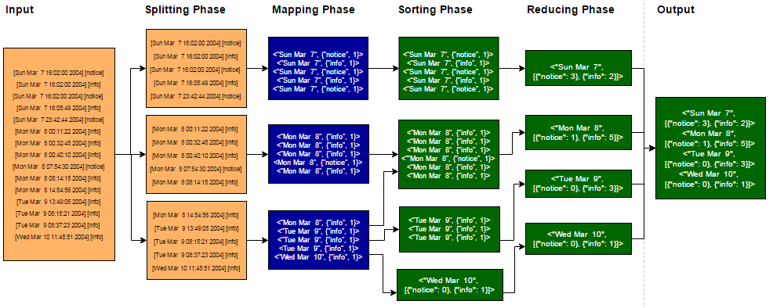
Requirements for Time Series Transformation
Functional Requirement | Supporting Technical Features
Convert time-stamped data to time series Convert time series data from one frequency to another (such as from weekly to monthly or vice versa). Represent text data with numeric values. | Support for MapReduce libraries Support for a wide range of time series frequencies: Yearly, Quarterly, Monthly, Weekly, Daily, Hourly and every minute. Support for aggregation functions such as: Sum, Count, Average, Min and Max. Ability to auto-detect and describe data characteristics e.g. data types, date field etc.
<"Sun Mar 7", [{"notice": 3}, {"info": 2}]> <"Mon Mar 8", [{"notice": 1}, {"info": 5}]>

Slide 22
Requirements for Thesis Time series Software
Functional Requirement / Software Feature | Time series Management | Time series Transformation | Time series Analysis | Time series Visualization
Create TS | X | X
Auto-adjust TS | X | X
Edit TS | X | X | X | X
Import and export TS | X | X
Transform TS |  | X
Frequency adjustment | X | X
Quantify qualitative variables |  | X | X
Report on Output |  | X | X | X
Analyze TS |  |  | X
Automatic Model Selection |  |  | X
Forecast TS |  |  | X | X
Variety of Models |  |  | X | X
Verify output | X | X | X | X
TS Visualization |  |  |  | X
Visualize multiple plots |  |  |  | X
Adjust graph |  |  |  | X
Print graph |  |  |  | X
Scalable plots |  |  |  | X

Slide 23
5
Usage Scenarios
& Mock Ups
How exactly will end users work with the software?

Slide 24
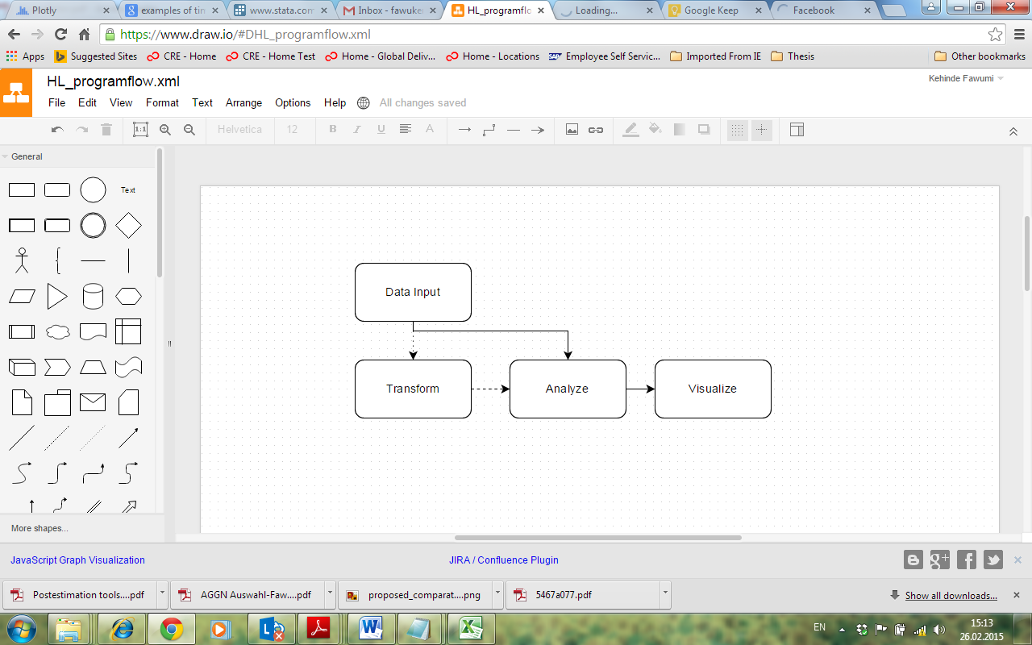
High-level process flow of software

Slide 25
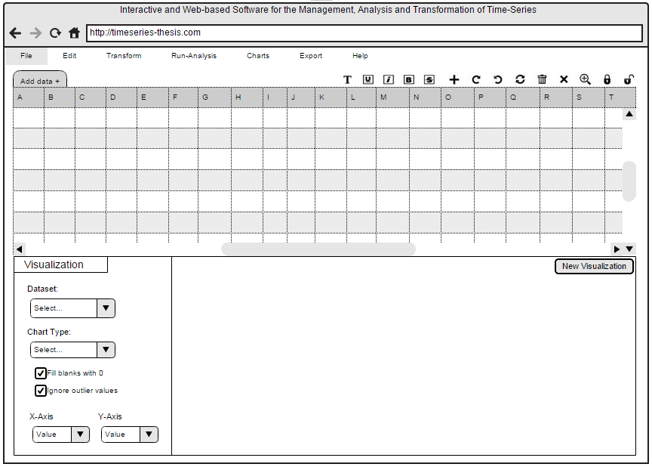
Mock Up: Generic Interface of Time Series Tool

Slide 26
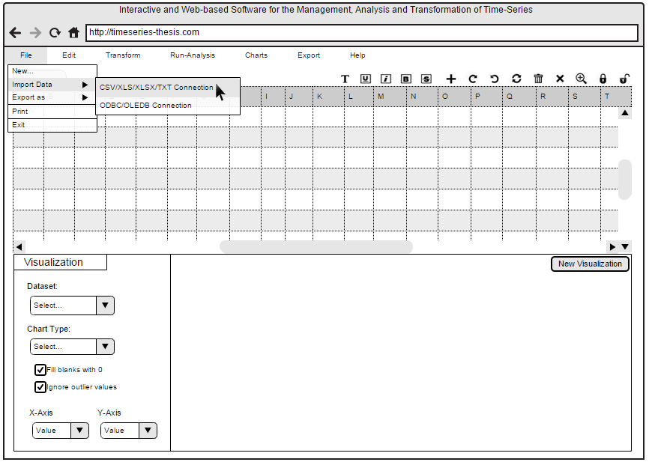
Mock Ups Data Import I

Slide 27
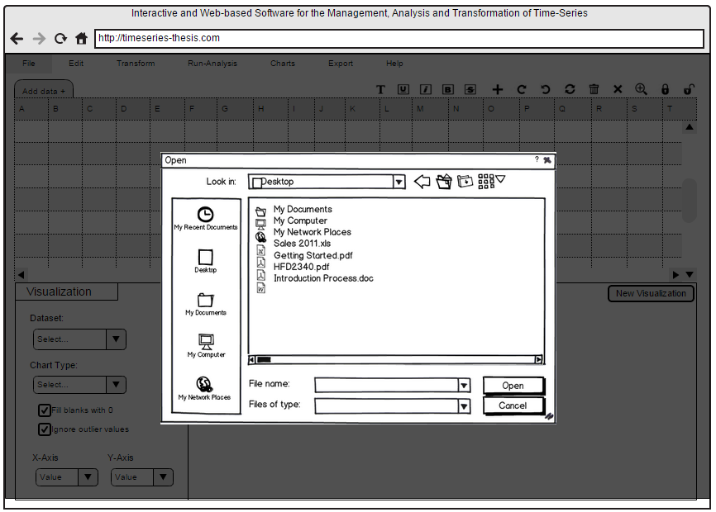
Mock Ups Data Import II

Slide 28
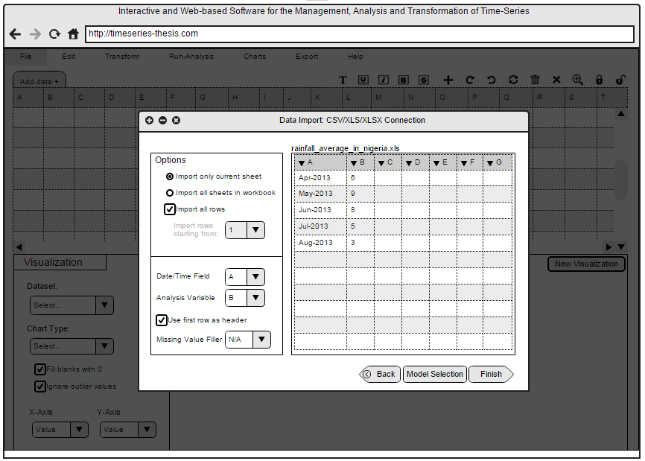
Mock Ups: Data Import III

Slide 29
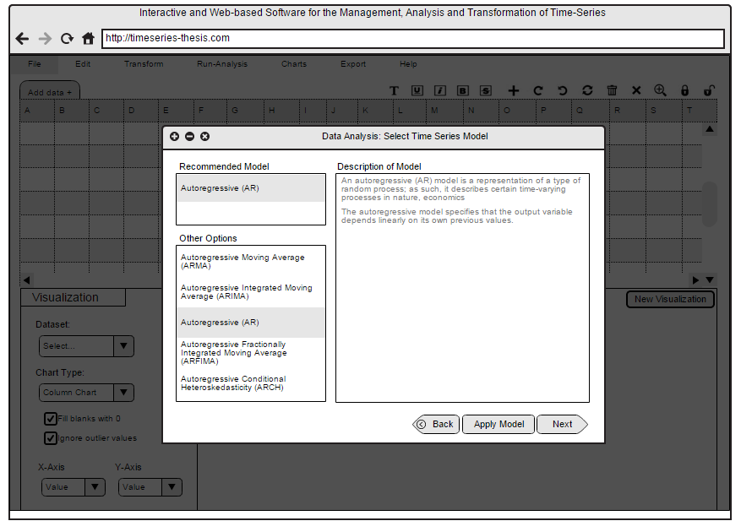
Mock Ups: Select Time series Model

Slide 30
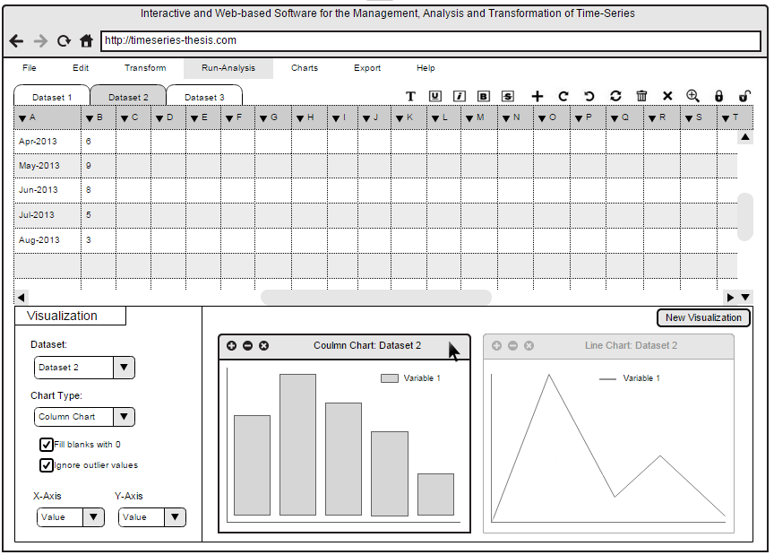
Mock Ups: Analyze Data

Slide 31
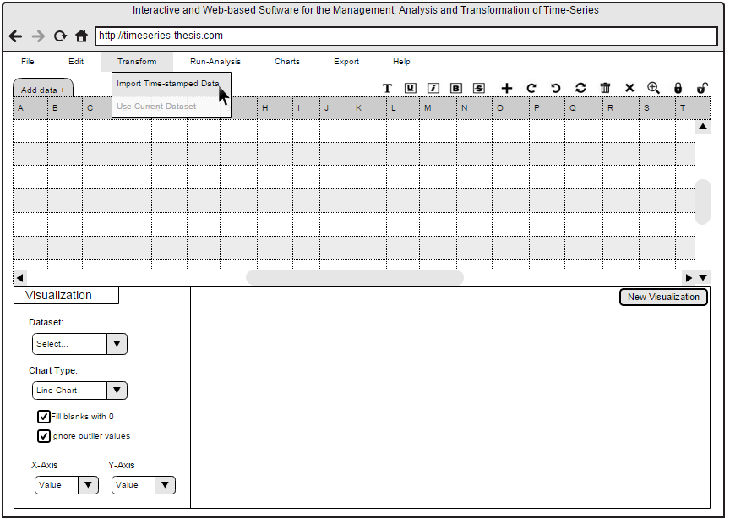
Mock Ups: Transform Time-stamped Data I

Slide 32
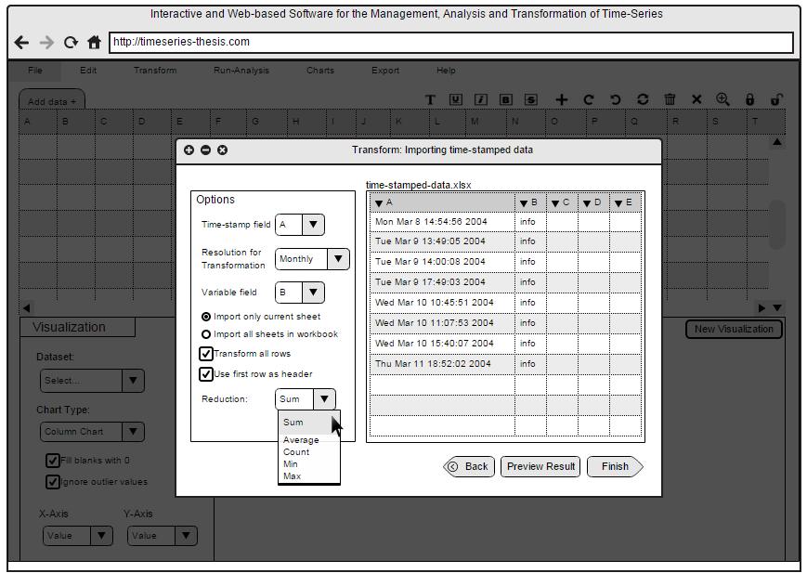
Mock Ups: Transform Time-stamped Data II

Slide 33
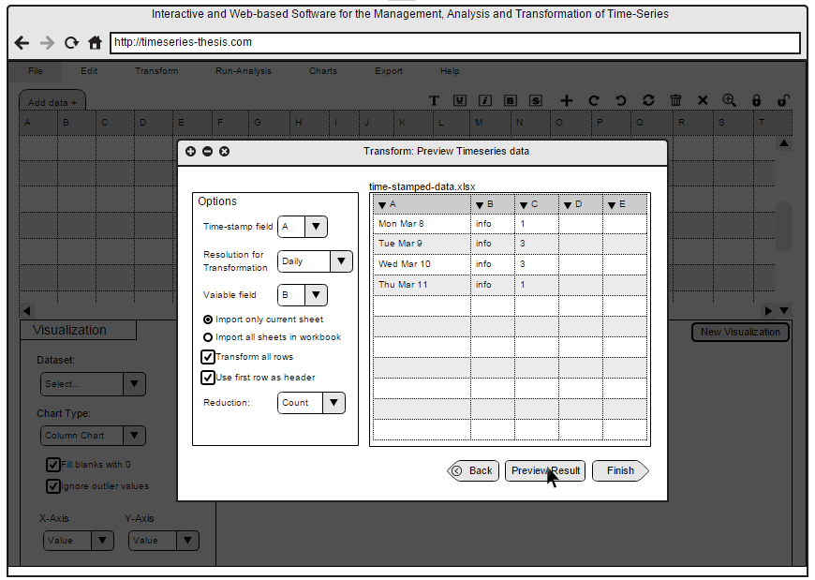
Mock Ups: Preview Transformed Data

Slide 34
Conclusion
What are Time-series and what features distinguishes them from other data types?
Time series have been defined and distinguished
How common are time-series patterns in spreadsheets today?
14% Time series
found in EUSES and Enrons Spreadsheet Corpuses
Which are the current tools used for managing and analyzing time-series?
What are their strengths
and weaknesses?
Up to 13 Time series tools were analyzed
What are the requirements for an
end-user oriented application for
managing, transforming and
analyzing time-series?
Requirements for Thesis Time series tool were identified and discussed.

Slide 35

Thank you for your attention!
Fawumi, Kehinde
MSc. Informatics Student

Slide 36
Backups

Slide 37
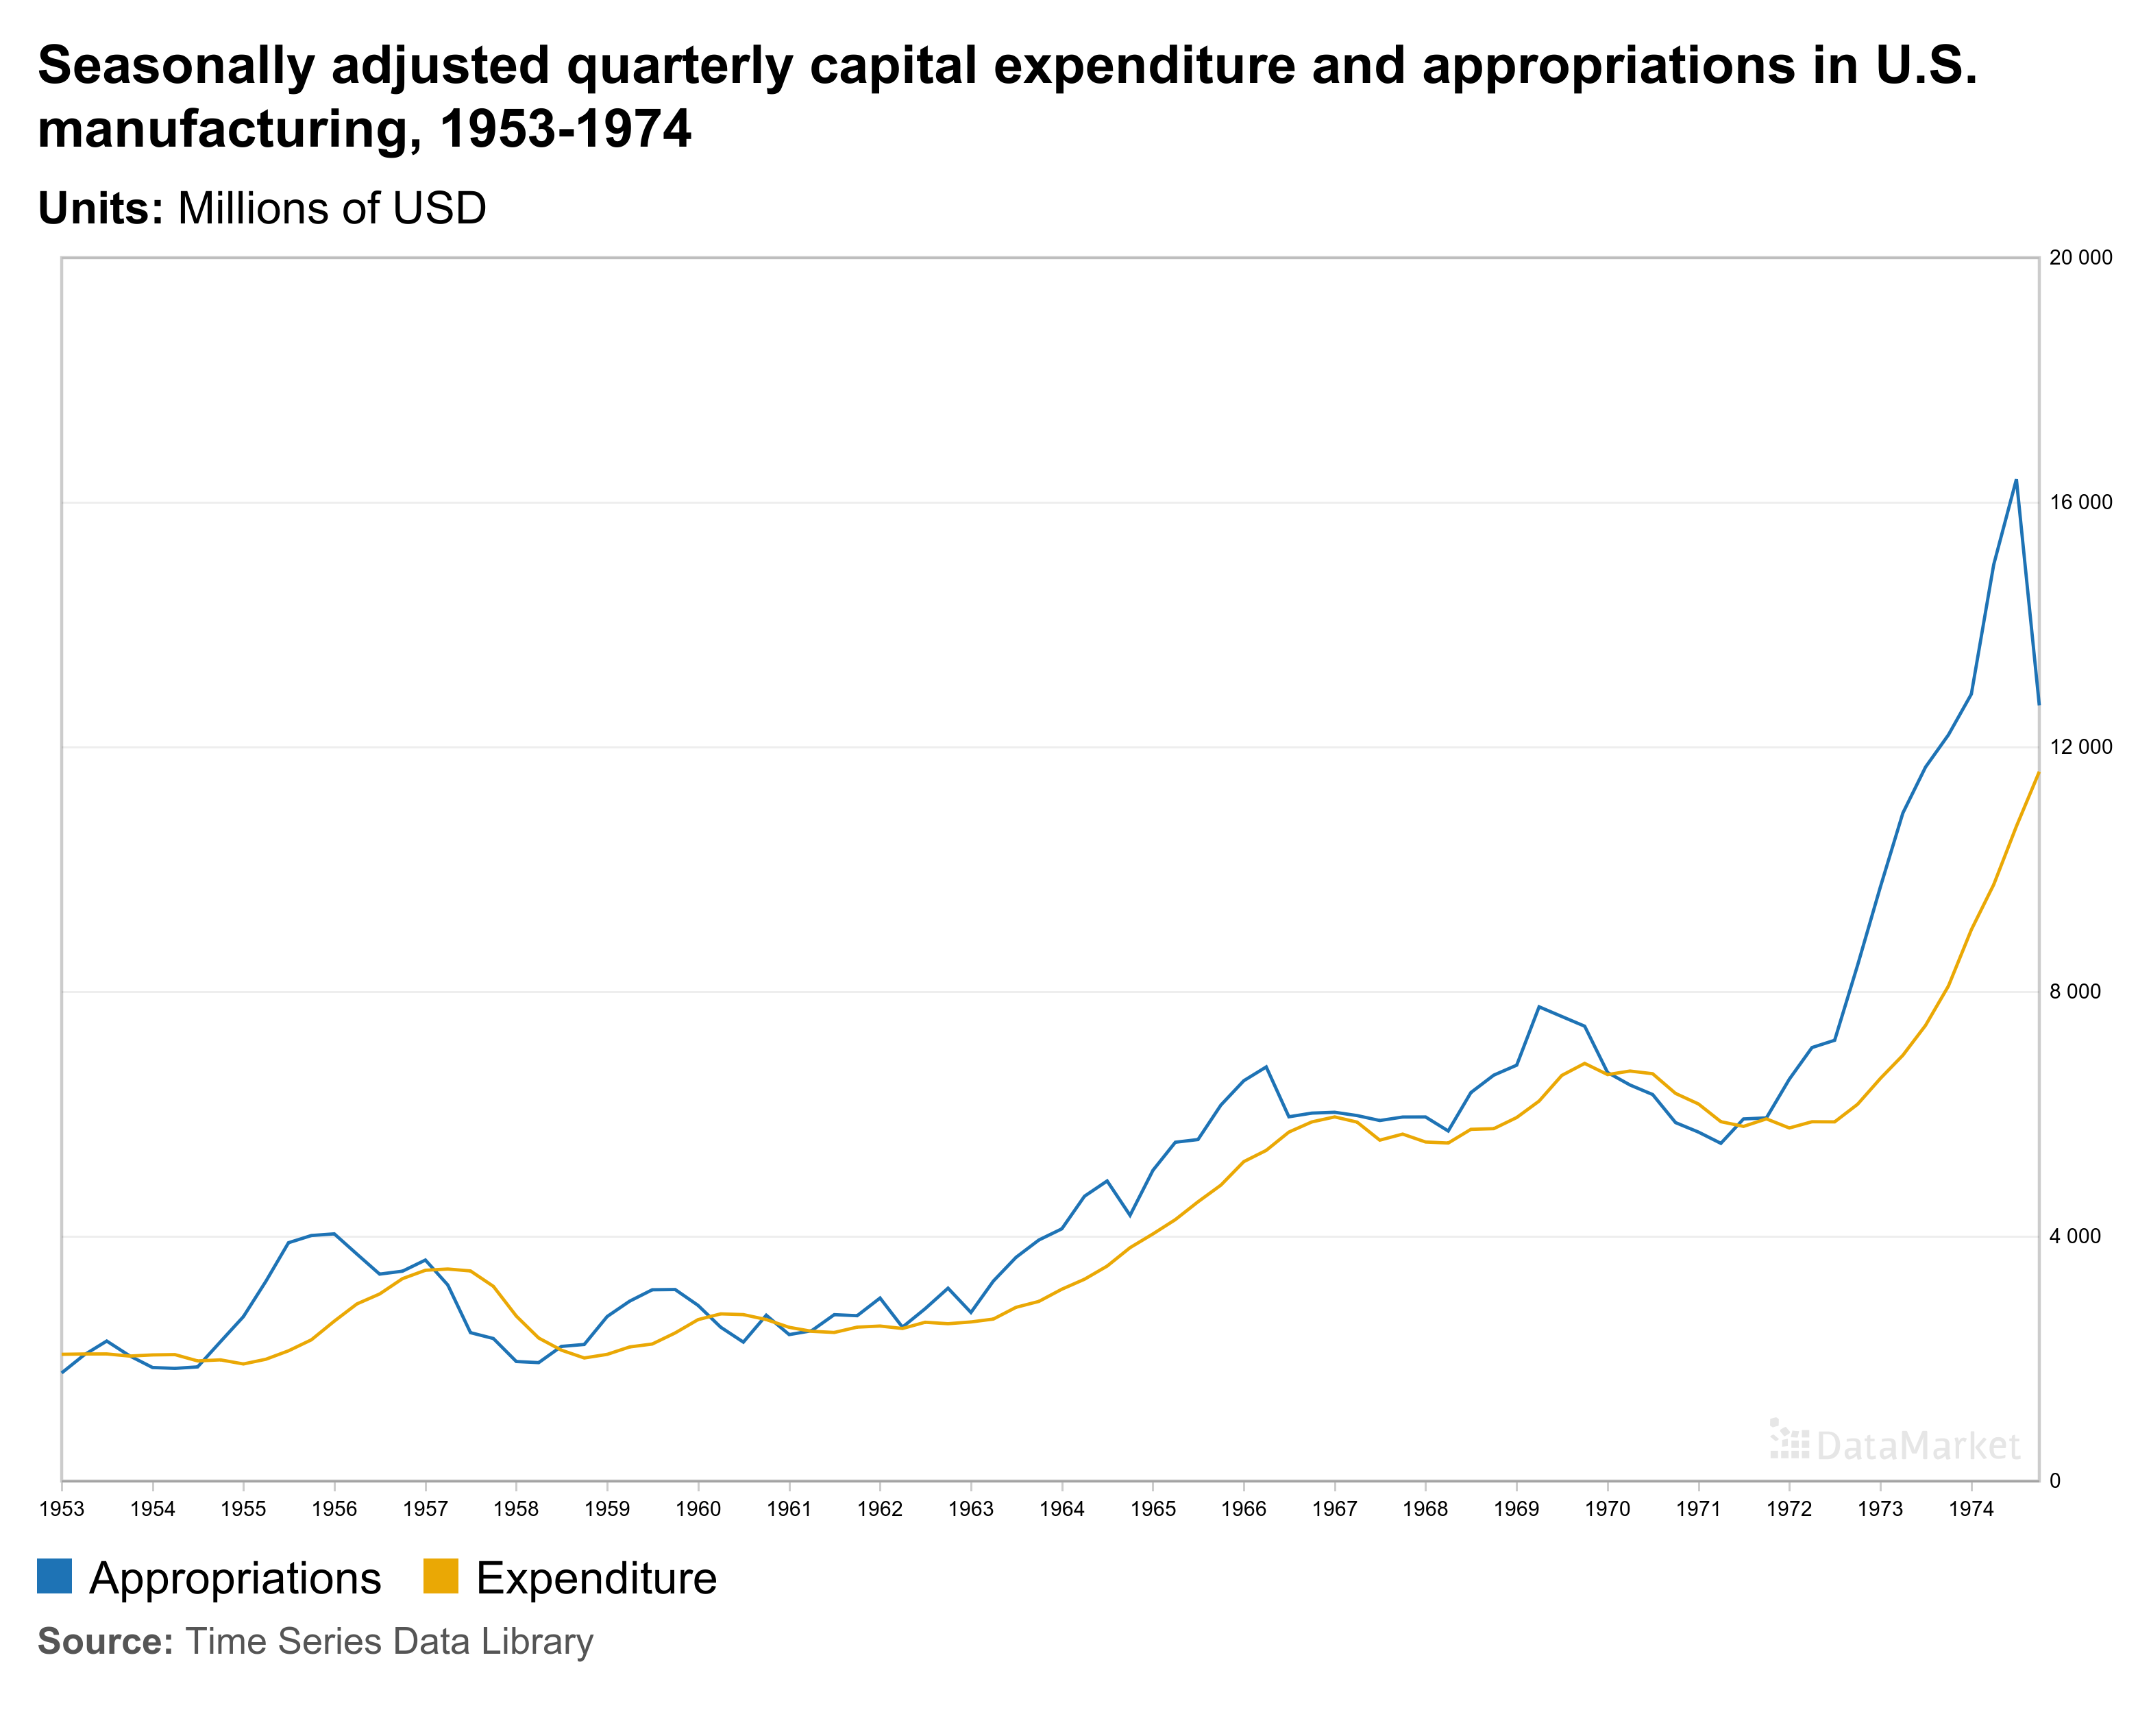
Multivariate Time series

Slide 38
Analysis of Existing Time Series Tools - Approach
Thesis Objectives
End-User perspective
User-friendliness
Time series Managment
Front-End Graphics
Time series Transformation
Time series tool
Support for Time series Analysis
Time series Analysis
Non functional Requirements
Time series Visualization
Cost

Slide 39
Criteria for identifying time series in spreadsheets
Data Fields:
Date-time
Date
Year
Month
Field Content/ Name / Formats:
Week numbers
Month numbers
Quarter Numbers

Slide 40
Criteria for Comparison of Tools
Criteria | Definition / Description | Values
User friendliness | Ease of use and learnability of tool to end users. e.g. use of 'click-and-go' buttons, least/no command-driven actions etc. Use of intuitive and common patterns, interfaces and menus Least dependency on user inputs for analysis and forecasting of time series | 1- Difficult 2 - Moderate 3 - Easy
Front-end/GUI | Good front-end/interface designs Use of high-standard look and feel elements for layout and flow, colours etc. Quality of graphical representation for visualizing time series | 1 – Poor 2 – Fair 3 – Good 4 – Excellent
Support for time series analysis | Level of support for time series models and tool integration with spreadsheets Basic: Supports only analysis models Moderate: Supports analysis and prediction models Advanced: Support all standard models for analysis, predictions, transformations for univariate and multivariate Time series | 1 – Basic 2 – Moderate 3 – Advanced
Non Functional Requirements | The non-functional requirements considered are: Performance Reliability Security Compatibility Robustness | 1 – Poor 2 – Fair 3 – Good 4 – Excellent
Cost & Availability | High: 1001euros and above Medium: 51euros - 1000euros Low: 1 - 50euros Free: incurs no financial costs (e.g. Open source) | 1 – High 2 – Medium 3 – Low 4 – Free

Slide 41
Criteria for Requirement-based tool comparison
No Support – Functionality not supported
Poor – No direct/strong support for functionality. It can however be adapted by end users manually or by programmatically combining functions
Fair – Functionality supported but not easily used by end users
Good – Functionality is supported and is easy to use by end users

Slide 42
Requirements Gathering - Tools Studied and Sources
Tool | Source(s)
SAS/ETS | (SAS Institute Inc., SAS/ETS 9.1 Users Guide, 2004)
GMDH Shell | (GMDH Shell LLC., 2013)
MATLAB | (The MathWorks Inc., 2015)
GRETL | (Cottrell & Lucchetti, 2015)
STATA | (Baum, 2003) (STATA, 2003)
DTREG | (DTREG, 2010)

Slide 43
List of Requirements for Thesis Time series Software
Create time series
Convert irregularly spaced data to equally spaced data and filling-in missing values.
Read time series data recorded in different ways
Edit time series data from a spreadsheet interface
Import and export time series in the following formats: xls, .xlsx, .txt, .csv.
Convert time-stamped data to time series
Convert time series data from one frequency to another (such as from weekly to monthly or vice versa).
Represent text data with numeric values. If user inputs categorical variables with data values such as “Male”, “Female”, “Married”, “Single”, etc., there is no need for users to code them as numeric values.
Generating tabular reports for viewing the created time series and adjusting them for correctness.
Analyzing time series and generating a model showing how best to predict future time series values
Automatic selection of the analysis model which fits best to the time series to be analyzed
Analyzing univariate and multivariate time series.
Forecasting future time series values
Possibility to use a wide variety of analysis and forecasting methods and models.
Guaranteeing that outputs of time series analysis are properly verified for precision
Standardized time series visualization
Viewable plots of the data, predicted versus actual values, prediction errors, and forecasts with confidence limits.
Adjustable time series and graphical representation.
Support for printing system output including spreadsheets and graphs.
Creating tabular reports such as balance sheets, and other row and column reports for viewing outputs of time series analysis.
Scalable to large data sets

Slide 44
Thesis Software application areas
In general, the thesis time series software is useful for:
Time series data management
Time series analysis and forecasting
Transforming time-stamped data to time series
Seasonal adjustment of time series data
Plotting and reporting of trends and forecasts of time series values

Slide 45
Project Timeline
ID |  | Activity/Task |  | Deadline |  | Completion Status |  | Comments
1 |  | First draft of the Abstract |  | 21. November 2014 |  | Completed
2 |  | Thesis Abstract Finalized |  | 27. November 2014 |  | Completed
3 |  | Specific features of time-series, differences to other semantic patterns |  | 19. Dezember 2014 |  | Completed
4 |  | State-of-the-art analysis of tools for managing and analyzing time-series |  | 16. Januar 2014 |  | Completed
5 |  | Related work on time-series in the context of spreadsheets/self-service BI. |  | 30. Januar 2015 |  | Completed
6 |  | Identification of use-cases |  | 13. Februar 2015 |  | Completed
7 |  | Derivation of requirements for Time Series Tool |  | 27. Februar 2015 |  | Completed
 |  | Architectural designs (process flow), Mock Ups for Time Series Tool (e.g. Use cases) |  | 6. März 2015 |  | Completed
8 |  | Chapter 1 |  | 13. März 2015 |  | Completed
9 |  | Chapter 2: Related Researches |  | 27. März 2015 |  | Completed
10 |  | Chatpers 3 & 4 |  | 10. April 2015 |  | Completed
11 |  | Chapters 5 & 6 |  | 17. April 2015 |  | Being Reviewed
12 |  | Final Presentation |  | 20. April 2015 |  | Ongoing
13 |  | Final Thesis Submission |  | 8. Mai 2015 |  | Not Started

Slide 46


Project Timeline
 |  | Nov | Dec | Jan | Feb | Mar | Apr | May
Time-Series Features and Theoretical Background
State-of-the-art analysis of Existing Tools
Literature Review / Related Works
Identification of Use Cases
Requirements, Mock Ups, Meta-model
Writing of Thesis Report
Presentation
Today
Complete
Ongoing
Not Started

Slide 47
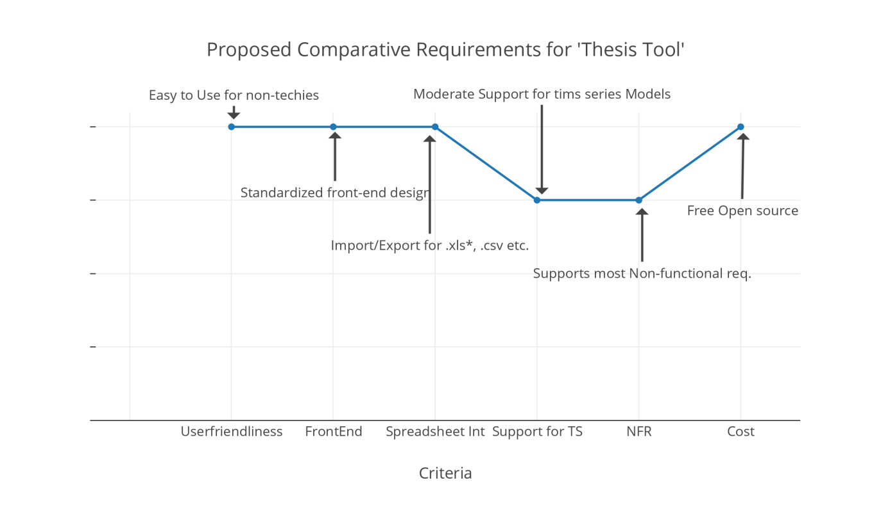
Requirements for time-series software
Tool | Ease of use / User friendliness | Front-end & graphical rep. | Integration with spreadsheet | Support for time series models | Non functional requirements | Cost / Availability
Thesis Time-Series Tool | Easy | Good | Yes | Moderate | Good | Free

Slide 48
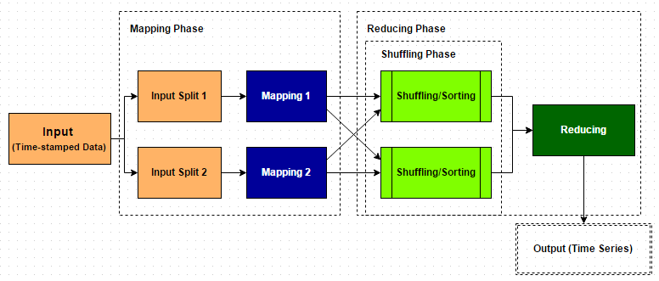
Use case 2: Transforming time-stamped data to time series
Transforming time-stamped data to time series Using Map Reduce

Slide 49
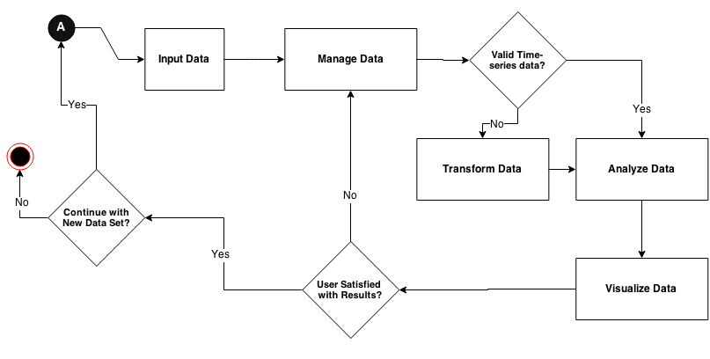
Activity Diagram: Generic Overview of Time Series Transform - Analyze - Visualize interactions

Slide 50
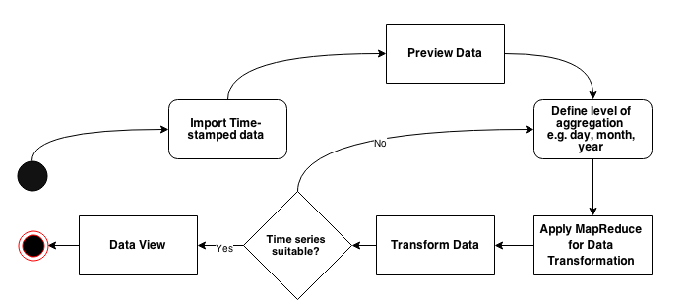
Use Case 2: Transformation of time-stamped data to Time Series Activity Diagram

Slide 51
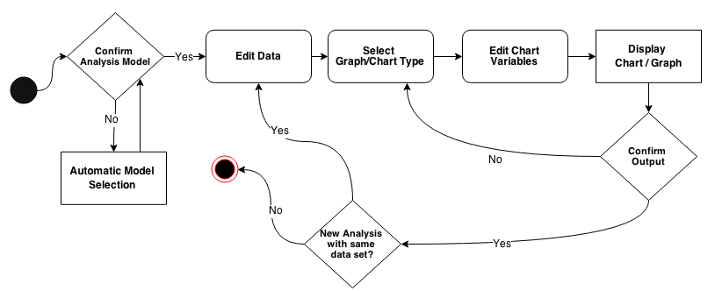
Use Case 3: Analyzing Time-Series Data Activity Diagram

