Slide 1
Design and Implementation of a Framework for Adaptive Knowledge-Intensive Processes in a Wiki
Maurice Laboureur – 25. November 2013
Notes:
Part of group project ModelWiki of Matheus Hauder
First peek on title: Using a wiki, it’s about processes that are hard to plan, and source code is written

Slide 2
Outline of the Presentation
From Taylorism to Knowledge Work
Requirements
Framework
Review process
Future steps
Literature
Notes:
Motivation
Applied procedure
Outcome
Example process
What’s to do

Slide 3
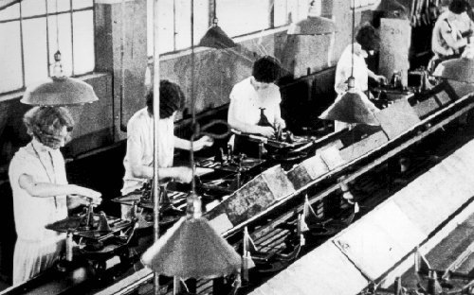
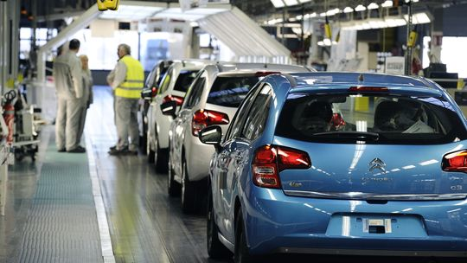
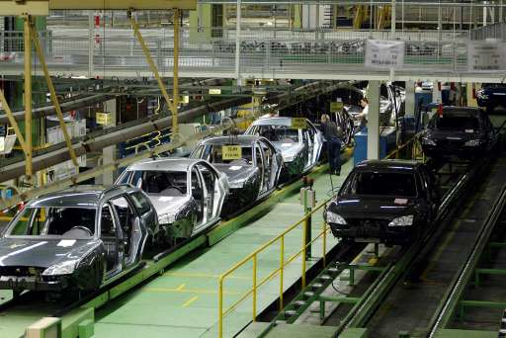
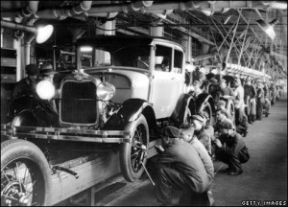
From Taylorism to Knowledge Work
Notes:
Society and business change
From assembly line/routine processes to BPM
Study about case management: 40% knowledge work → considerable part of processes not 100% structured
Organizations profit from change and/or they have to change in order to stay competitive
Need for tool that support flexible, unstructured processes
Quelle für “40%”: Adaptive Case Management: Overview and Research
Challenges

Slide 4
Adaption of Informations Systems at Runtime
designed system interaction emergent
structured processes
dynamic process
case management
social collaboration
Top down and industrialized
Bottom up and adaptive
Process
People
Notes:
Slide tries to illustrate matter
Bisher: viele Lösungen für “linke Seite” für hochfrequentierte Prozesse ohne Sonderfälle
Prozesse, die vor Ausführung entwickelt werden ←→ Prozesse, die während Laufzeit entwickelt werden
Zustände/Änderungen/Erweiterungen müssen (während Laufzeit) modelliert werden können
Beides zusammenbringen/erlauben = Case Management
(Noch) keine Standardlösung im Case Management

Slide 5


Research Objective of the Project
How can knowledge workers be supported with structured and unstructured information and processes?
  Combination of normative and adaptive process support
  Adaption of processes at runtime by end users
  Integration with hetergoneous information sources and application services
  Data as main driver for process execution
  Tool development for knowledge workers
Possible application scenarios
  Enterprise Architecture Management
  Business Process Management
  Knowledge Work
  Software Development
Research Partners:
Notes:
Main thesis of project: Support knowledge work that can have both structured and unstructured processes
My master thesis only a part that deals with
Difficulty to enable end user (no modelling expert) to adapt processes any time
Support from Datev, e.g. Innovationsprozess (similar to EasyChair): submit ideas, voted/ranked, when selected money bonus
Some tools put logic in code, we aspire to a more flexible, intuitive solution

Slide 6
Outline of the Presentation
From Taylorism to Knowledge Work
Requirements
Framework
Review process
Future steps
Literature
Notes:
Presented you the general problem
How did we advance…

Slide 7
Collaborative model adaption challenges at runtime
a)
Which elements should be in the model?
A
Are there any conflicted model elements?
B
I
C
D
Global
Local
b)
c)
d)
A
E
A
A
B
I
B
I
B
K
C
D
F
C
D
H
C
D
How can I use elements from a colleague?
How can I contribute to the model?
How can I make local changes?
Schema
Instance
Model Element
Conflict
Stakeholder
Notes:
Few meetings where the team gathered ideas
Global model as standard
Global modell can be adjusted anytime, when new findings/laws/habits/condition
Local models adaptable to special cases of business object (new local states)
Local changes on global model possible (locally deleted states)
Overviews for authorized users to draw conclusions

Slide 8
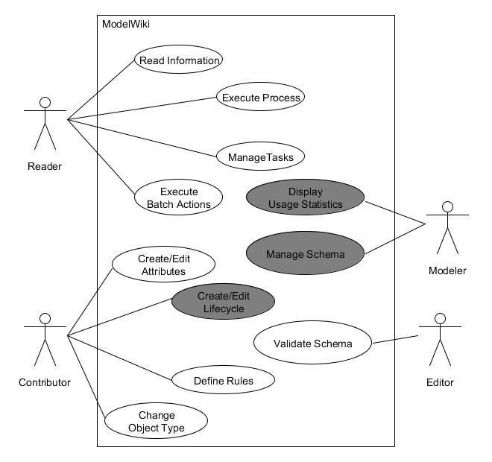
General modeling use cases in the framework
  Research Questions:
  Q1: Which concepts are needed in social soft-ware to execute pro-cesses and workflows?
  Q2: What does a GUI have to look like to support all concepts?
  Q3: How can the com-pulsory concepts be im-plemented?
  Q4: How can real world challenges be solved with the application?
Notes:
Then made up use cases
Four roles
Reader: Execute process
Contributor: Fit to local specialities
Modeller: merge local modifications to global model
Editor: Supervise and validate
Which concepts; UI; implementation; demo/example on a real problem

Slide 9
Outline of the presentation
From taylorism to knowledge work
Requirements
Framework
Review process
Future steps
Literature
Notes:
See how requirements implemented

Slide 10
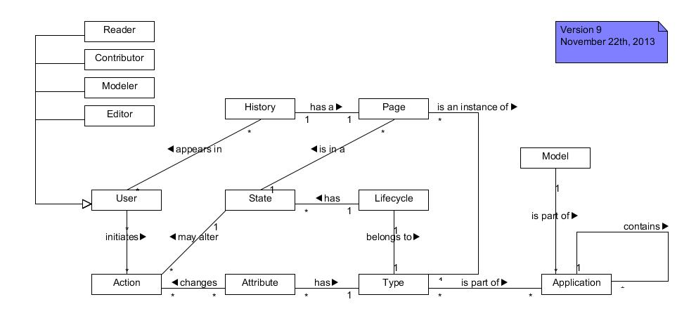
Simplified Concept
Notes:
“Model” some kind of folder for project/production cycle/what ever
“Application” in Case Management Tool often “Case”: one process that can be instantiated
In center: “State” und “Lifecycle”
“States” and “Attributes” global, but can be adapted locally (new)
Lifecycle consists of several states, belongs to
Type, description page like class
“Action”en hang at “User” and data (=difference to conventional Workflowmanagement: action only at User)
As indicated user in different roles (see next slides)

Slide 11
Modeling Roles in the Framework
Contributor
Reader
Modeller
Editor
 | R | C | M | E
Modify values from attributes located on pages | R
Create or edit model elements on the local level |  | R | C | I
Apply model elements on the global level |  |  | R | C
Validate model elements on the global level |  |  |  | R
Explanation:
  Responsible
  Accountable
  Consulted
  Informed

Slide 12












ModelWiki Architecture
Front-End
Client
Middle-Layer
Back-End
Notes:
Deploymentdiagram unseres Systems
Mein Aufgabenbereich
http://creativeproject.files.wordpress.com/2013/08/jointjs.jpg%3Fw%3D580
http://b.cksource.com/a/1/10th/ckeditor10years.png
http://www.finiteinfotech.com/subimages/21977.png
http://static-dbs1.dbsclients.com/dbswebsite.com/wp-content/uploads/2013/01/json.png

Slide 13
Outline of the Presentation
From Taylorism to Knowledge Work
Requirements
Framework
Review process
Future steps
Literature
Notes:
Tool/Platform vorstellen: Bild der Architekturkomponenten/Deploymentdiagramm;
Was ist EasyChair?
Rollen, was ist das, etc.;
Screenshots mit anlegen Zustand, Link etc.;
danach Demo; Prozess zeigen

Slide 14
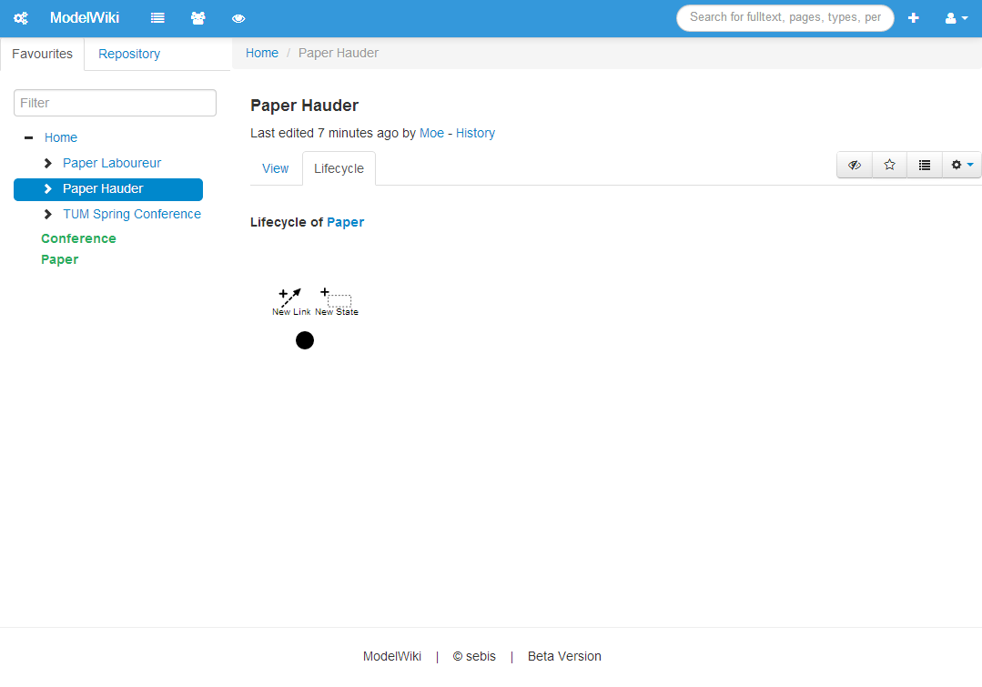
Behavior (as Contributor): Mouse-Over Start State
Contributor
Notes:
General layout: Favs/Repository on left, search bar on top and content in centre
Two tabs: View for data and Lifecycle
Editing lifecycle as Contributor
Start state initially set (black dot)
Hover start state: new (local) link and state

Slide 15
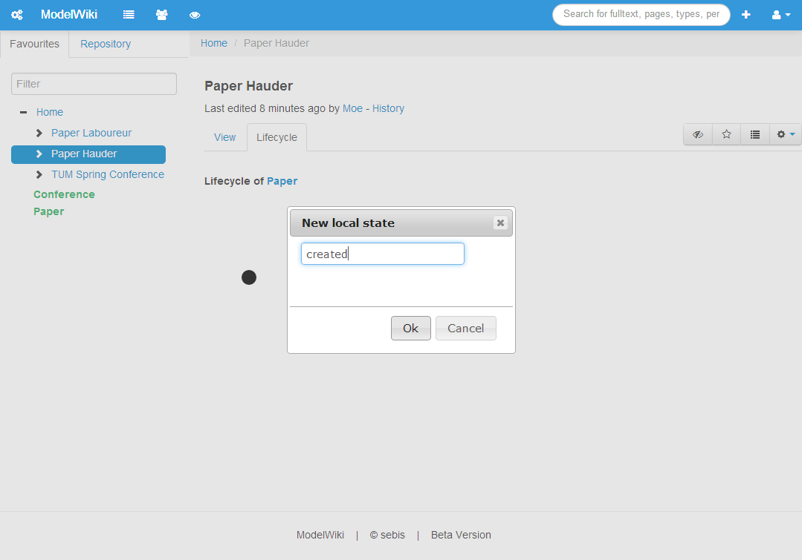
Behavior (as Contributor): New Local State
Contributor
Notes:
Choice of new state opens modal/dialog to enter name

Slide 16

Behavior (as Contributor): Mouse-Over State
Contributor
Notes:
Same for states: Hovering offers possible actions
Delete state or
New link

Slide 17
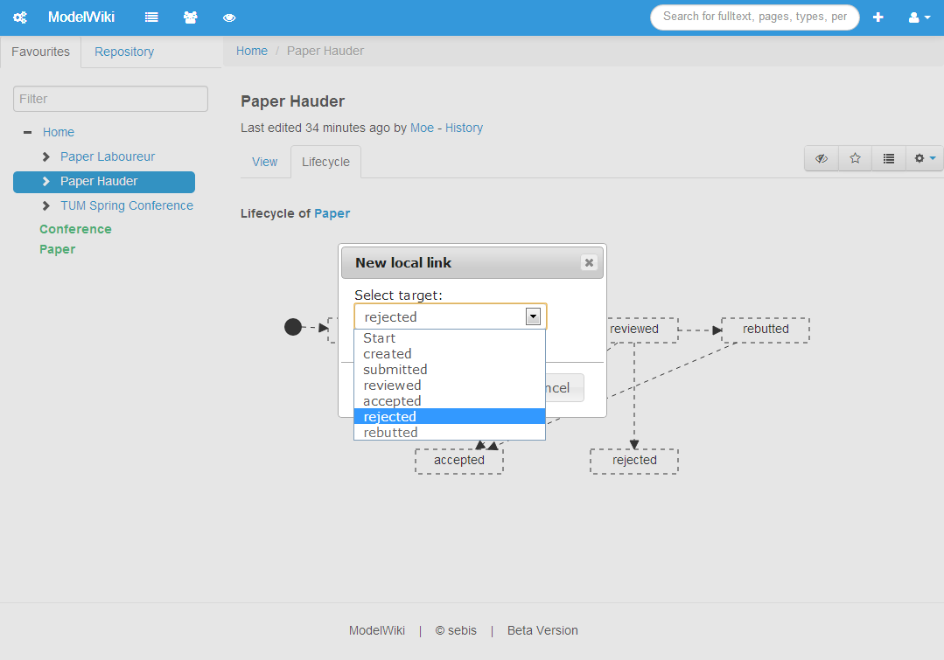
Behavior (as Contributor): New Local Link
Contributor
Notes:
Some states have been added
Dashed lines mean ‘local’
Also modal for links: select target in drop down box
Result: dashed arrow

Slide 18
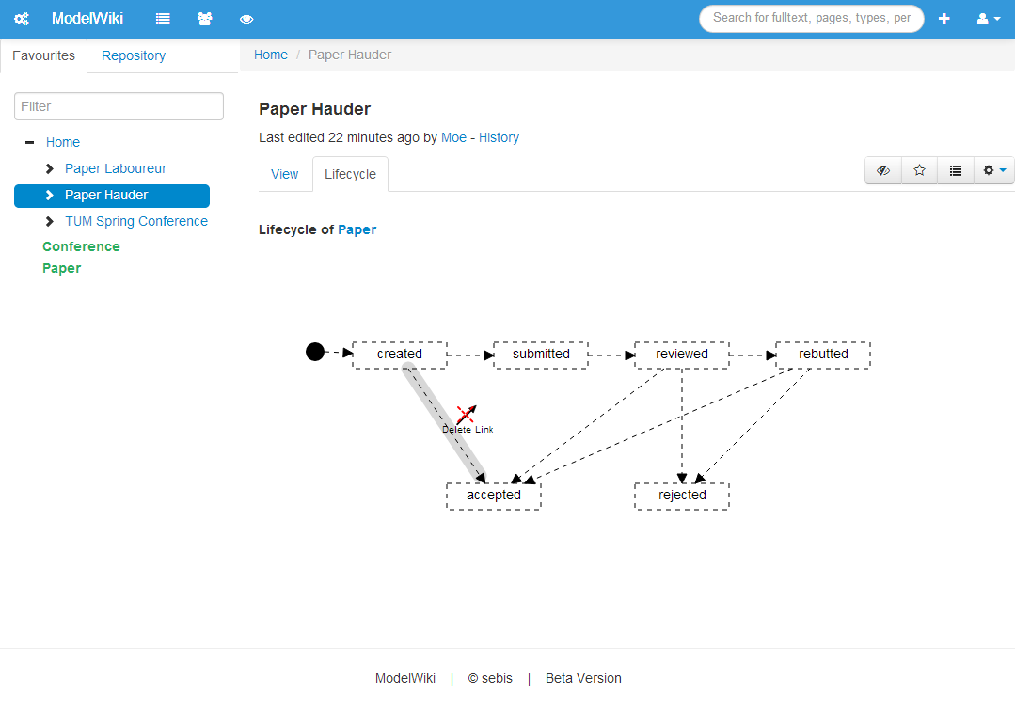
Behavior (as Contributor): Delete Link (Locally)
Contributor
Notes:
Want to delete a link? – Hovering pops up icon

Slide 19

Behavior (as Modeler): Mouse-Over State
Modeler
Notes:
Other role: Modeler
Icon to apply globally
Usage rate as decision support
Rolle als Bild mit reinnehmen

Slide 20
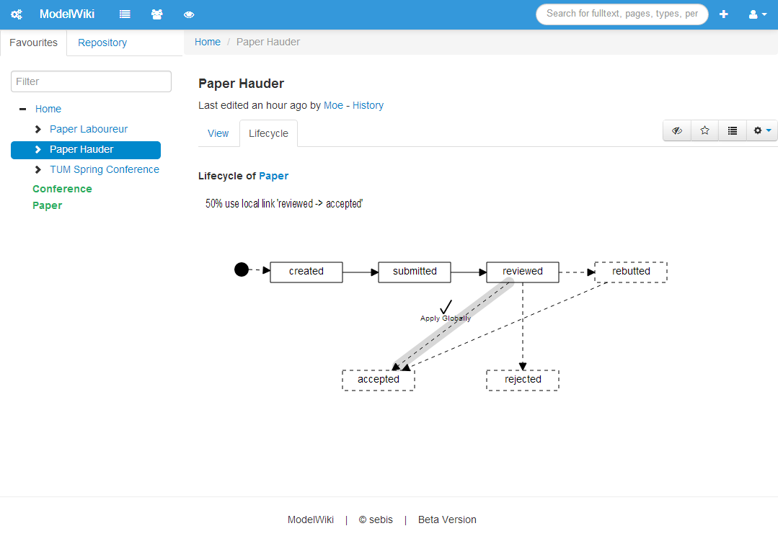
Behavior (as Modeler): Mouse-Over Link
Modeler
Notes:
Same icon to apply globally
50% usage rate
Some states and links have been made global

Slide 21

Application Example
Simplified version of [1]:
                Management of participants
                Submission of papers and reviews
                Online discussions
                Custom review forms
                Documentation of outcome
                Mailing to participants
  “EasyChair was designed to help conference organisers to cope with the complexity of the refereeing process” [2]
Objects to manage
Types
Paper | Participant
Review | Conference
[1] http://www.easychair.org/images/logoEC.gif
[2] http://www.easychair.org/
Notes:
Quelle: http://www.easychair.org/
Prototypisch implementiert
Übergänge noch “hart codiert”

Slide 22
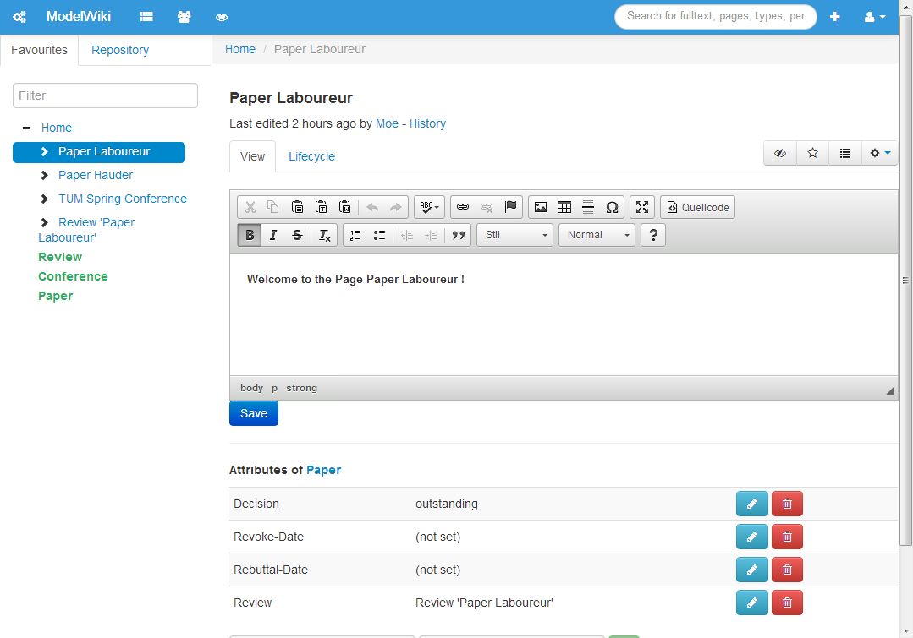
EasyChair Demo: Paper Attributes
25.11.2013
Review available!
22.11.2013
Final version of paper is online!
Dear Reviewers,
I have uploaded the latest .pdf. The last two sections have been revised and partly rewritten.
‘Review’ set
=>
current state ‘reviewed’
Notes:
Text über unstr. Teil legen

Slide 23
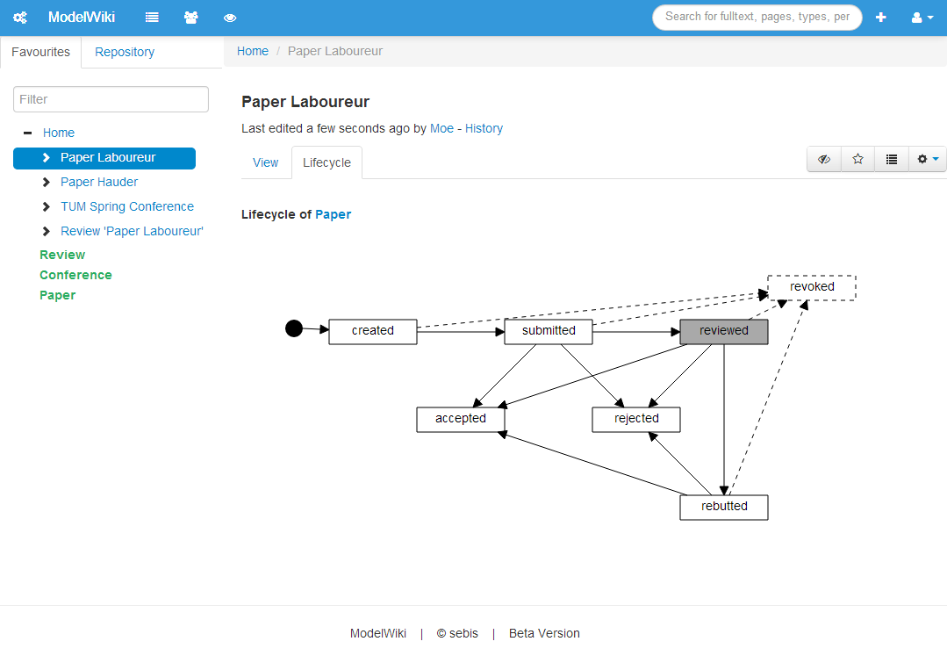
EasyChair Demo: Paper Lifecycle
‘Revoke-Date’ attribute set to a date (in the past)
.pdf has been uploaded
‘Review’ attribute set to another page
None of the others
‘Decision’ attribute set to ‘accepted’
‘Decision’ attribute set to ‘rejected’
‘Rebuttal-Date’ attribute set and in past

Slide 24
Outline of the Presentation
From Taylorism to Knowledge Work
Requirements
Framework
Review process
Future steps
Literature

Slide 25


Discussion/Future Steps
Learnings from Thesis
  It can be modelled graphically!
  Bringing together two worlds: Wikis and BPM → Basis for framework with more flexible actions
  Further, practical evaluation necessary, e.g. innovation process at or scenario planning at
Future steps
  User-definable actions
    Perspicuous designation
    Necessary and possible input
    Intuitive visualization of input forms
    Persistence
    Application/checking
  Interfaces
    Integrate other applications into ModelWiki
    Offer interface to access ModelWiki through other applications
Notes:
First insight: graphical UI possible
Alexej’s Arbeit: Definition of actions
How can they be described?
How can end-users define them?
Integrate other applications
http://www.huk.de/content/dam/hukde/images/logo_huk.png

Slide 26
Outline of the presentation
From taylorism to knowledge work
Requirements
Framework
Review process
Future steps
Literature
Notes:
Wichtigste Quellen auf zwei Folien → menedely

Slide 27
Literature
M. Brambilla, P. Fraternali, and C. K. Vaca Ruiz. Combining social web and BPM for improving enterprise performances, page 223. Association for Computing Machinery, 2012.
C. M. Chiao, V. Künzle, and M. Reichert. Schema Evolution in Object and Process-Aware Information Systems: Issues and Challenges. Springer-Verlag, 2013.
T. Dollmann, C. Houy, P. Fettke, and P. Loos. Collaborative Business Process Modeling with CoMoMod - A Toolkit for Model Integration in Distributed Cooperation Environments, pages 217–222. Institute of Electrical and Electronics Engineers, Jun 2011.
M. Hauder. Bridging the gap between social software and business process management: A research agenda: Doctoral consortium paper, pages 1–6. Institute of Electrical and Electronics Engineers, May 2013.
V. Künzle and M. Reichert. PHILharmonicFlows: towards a framework for object-aware process management. Journal of Software Maintenance and Evolution: Research and Practice, 23(4):205–244, Jun 2011.
G. Neumann and S. Erol. From a Social Wiki to a Social Workflow System. Springer-Verlag, 2009.
R. Schmidt and S. Nurcan. BPM and Social Software. Springer-Verlag, 2009.
W. van Osch and C. K. Coursaris. Organizational Social Media: A Comprehensive Framework and Research Agenda, pages 700–707. Institute of Electrical and Electronics Engineers, Jan 2013.

Slide 28
Thank you for your Attention. Questions?
Maurice Laboureur
Maurice.Laboureur@gmail.com
17132
matthes@in.tum.de

Slide 29
Default form settings and cut & paste forms
Default
Line Style
Info
Default
Text
Default Rectangle
Default
Rounded R.
User
Store
Information
Arrow
Process
Box
Explanation
Fast
Form 1
Fast
Form 2
Fast
Form 3
Fast
Form 4
Fast
Form 5
Fast
Form 6
Fast
Form 6
Fast
Form 1
Fast
Form 2
Fast
Form 3
Fast
Form 4
Fast
Form 5
Fast
Form 6
Fast
Form 6

