Slide 1
Tool support for architectural decision making in large software-intensive agile projects
Manoj Bhat, Klym Shumaiev, Florian Matthes

Slide 2
Motivation
Software architecture is considered as a set of architectural design decisions.
Design decisions link stakeholders’ concerns and the architectural elements.
Design decisions are not explicitly documented which leads to knowledge evaporation.
Goal
Framework for managing design decisions in large software-intensive agile projects.
Support architects and developers to learn from past design decisions to make sustainable informed decisions in their current projects.
Provide a perspective on Who did What, Why and When in the software architecture decision-making context.
Notes:
Documenting dd will support tracability

Slide 3
Example scenario (1)
Apache Spark
Issues captured since early 2014
Versions from 0.9.0 to 2.1.0
# contributors - 1,146
# issues - 21,660
Users
We want to use Spark SQL in our project, but we found that the Spark SQL performance is not very well as we expected.
SPARK-7393
?
Software architects
Software developers

Slide 4
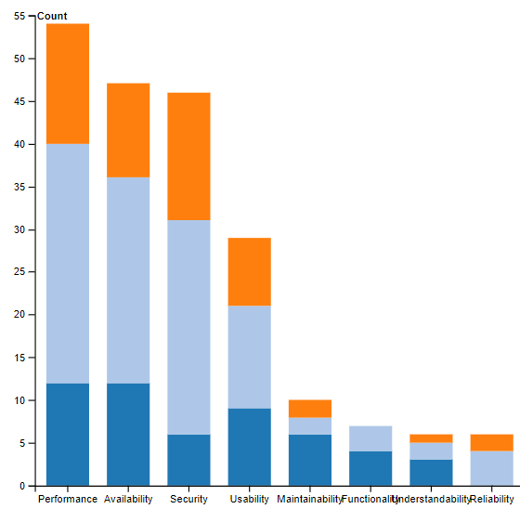
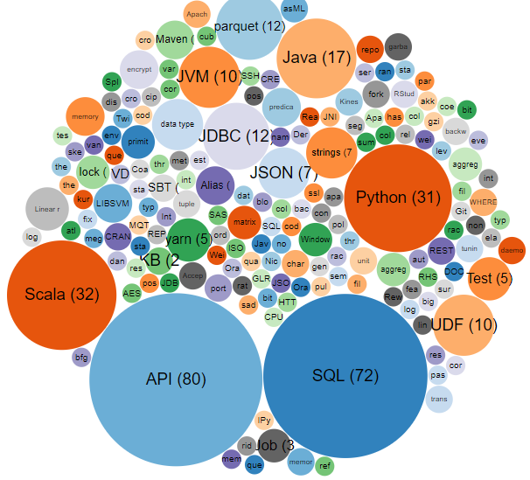
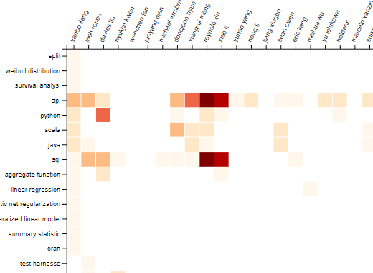
Example scenario (2)
21,660 issues
Extract design decisions
466 design decisions
226 structural decisions
389 behavioral decisions
166 ban decisions
Classify design decisions
14
Enrich design decisions
28
12
Generate views

Slide 5
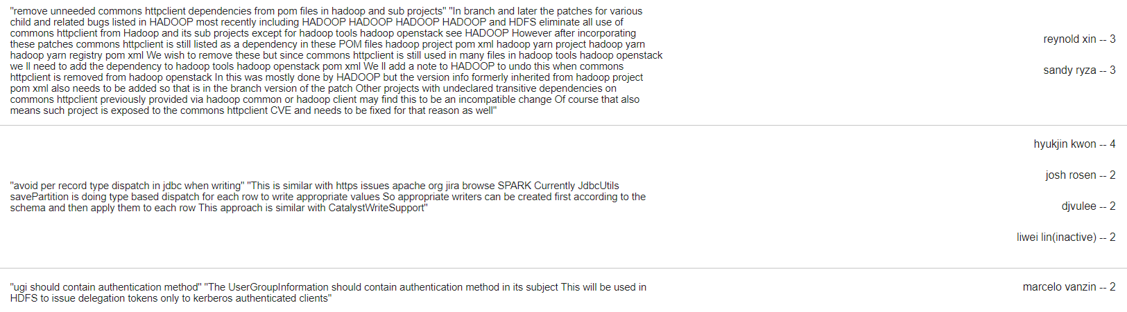
Example scenario (3)
Users
We want to use Spark SQL in our project, but we found that the Spark SQL performance is not very well as we expected.
SPARK-7393
Software architects
Software developers

Slide 6
Extraction and classification of design decisions from issue management systems
AKM tool
Phase 1
Phase 2
Structural decision
Issue management system
issues
Decision detector
classify
Decision
load
Decision classifier
classify
Behavioral decision
Syncpipes
uses
uses
Not a decision
Decision detection ML model
Decision classification ML model
Ban decision
Part 1: Process documents
Labeled dataset
Preprocessing
issues
Tokenize
Transform cases
Filter stop words
Stem words
Generate n-Grams (n=1..5)
Create TF-IDF representation
Part 2: Generate model
(10-fold validation)
Shuffled split
Classification model
model
Training
Training data
Multi-class classifiers
Results
Testing – Apply model
Testing data
Bhat M.; Shumaiev, K.; Biesdorf, A.; Hohenstein, U.; Matthes, F.: Automatic extraction of design decisions from issue management systems: a machine learning based approach. ECSA 2017.
https://github.com/sebischair/DocClassification

Slide 7
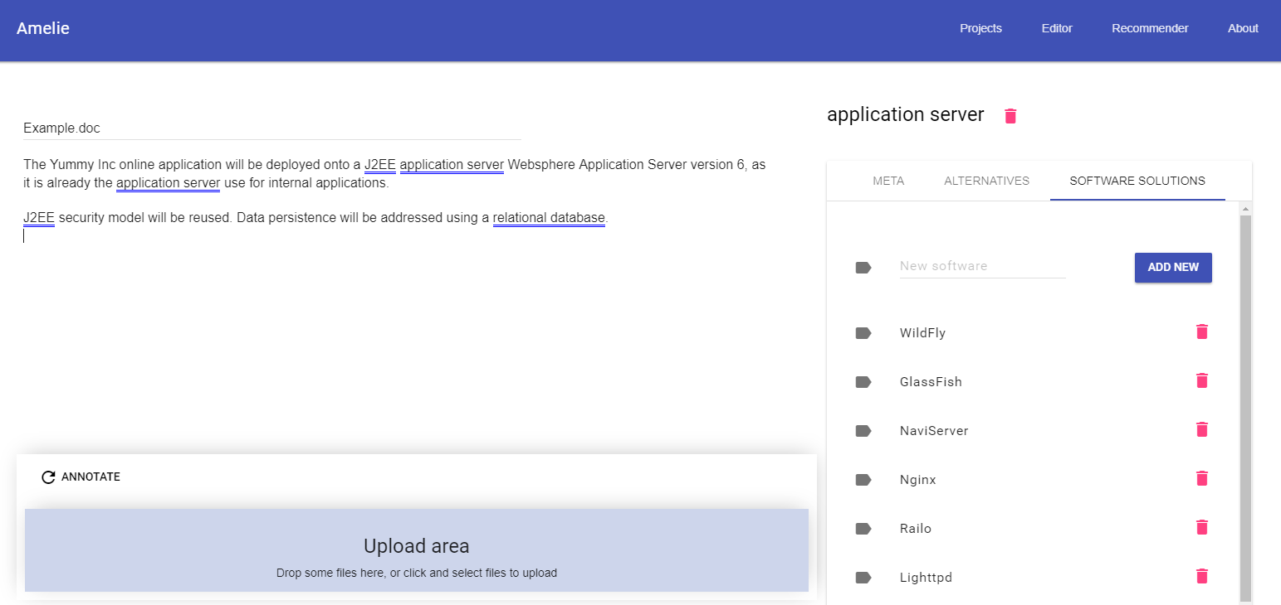
An ontology-based approach for software architecture recommendations
DBpedia ontology – 4.2 million instances, 685 concepts, 2795 properties
Automatic extraction and annotation of architectural elements in text
Generate recommendations for alternative options for decision making
Bhat M.; Shumaiev, K.; Biesdorf, A.; Hohenstein, U.; Hassel, M.; Matthes, F.: An Ontology-based Approach for Software Architecture Recommendations, AMCIS 2017 Boston.
https://github.com/sebischair/akre-server
Notes:
Replace it with text reduce complexity

Slide 8
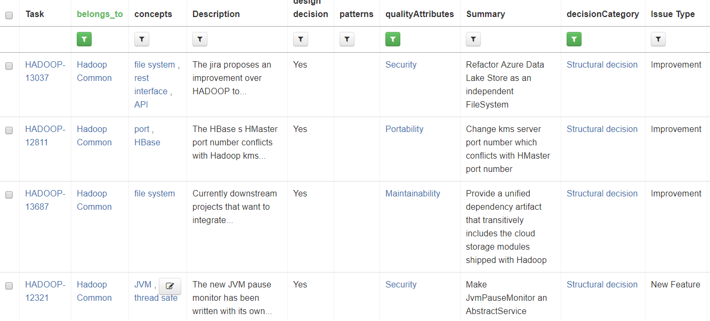
Why was a design decision made?
DEMO: goo.gl/mgE5mo

Slide 9
Who should be involved in making a design decision?
How to quantify the architectural expertise of an architect/developer?
What should be the expertise of an architect/developer to address a design decision?
DEMO: goo.gl/mgE5mo

Slide 10




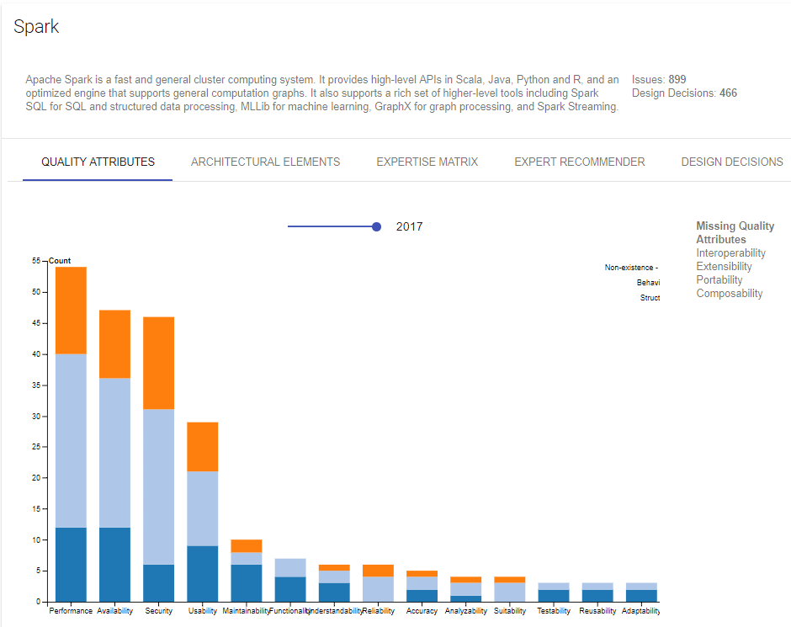
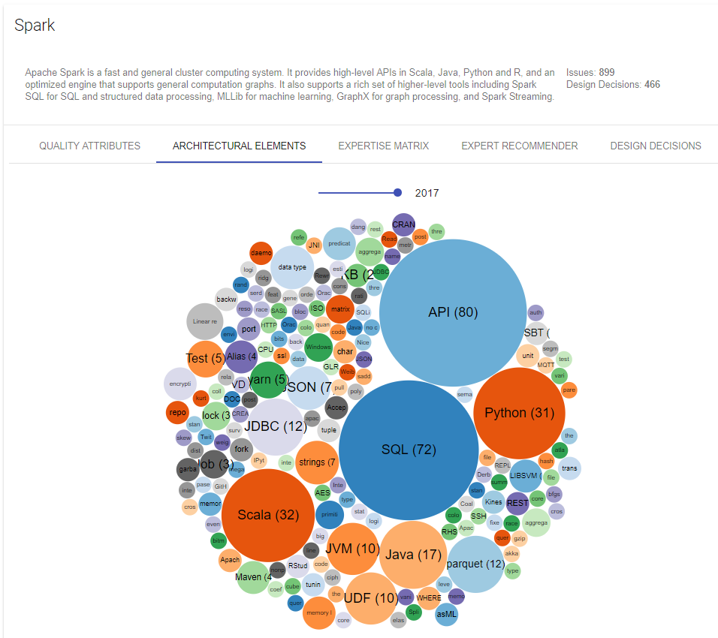
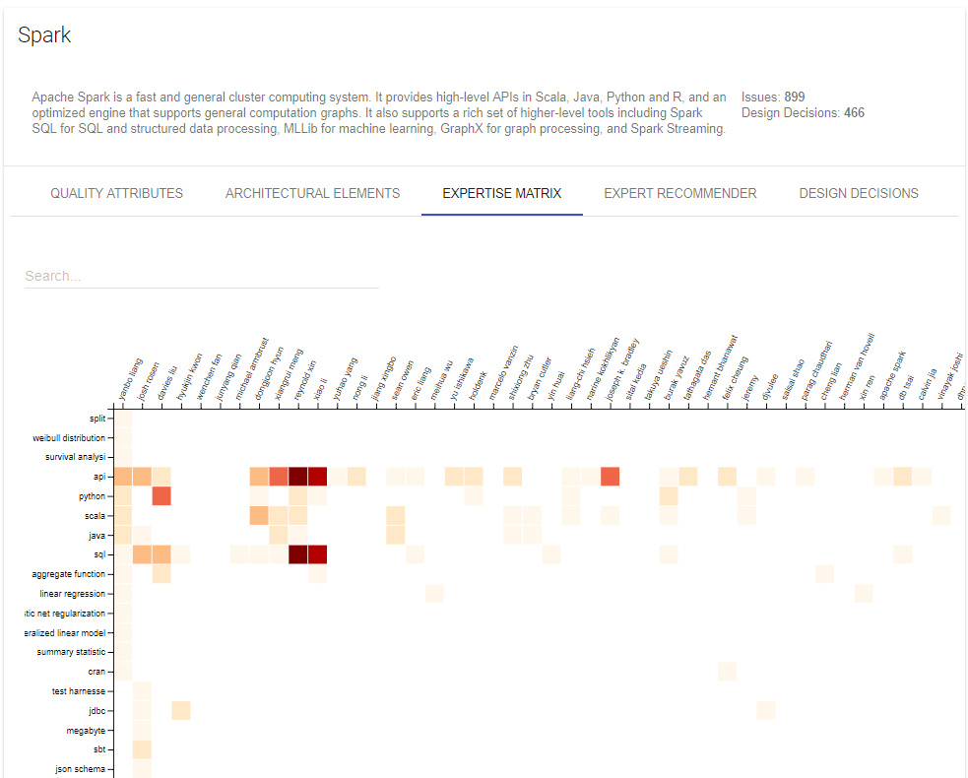
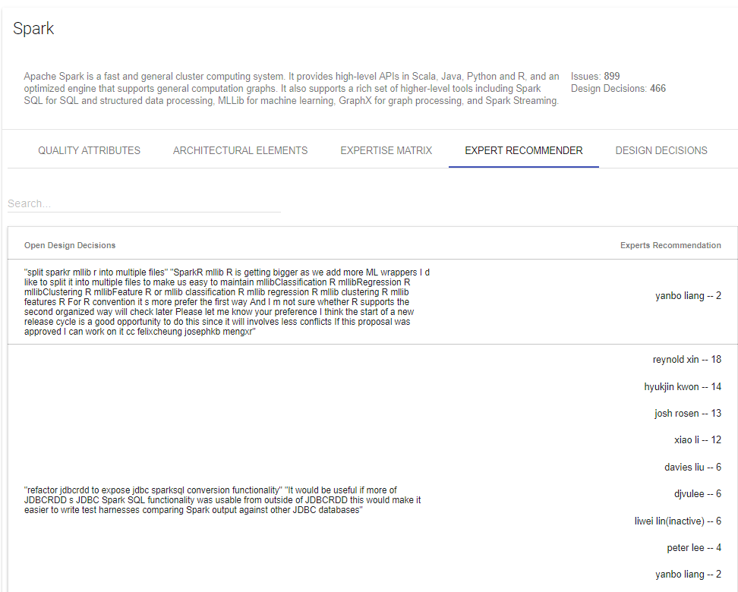

Big picture
1
2
3
4
5
Import project data
Extract design decisions
Annotate architectural elements
Annotate quality attributes
Generate recommendations
ML model for decision detection and classification
ISO/IEE 25010
Expertise profile
software project
uses
uses
uses
uses
Decision classifier
uses
Architectural solutions recommender
Rationale extractor
Expert recommender
SyncPipes
AE annotator
design
decisions
annotated
document
recomme-ndations
quality
attributes
architects &
developers
documents
documents
architectural
element (AE)
project data
design
decisions
design
decisions
Software architects
Software developers
Meta-model based AKM system
DEMO
goo.gl/mgE5mo
Bhat M.; Shumaiev, K.; Matthes, F.: Towards a framework for managing architectural design decisions. ECSA 2017.

Slide 11
M.Sc.
Manoj Mahabaleshwar
18162
manoj.mahabaleshwar@tum.de

Slide 12
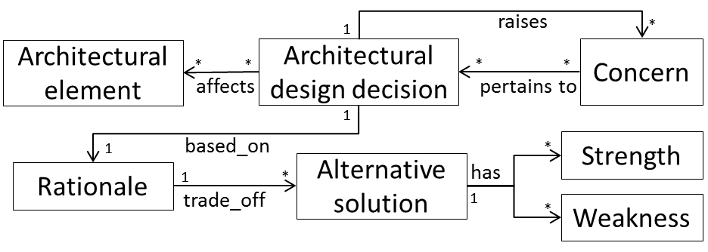
Architecture design decision model

Slide 13
Research questions
RQ 1: How to consolidate project data from disparate information systems?
RQ 2: How to extract design decisions from textual information?
RQ 3: How to identify architectural elements and recommend alternative choices to support decision making?
RQ 4: How to identify the rationale behind a design decision?
RQ 5: Who should be involved in making a design decision?

Slide 14
SyncPipes
A platform for implementing reusable adapters
RQ 1
1
SyncPipes Configurator
Input configuration
Sync
configuration
Output configuration
establish connection
establish connection
2
SyncPipes Mapper
concept mapper
SC model
SC KB
Tool A
Data model A
concept mapper
Get Types
and Properties
Get Types
and Properties
attribute mapper
JIRA
GitHub Issues
Microsoft Project
Enterprise Architect
Create Entities
3
SyncPipes Execution
Get Entities
Update Entities
4
SyncPipes Synchronizer
https://github.com/sebischair/syncpipes-server,
https://github.com/sebischair/syncpipes-client
Bhat, et al.: Meta-model Based Framework for Architectural Knowledge Management, SAGRA workshop at ECSA 2016

Slide 15
SocioCortex for architectural knowledge management
Source tools
Non-structural data
Client Apps
Model designer
Rules manager
Value
Added
Services
SyncPipes
IR-application
Platform
REST API
Access control
Rule engine (Reasoning knowledge)
Events & notifications
Model-based expressions
Meta-model
Static knowledge model
Dynamic knowledge model
Static knowledge base
Dynamic knowledge base
Bhat, M.; Shumaiev, K.; Biesdorf, A.; Hohenstein, U.; Hassel, M.; Matthes, F.: Meta-model Based Framework for Architectural Knowledge Management, SAGRA workshop at European Conference on Software Architecture 2016, Nov. 28 - Dec. 02, 2016, Copenhagen, Denmark

Slide 16
Knowledge model
Customer
Domain
Geography
1..*
has
has
Dynamic knowledge model
Key activity
Business plan
Test case
refers to
0..*
Role
Expertise
Team
Dynamic knowledge base
refers to
has
has
belongs to
elaborated by
Requirement
1..*
Project
Person
1..*
0..*
Quality requirement
Functional requirement
0..*
1..*
Assignment
pertains to
Architecture rational
Work
justifies
1..*
based on
Design alternative
0..*
1..*
1..*
0..*
Activity
Task
1
Decision
1
0..*
affected by
0..*
depends on
belongs to
has
has
Element
Architecture
1..*
Category
Status
Priority
1..*
Method
Attribute
Change request
Issue
Bug
Architectural element
Phase
Standard
belongs to
confirms to
Static knowledge model
uses
*
1
*
results in
*
requires
Static knowledge base
Artifact
*
1
Method
*
*
Resource
belongs to
1
comprises of
1
*
*
*
has
*
Template
Method step
Expert

Slide 17


Who should be involved in making a design decision?
RQ 5
Preparation phase
Issue management system
uses
(cold-start problem)
uses
AMELIE
AMELIE
Architecture elements annotator
C1
Decision detector
description
assignee
C2
C3
assignee
issue
design
decision
D1
A1
design
decision
5
A1
D2
A2
2
A2
D3
A3
4
1
A3
4
Issue n
Decision n
C1
C2
C3
concept
vector
1
2
3
2
1
5
Recommender
Matching and prioritizing
A3
6
Application phase
A2

Slide 18
Which similar design decisions were made in the past?
Given a new design decision, search the knowledge base for similar earlier made design decisions.
Research questions:
How to identify similar design decisions?
What are the context parameters that needs to be considered?
Analyze the alternatives for performing text similarity
Syntactic similarity
Machine learning algorithms for unsupervised clustering
Semantic similarity –NLP based (using tag trees)
https://wwwmatthes.in.tum.de/pages/l2inbfu3sbe7/Master-Thesis-Prateek-Bagrecha

Slide 19
Heuristics in decision making
Hypothesis:
Software architects do not always take rationalistic approach (best-fit) during decision making (in general humans are not “maximizers”) but favor naturalistic decision making (heuristic-based, first satisfiable solution, first-fit)
Research questions:
What are the heuristics used by software architects and developers during the decision-making process?
Examples:
Past experience - I have successfully used X in the past, so I will use it in this project
Project constraints - My team has experience in Java, so we will use Java for implementation
Project’s domain specific - In-memory databases are efficient for managing user sessions in web applications
Trending technology – OAuth, material design, microservices…
https://wwwmatthes.in.tum.de/pages/19gmopufr04wi/Master-Thesis-Akash-Manjunath

Slide 20
Who did what, why and when?
Existing work on ADD models do not consider user preferences, project context, and heuristics to support the decision-making process
AIM
  Extract who took the decision, how long did it take to implement, complexity of tasks
  Extract architects’ preferences related to technologies and types of issues handled to build user profiles.
RESULT
Combining user profiles with the ADD model should support the recommendation of
  Who should be responsible to address a specific concern?
  What is the complexity of addressing a specific concern?
  What are the alternatives available to address a problem?
?
Notes:
Use issue management system as the main input source
Focus on a specific domain (e.g. analytics domain) and system (e.g. component-based)

Slide 21
How are design decisions interrelated?
Focus on extracting relationships between design decisions (influences, refinedBy, decomposesInto, compatibleWith, incompatibleWith)
  Important for
    Documentation - specifying constraints on design decisions
    Communication - visual representation of the constraint graph model
    Inferring the complexity for addressing similar design decisions
Analyze the applicability of model-based expression language (MxL) in SocioCortex
Decision topic
contains
influences
refinedBy
decomposesInto
Design decision
Reference model:
Zimmermann, Olaf, et al. "Managing architectural decision models with dependency relations, integrity constraints, and production rules." Journal of Systems and Software 82.8 (2009): 1249-1267.

Slide 22
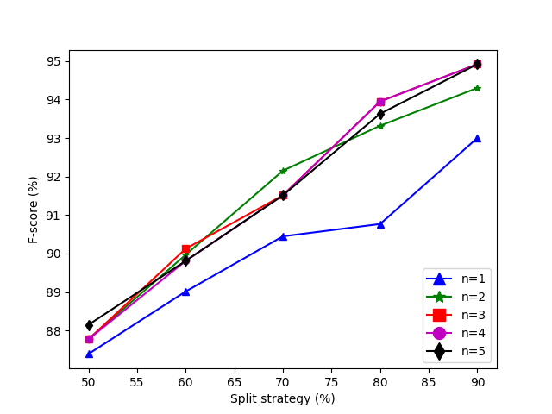
Results - Automatic Design Decision Detection
Average accuracy | F-score (%)
SVM classifier | 91.29
Logistic regression | 83.43
One-vs-rest | 79.45
Decision tree | 79.18
Naive Bayes | 76.04
70% Split 3-gram | True decision | True not a decision | Class precision
Decision | 212 | 18 | 92.17%
Not a decision | 22 | 219 | 90.87%
Class recall | 90.60% | 92.41%
Impact of split strategies.
Impact of n-gram.
With linear SVM classifier and n-gram (n >= 2) representation of words, we can automatically extract design decisions from issues with an accuracy of 91.29%.

Slide 23
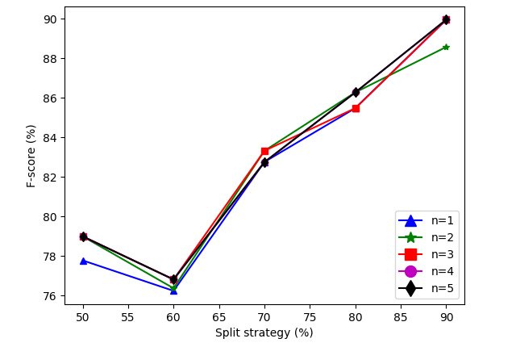
Results - Automatic Design Decision Classification
Average accuracy | F-score (%)
SVM classifier | 82.79
Decision tree | 59.09
One-vs-rest | 30.00
70% Split 3-gram | True ban | True structural | True behavioral | Class precision
Ban | 45 | 3 | 0 | 93.75%
Structural | 4 | 41 | 13 | 70.69%
Behavioral | 0 | 6 | 39 | 86.67%
Class recall | 91.84% | 82% | 75%
Lower precision and recall for structural and behavioral decisions
Impact of split strategies
Impact of n-grams
With linear SVM classifier we can automatically classify design decisions into structural, behavioral, and ban decision categories with an accuracy of 82.79%.

