Slide 1



@ GHC 2022

Slide 2
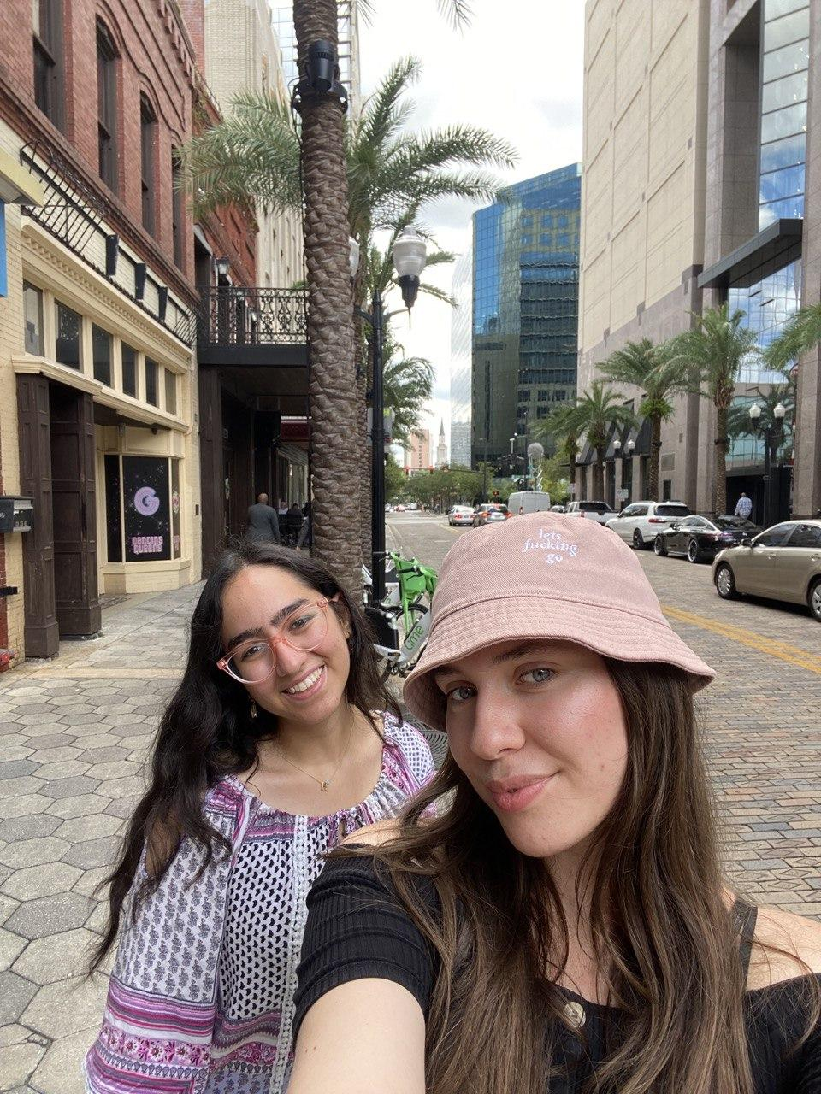
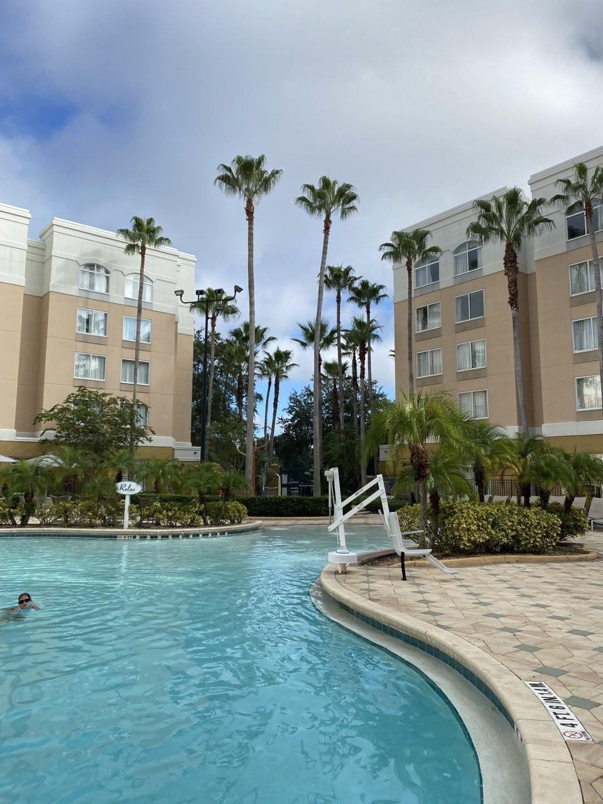
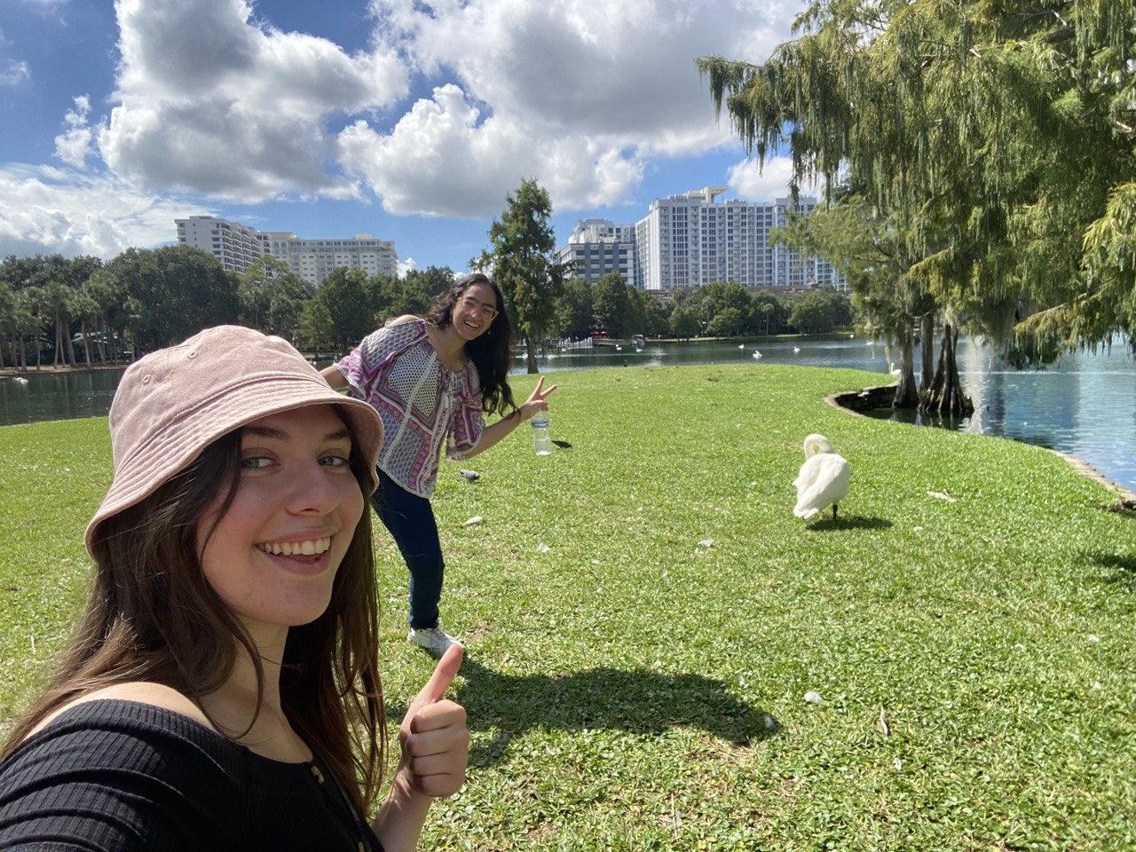
Hello Florida🌴

Slide 3
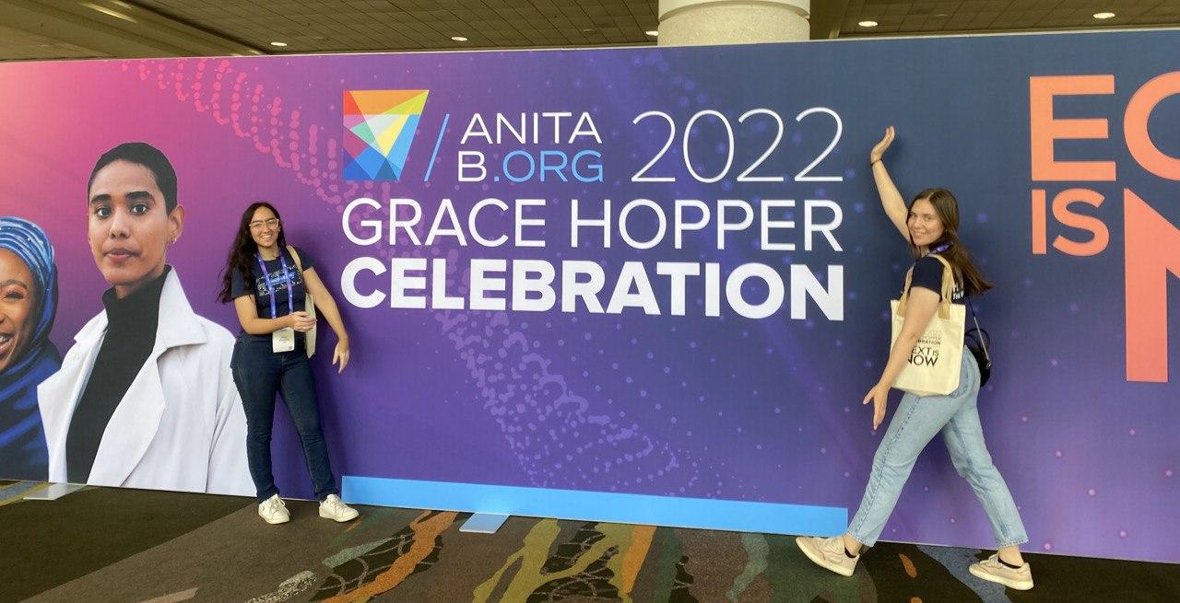
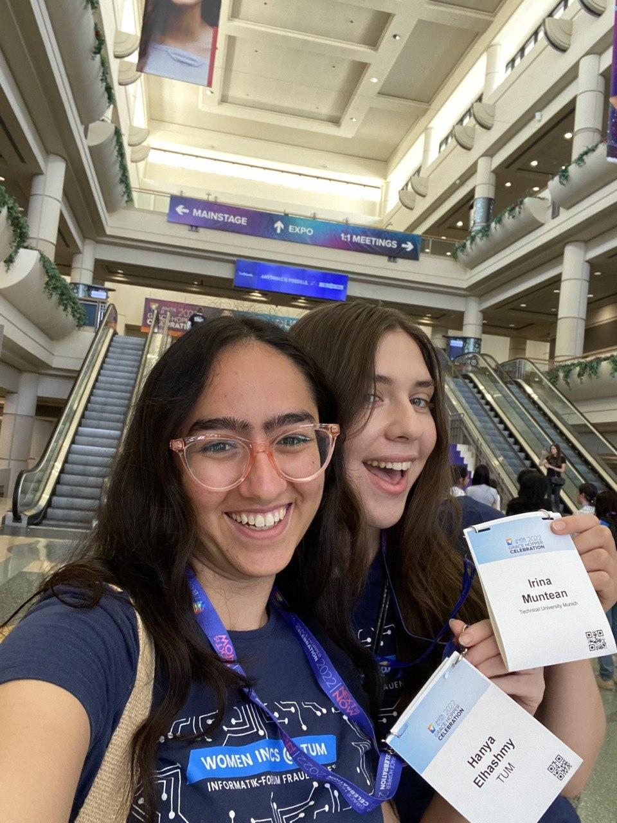
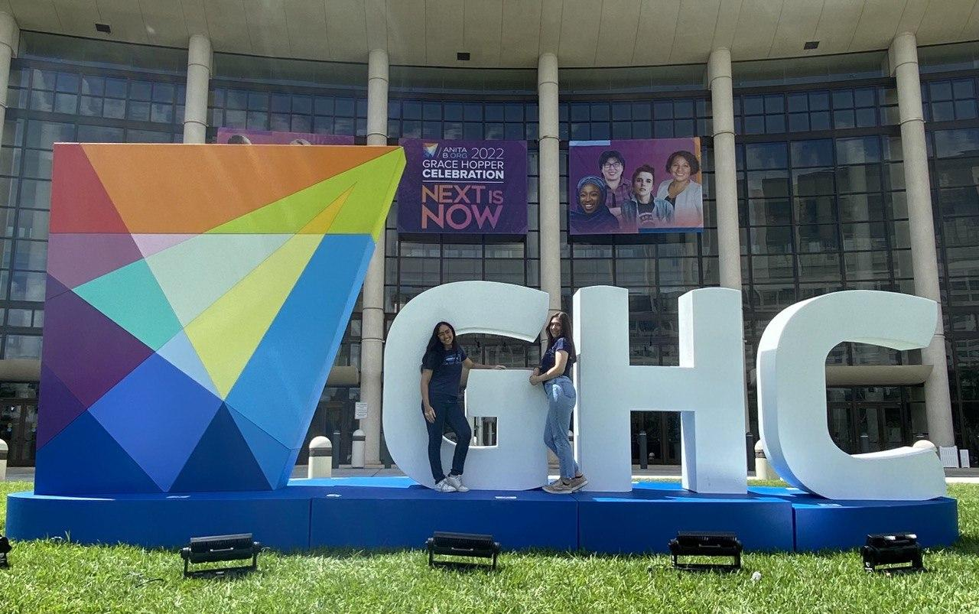
GHC22 starter pack

Slide 4
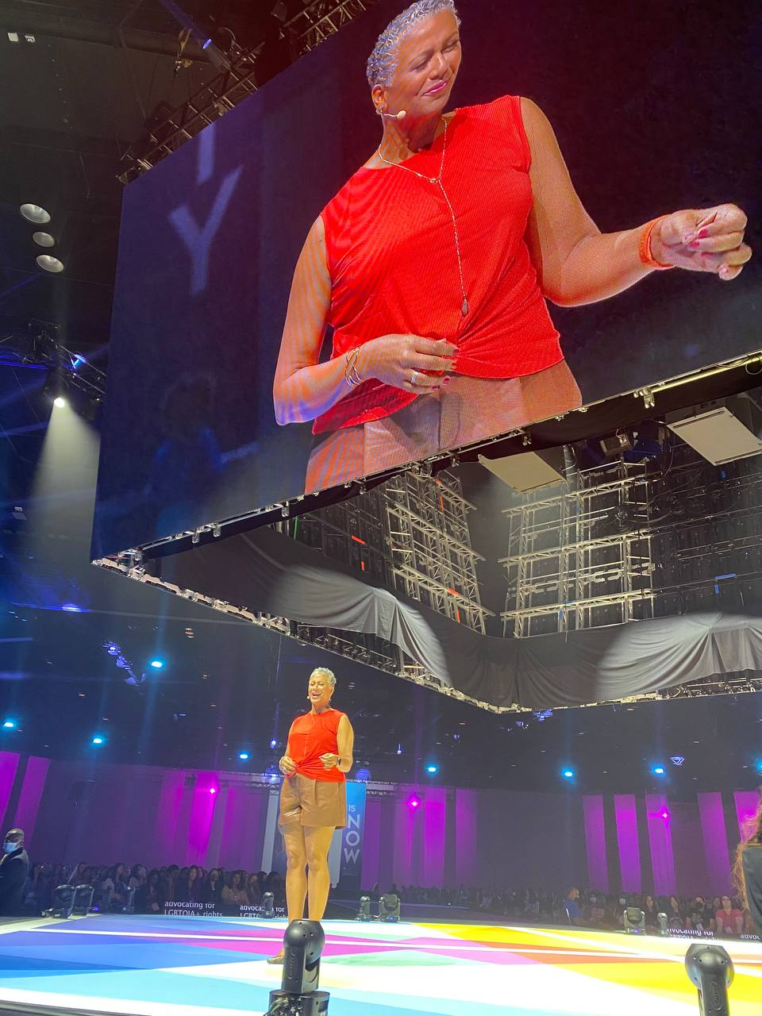
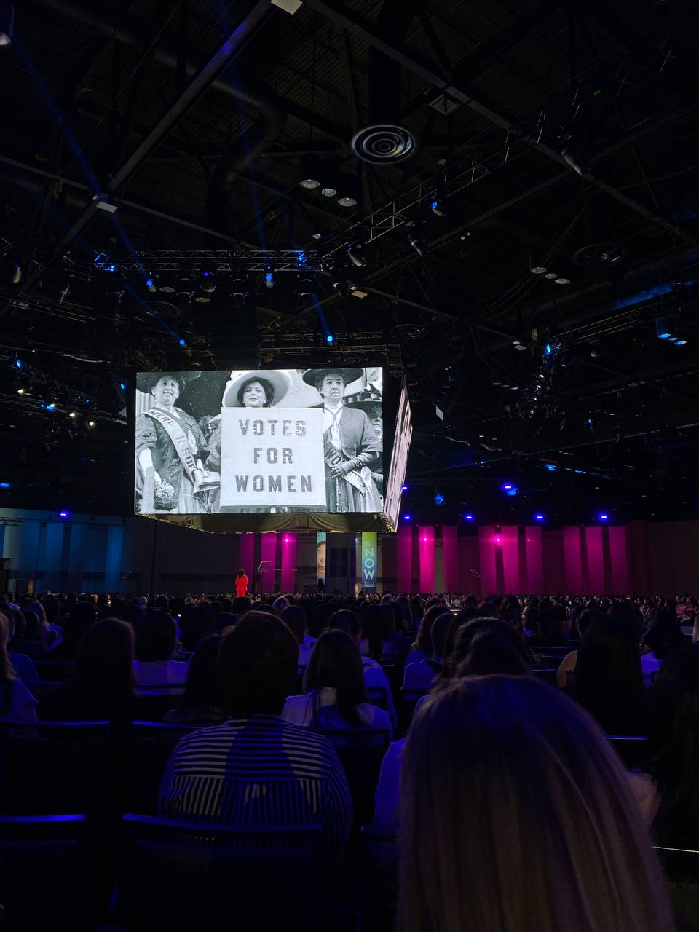
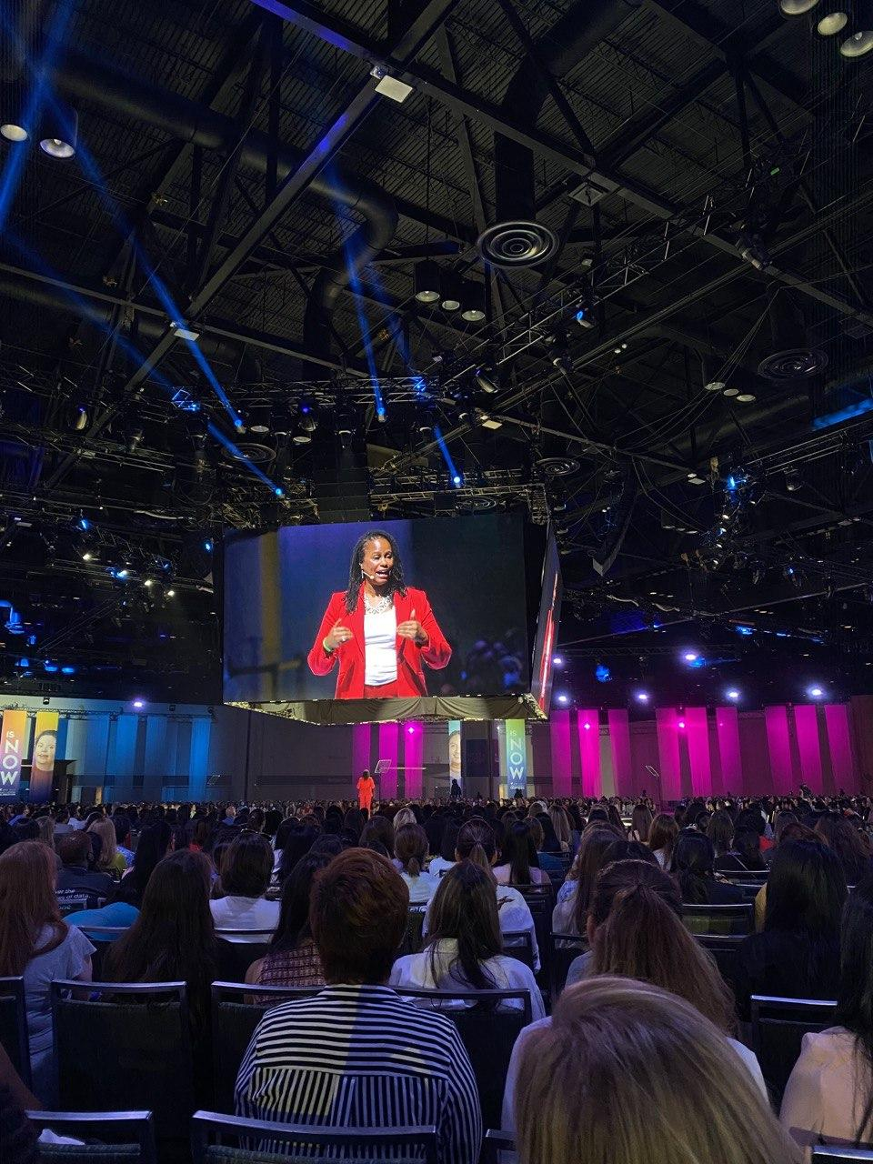
Speakers & Storytellers
  https://ghc.anitab.org/2022-speakers/

Slide 5
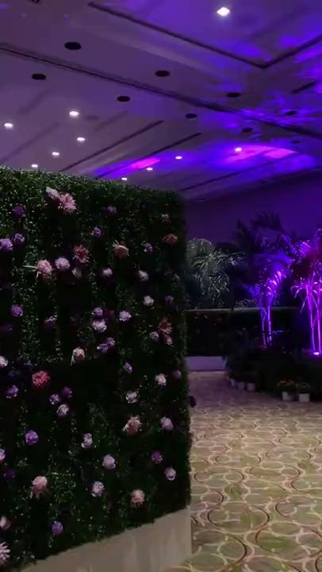
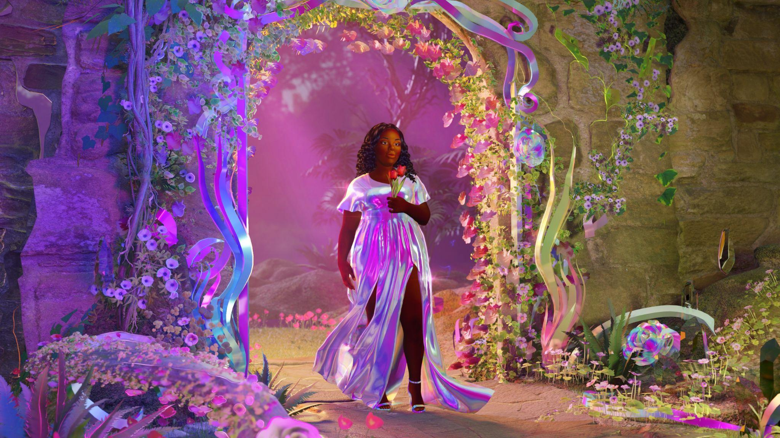
AR/VR Experience - Breonna’s Garden
In solidarity with Breonna Taylor's family, artist and curator Lady Pheonix developed Breonna's Garden, a framework for veneration through AR.
This AR experience cultivates a safe space to process complex emotions.

Slide 6
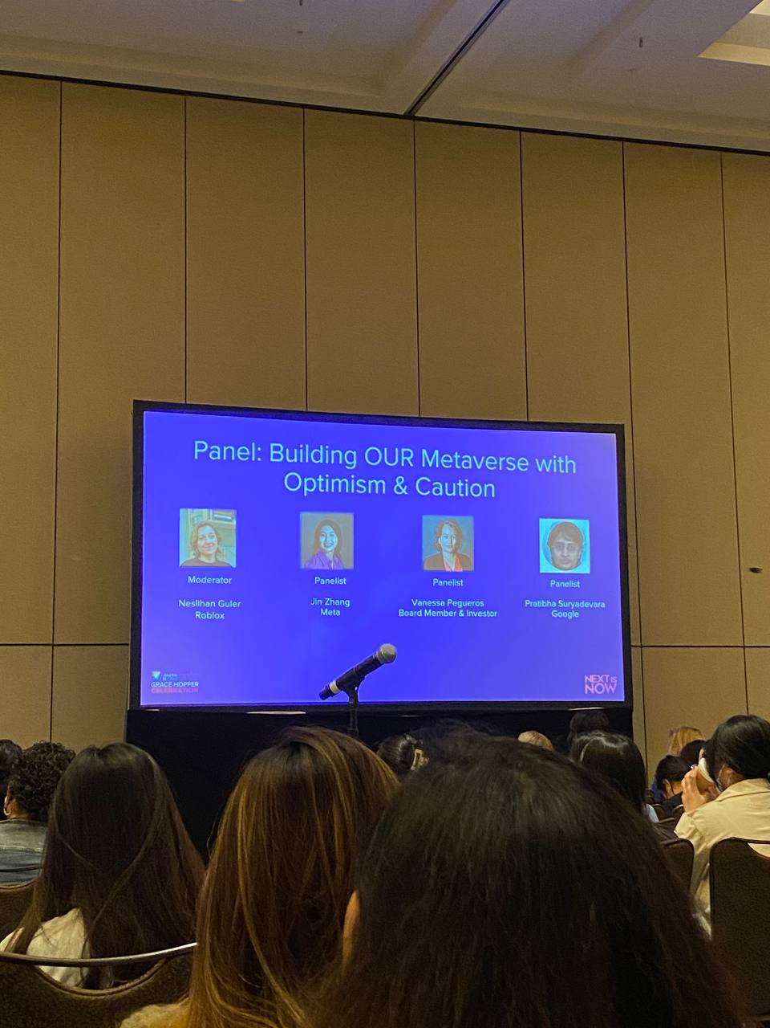
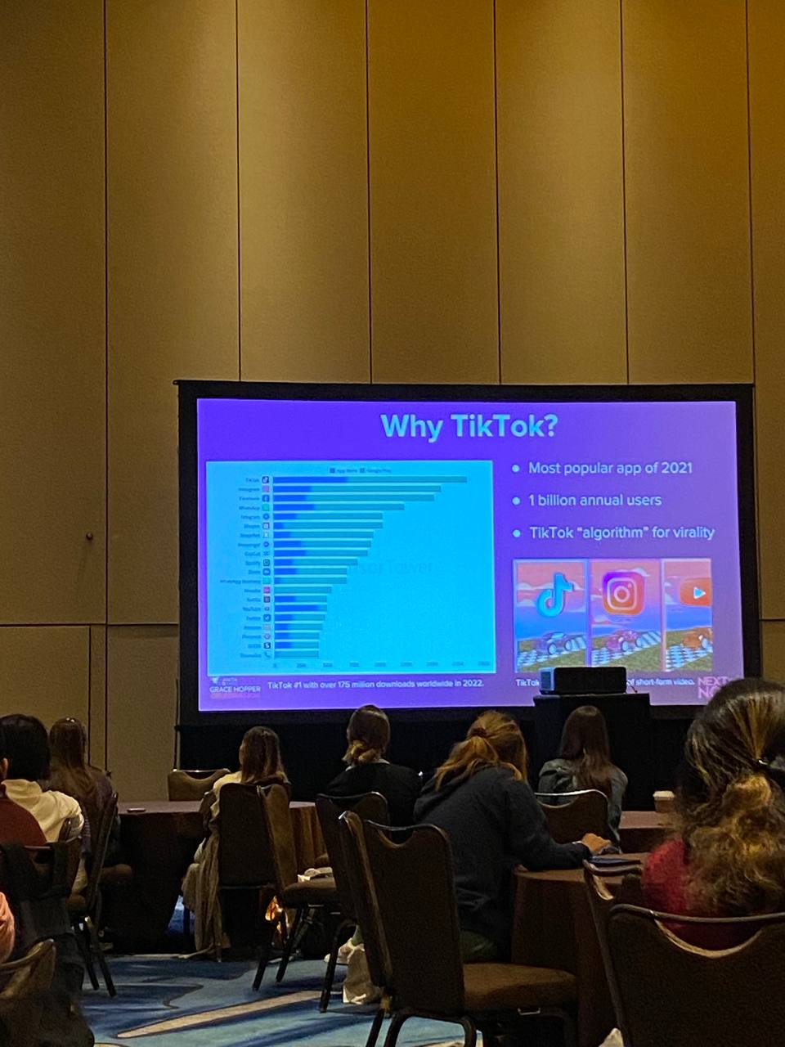
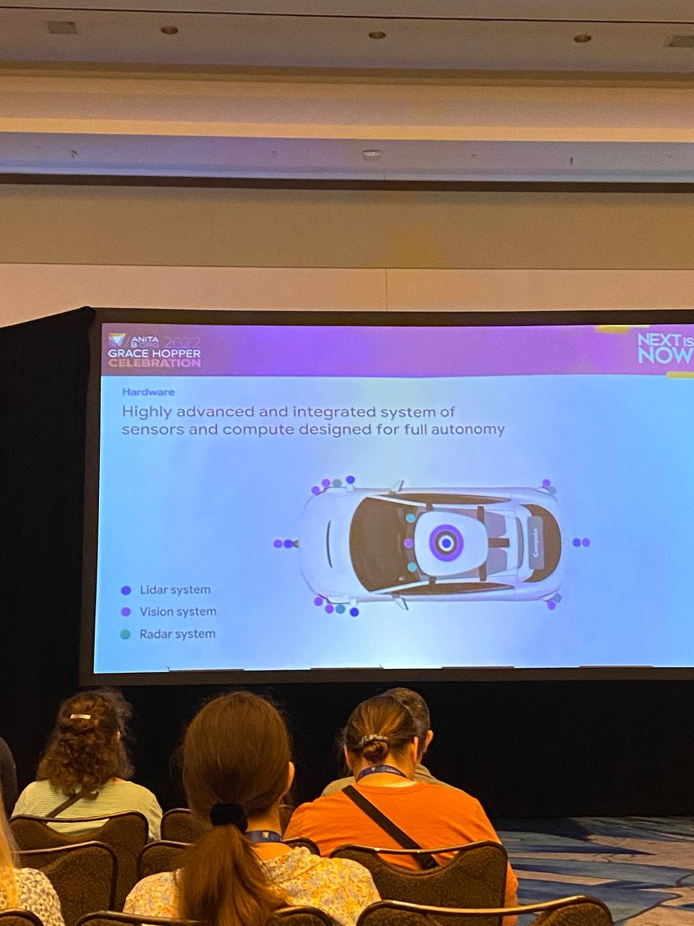
Workshops & Panel Discussions

Slide 7
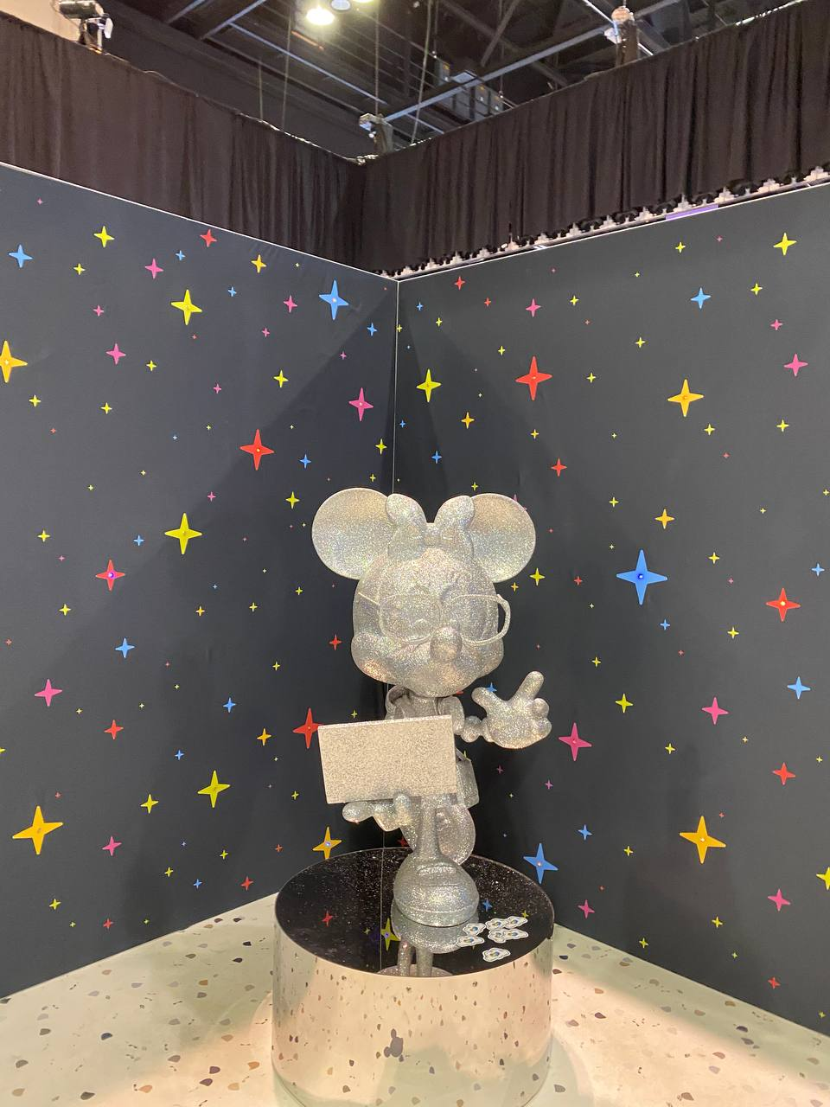
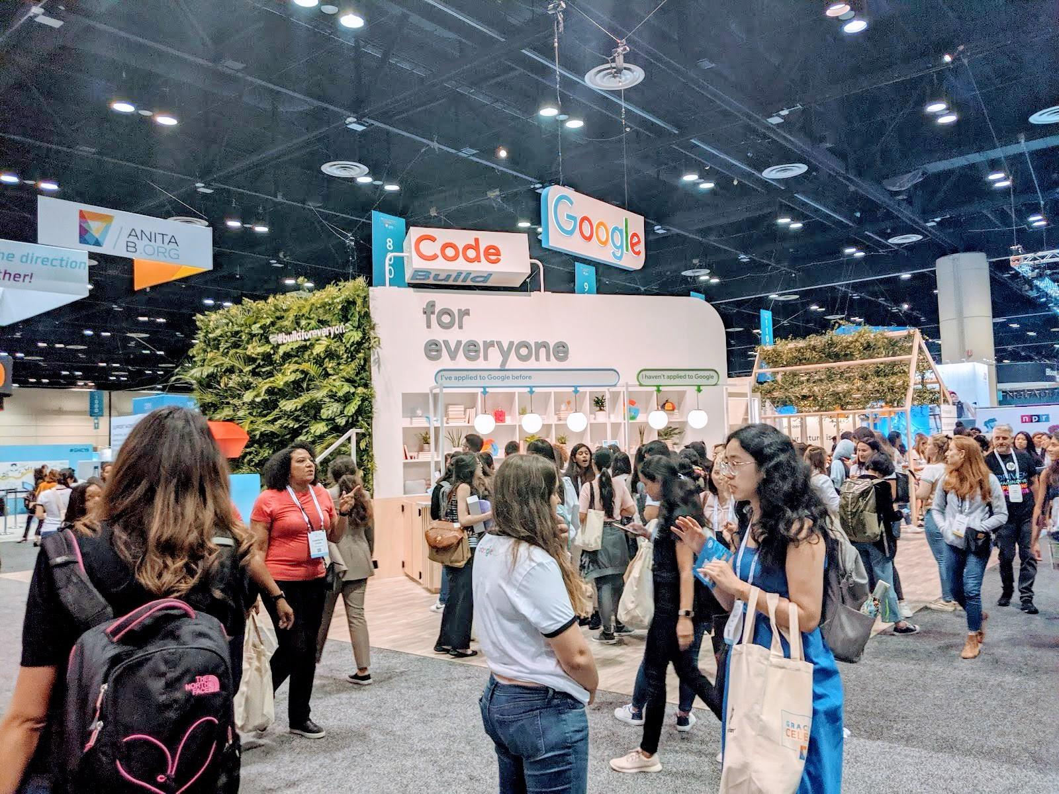
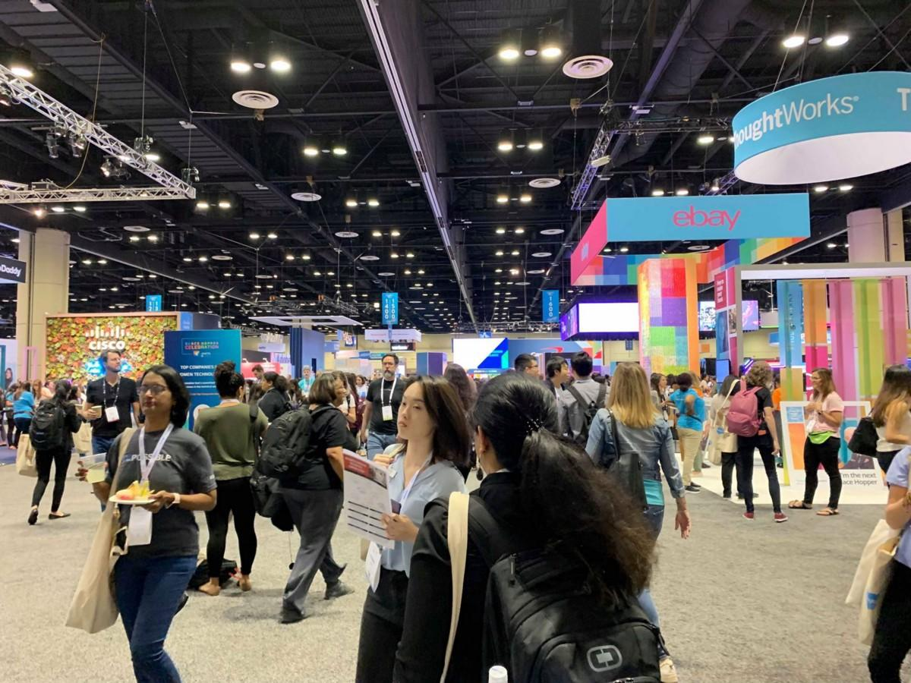
Career Fair

Slide 8
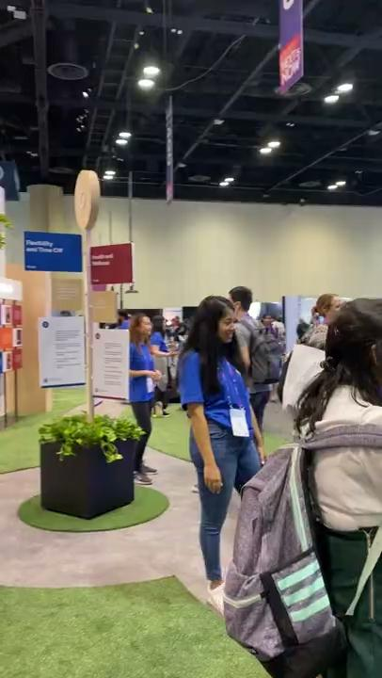
Career Fair

Slide 9
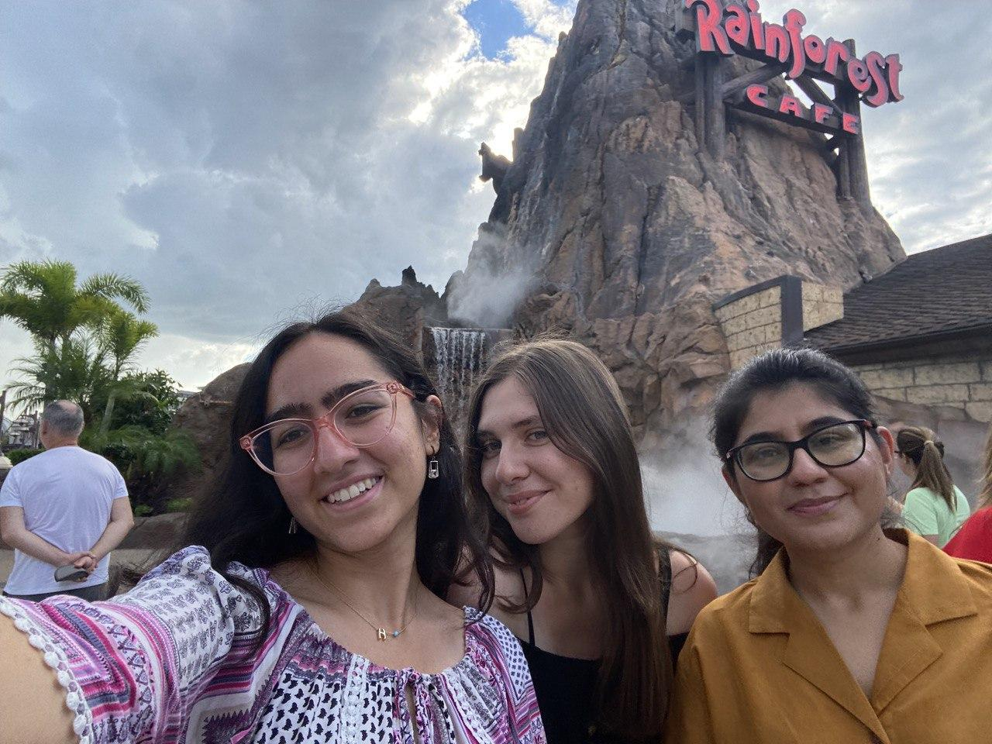
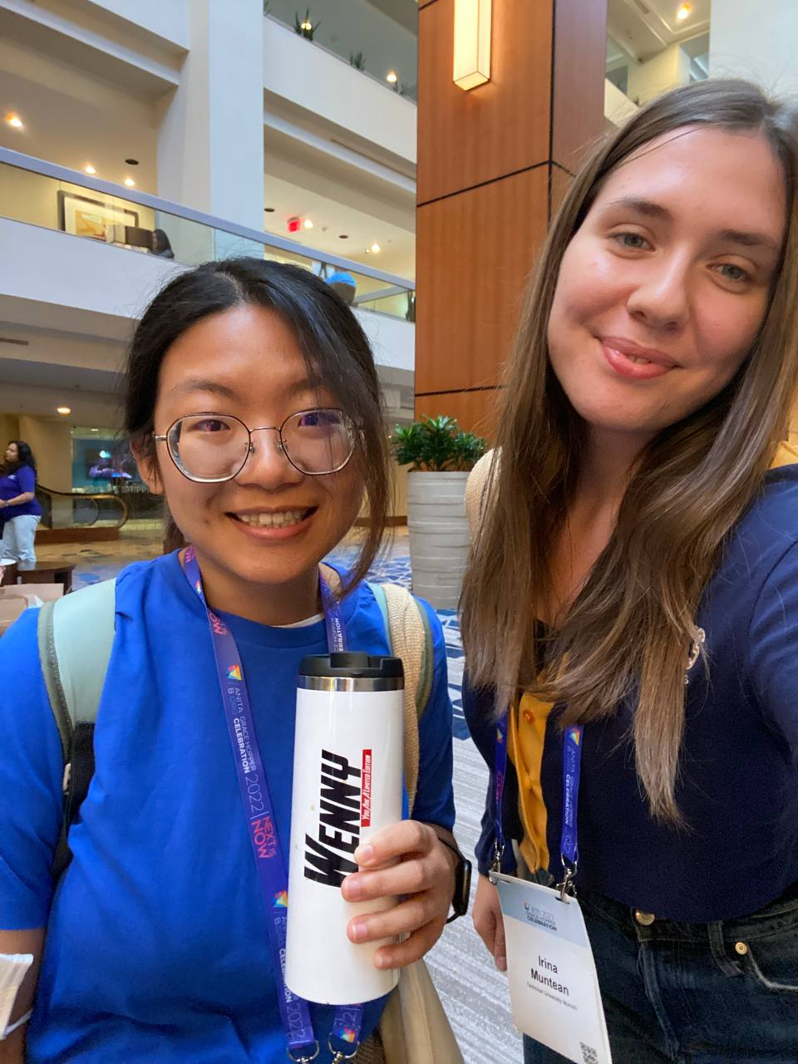
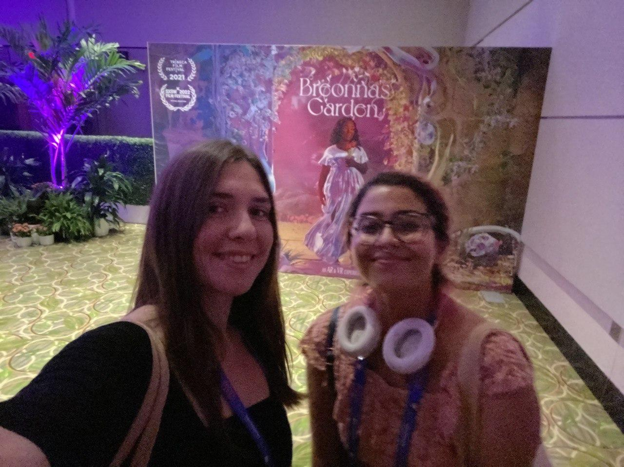
Networking
… made some new friends:)

Slide 10
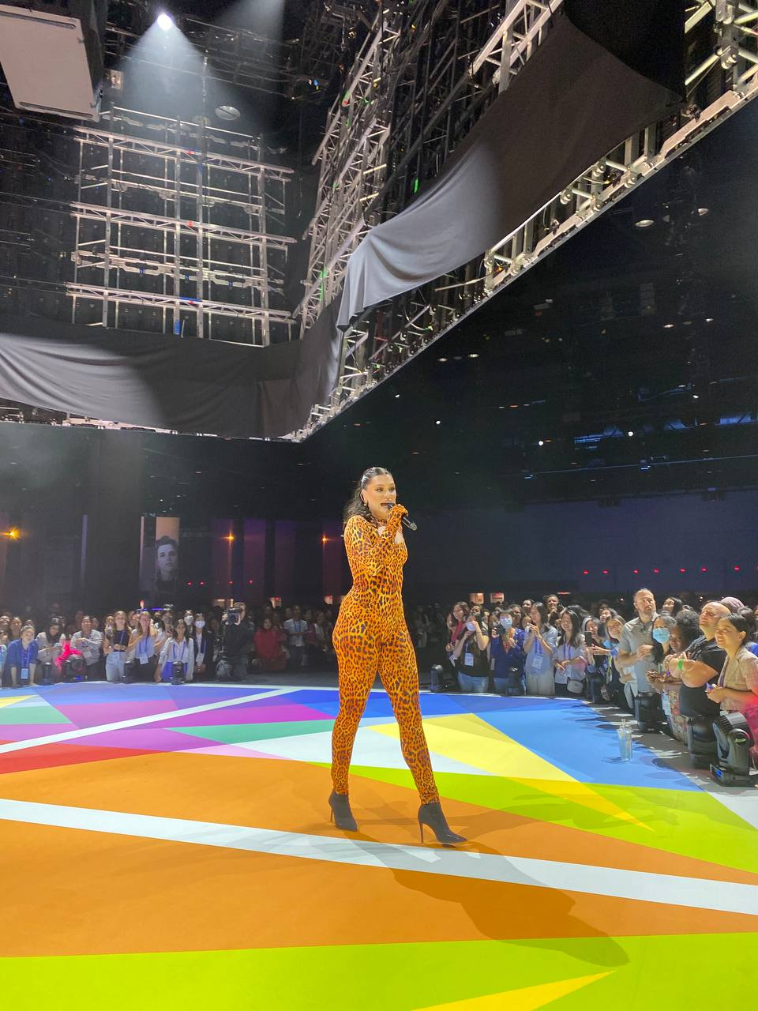
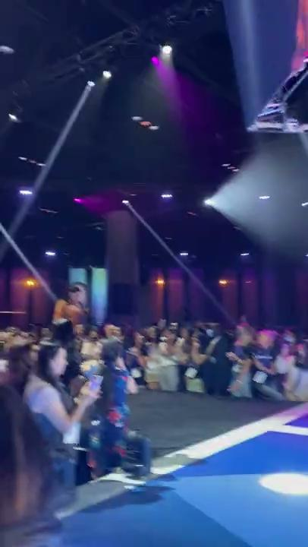
Last but not least…

Slide 11
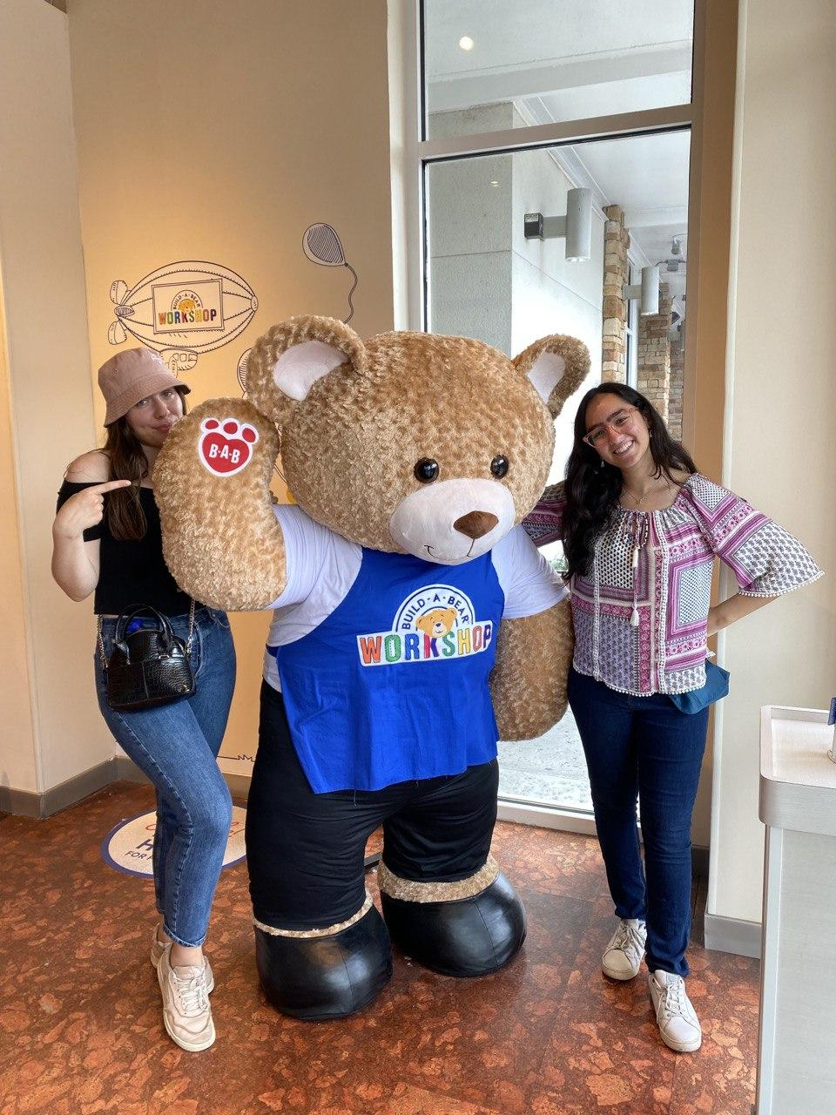
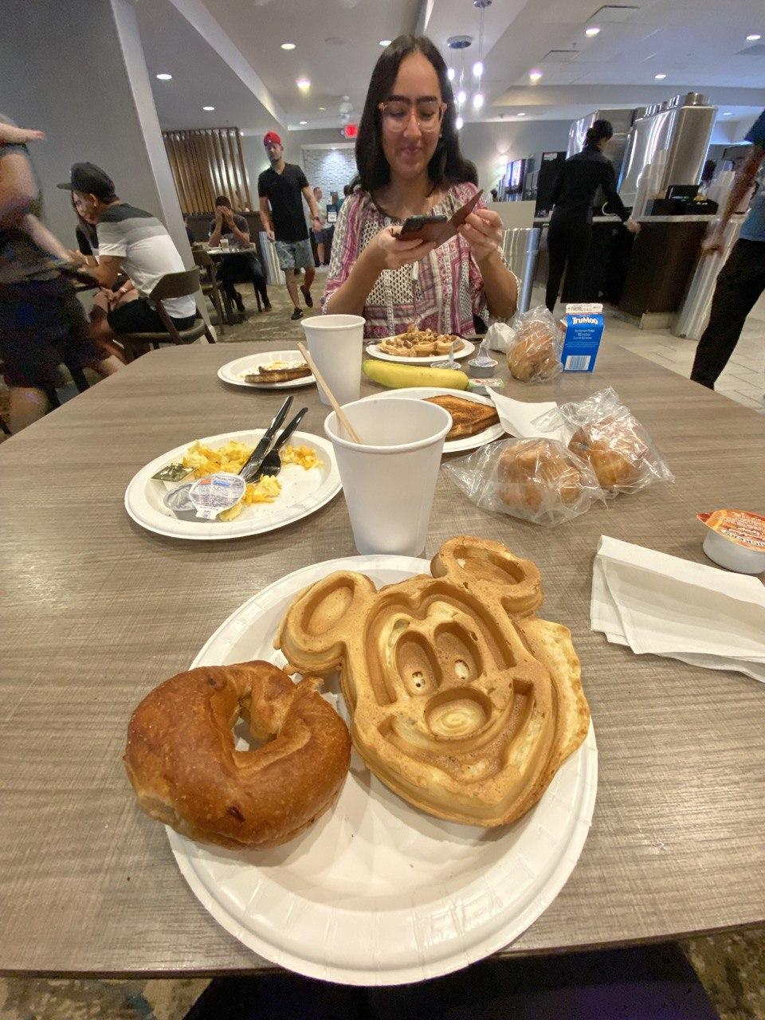
Takeaways
Overall amazing, empowering, inspiring experience
Great chance to get a job / internship (prepare CVs in advance!)
Nice self-development & tech workshops - main focus on female empowerment
Even nicer after-events (networking + free food)
Book GHC hotel BUT THOUGH BOOKING! (shuttles don’t check the booking method)
Jessie J is amazing
Prepare for a lot of Mickey mouse-shaped food when visiting Orlando

