Slide 1
GPU-Based Real-Time Discrete Euclidean Distance Transforms with Precise Error Bounds
Jens Schneider
Martin Kraus
Rüdiger Westermann

Slide 2
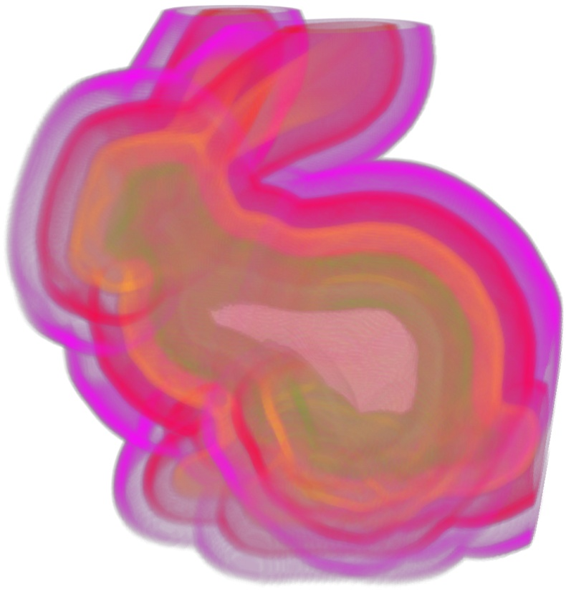
Euclidean Distance Transforms
Given a set of N points
,
Notes:
Let‘s start with a problem definition of what a Euclidean Distance Transform is…

Slide 3
Euclidean Distance Transforms
Given a set of N points
,
and a set of k features,
,
Notes:
NOTE: features consist themselves of sets of points. This makes feature classification using IDs easier.

Slide 4
Euclidean Distance Transforms
Given a set of N points
,
and a set of k features,
,
compute
Notes:
Phi stores the distance to closest feature

Slide 5
Euclidean Distance Transforms
Given a set of N points
,
and a set of k features,
,
compute
i.e., measures the closest Euclidean
Distance between and any feature point .

Slide 6
Euclidean Distance Transforms
Variations:
-
i.e., stores the feature‘s position closest to .
Notes:
This variation will be important for our algorithm.

Slide 7
Euclidean Distance Transforms
Variations:
-
i.e., stores the feature‘s position closest to .
-
i.e., stores feature IDs (aka. Voronoi Diagram)
Notes:
Mapping to feature Ids results in a Voronoi Diagram, discrete Voronoi Diagram just analogously.

Slide 8
Euclidean Distance Transforms
Variations:
-
i.e., stores the feature‘s position closest to .
-
i.e., stores feature IDs (aka. Voronoi Diagram)
Generalization:
Features may consist of curves
Notes:
Mapping to feature Ids results in a Voronoi Diagram, discrete Voronoi Diagram just analogously.

Slide 9
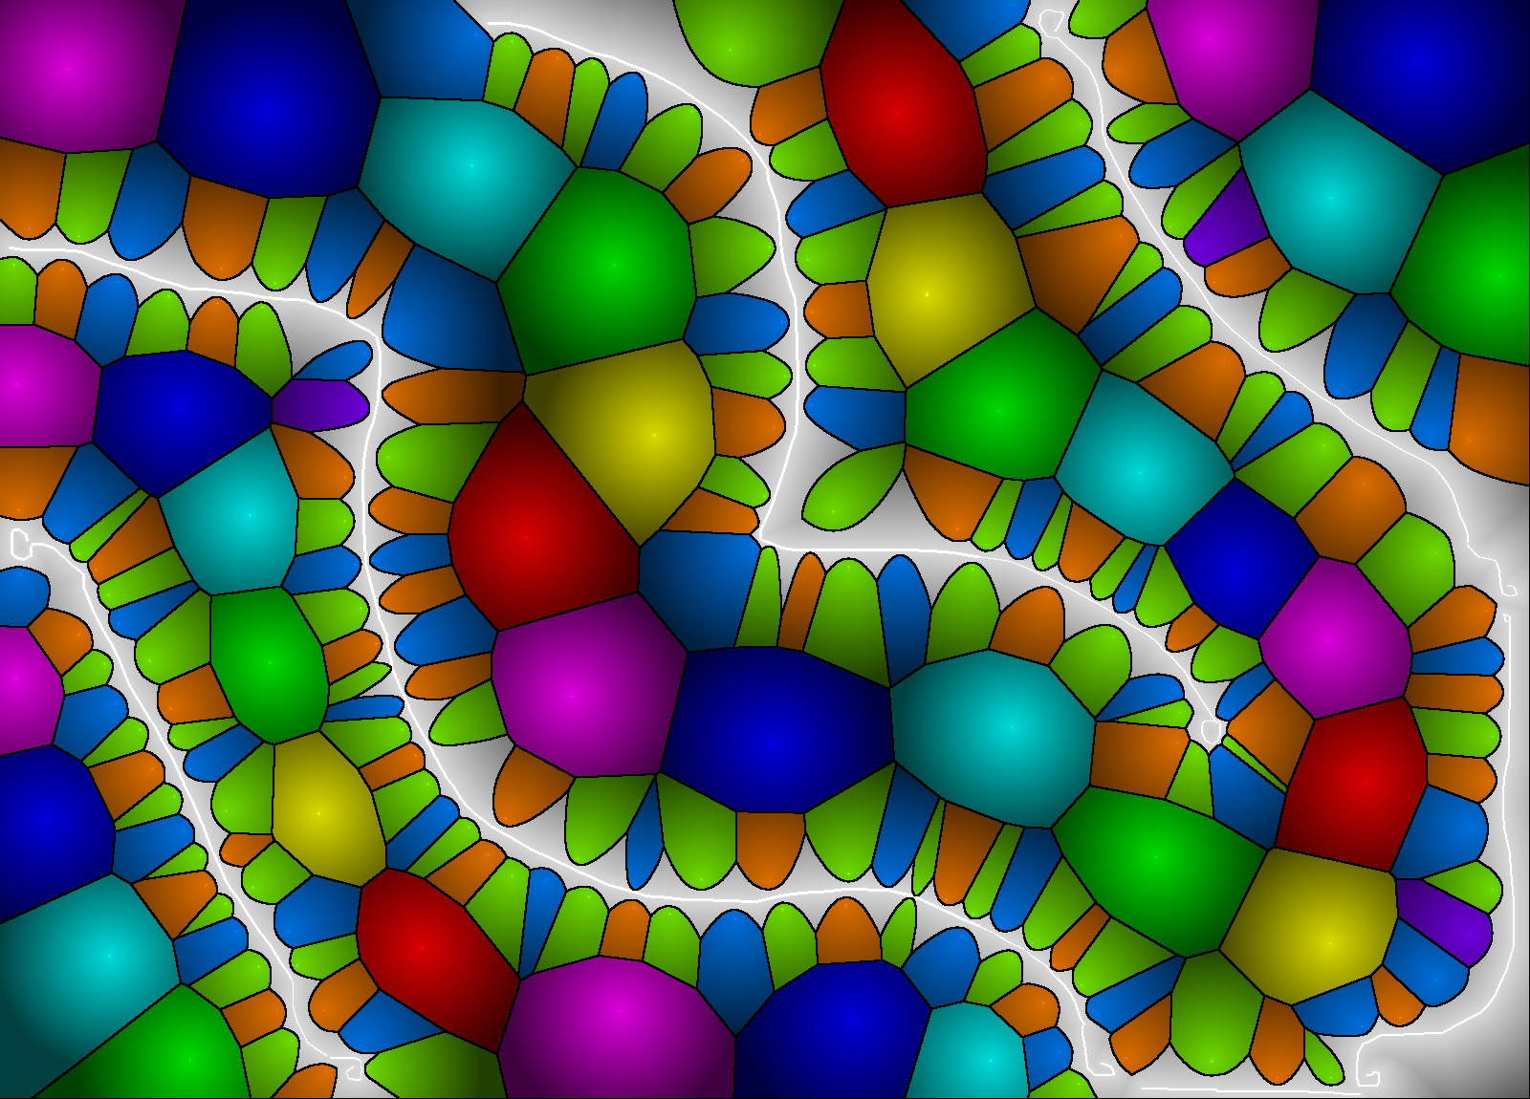
„Generalized“ Voronoi Diagram
Notes:
Example for a generalized Voronoi Diagram, computed at over 60Mpixels/sec. Note that the convex Voronoi regions are now bounded by curves.

Slide 10
Euclidean Distance Transforms
Continuous Runtime (e.g. Fortune 1986):
BUT: No efficient algorithm for generalizations!
Notes:
No efficient algorithms, since distance to arbitrary curve must be computed. Variational calculus to find closest point on curve corresponds to finding roots in arbitrary polynomials!

Slide 11
Euclidean Distance Transforms
Continuous Runtime (e.g. Fortune 1986):
BUT: No efficient algorithm for generalizations!
Discrete Runtime (e.g. Maurer 2003, Danielsson 1980)
number of image pixels
Generalizations trivial – curves are rasterized!
Notes:
Discrete runtime = runtime for rasterized images. Maurer: Tensor-product approach, harder to parallelize, Danielsson will be discussed shortly hereafter.

Slide 12
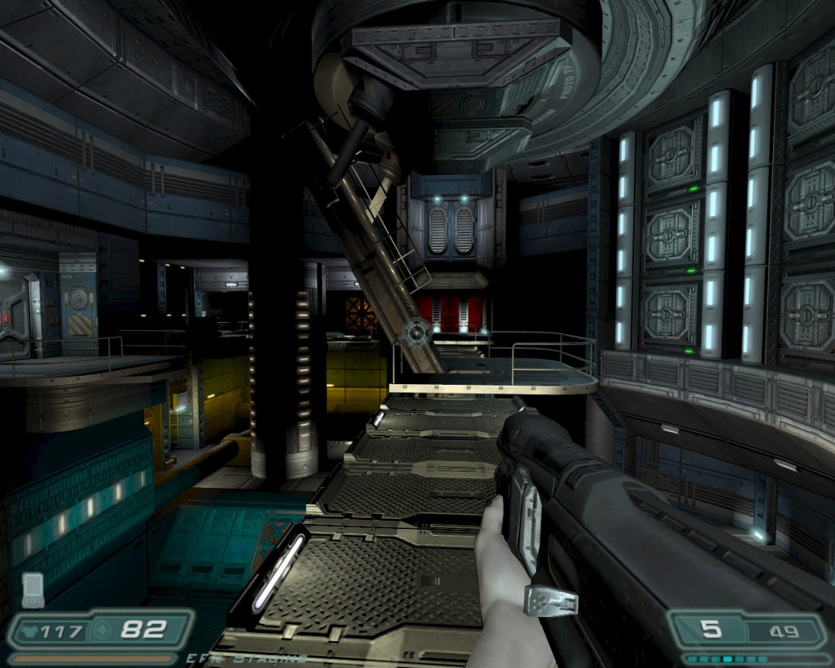
Why GPUs?
Far Cry 2, © Crytek 2008
Doom 3, © id Software 2004
Specs (NVIDIA GeForce 285)
+ 240 parallel processors
+ 159 GB/s bandwidth
+ TFlops
+ cheap (<600 €)
Data Parallelism req‘d
1GB RAM (only)
Programming: „Think CG“…
Notes:
If we hear GPUs, we typically think of games – for a good reason!
Typical Game: 2Mpixel view port, 60Hz refresh rate, overdraw>5, trilinearly sampled mipmap → ~5 billion texture accesses per second, not counting multi-texturing!
GPU highly optimized, high parallelism, high bandwidths

Slide 13
Why GPUs ?
Existence of entirely GPU-based pipes
Lots of algorithms exist!
Adobe Photoshop CS 4 completely GPU-based
„Classic“ Image processing easy to port
Good speed-ups possible
GPGPU
Distance Transforms

Slide 14
Limitations of current GPUs
Programming:
Graphics APIs
OpenGL 2.1, DirectX 10
GPGPU APIs
CUDA, CTM, OpenCL, DirectX 11 Compute Shaders
Caveats
Data (SIMD) Parallelism
Concurrent Read/Write access expensive
Notes:
Very specific programming models, even for General Purpose GPU languages knowledge of the graphics pipe is a strong plus! In our case: DirectX 10, since immediate visual feedback desirable – but can be programmed in any other API.

Slide 15
Vector Propagation (Danielsson 1980)
Closest Feature is stored by nD Vector, i.e.

Slide 16
Vector Propagation (Danielsson 1980)
Closest Feature is stored by nD Vector, i.e.
Initialize each feature with pointer to itself,
each other pixel with pointer to infinity

Slide 17
Vector Propagation (Danielsson 1980)
Closest Feature is stored by nD Vector, i.e.
Initialize each feature with pointer to itself,
each other pixel with pointer to infinity
Perform „Sweeps“ to update closest features

Slide 18
Vector Propagation (Danielsson 1980)
Closest Feature is stored by nD Vector, i.e.
Initialize each feature with pointer to itself,
each other pixel with pointer to infinity
Perform „Sweeps“ to update closest features
For each sweep and each pixel
Check candidates (neighboring pixels) for closest feature so far

Slide 19
Vector Propagation (Danielsson 1980)
Closest Feature is stored by nD Vector, i.e.
Initialize each feature with pointer to itself,
each other pixel with pointer to infinity
Perform „Sweeps“ to update closest features
For each sweep and each pixel
Check candidates (neighboring pixels) for closest feature so far
If candidate closer than best guess so far, update

Slide 20
Vector Propagation (Danielsson 1980)
8-SED (2D images)
8 neighbors Signed Distance Transform
4 sweeps, gives rise to „vector templates“

Slide 21
Vector Propagation (Danielsson 1980)
Fast (even on CPUs)
Easy to implement
Very low errors
Analysis shows that VP offers best speed vs. Error rate trade-off of all approximative schemes
(Jones et al. 2006)
BUT: Data parallelism problematic
Reason: L-shaped template result in complicated dependency graphs

Slide 22
Modified Vector Propagation
Modified Templates
Advantages:
Sweeps perfectly separated along X- and Y-axes
SIMD Parallel
Uses only mutual exclusive Read/Write operations

Slide 23
Implementation
Store all data in textures / buffers (int16-tuples)
Read Buffer
Write Buffer

Slide 24
Implementation
Store all data in textures / buffers (int16-tuples)
Read Buffer
Write Buffer

Slide 25
Implementation
Store all data in textures / buffers (int16-tuples)
Read Buffer
Write Buffer

Slide 26
Implementation
Store all data in textures / buffers (int16-tuples)
Read Buffer
Write Buffer

Slide 27
Implementation
Store all data in textures / buffers (int16-tuples)
Read Buffer
Write Buffer

Slide 28
Implementation
Store all data in textures / buffers (int16-tuples)
Read Buffer
Write Buffer

Slide 29
Implementation
Store all data in textures / buffers (int16-tuples)
Read Buffer
Write Buffer

Slide 30
Implementation
Store all data in textures / buffers (int16-tuples)
Read Buffer
Write Buffer

Slide 31
Implementation
Store all data in textures / buffers (int16-tuples)
Read Buffer
Write Buffer

Slide 32
Implementation
Store all data in textures / buffers (int16-tuples)
Read Buffer
Write Buffer

Slide 33
Implementation
Swap Read and Write Buffers and advance
Write Buffer
Read Buffer

Slide 34
Implementation
Repeat procedure for each column
Alternating between R/W Swaps yields:

Slide 35
Merging Sweep Pairs
Correct values after „+X“ Sweep, prior to „-X“
Read Buffer
Write Buffer
Copy Column

Slide 36
Merging Sweep Pairs
Correct values after „+X“ Sweep, prior to „-X“
Correct values of „-X“ Sweep
Read Buffer
Write Buffer

Slide 37
Merging Sweep Pairs
Perform „-X“ Sweep
Buffer A
Buffer B

Slide 38
Implementation
Merge interleaved results
Write Buffer
Read Buffer

Slide 39
Implementation
Copy Buffer and perform sweep in Y-direction
Read Buffer
Write Buffer

Slide 40
Performance 2D
CPU: single thread on Core2Duo 6600 @ 2.4GHz
GPU: NVIDIA GeForce 8800GTX
Resolution | CPU time | GPU time | Pixel rate | Speed-up
128² | 1.04 ms | 2.50 ms | 6.23 M/s | 0.42 x
256² | 4.60 ms | 4.21 ms | 14.84 M/s | 1.09 x
512² | 20.02 ms | 7.42 ms | 33.68 M/s | 2.70 x
1024² | 91.83 ms | 15.14 ms | 66.02 M/s | 6.06 x
2048² | 696.6 ms | 41.68 ms | 95.96M/s | 16.72 x
4096² | 2751 ms | 186.5 ms | 85.79 M/s | 14.74 x
CPU: single thread on Core2Duo 6600 @ 2.4 GHz
GPU: NVIDIA GeForce 8800 GTX

Slide 41
Errors
Systematic error
Due to rasterization, half pixel diagonal
Additionally: classification error
< 0.091033 Pixels
Relative error: about 0.3%
Negligible in practice
Error likelihood (classification):
0.56 per Million pixels (randomly seeded)
Decreases with increasing number of seeds

Slide 42
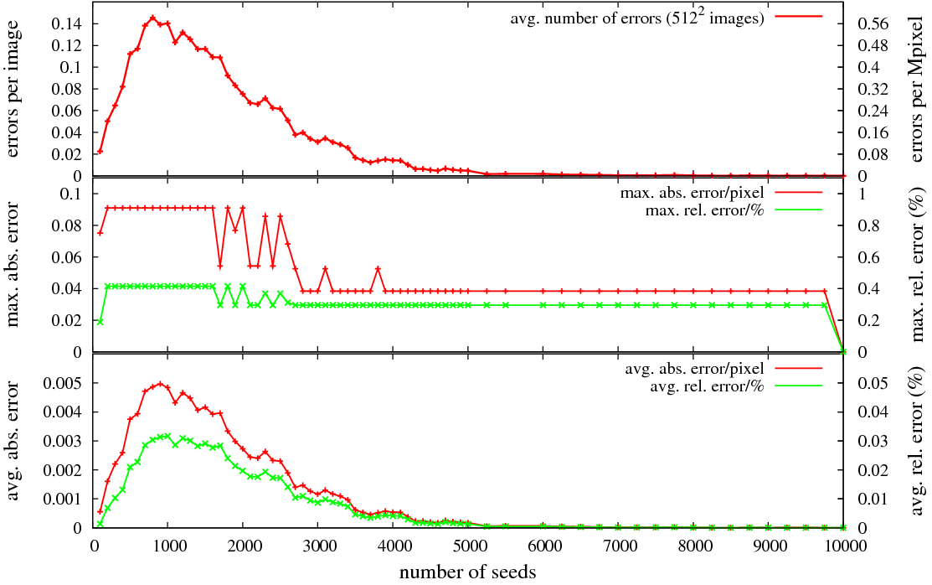
Errors
Notes:
A word on countours…

Slide 43
Generalization to 3D
Canonic Extension
straight-forward (in principle)
Rendering to 3D Textures limited to Z-slices
Memory could be a problem (Quadro 5800: 4GB)
Different Error bounds!
Not discussed in the paper
Still sub-voxel

Slide 44
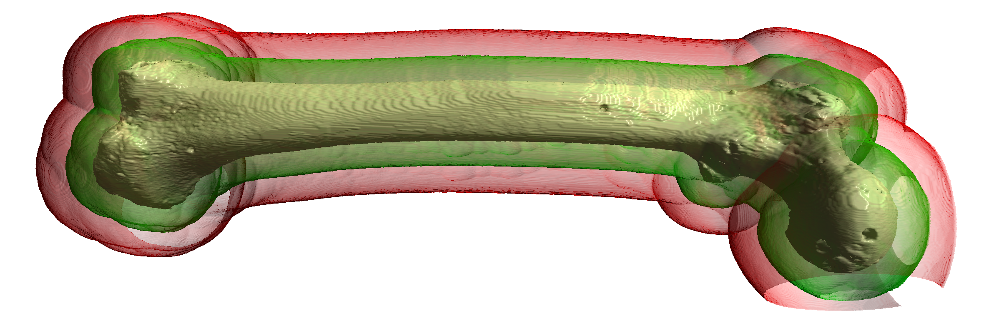
Generalization to 3D
voxel grid of a right femural bone
Spacing 0.373mm x 0.373mm x 1.0mm
Iso-surfaces 15mm (green) and 30mm (red) away
1860ms (65.2MVoxels/s), Quadro5600, 1.5GB

Slide 45
Performance 3D
CPU: single thread on Core2Duo 6600 @ 2.4GHz
GPU: NVIDIA GeForce 8800GTX
Resolution | CPU time | GPU time | Pixel rate | Speed-up
32³ | 9.67 ms | 3.71 ms | 8.42 M/s | 2.61 x
64³ | 84.18 ms | 8.21 ms | 30.45 M/s | 10.25 x
128³ | 1020 ms | 30.85 ms | 64.83 M/s | 33.08x
256³ | 9195 ms | 213.0 ms | 75.12 M/s | 43.17 x
CPU: single thread on Core2Duo 6600 @ 2.4 GHz
GPU: NVIDIA GeForce 8800 GTX

Slide 46
Conclusions
Good speed-up for higher 2D resolutions
Sweet spot for 2048x2048
Lower resolutions can be „packed“ to larger image
Amazing speed-up for 3D
Caching issues become overwhelming on CPU
Limited VRAM could be a problem (up to 4GB)

Slide 47
Future Work
More error sometimes tolerable
LOD computation possible
Coarse computation using this method
One additional pass of JFA (Rong et al. 2006)
Less memory footprint, faster
Subpixel accuracy for iso-contours
Bricked computation

Slide 48
Notes:
Now to something completely different…

Slide 49
Thank you for your attention!
Questions ?
jens.schneider@in.tum.de

