Slide 1
ClearView:
An Interactive Context Preserving Hotspot Visualization Technique
Jens Krüger – Jens Schneider – Rüdiger Westermann
computer graphics & visualization

Slide 2
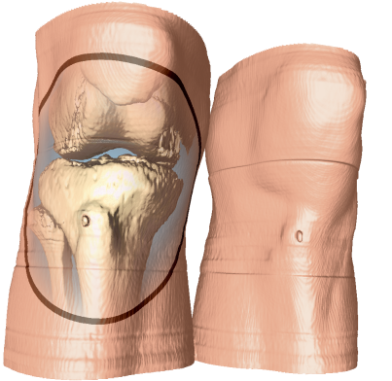
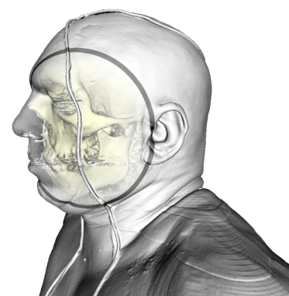
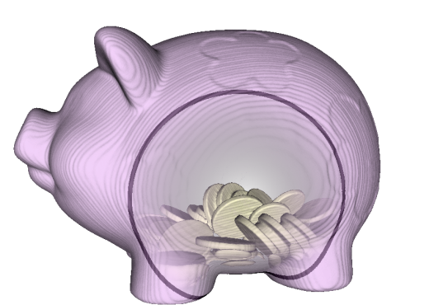
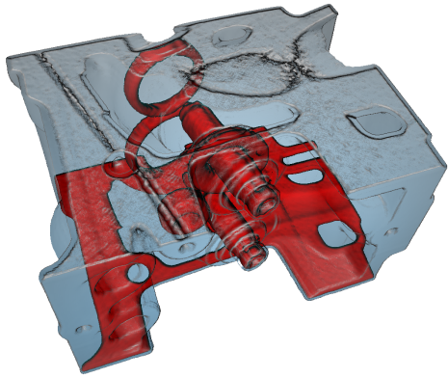
ClearView: An Interactive Context Preserving Hotspot Visualization Technique
Fast
Versatile
Intuitive
ClearView

Slide 3
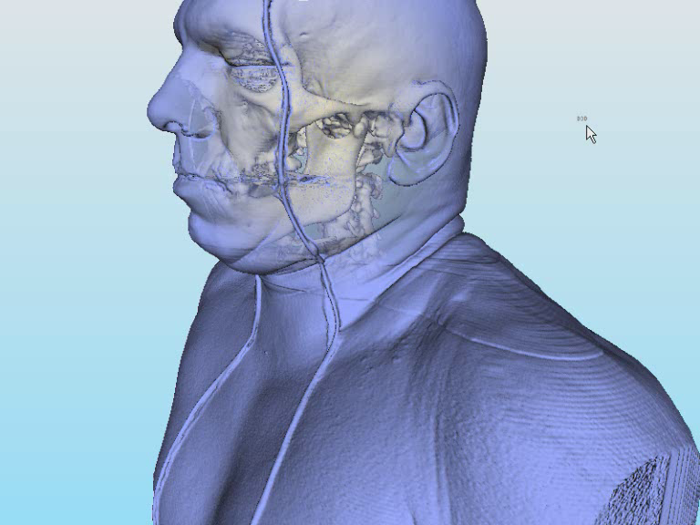
Buzzwords
Fast
Versatile
Intuitive
Interactive
Applicable to many different modalities
… at the same time
Instant access to the system

Slide 4
History (Lenses)
1990
Gaze-directed volume rendering
Levoy and Whitaker
1994
Taxonomy of distortion-oriented presentation techniques
Leung and Apperley
1996
2D & 3D Distortion View
Carpendale et al.
1999
Interactive Lens Techniques
Shaw et al.
2001
Magnification Lenses for interactive Volume Rendering
LaMar et al.
2003
Deformations for Browsing data
McGruffin et al.
2004
Interactive F+C Volume Rendering
Ikits et al., Cohen et al.
2005
Magic Volume Lens
Wang et al.

Slide 5
History (Colors)
1993
Toolglass UI
Bier et al.
1997-
Volume Illustration, NPR
Interrante et al., Ebert et al., Rheingans et al., Gooch & Gooch, Lum et al., Stompel et al.
2002
Transparency & Interactive Cut-Aways
Diepstraten et al.
2005
Volumeshop
Bruckner et al.
2006
Illustrative Context-Preserving Exploration of Volume Data
Bruckner et al.

Slide 6
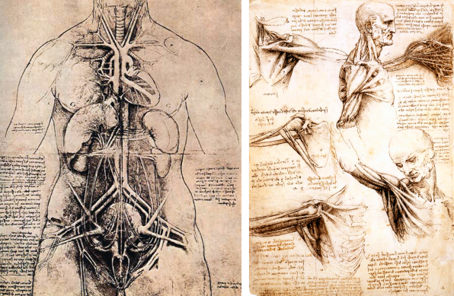
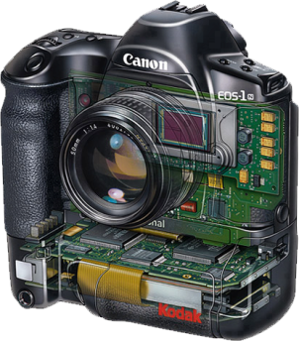
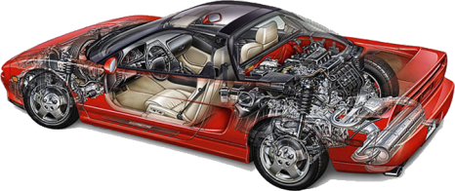
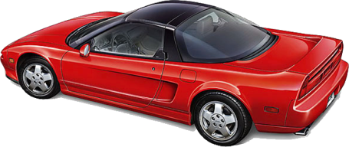
“Handcraft History”
AD 2000
AD 1500
L. DaVinci
Dell’anatomia fogli A et B, Quaderni d’anatomia I-IV
Kevin Hulsey Illustration, Inc.
Acura, Kodak

Slide 7
Analysis
Context Region
Focus Region
Context “clues”
Image courtesy of Kevin Hulsey Illustration, Inc.

Slide 8
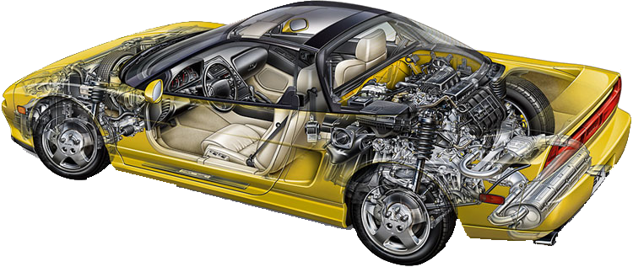
Analysis
Focus Region
Context Region
Context “clues”
Image courtesy of Kevin Hulsey Illustration, Inc.

Slide 9
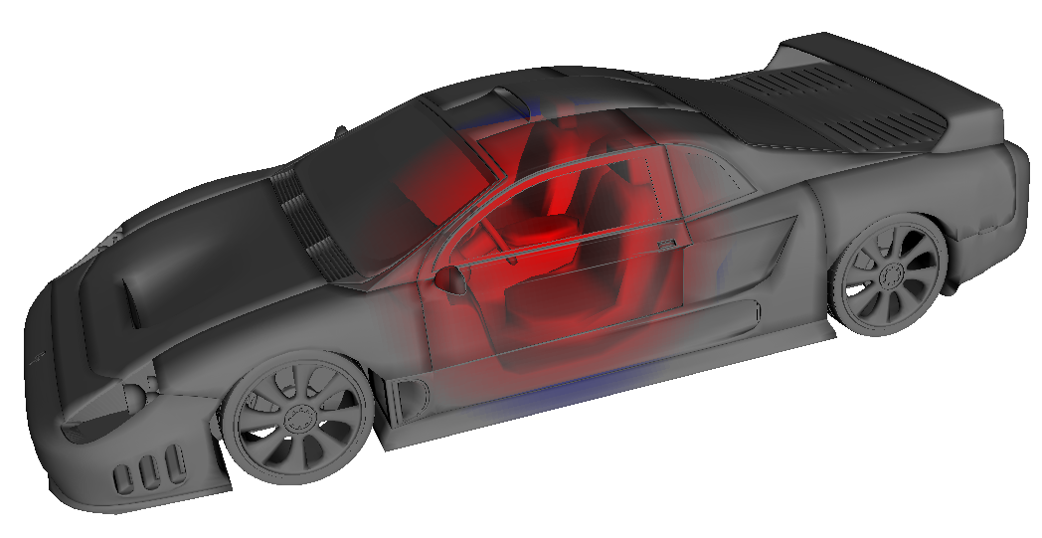
ClearView Image
Focus Region
Context Region
Context “clues”

Slide 10
Components
Context
Focus
Compositing
one or more semi-transparent context layers
one or more opaque focus layers
emphasize important features in the context to embed the focus
hide unimportant context regions

Slide 11
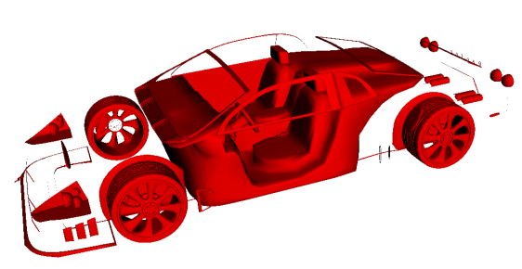
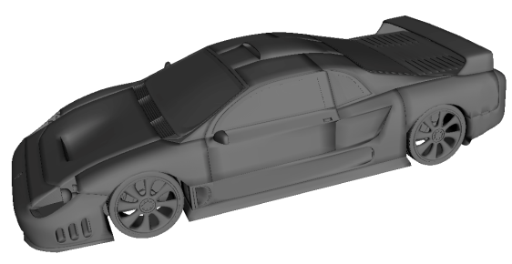
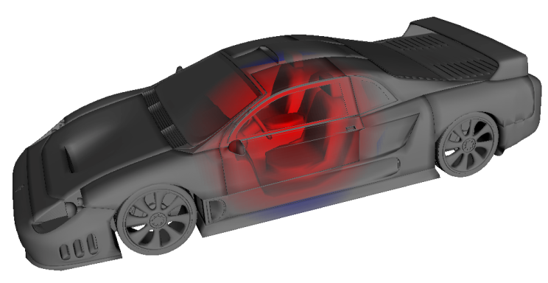
Overview
Compositing
Features
Layers

Slide 12
Layers
Compositing
Features
Layers

Slide 13
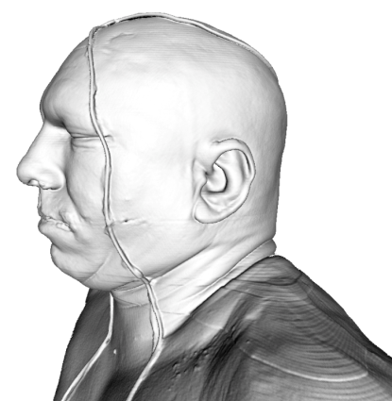
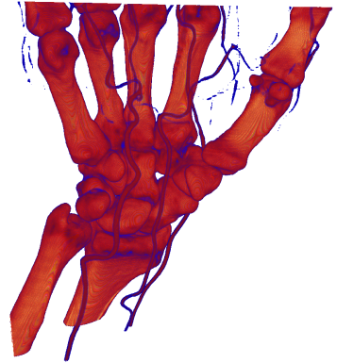
Layers
Isosurfaces
Direct Volume Rendering
Meshes
Compositing
Features
Layers

Slide 14
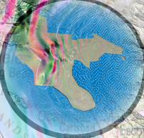
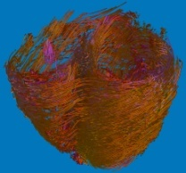

Layers
GPU-Based
Raycasting
Direct
Rendering
Other
Modalities
Compositing
Features
Layers

Slide 15
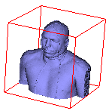

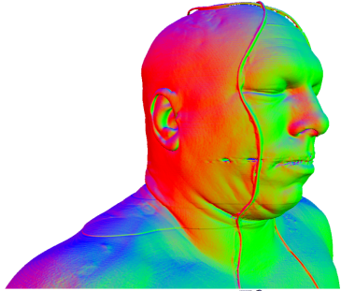
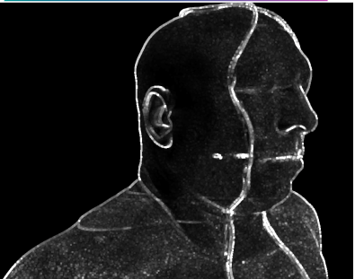
Layers & Features
Compositing
Features
Layers
GPU-Based
Isosurface Raycasting

Slide 16
Curvature Estimation

Slide 17
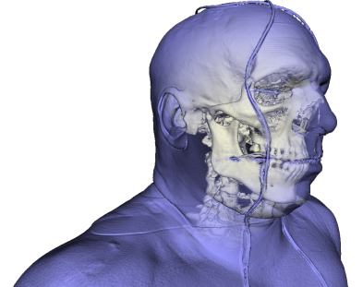
Compositing
Compositing
Features
Layers
Context
Context
Compositing
Focus
Focus

Slide 18
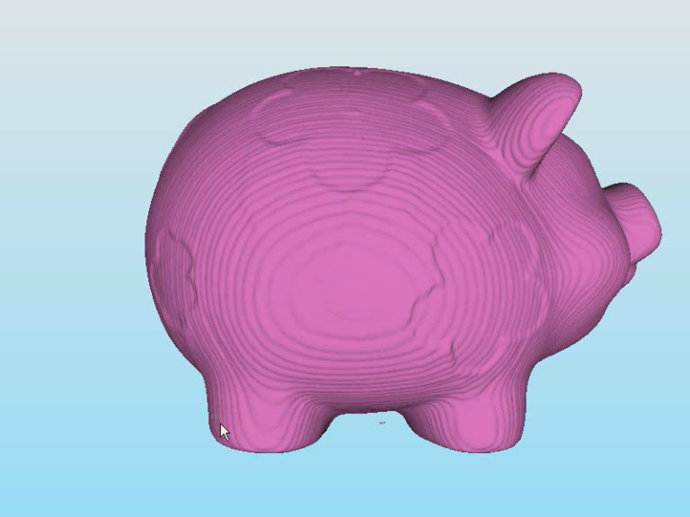
Compositing

Slide 19

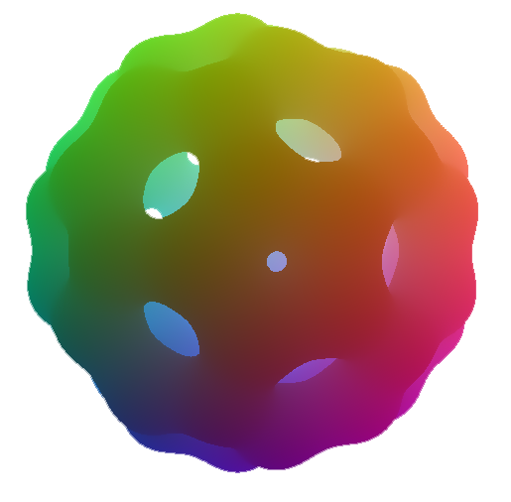
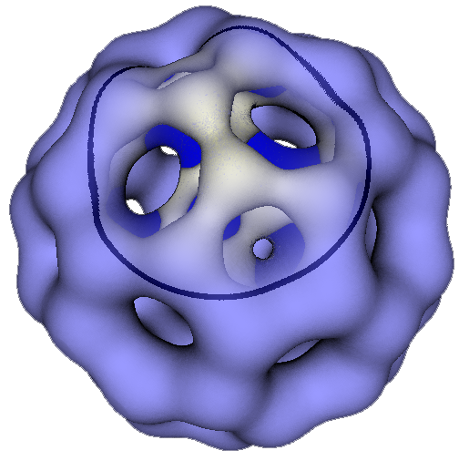
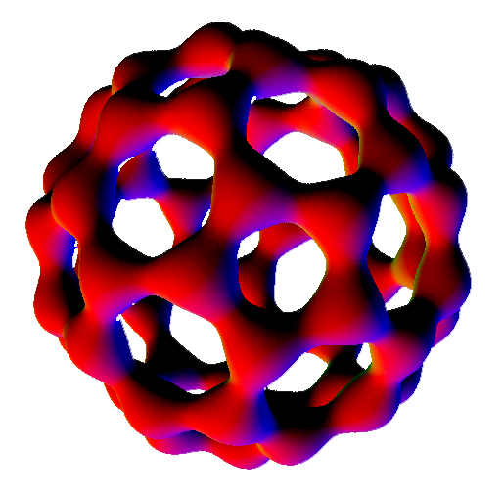
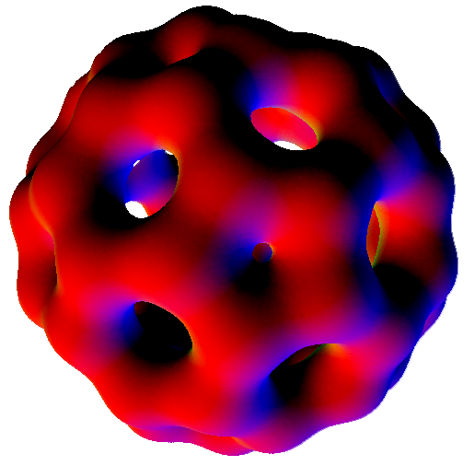
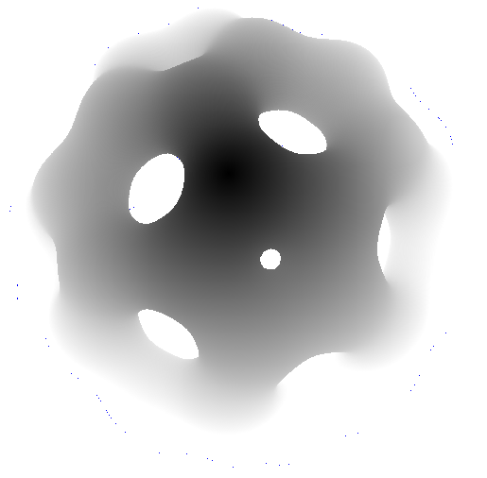
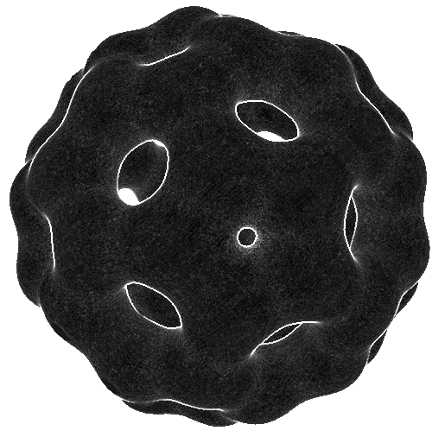
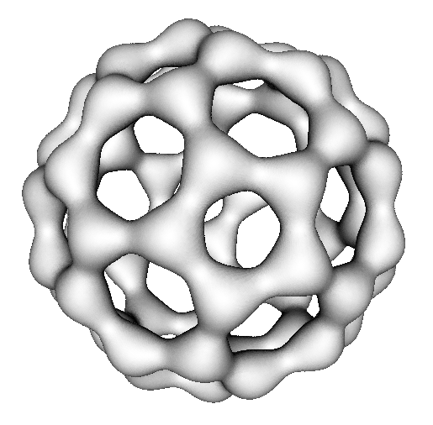
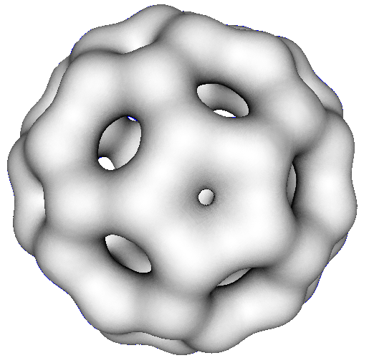
Compositing:

Slide 20

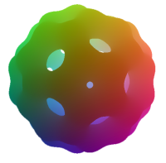
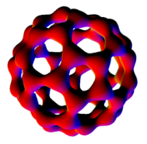
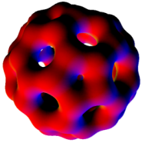
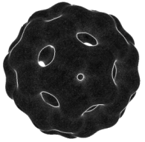
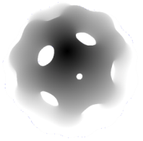
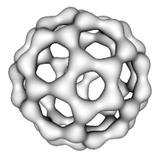
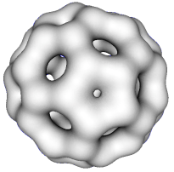
Compositing

Slide 21
Compositing: Importance

Slide 22
Compositing: Importance
Curavture Based
Context layer curavture
View-Distance Based
Distance between surfaces along view ray
Normal Distance Based
Distance between surfaces along the normal of the context surface

Slide 23
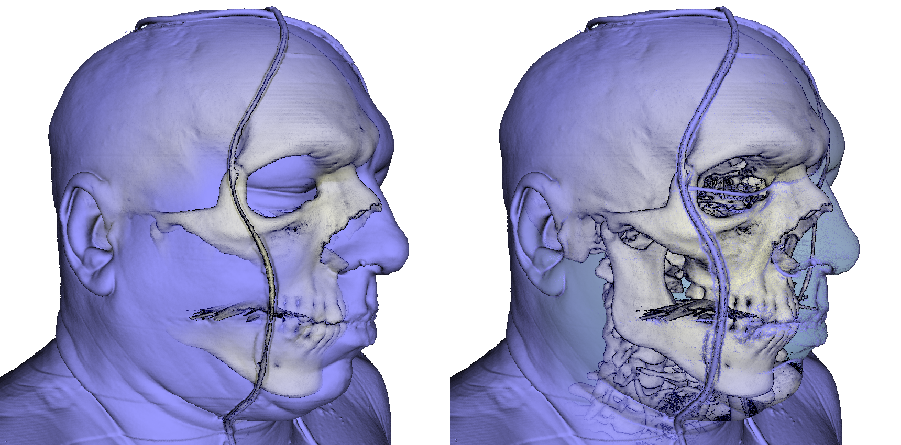
Distance vs. Curvature

Slide 24
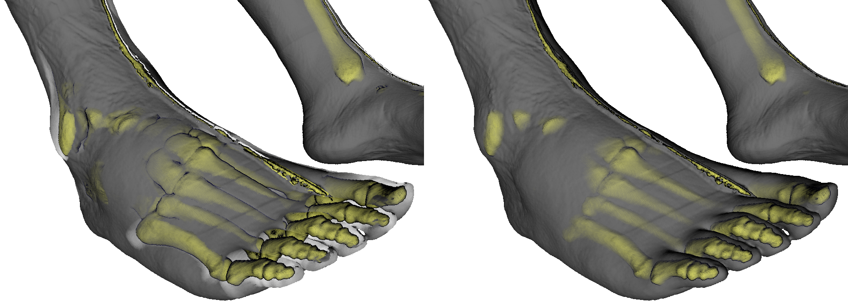
Normal – vs. View – Distance
view
normal
view

Slide 25
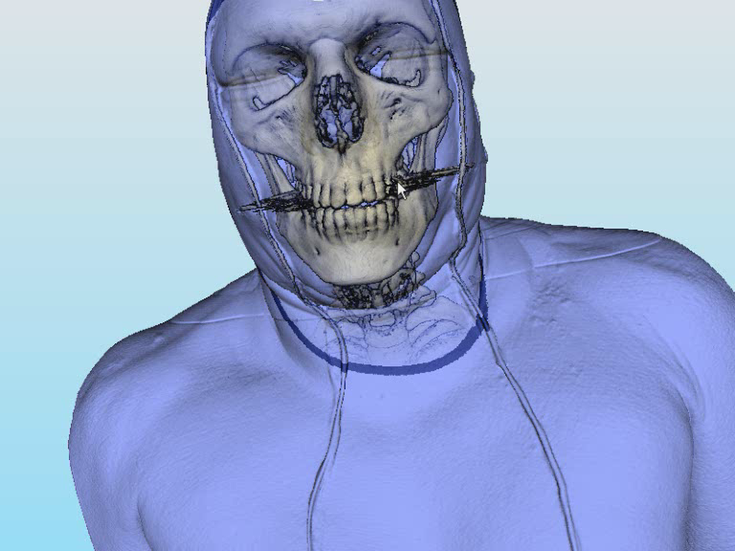
View – vs. Normal – Distance

Slide 26
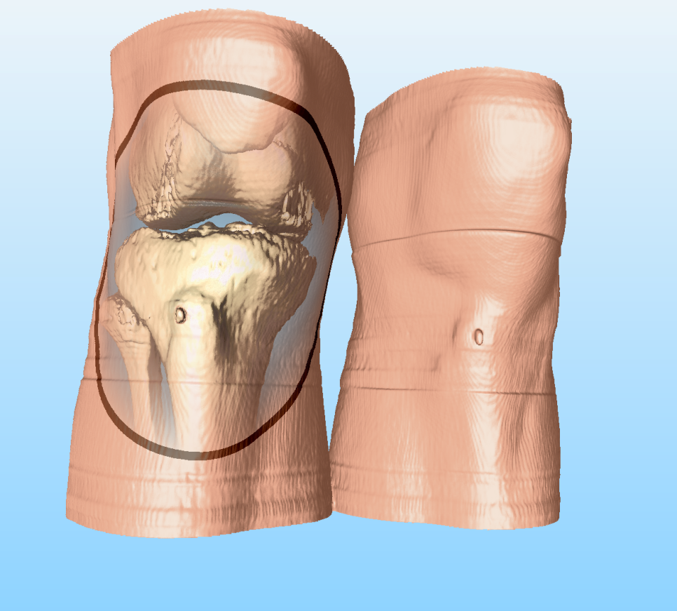
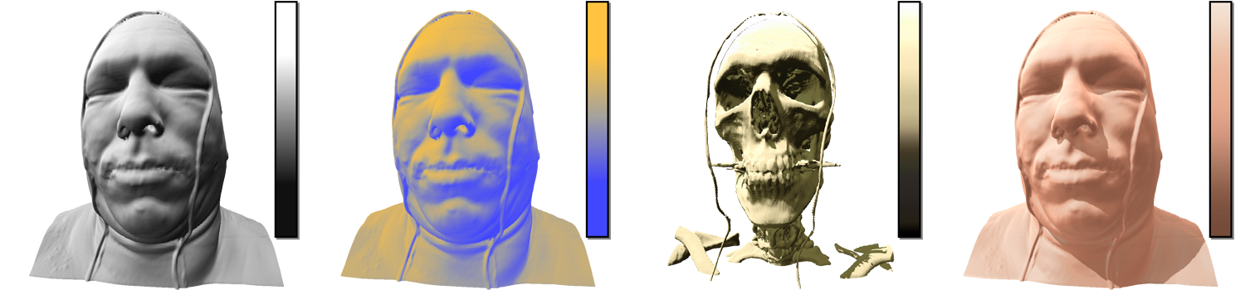
Compositing: Customization

Slide 27
Customization continued

Slide 28
Results
Fast
Versatile
Intuitive
predefined compositing and shading modes
any “renderable primitive”
Compositing:
300 fps @ 1600 x 1200
Raycasting:
5 fps @ 1600 x 1200
Volumes
Meshes
Points
Charts
…
highly customizable shading and compositing unit

Slide 29
Future
Software
Hardware

Slide 30
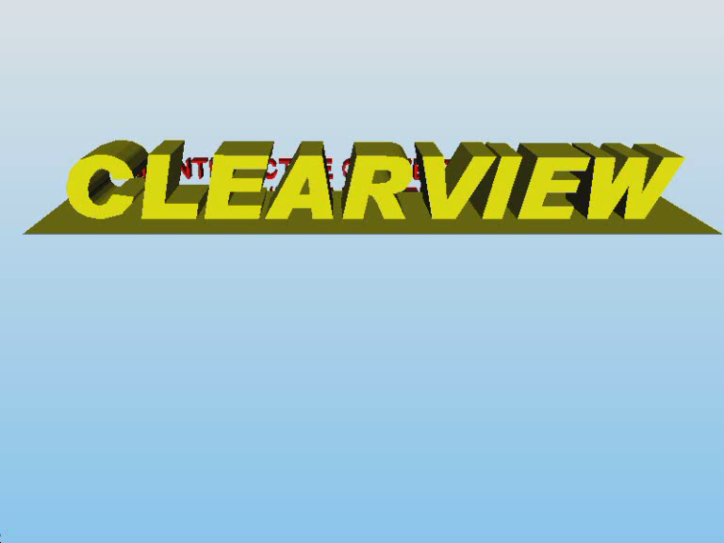
That‘s all Folks!
Any questions?

